Slide 1
Abruptio Placenta and Placenta Previa
Berry Campbell, MD

Slide 2
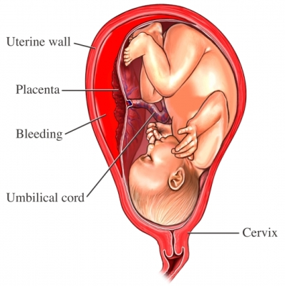
ABRUPTIO PLACENTA
Incidence 1%
Overt vs concealed
Acute vs chronic
Mild (<50%) vs severe (>50%)
Dark red bleeding, tachysystole, uterine tenderness, abnormal FHT, fetal death
CLINICAL DIAGNOSIS - Ultrasound is NOT DIAGNOSTIC

Slide 3
ABRUPTIO
Severe abruptio (≥50%) associated with abnormal FHT
Coagulation studies: fibrinogen abnormal 1st (<300)
If fetal demise, blood loss ≥ 2000 ml & DIC underway

Slide 4
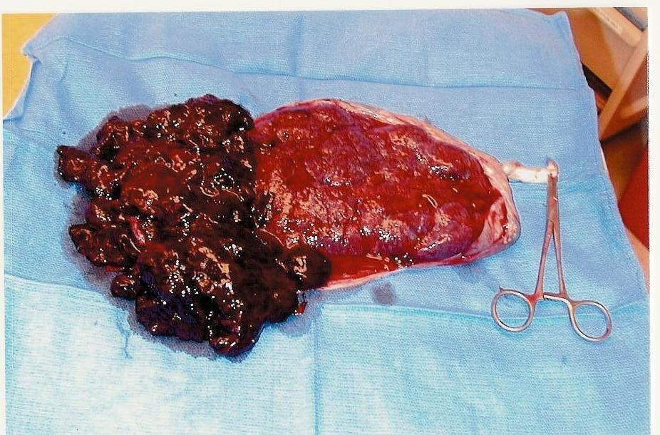
Abruptio Placenta
Risk Factors
HTN
Cocaine (10% if in 3rd trimester)
Smoking
Trauma
AMA, multiparity
PROM
Polyhydramnios
Prior abruptio (15%)

Slide 5
Abruptio Placenta
Management
Remote from term: expectant with FHT and steroids, serial labs
Term: deliver
Route: depends on fetal, maternal status
Severe abruptio: deliver regardless of GA
Marginal abruptio: inpatient vs outpatient; delivery individualized

Slide 6
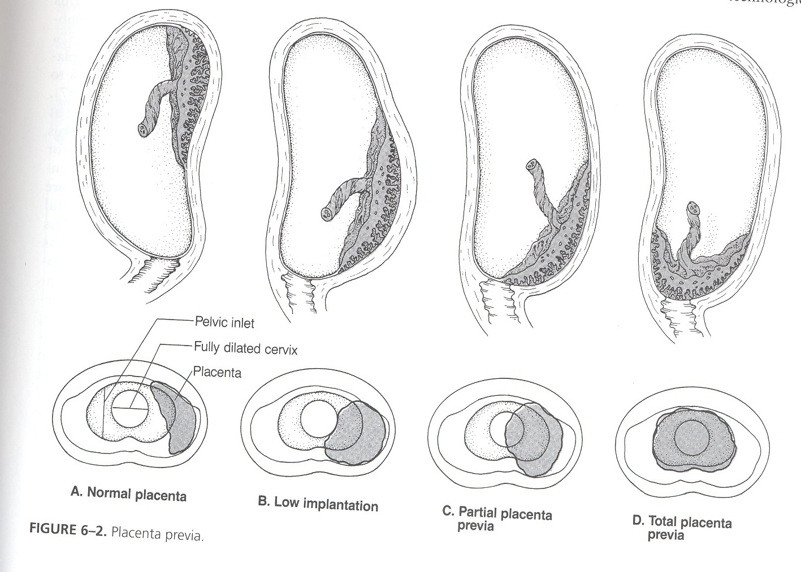
Placenta Previa
Placenta covers the cervix
Bright red bleeding, can be catastrophic
Incidence 1:200
Higher incidence with prior CS
± Contractions
Cesarean required for delivery
Delay delivery if preterm and
bleeding stops
Recurrent bleeding is the rule
Severe anemia possible;
coagulopathy less common

Slide 7
Previa

Slide 8
PREVIA
Aggressive fluid resuscitation
Blood products as needed
Tocolytics as needed
Mag sulfate for fetal benefit if <32 weeks
Steroids for fetal benefit

Slide 9
Previa
Inpatient vs outpatient: individualize
Delivery timing: 36-37 weeks or earlier with recurrent heavy bleeding

Slide 10
Project ECHO South Carolina Pregnancy Wellness
Visit Our Website: https://sctelehealth.org/services/pregnancy-wellness
1st & 3rd Wednesday/Month 12:15 pm – 1:00 pm
NEW MODULE BEGINNING NEXT SESSION JULY 21ST SEPSIS

Slide 11
To Request a Copy of today’s Didactic Video Presentation Contact Rachel Grater, Program Coordinator grater@musc.edu

Slide 12
Tele-Mentoring Programs in South Carolina
Project ECHO Opioid Use Disorders
Medical Director
Dr. Karen Hartwell, MUSC
Program Coordinator: Rachel Grater, grater@musc.edu
Website: www.scmataccess.org
1st and 3rd Friday of each month
12-1 pm
Project ECHO Pregnancy Wellness
Co-Medical Directors
Dr. Berry Campbell, USC and Dr. Donna Johnson, MUSC
Program Coordinator: Rachel Grater, grater@musc.edu
Website: www.pregnancywellnesssc.com
1st and 3rd Wednesday of each month
12:15-1 pm
Southeast Viral Hepatitis Interactive Case Conference
Medical Director
Dr. Divya Ahuja, USC
Program Coordinator: Adrena Harrison, adrena.harrison@uscmed.sc.edu
Website: http://schivtc.med.sc.edu/
1st and 3rd Wednesday of each month 12-1pm
4th Wednesday of each month 1-2pm
Project ECHO Peer Recovery Support Specialists
Co-Directors
Dr. Karen Hartwell, MUSC and Mike Malone, CPSS, NCPRSS, FAVOR Greenville
Program Coordinator: Rachel Grater, grater@musc.edu
2nd and 4th Tuesday of each month
12-1 pm

