Slide 1
Treating Opioid Withdrawal in Pregnancy
Rubin Aujla, MD MPH
MUSC Women’s Reproductive Behavioral Health Program
aujlar@musc.edu

Slide 2
What if a pregnant patient is admitted with recent illicit opioid use?
OPPORTUNITY TO ENGAGE HER IN TREATMENT!
Consult Psychiatry C/L Service
Place order and page/call psychiatry resident on call
Patient will be seen within 24hours
Can start Buprenorphine while inpatient
WRBH Outpatient Clinic

Slide 3
Perinatal OUD Treatment
SAMHSA Clinical Guide Recommendations:
Buprenorphine and Methadone are the safest medications for managing OUD in pregnancy
Medication assisted withdrawal is NOT recommended during pregnancy

Slide 4
Opioid Withdrawal:
Tachycardia
Hypertension
Muscle aches
Restlessness
Anxiety, irritability
Lacrimation (tearing)
Rhinorrhea (runny nose)
Insomnia
Yawning
GI distress (N/V, abdominal cramping)
Dilated pupils
Goosebump skin

Slide 5
Treating Opioid Withdrawal
COWS Rating Scale & Comfort Medications (Supportive Care)
Clonidine vs Metoprolol – tachycardia, hypertension
Sleep Aid: Trazodone, Seroquel – insomnia
Bentyl, Imodium, Phenergan – GI distress
Flexeril – MM aches/tension/spasms
Gabapentin? – restlessness, anxiety

Slide 6
Comfort Medications in Pregnancy Treat the withdrawal sx
Clonidine – no increased risk for structural malformation (animal studies only, human case reports unclear), risk for behavioral effects in children?
Metoprolol – no increased risk for malformation (animal and human studies)
Sleep: Trazodone, Seroquel…
GI distress: Bentyl vs Phenergan
Restlessness, anxiety: Gabapentin? – animal studies showing fetal growth and developmental impairment
MM tension/aches: Flexeril – no increased risk for congenital anomalies (animal studies)

Slide 7
Opioid Withdrawal, why treat?
Compassionate standard of care
Aids in discussions and decision making about engaging in care
Non-judgmental discussion and education
Motivational interviewing (MI) techniques
Again, opportunity to start Buprenorphine while admitted
Lowers risk that patient will leave AMA to use illicit substances or use immediately after discharge

Slide 8
OPPORTUNITY TO ENGAGE Patient IN TREATMENT!
Identify illicit substance use including opioid use disorder
Place consult with Psychiatry Consult Service
- Can potentially start Buprenorphine within 24 hours
Establish outpatient treatment plan for after discharge
- MUSC Womens Reproductive Behavioral Health program

Slide 9
Womens Reproductive Behavioral Health program
MOMs Phone: (843) 614-9510
Provider or patient can call or text
Patient is fast-tracked into our clinic

Slide 10
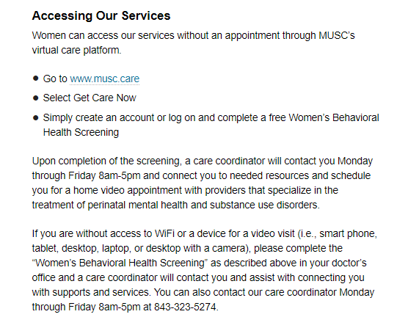
Womens Reproductive Behavioral Health program

Slide 11
Starting November 4, 2020
Special Focus: Updates on Pregnancy During the Covid-19 Pandemic
________________________________________________________________
Upcoming Modules
Safety Bundles
Recognition, Differential Diagnosis, and Appropriate Treatment for Pregnancy
Module I | Hypertension
Module II | Postpartum hemorrhage
Module III | Sepsis
Module IV | Diabetes

Slide 12
Tele-Mentoring Programs in South Carolina
Project ECHO Opioid Use Disorders
Medical Director
Dr. Karen Hartwell, MUSC
Program Coordinator: Rachel Grater, grater@musc.edu
Website: www.scmataccess.org
1st and 3rd Friday of each month
12-1 pm
Project ECHO Pregnancy Wellness
Co-Medical Directors
Dr. Berry Campbell, USC and Dr. Donna Johnson, MUSC
Program Coordinator: Rachel Grater, grater@musc.edu
Website: www.pregnancywellnesssc.com
1st and 3rd Wednesday of each month
12:15-1 pm
Southeast Viral Hepatitis Interactive Case Conference
Medical Director
Dr. Divya Ahuja, USC
Program Coordinator: Adrena Harrison, adrena.harrison@uscmed.sc.edu
Website: http://schivtc.med.sc.edu/
1st and 3rd Wednesday of each month 12-1pm
4th Wednesday of each month 1-2pm

