Slide 1
P:C RATIO OR 24 HOUR URINE WHAT TESTS DO I NEED TO ORDER FOR PRE_GESTATIONAL DIABETES
Donna D. Johnson, MD

Slide 2
ROUTINE PRENATAL LABS
Asymptomatic bacteriuria
3-5 times more common in DM
Can consider culturing every trimester
Monitor dip stick each visit

Slide 3
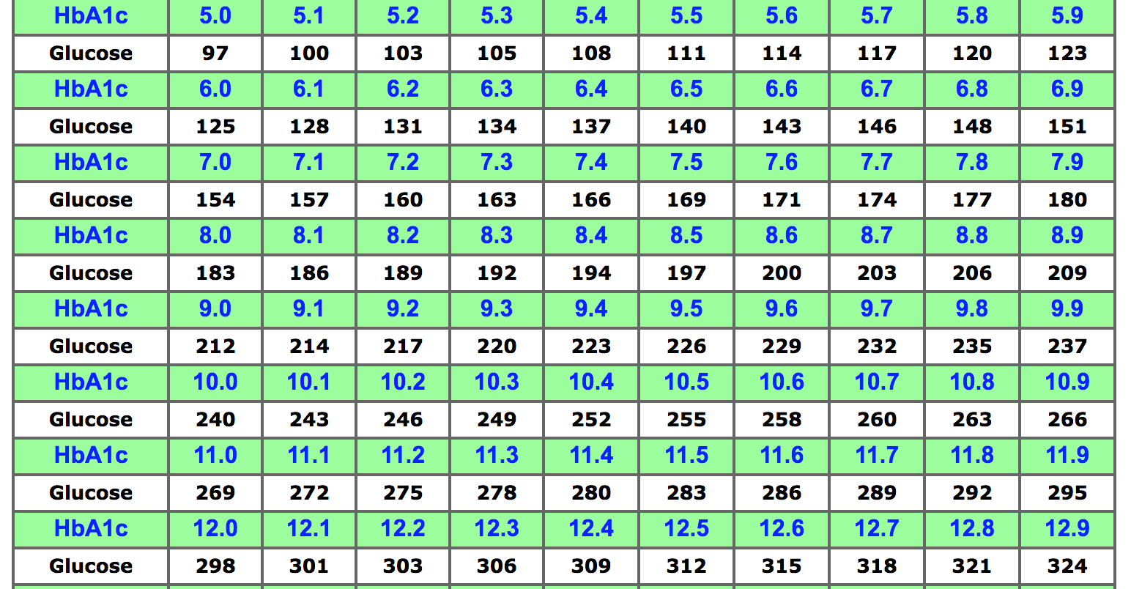
HEMOGLOBIN A1C

Slide 4
BASIC TESTS
BMP
TSH
Dilated eye exam

Slide 5
P:C RATIO vs. 24 Hour Urine
Baseline protein by dipstick
24 hour urine and creatinine clearance
PE work up the same
No proteinuria
P:C ratio
PE work up the same

Slide 6
EKG
Any symptoms
Hypertension
Any vasculopathy
Retinal or renal

Slide 7
FREQUENCY OF TESTS
Test | Frequency
HA1C | Every 4-6 weeks
Home glucose monitoring | 4 times a day
Urine ketones | During illness
Urine protein assessment | Each visit
Serum creatinine | Baseline and worsening proteinuria or BP
Thyroid function | Baseline
Ophthalmology exam | Baseline and follow recommendations

