Slide 1
PRACTICAL ADVICE FOR
COVID IN THE OFFICE
Donna D. Johnson, MD

Slide 2
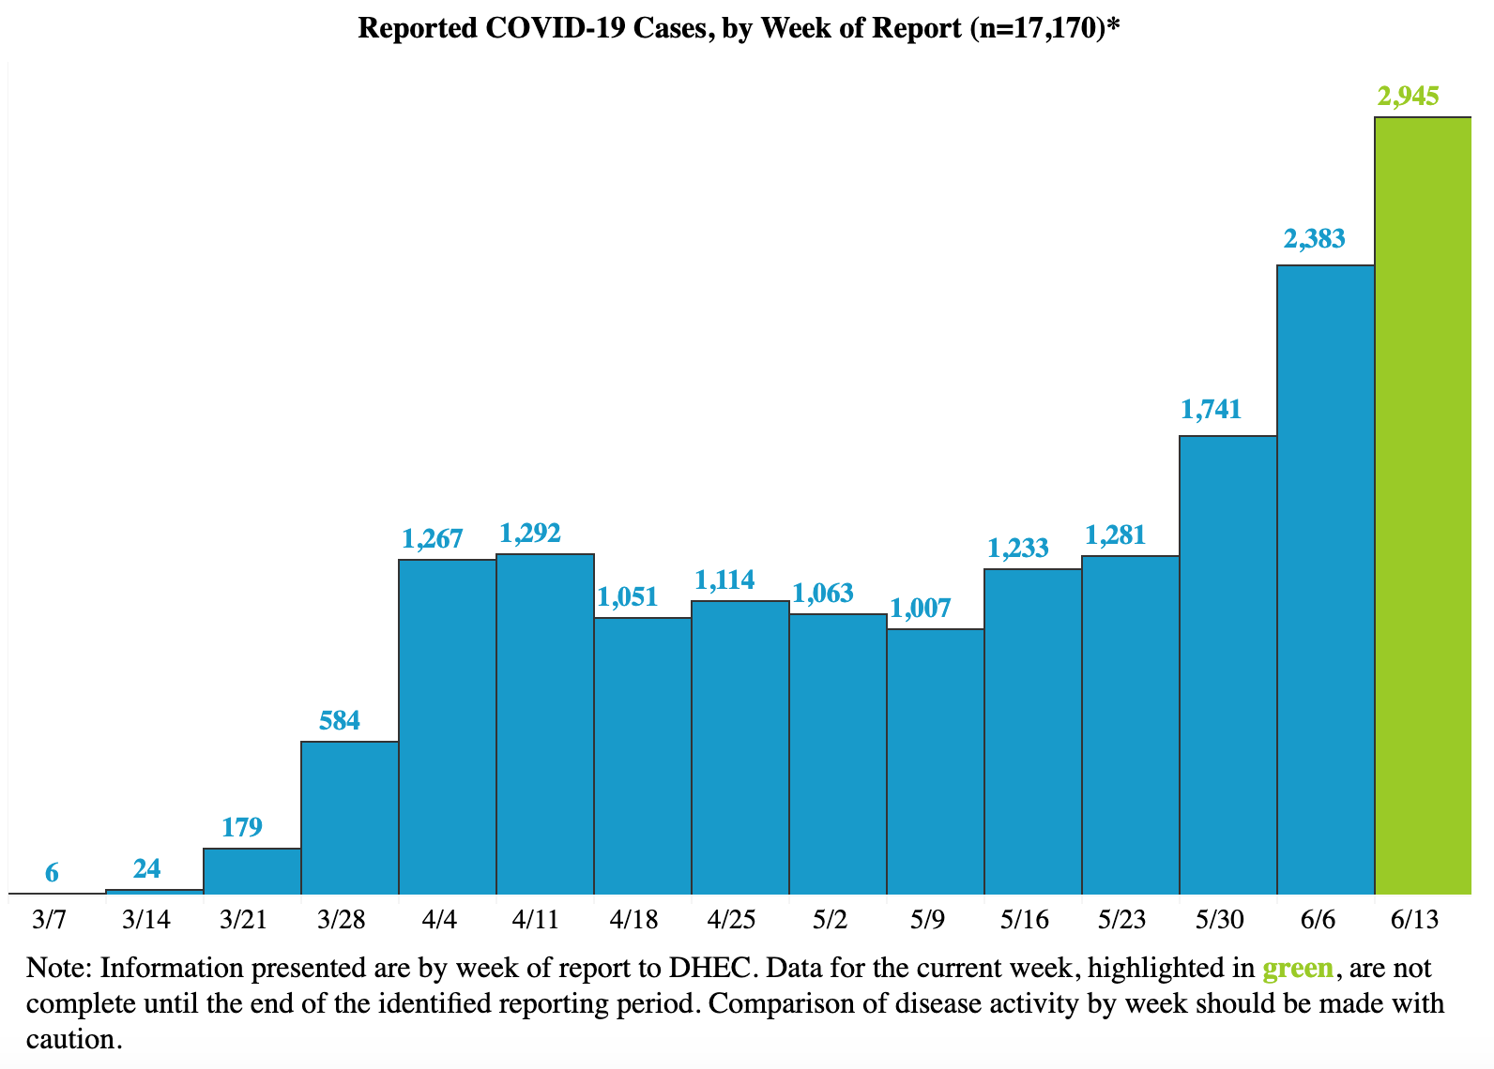
CORONAVIRUS
IS STILL HERE

Slide 3
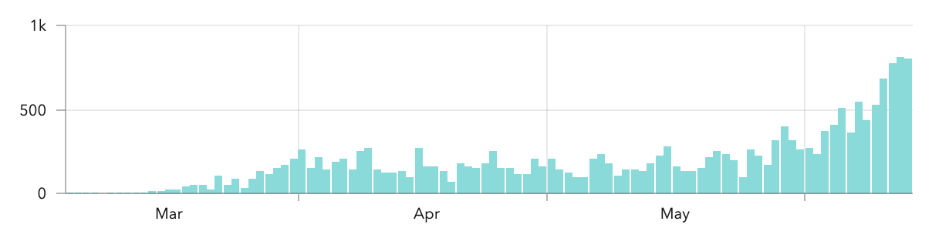
CASES PER DAY

Slide 4
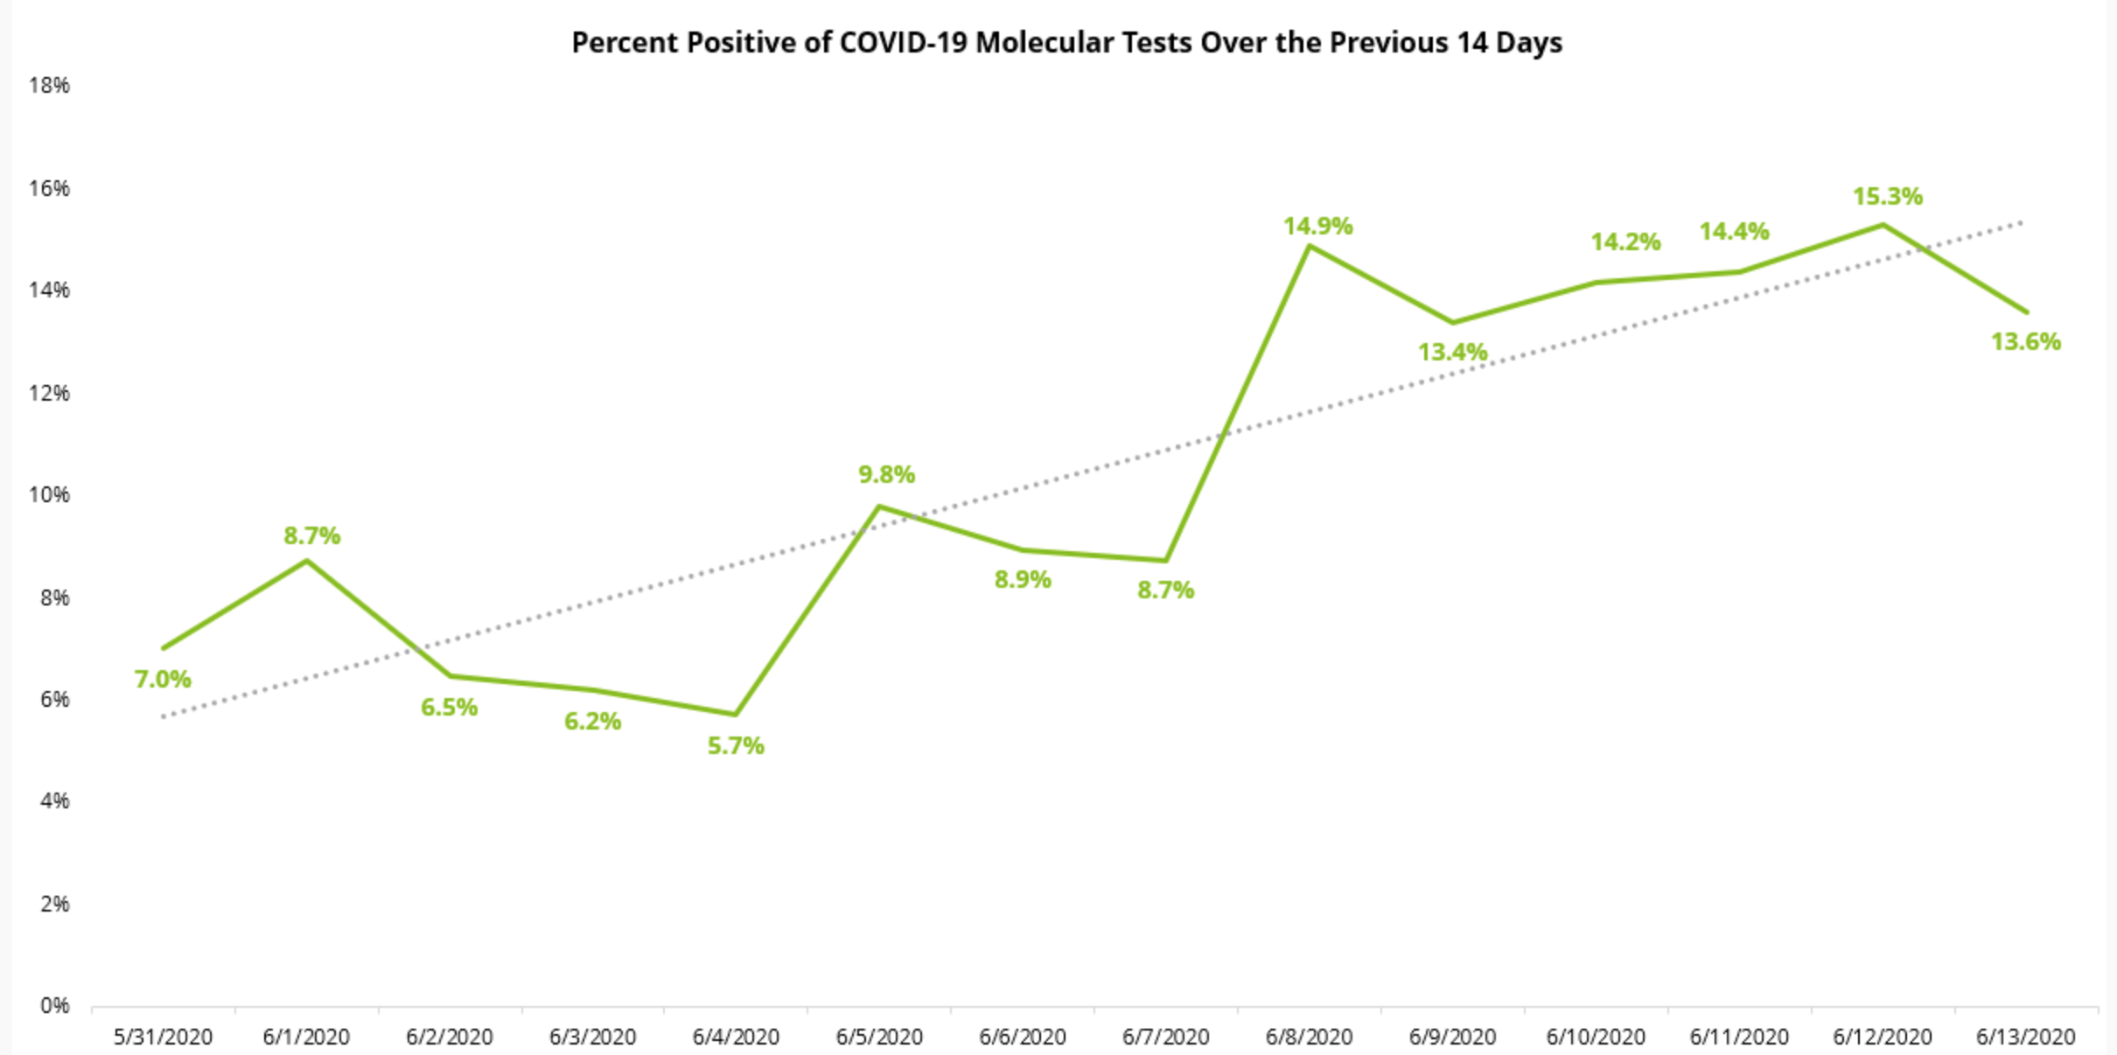
POSITIVE TESTS

Slide 5
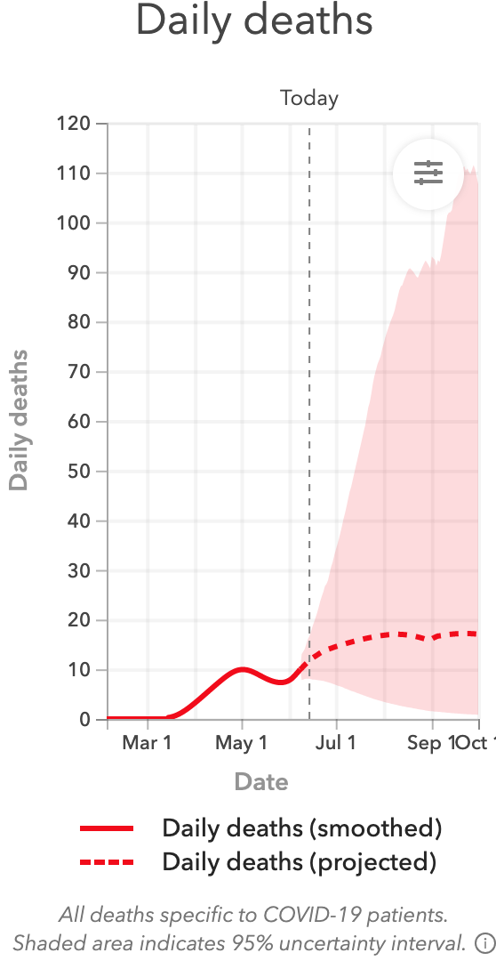
DAILY DEATHS

Slide 6
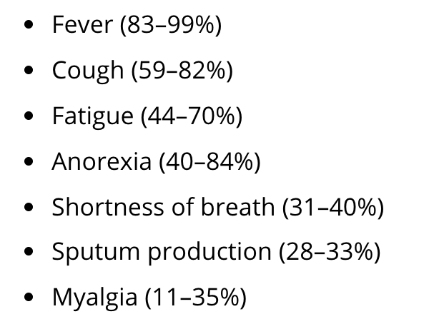
SYMPTOMS

Slide 7
STAFF
No one should come to work sick
Wear masks
Wash hands before and after patient encounters
Should be 6 feet from patient when possible

Slide 8
WAITING ROOM
Must wear mask correctly
Keep social distancing
If not possible
  Space appointments
  Allow patients to wait in car
  Text when room available

Slide 9
APPOINTMENTS
Patient should not come in when sick
Delay appointment if you can
Consider taking temperature on arrival
  If > 99.6 reschedule
If you can’t delay appointment, bring patient in at the end of the day.

Slide 10
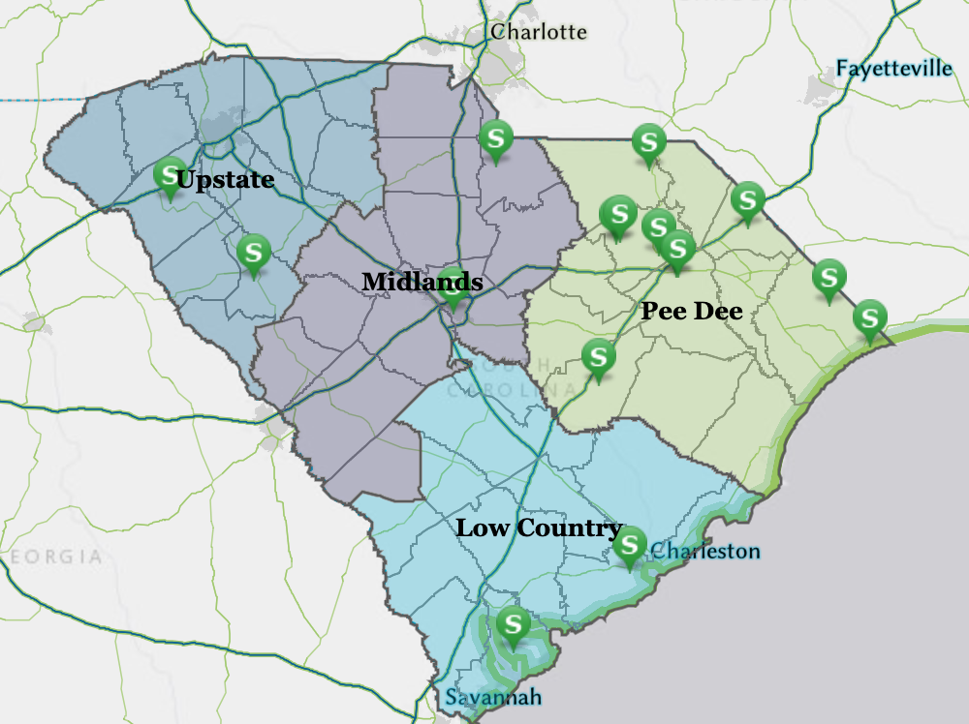
TESTING: SYMPTOMATIC

Slide 11
ANTIBODY TESTING
CDC: Against
Many on the market
Very few FDA approved
False positive: high
Who to test:
  Patient who presents late in COVID
  Multisystemic Inflammatory Syndrome

Slide 12
WHEN IS A COVID + HCW ABLE TO RETURN
Two strategies:
Testing:
  Two consecutive negative tests
  Nucleic acid test
  24 hours apart
Symptoms:
  72 hours since recovery
  10 days from first symptoms
Should wear a face mask

Slide 13
RECOMMENDATION FOR PREGANT PATIENTS
They can work
Avoid PUI or known +
Avoid aerosol generating procedures
Use normal PPE
If exposed, self-monitor
2 week self isolation prior to EDC

