Slide 1
TESTS AND REST
Donna D. Johnson, MD
Chair, Department of Ob/Gyn
Lawrence Hester Endowed Chair

Slide 2
FDA
Emergency use authorization (EUA)
Lab developed test
State authorization

Slide 3
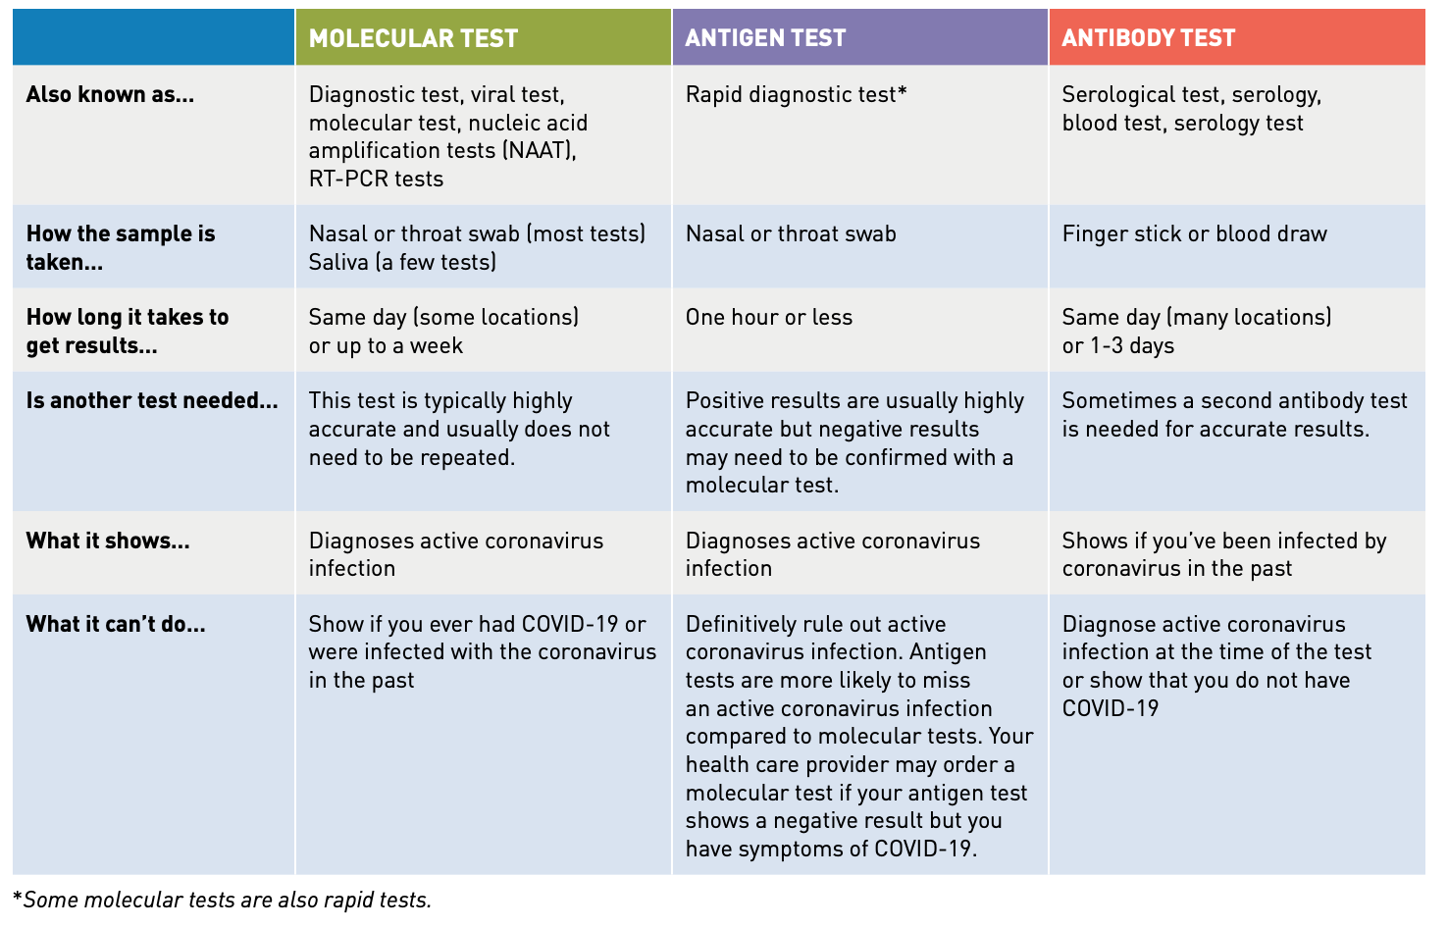

Slide 4
DIAGNOSTIC TEST
Not collected appropriately
May be contaminated
Specimen kept at wrong temperature
Reagents may not be working

Slide 5
WHO SHOULD BE TESTED
Patients with symptoms
Patients with high risk exposure

Slide 6
ANTIBODY TESTING
Not currently recommended
Can only tell you have been exposed
Can have false positives

Slide 7
WHAT TO DO WITH THE BABY?
Newborn separation from parent (AAP)
Separation and placement in postpartum room with an asymptomatic caretaker
Rooming in with COVID-19 + mother strict precautions

Slide 8
LEVEL 2 & 3
10 days from the onset of symptoms
Positive IgG

Slide 9
WORKERS
10 days from the onset of symptoms
Positive IgG

Slide 10
STAY HEALTHY MENTALLY
Stay in contact with family
If your children have concerns, talk with them
Don’t attach it to an ethnic group or nationality
Avoid using unhealthy and unhelpful coping strategies, such as alcohol, drugs, and tobacco
Be supportive of each other
Exercise at home
Feeling under pressure is normal
Get the facts
Limit social media & video games

Slide 11
Upcoming Topics
http://www.pregnancywellnesssc.com
Date | Pregnancy Wellness During the Corona Virus Public Health Emergency
8/5/20 | Panel Discussion: Pregnancy Wellness During the Corona Virus Public Health Emergency Lessons Learned and Looking Forward
Date | Substance Use Disorder in Pregnancy August 19, 2020 – October 21, 2020 | Presenter
8/19/20 | Subutex, Methadone, or Suboxone: Which is Better for Baby? | Dr. Lisa Boyars
9/2/20 | Can a Professional Wean Opioids During Pregnancy? | Dr. Connie Guille
9/16/20 | Pain Management After Delivery in OUD Patients on Medical Maintenance Therapy | Dr. Berry Campbell
10/7/20 | How do I Get Patients into Treatment? | Dr. Claire Smith
10/21/20 | What to Do When a Patient is Admitted on OB with Recent Illicit Drug Use | Dr. Rubin Aujla

