Slide 1
ACUTE CONTROL OF SEVERE HYPERTENSION
Donna D. Johnson, MD

Slide 2
MATERNAL DEATHS
Occurs every 12 hours
Hemorrhage
Hypertension

Slide 3
SEVERE HYPERTENSION
>160/110
Persistent
>180/120
>240/140
Treated within one hour

Slide 4
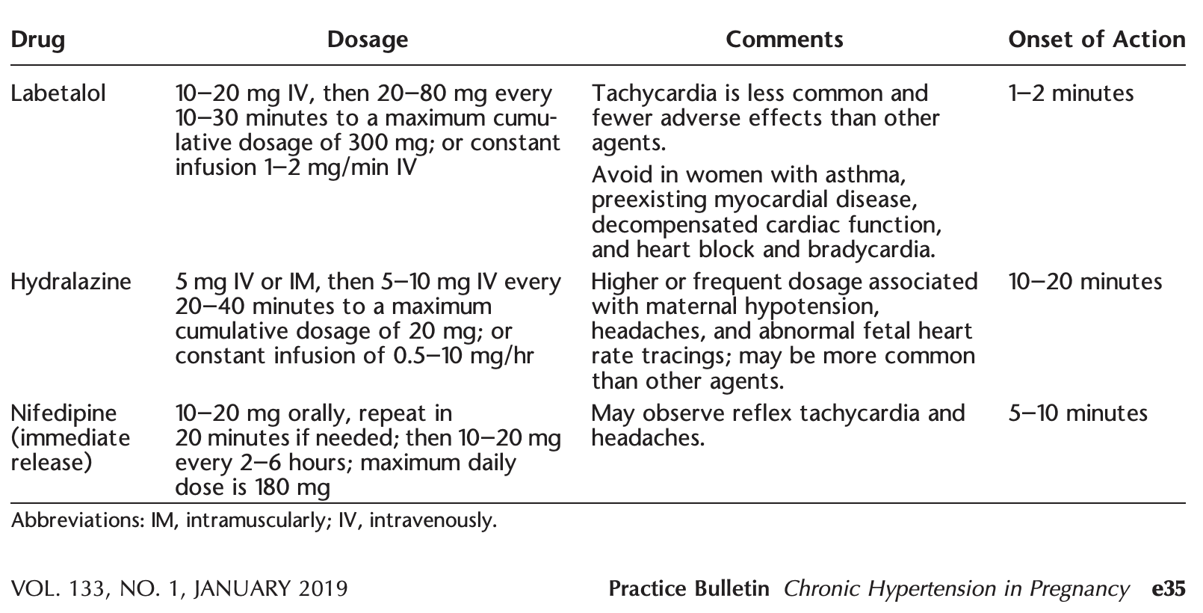
MEDICATION

Slide 5
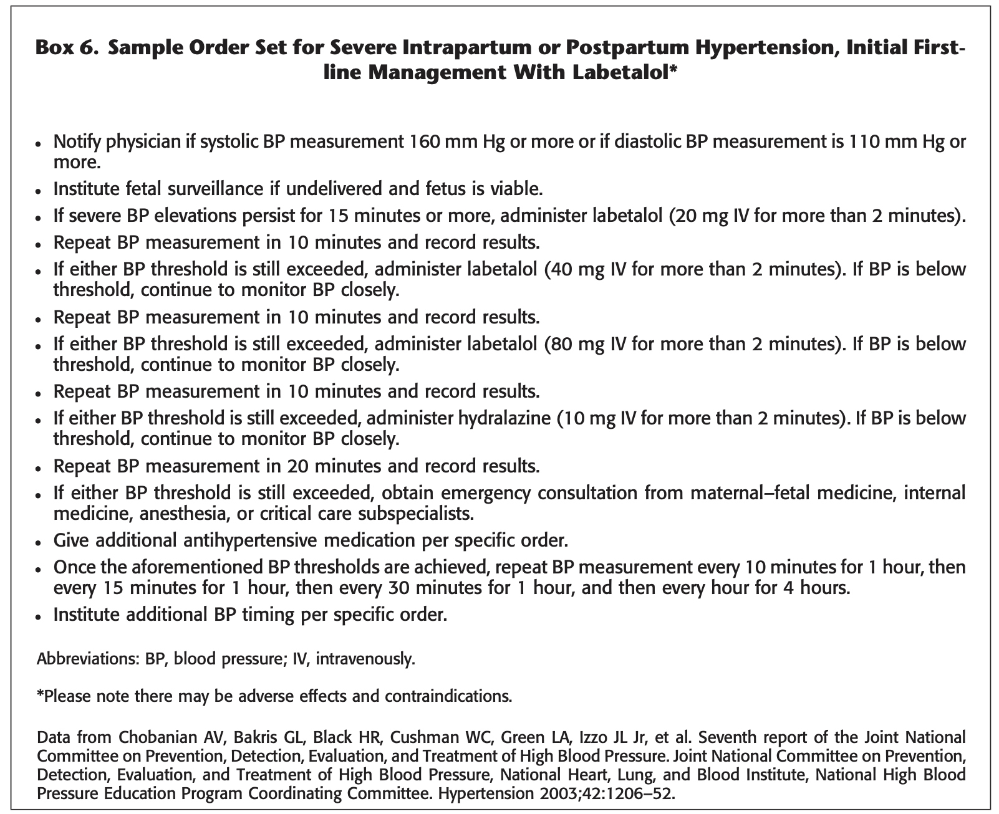

Slide 6
TIPS
Avoid <140/80
Epidural ↓ BP 15%
Start oral medications

