Slide 1
ANEMIA
DURING PREGNANCY
Donna D. Johnson, MD

Slide 2
ANEMIA IN PREGNANCY
Nutrition
  Iron
  B12
  Folate
Hemoglobinopathies
  Thalassemia
  Sickle cell

Slide 3
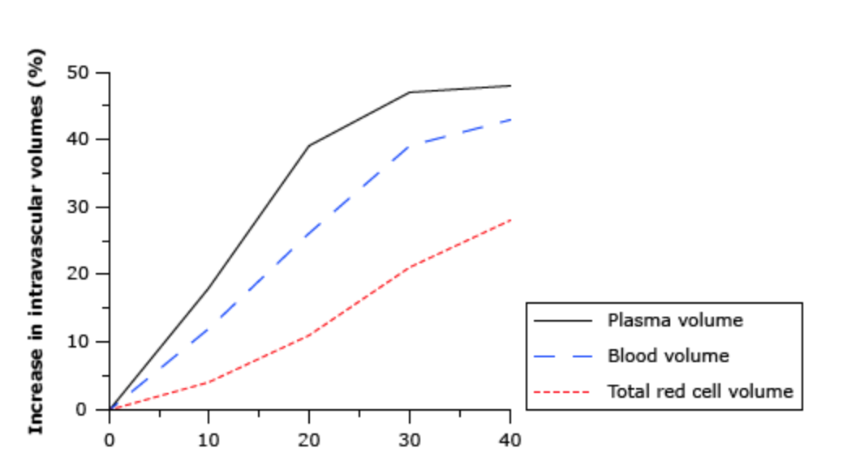
PHYSIOLOGY OF PREGNANCY
Uptodate, 2022

Slide 4
DEFINITION
First trimester – Hgb <11 g/dL (≈Hct <33%)
Second trimester – Hgb <10.5 g/dL (≈Hct <32%)
Third trimester – Hgb <11 g/dL (≈Hct <33 %)
Postpartum – Hgb <10 g/dL (≈Hct <<30%)
CDC, 2016
Ruiz de Viñaspre-Hernández, Birth, 2021

Slide 5
SCREENING FOR ANEMIA
Hemoglobin
Hematocrit
MCV
  <80 microcytic fL
  80-100 normocytic fL
  >100 macrocytic fL

Slide 6
IRON DEFICIENCY
Most common
Risk factors
  Prior pregnancies
  Heavy menses
  Teen
  AA
  Gastric bypass
  Vegetarian

Slide 7
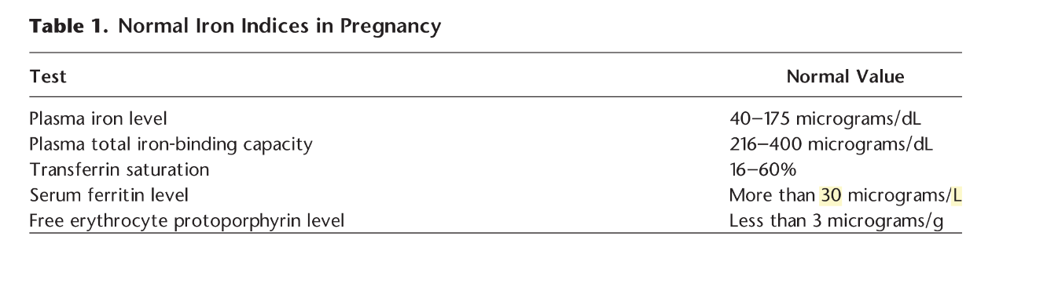
NORMAL IRON INDICES
ACOG, PB, 223

Slide 8
IRON DEFICIENCY
⬇ Iron
⬆ TIBC
⬇ Ferritin
Ferritin < 30 micrograms/L

Slide 9
IRON
15 mg elemental iron
27 mg/day in pregnancy

Slide 10
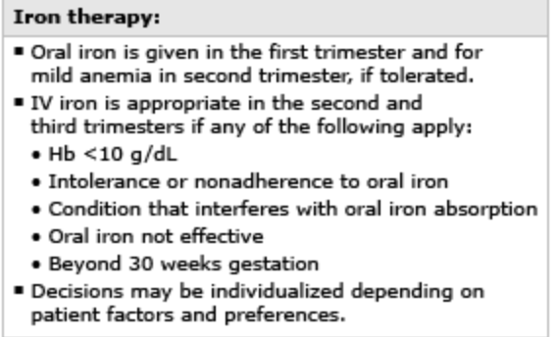
IRON THERAPY
Uptodate, 2022

Slide 11
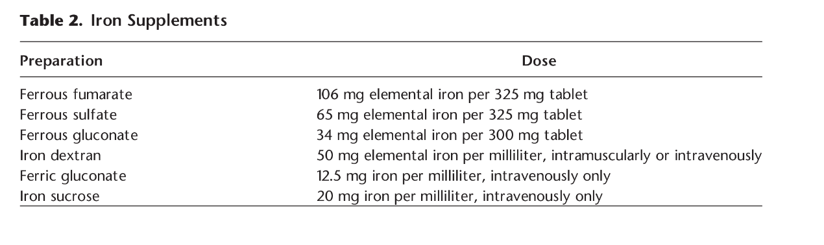
IRON SUPPLEMENTATION
ACOG PB 233

Slide 12
RESPONSE TO TREATMENT
Reticulocyte count: 1 week
Hgb ⬆ 1 gm/dL: 2 to 3 weeks
Ferritin: 3 weeks

Slide 13
MACROCYTIC ANEMIA
Serum folic acid levels
B₁₂ levels
Folic acid deficiency more common

Slide 14
FOLATE
Requirements: ⬆ from 50 to 400 micrograms
Leafy vegetables
Legumes
Animal proteins

Slide 15
B₁₂
Vegan diets
Partial or total gastric resection
Crohn’s disease

Slide 16
Upcoming Session
September 17, 2022
Vaccination in Pregnancy
Donna Johnson, MD
Please be sure that you have sent a chat to Rachel Grater w/:
First and Last
Email
Credential(s)
Name of Practice
County

