Slide 1
CHRONIC HEPATITIS IN PREGNANCY
Donna D. Johnson, MD

Slide 2
PRENATAL TESTING
Hepatitis B surface antigen
Hepatitis C antibody
  Every adult at least once
  Prenatal labs

Slide 3
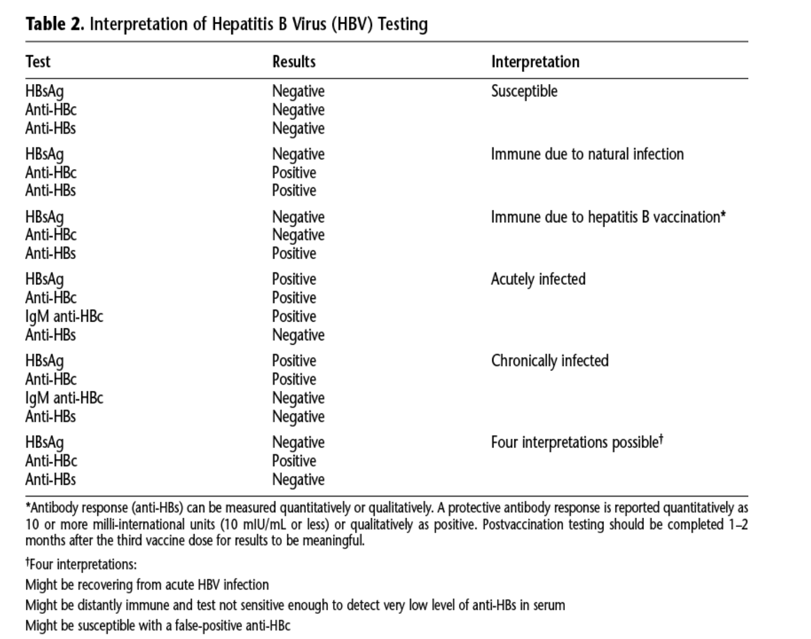
ACOG PB 86, 2021

Slide 4
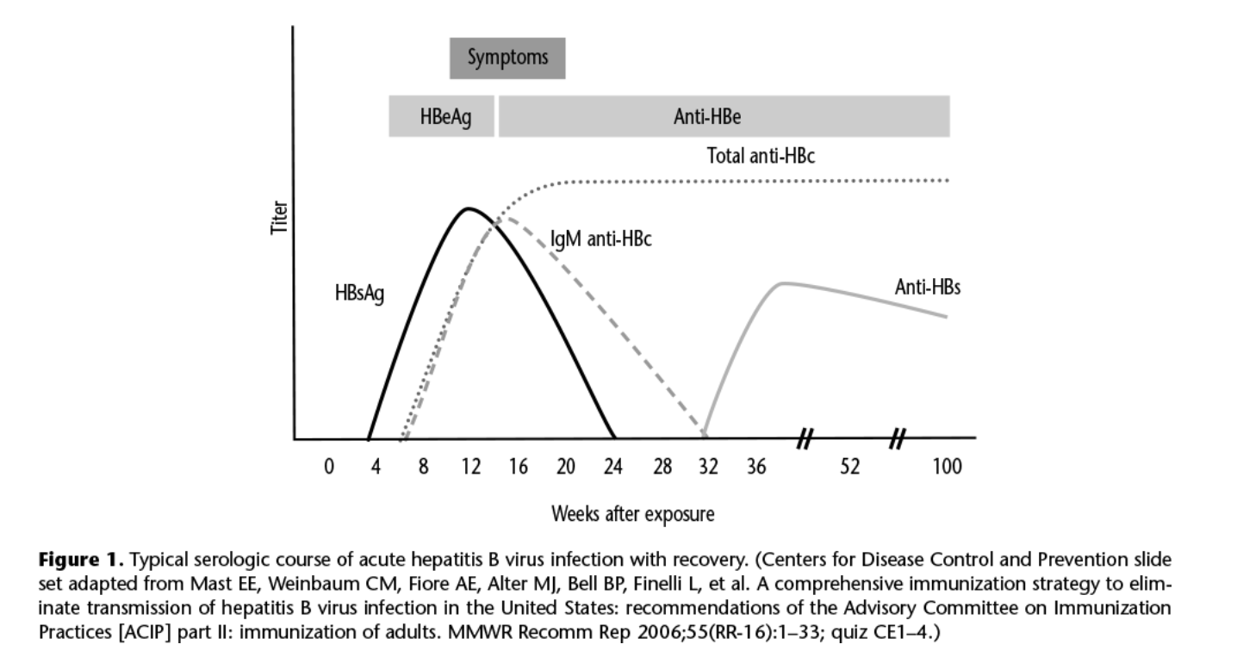
HEPATITIS B sAg Positive
ACOG PB 86, 2021

Slide 5
CHRONIC HEPATITS B
Hep B sAg positive
Hep B sAb negative

Slide 6
HEPATITIS B
HBV DNA is > 200,000 IU/ml or 1,000,000 cps/ml
Hep BeAg positive and > 20,000 IU/ml
  Treat with tenofovir from 28 weeks on
  May continue up to 3 months postpartum
  Contraindicated in breastfeeding

Slide 7
HEPATITIS B VERTICAL TRANSMISSION
  Hbig
  Vaccination
  <12 hours of age
  Can breastfeed if vccinated

Slide 8
HEPATITIS C
Antibody is positive
Reflex test for Hep C RNA
If Hep C RNA is positive= chronic carrier

Slide 9
HEPATITIS C VERTICAL TRANSMISSION
No newborn prevention strategies
Controversial if viral load is associated with transmission risk
Genotype of hep C does not increase transmission
Co-infection with HIV increases transmission
  c/s is recommended based on HIV algorithm only
Continue IVDA increases transmission

Slide 10
OB PREVENTION
Invasive prenatal testing
Prolong ROM
FSE

Slide 11
HEPATITIS C
Please arrange follow up during pregnancy
99% can be cleared
Decrease risk of cirrhosis and cancer

