Slide 1
CORONAVIRUS UPDATE:
WHAT WE KNOW NOW
Donna D. Johnson, MD

Slide 2
PREGNANCY
No increase in mortality
May have increased morbidity
Rare transmission to fetus
Preterm delivery
Unclear of implications in early pregnancy

Slide 3
CORONAVIRUS
80% mild or no symptoms
15% hospitalized
5% critically ill
Long term sequalae unknown
Death rate down 18%
Standard treatment: steroids and remdesivir
Convalescent serum: unclear
DVT prophylaxis

Slide 4
PREVENTION OF CORONAVIRUS
Vitamin D
1000 IU of vitamin D raises serum levels 5 ng/ml
Vitamin C 1000 mg
Zinc 35-50 mg
Ok to take NSAIDs

Slide 5
TESTING
PCR nasal swab still the gold standard
Antigens (Rapid test)
  Less sensitive
Antibodies
  At least 14 days
Collection sites:
  Nasal pharyngeal

Slide 6
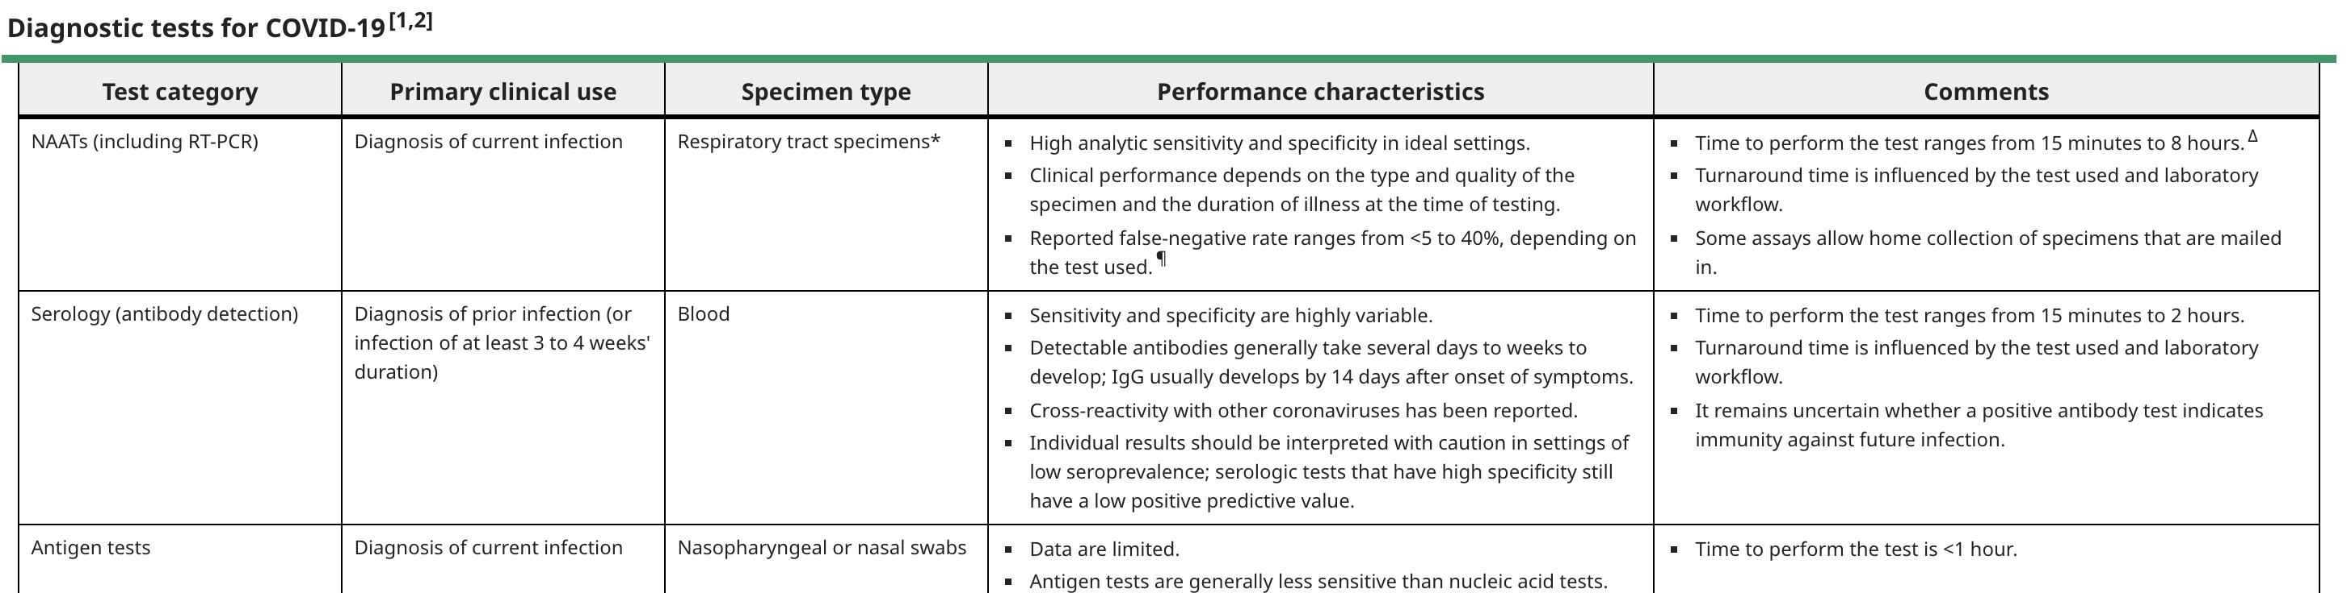
TESTING

Slide 7
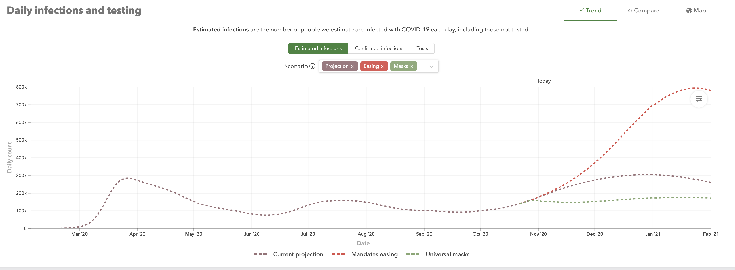
WHAT TO EXPECT

Slide 8
WHY
COVID fatigue
Holidays
People are inside
More places open

Slide 9
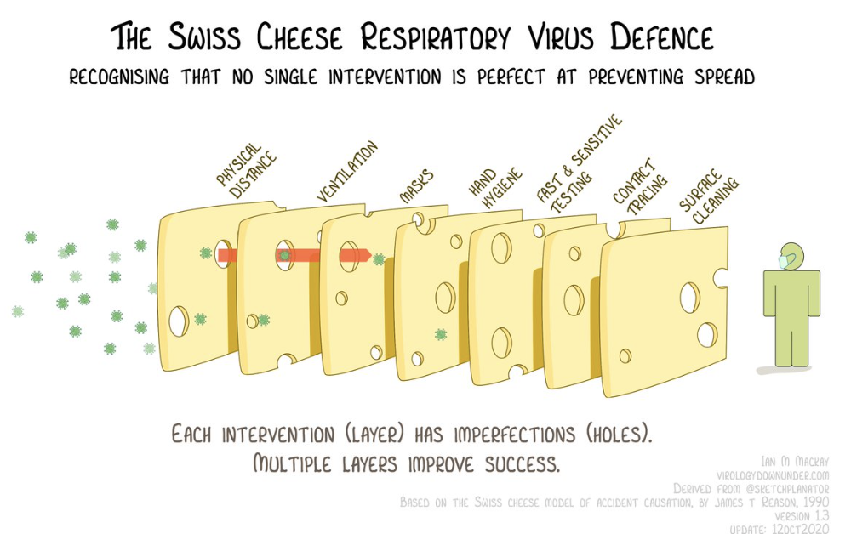
WHAT CAN WE DO?

Slide 10
VACCINATIONS
GET THE FLU SHOT
Limited doses
Build antibodies
Effectiveness
Duration

