Slide 1
DV and Non-Lethal Strangulation
Shannon Scott, BSN, RN, CEN, SANE-P, FN-CSp
Forensic Nurse Examiner Program Coordinator
And
Cheryl Neuner, BSN, MBA, RNC-NIC, NPD-BC, NE-BC
Regional Systems Developer-Perinatal Outreach

Slide 2
Objectives
Understand the correlation between DV and non-lethal strangulation
Understand the signs and symptoms of non-lethal strangulation
Understand the dangers of minimizing
Understand new technology for non-lethal strangulation injury detection

Slide 3
Thoughts…
There is a difference between choke and strangle.
If a victim of an assault can’t give details of what happened to them, they are lying or hiding information.
Most strangulation victims will present with visible injuries.
If a person can make noise or breath, they are not really being strangled.
What is the recommended radiographical study for non-lethal strangulation victims?
Notes:
We will look at these again at the end and compare your thoughts/ideas/beliefs to what we have learned.

Slide 4
Case Study
Female presented to with ED with suicidal ideation
Disclosed strangulation during nursing assessment
Patient declined law enforcement and forensic services
ED nurse called FNE for advice
FNE spoke with the patient on the phone
FNE spoke with ED MD
Soft tissue x-ray of the neck= Normal results
FNE advocated for “Gold Standard” radiographical study
Results= Laryngeal edema
Results implemented change in policy/protocol
https://www.facebook.com/watch/?v=186206466658229

Slide 5
South Carolina
First time in Violence Policy Center’s 10-year history SC not in top ten
2018: SC ranked 11th in country for number of women killed by men
2019: 36 women & 6 men were victims of DV homicide
78.5% committed with a firearm
2020 single day, DV programs served
620 victims
received 101 calls
averaging 4 contacts/hour
*In one day: 134 service requests not be provided due to lack of resources
Notes:
The first time in the Violence Policy Center’s 10-year history SC was not in the top ten.
DISCUSSED LAST WEEK

Slide 6
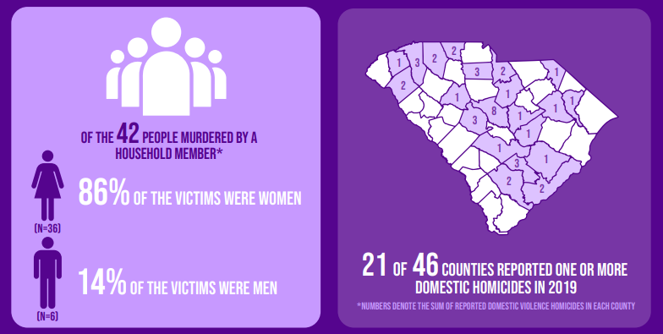
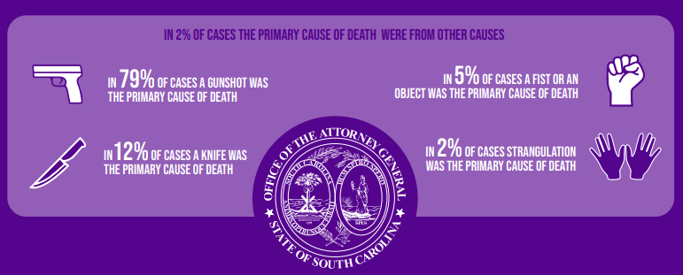
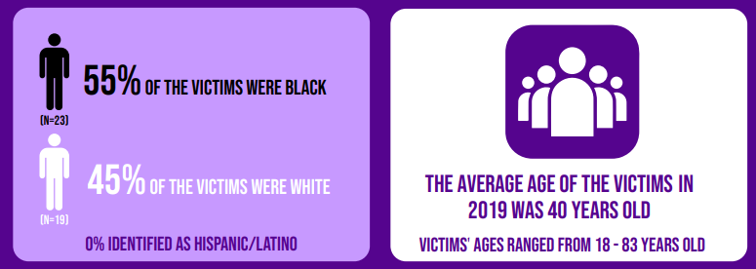
2020 South Carolina domestic violence fatality report : silent witness statistical report on victims of domestic homicide from 2019. Taken from https://dc.statelibrary.sc.gov/handle/10827/39608.
Notes:
2% strangled…. How many victims were strangled, but not to the point of no return

Slide 7
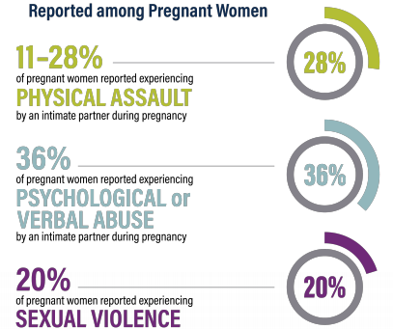
Prevalence of Prenatal Exposure to DV
Holmes and Kim, 2019
Notes:
According to the CDC, between 3-6% of pregnant women in the US experience a physical form of DV.
However, clinical studies that use more comprehensive DV measuring tools, yield these higher rates.

Slide 8
Non-lethal strangulation...
750% more likely to be killed by the same perpetrator
Leading indicator of escalating violence
Ultimate method to exert power and control
“I can kill you at any time”
Notes:
LEADING INDICATOR for escalating violence

Slide 11
S
Do you feel SAFE? Should I be concerned for your SAFETY?
A
Have you felt AFRAID? Has your partner ever ABUSED you?
F
Do your FRIENDS and/or FAMILY know you have been hurt?
E
Where will you go in an EMERGENCY? Do you have an ESCAPE plan?

Slide 12
“Have you been choked or strangled?”
“Are you having/Did you have difficulty breathing or swallowing?”
“Do you have a cough or changes in your voice?”
“Did you lose consciousness or nearly lose consciousness?”
“Did you lose control of our bowel or bladder?”
“Did you think you were going to die?”
Notes:
5 main/basic strangulation questions

Slide 13
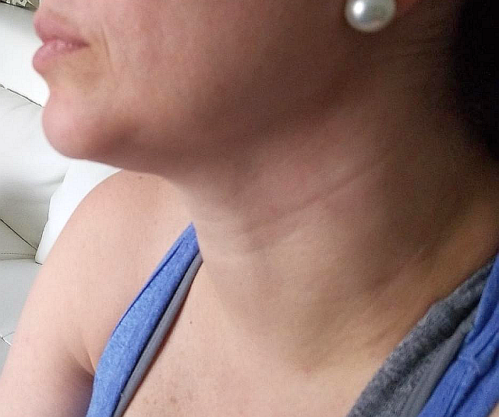
New Technology of the Forefront
Notes:
Cheryl’s discussion

Slide 14
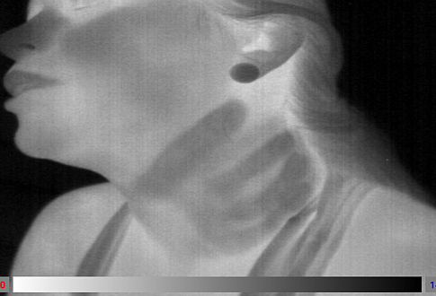
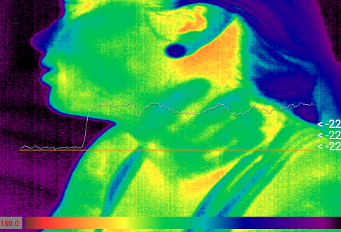
“…researchers report that only half of strangulation victims have visible injuries, and only 15% have injuries that can be photographed.” -The Strangulation Training Institute
Notes:
Cheryl’s discussion

Slide 15
Notes:
Cheryl’s discussion

Slide 16
Discussion
There is a difference between choke and strangle.
If a victim of an assault can’t give details of what happened to them, they are lying or hiding information.
Most strangulation victims will present with visible injuries.
If a person can make noise or breath, they are not really being strangled.
What is the recommended radiographical study for non-lethal strangulation victims?
Notes:
Ask for answers in chat box….

Slide 18
Contact Information
Shannon Scott,
BSN, RN, CEN, SANE-P, FN-CSp
Cheryl Neuner,
BSN, MBA, RNC-NIC, NPD-BC, NE-BC
Forensic Nurse Examiner Program Coordinator
(FO) 843-777-1449 or 1450
(O) 843-777-5219
(C) 540-273-0696
shannon.scott@mcleodhealth.org
Regional Systems Developer-Perinatal Outreach
(O) 843-777-5059
(C) 843-319-4543
cneuner@mcleodhealth.org
Notes:
Ok to keep

Slide 19
Resources
Holmes, M. R. & Kim, J. Y. (2019). Prenatal Exposure to Domestic Violence: Summary of Key Research Findings. Case Western Reserve University. Cleveland, OH. Available from: https://case.edu/socialwork/traumacenter/resources
https://www.strangulationtraininginstitute.com/
https://www.sccadvasa.org/domestic-violence/
Notes:
Ok to keep

Slide 20
Project ECHO South Carolina Pregnancy Wellness
Visit Our Website: https://sctelehealth.org/services/pregnancy-wellness
1st & 3rd Wednesday/Month 12:15 pm – 1:00 pm
Date | Topic | Presenter
4/20/22 | Part 3: Domestic Violence Women’s Reproductive Behavioral Health | Dr. Connie Guille

Slide 21
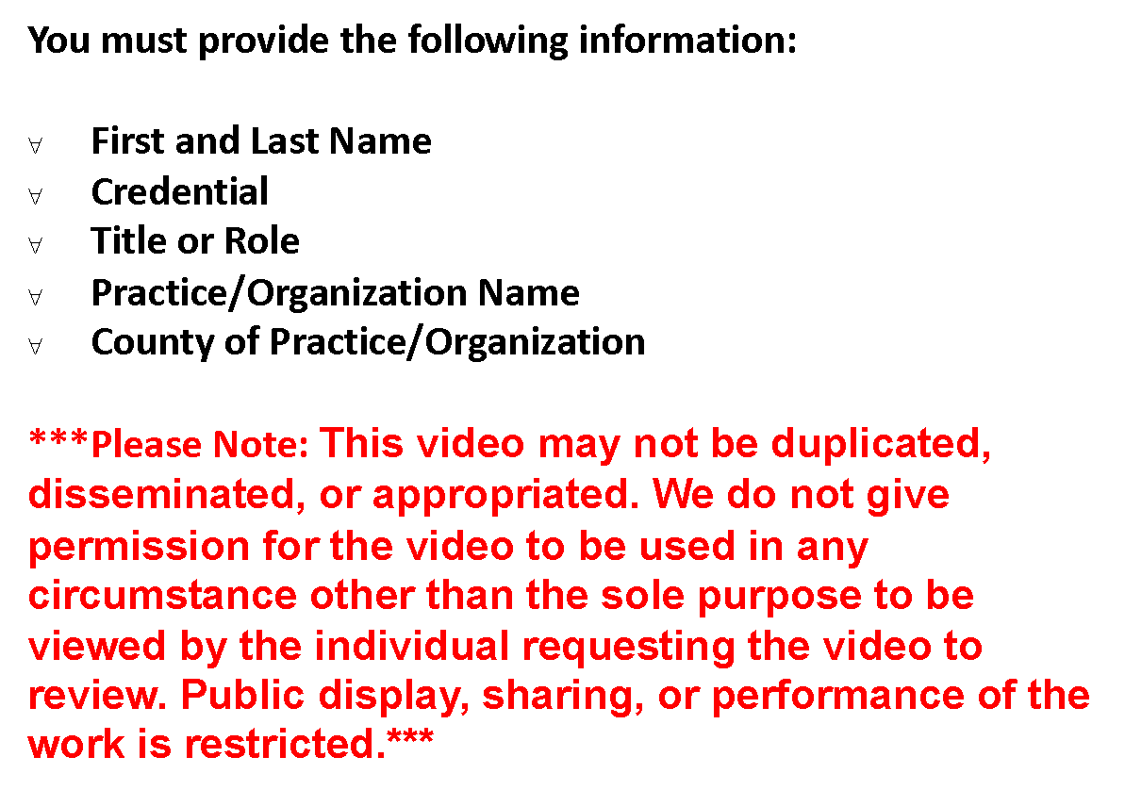
To Request a Copy of a Didactic Video Presentation Contact Rachel Grater, Program Coordinator grater@musc.edu
https://sctelehealth.org/services/pregnancy-wellness

