Slide 1
DV and Pregnancy
Shannon Scott, BSN, RN, CEN, SANE-P, FN-CSp
Forensic Nurse Examiner Program Coordinator

Slide 2
Objectives
Understand:
Prevalence of prenatal exposure to DV
Effects on maternal health & child outcomes
Implications for policy & practice
Strangulation & dangers of minimizing & new technology for detection
Notes:
Way too long.
You need less than 15 slides and objectives are too many three at most

Slide 3
During Pregnancy
3-9% of women experience abuse during pregnancy
Some studies: Up to 50% experience some type of abuse
Notes:
-well established risk factors that are associated with higher rates of abuse, including young age, single relationship status, minority race/ethnicity, and poverty.
-Studies conducted among samples of low-income, predominantly single women have noted higher prevalence with rates up to 50%.
-Wide range has been attributed to several differences among the populations sampled, measurements used to assess for IPV, inconsistencies in defining IPV, and differences in defining the time frame for abuse during the perinatal period.
OK TO USE

Slide 4
South Carolina Statistics
First time in Violence Policy Center’s 10-year history SC not in top ten
2018: SC ranked 11th in country for number of women killed by men
2019: 36 women & 6 men were victims of DV homicide
78.5% committed with a firearm
2020 single day, DV programs served
620 victims
received 101 calls
averaging 4 contacts/hour
*In one day: 134 service requests not be provided due to lack of resources
Notes:
The first time in the Violence Policy Center’s 10-year history SC was not in the top ten.
DISCUSSED LAST WEEK

Slide 5
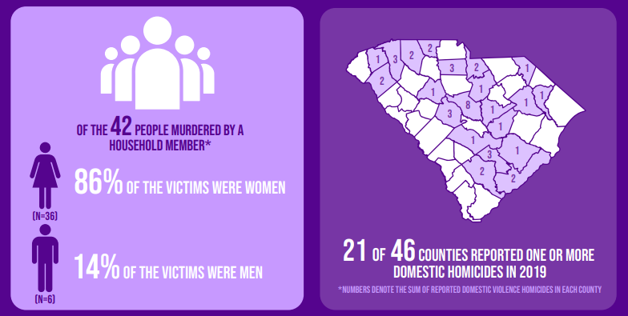
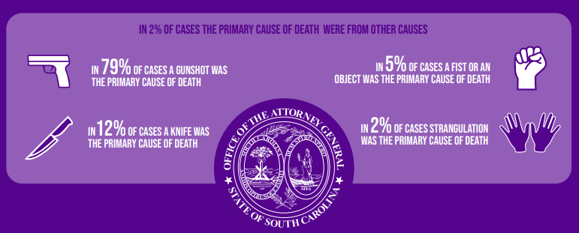
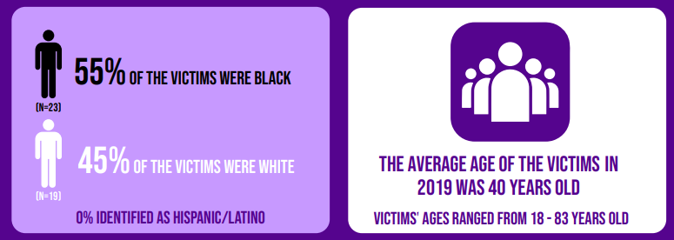
2020 South Carolina domestic violence fatality report : silent witness statistical report on victims of domestic homicide from 2019. Taken from https://dc.statelibrary.sc.gov/handle/10827/39608.
Notes:
CAN USE AS A REVIEW

Slide 6
Types of Abuse

Slide 7
Physical
The intentional use of physical force with the potential for causing injury, harm, disability or death
Kicking, hitting, biting, strangulation, pushing, hair pulling, assaults with weapons
Certain areas of body can be targets, such as abdomen of pregnant woman
Notes:
Physical Abuse:
-Most apparent
TYPES OF ABUSE WAS DISCUSSED LAST WEEK BUT OK TO REVIEW TYPES BUT PUT ON ONE SLIDE

Slide 8
Sexual Violence
The use of physical force, coercion, or threats to force a person to perform or receive a sexual act against his or her will
Forcing the victim to watch or create pornography
Forced pregnancy or termination
Notes:
Sexual violence
-Used to humiliate, hurt, degrade, and dominate
-Brutality usu. escalates over time
-They deny contraception or protection against/medication for STIs
-Goal: Is to send the message to the victim that they have absolutely no say over their own body.

Slide 9
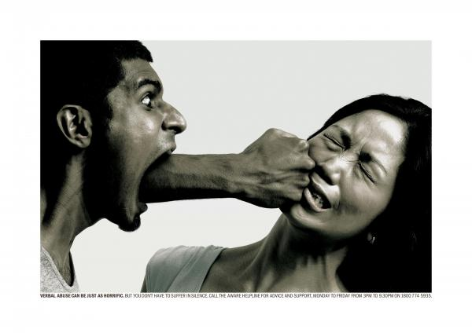
Psychological/Verbal/ Emotional
The use of physical force, coercion, or threats to force a person to perform or receive a sexual act against his or her will
Humiliation Isolation Degradation Blackmailing Intimidation
Name calling Insulting Criticizing Blaming Accusing
Questioning victim’s sanity Threatening physical abuse
Coercion
Notes:
***SYSTEMATIC destruction of a person’s self-esteem…
-Grown-up bullies with extreme controlling behavior
-Isolation- Gain control over victim’s time, activities and contact with others. Starts off as “I want to spend time with you because I love you so much.” This is replaced with verbal abuse, such as “your family is interfering” or “you spend too much time with them.” This can led to taking her keys away, forcing her to quit her job, moving to a new location, away from victim’s support system.
-Intimidation- Attacks against property or pets. He punches the wall she is leaning against. She hides behind a door and he rips the door off the hinges. He strangles her cat in front of her, and yells, “Look what you made me do.” Message: “You could be next.” Doesn’t have to be physical. Yelling in her face. Putting victim under surveillance. Discredit them with neighbors/family/friends.
-Blackmailing- Force them into committing illegal crime, such as prostitution or shop lifting and then threaten to expose them
-Threatening physical abuse- Against children, family, friends. May threaten to commit suicide. Can be done with words or actions (stalking, displaying weapons, hostage taking)
-Coercion- the practice of persuading someone to do something by using force or threats

Slide 10
Economic
Occurs when an abuser controls finances and the victim’s ability to obtain money or control over his/her finances
Prevents the victim from having a job
Interferes with the victim’s job
Harasses the victim at work
Taking the victim’s money
Demanding an account of everything bought
Controlling the victim’s access to financial information
Not allowing the victim’s names to be on accounts
Not allowing the victims to obtain health insurance, welfare, disability, etc.
Notes:
-Because batterers often control victims by controlling their access to all family resources (time, transportation, food, clothing, shelter, insurance, and money) it does not matter who the primary provider is or if both partners work and contribute financially. The batterer controls the money and reduce the victim down to having to get permission to spend money, even on basic family needs.
-Money is one way the batterer maintains control over the victim if they try and leave. Won’t pay bills, instituting expensive legal proceedings, destroy assets…. No money=not going to leave or will return

Slide 11
Abusers
Who are they?

Slide 12
EQUAL OPPORTUNITY
All races & cultural groups
All educational backgrounds
All socioeconomic backgrounds
All religious backgrounds
All ages
Notes:
Equal opportunity
SAID LAST WEEK
YOU CAN JUST KEEP IN THE CHARACTERISTICS SLIDE
AND SAY IT IS EQUAL OPPORTUNITY and these are characteristics

Slide 13
Characteristics
Jealousy
Controlling behavior
Quick Involvement
Unrealistic expectations
Isolation
Blames other for his problems
Blames others for his feelings
Hypersensitivity
Cruelty to animals and children
Dr. Jekyll & Mr. Hyde
“Playful” use of force during sex
Verbal abuse
Rigid sex roles
Threat of violence
Breaking or striking objects
Notes:
-Use violence and threats to establish power and control over their partners through fear and intimidation
-Wants compliance
-Tactics are selectively chosen and purposeful
-Impossible to appease abusers. They never have enough control

Slide 14
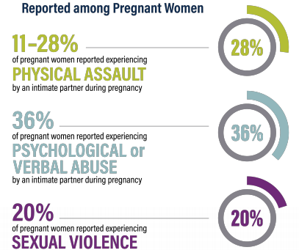
Prevalence of Prenatal Exposure to DV
Holmes and Kim, 2019
Notes:
According to the CDC, between 3-6% of pregnant women in the US experience a physical form of DV.
However, clinical studies that use more comprehensive DV measuring tools, yield these higher rates.

Slide 15
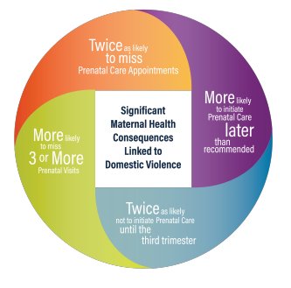
Correlation Between DV and Maternal Health
Holmes and Kim, 2019
Notes:
Domestic Violence and Maternal Health Women who experience domestic violence during pregnancy are twice as likely to miss prenatal care appointments or initiate prenatal care later than recommended, twice as likely not to initiate prenatal care until the third trimester, and are significantly more likely to miss three or more prenatal visits than non-abused women. Poor nutrition, inadequate gestational weight gain, and higher rates of smoking, alcohol use, and substance use have also been associated with experiencing domestic violence during pregnancy. Domestic violence during pregnancy and in the postpartum period has been associated with depression and post-traumatic stress disorder.
GOOD

Slide 16
16% more likely to have low-birth weight pregnancies
1.5x more likely to acquire HIV
1.5x more likely to contract syphilis, chlamydia, or gonorrhea
2x more like to experience depression
Almost 2x more likely to abuse alcohol
More likely to be the victim of homicide…31% of all murdered women are killed by their abuser
If non-lethal strangulation is used, the victim is 7x more likely to be murdered by their abuser
*Homicide leading cause of traumatic death for pregnant and postpartum women in US, accounting for 31% maternal injury deaths*

Slide 17
Visible Injuries
Contusions/hematomas
Neurological
Cardiovascular & Respiratory
Hypertension
Digestive
Ulcers
Reproductive/Genital
Broken bones
Handprints
Strangulation marks
Tendon/ligament injuries
Lacerations
Facial trauma
Broken teeth
Bites/Burns
Chronic pain
Stammering/stuttering
Decreased concentration
Headaches
CNS impairment
Fainting
Back pain
Stroke
TBI
Vision/hearing impairment
CP
Hyperventilation
MI
Asthma
Palpitations
Arrythmias
Diarrhea
Constipation
IBS
Loss of appetite
Abdominal pain
Weight control
Risk of diabetes
Poor pregnancy outcomes
STIs
Vaginal and/or anal tearing/bleeding
UTIs
Dysmenorrhea
Mental Health
Depression
Suicidal ideation
PTSD
Alcohol use
Drug use
Anxiety
Chronic & acute stress

Slide 18
Prenatal Exposure to DV and Child Outcomes
Increases in low birth Weight and Preterm birth
Leading causes of neonatal morbidity and mortality
Perinatal and Neonatal Death
Perinatal after 20 weeks gestation
Neonatal within first months of life
Infant Post-Traumatic Symptoms
Difficult Infant Temperament
Easily startled
Repeating same action without enjoyment
Withdrawn
Slow to adapt
General negative mood
Childhood Behavioral Problems
Externalizing behaviors
Internalizing symptoms
Notes:
-Low Birth Weight and Preterm Birth Women who experience domestic violence during pregnancy have a higher risk of preterm birth and delivering low birth weight neonates. Low birth weight and preterm birth are leading causes of neonatal morbidity and mortality.
-Perinatal Death Domestic violence occurring during pregnancy is associated with an increased risk of perinatal death (fetal loss after 20 weeks gestation up to neonatal death occurring ≤28 days after delivery) and neonatal death (deaths within the first month of life). Women who have been hospitalized for a physical assault during their pregnancy are at higher risk—8 times the risk of fetal death and nearly 6 times the risk of neonatal death
-Infant Post-Traumatic Symptoms Prenatal domestic violence exposure is associated with increased levels of trauma symptoms (being easily startled, repeating the same action without enjoyment), while considering cumulative risk and postnatal domestic violence exposure.
-Difficult Infant Temperament Infants with prenatal exposure to domestic violence are twice as likely as their nonexposed counterparts to be considered as having a difficult rather than easy temperament (being withdrawn, slow to adapt, and a general negative mood).
-Childhood Behavioral Problems Prenatal exposure to domestic violence is related to more externalizing behaviors (physical aggression, disobeying rules, cheating, stealing, or destruction of property) and internalizing symptoms (anxiety or depression) during middle childhood compared with nonexposed children. If the child continued to experience domestic violence exposure throughout his or her lifetime, the child continued to have increased externalized behavior problems and internalizing symptoms.

Slide 19
Implications for Policy and Practice
Trauma-Informed Care
Screening tools
Community-based referrals for further care
Training for staff on TIC and how to limit re-victimization
Community-Based Services
Continuity of care
Collaboration
Interventions
Parent engagement models
Preventative Education
Primary prevention
Prenatal education
Fatherhood programs
High-risk groups
Notes:
-Implementation of Trauma-Informed Care Medical professionals have called for system-level change to train physicians and nurse practitioners in the implementation of domestic violence screening tools, and referral to community-based subsequent care (e.g., counseling, mental health support, other health and social services). Such system-wide change should include training in the application of trauma-informed care with patient interactions to reduce potential revictimization during screening and enhance the likelihood of preventative care engagement.
-Continuity of Community-Based Services To improve and restore domestic violence–exposed children’s health and development, intervention effectiveness for domestic violence could be improved by establishing continuity of services that extends beyond clinic settings for vulnerable mothers, including collaboration among service providers; linkages between health, justice, and social systems; and long-term follow-up for advocacy and peer support.38,39 Community-based interventions, such as home visiting programs/nurse-family partnerships (home-based nurse visitation program for at-risk mothers and their infants), and parent engagement models such as Triple P (parent-child engagement program to develop strategies for parenting), show positive effects on children exposed to domestic violence.
-Prenatal Preventive Education for High-Risk Mothers and Fathers Prenatal education about adverse developmental outcomes associated with prenatal domestic violence exposure should be implemented as primary prevention for high-risk women (e.g., those with lower prenatal care visits and/or prenatal substance use). Fatherhood programs engaging all men and especially high-risk groups (e.g., teenagers, men with histories of domestic violence perpetration) will serve as a critical inlet for the prevention and intervention of domestic violence.

Slide 20
Notes:
Delete

Slide 21
“A woman who has suffered a nonfatal strangulation incident with her intimate partner is 750% more likely to be killed by the same perpetrator…with a gun… Researchers and law enforcement professionals have determined that nonfatal strangulation is a leading indicator of escalating violence in a relationship and an important risk factor for homicide in women.”
-Strangulation Training Institute
“Attempted strangulation is the ultimate method that an abuser can use to exert power and control in a relationship because it communicates to a victim that ‘I can kill you at any time.’”
-Diana Faugno, MSN, RN, CPN, SANE-A, SANE-P, FAAFS, DF-IAFN, DF-AFN, board director of End Violence Against Women and president of the Academy of Forensic Nursing
Notes:
Provide an overview and redo this slide

Slide 24
Do you feel SAFE? Should I be concerned for your SAFETY?
Have you felt AFRAID? Has your partner ever ABUSED you?
Do your FRIENDS and/or FAMILY know you have been hurt?
Where will you go in an EMERGENCY? Do you have an ESCAPE plan?
S
A
F
E
Notes:
We talked about the different screening methods last week
Ok to keep

Slide 25
Ask the question…
“HAVE YOU BEEN STRANGLED OR CHOKED?”
“Does he/she put his/her hands around your throat?’
“Does he/she squeeze your throat?”
“Does he/she “choke” you during sex?”
“Does he/she put a hand on your throat to intimidate?”
“Does he/she control or silence you by holding you by your throat?”
“Does he/she push you against the wall/floor when he/she has a hand/arm on your throat?”

Slide 26
5 strangulation questions
“Are you having/Did you have difficulty breathing or swallowing?”
“Do you have a cough or changes in your voice?”
“Did you lose consciousness or nearly lose consciousness?”
“Did you lose control of our bowel or bladder?”
“Did you think you were going to die?”

Slide 27
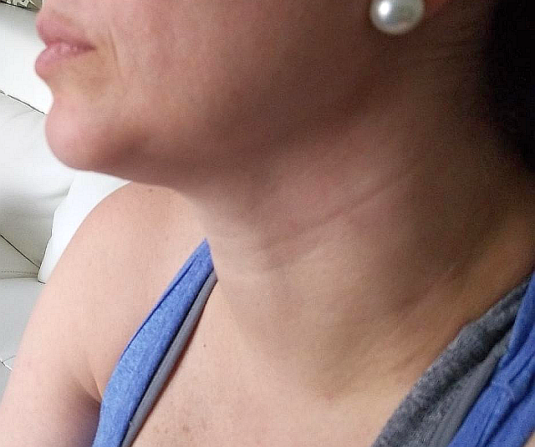
New Technology of the Forefront

Slide 28
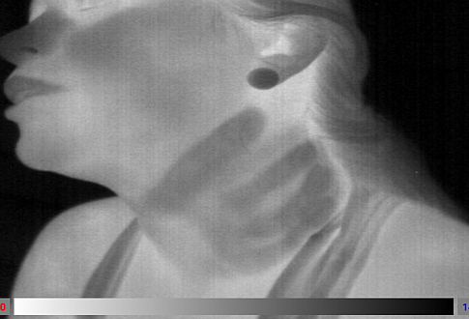
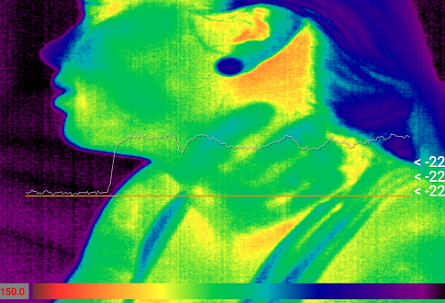
“…researchers report that only half of strangulation victims have visible injuries, and only 15% have injuries that can be photographed.” -The Strangulation Training Institute
Notes:
Can be put in the strangulation area

Slide 29
Notes:
Can discuss documenting injuries

Slide 30
Contact Information
Shannon Scott,
BSN, RN, CEN, SANE-P, FN-CSp
Cheryl Neuner,
BSN, MBA, RNC-NIC, NPD-BC, NE-BC
Forensic Nurse Examiner Program Coordinator
(FO) 843-777-1449 or 1450
(O) 843-777-5219
(C) 540-273-0696
shannon.scott@mcleodhealth.org
Regional Systems Developer-Perinatal Outreach
(O) 843-777-5059
(C) 843-319-4543
cneuner@mcleodhealth.org
Notes:
Ok to keep

Slide 31
Resources
Holmes, M. R. & Kim, J. Y. (2019). Prenatal Exposure to Domestic Violence: Summary of Key Research Findings. Case Western Reserve University. Cleveland, OH. Available from: https://case.edu/socialwork/traumacenter/resources
https://www.strangulationtraininginstitute.com/
https://www.sccadvasa.org/domestic-violence/
Notes:
Ok to keep

