Slide 1


“Fetal Heart Rate Tracings –
What is the baby telling you?”
Project ECHO
09/15/2021
Michelle Flanagan, BSN, RNC-OB, C-EFM
Prisma Health Richland Hospital
Perinatal Systems
Obstetric Outreach Educator
Michelle.Flanagan@PrismaHealth.org

Slide 2
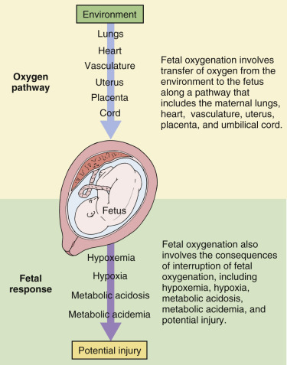
Benefit of EFM
Theory is to identify and intervene on fetal hypoxia secondary to the physiologic demands of normal and abnormal labor
Remember!
  Normal components of labor result in transient decreases in oxygen delivery and gas exchange for the fetus
  These events place the fetus at risk for interruption in oxygenation and hypoxia even in uncomplicated pregnancies
  Examples:
    Contractions throughout the first and second stage
    Maternal expulsive efforts during the second stage
Image from: Fig. 15.1 - The Oxygen Pathway.
Gabbe's Obstetrics: Normal and Problem Pregnancies.
Landon, M. Gabbe's Obstetrics: Normal and Problem Pregnancies Eighth Edition 2021
Notes:
Recall: Normal components of labor result in transient decreases in oxygen delivery and gas exchange for the fetus which places the fetus at risk for interruption in oxygenation and hypoxia even in uncomplicated pregnancies
Contractions throughout the first and second stage
Maternal expulsive efforts during the second stage

Slide 3
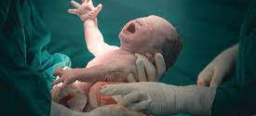
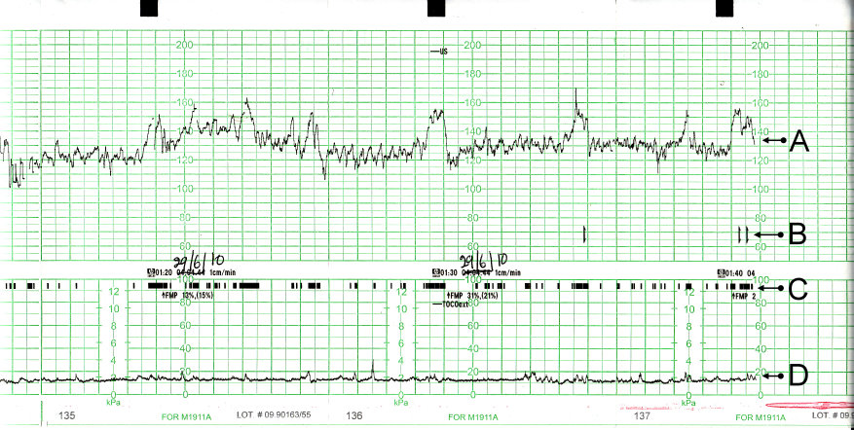
What Information Can We Gain from
Electronic Fetal Monitoring?
Positive Outcomes Associated Intrapartum EFM
  Several studies have shown that persistent Category I fetal monitoring strip, or the presence of accelerations, is associated with a normal pH
  Moderate variability has also been associated with a normal pH
MUST Recognize:
  Neither category I nor moderate variability is 100% specific for a normal pH
  Assess all of the EFM patterns together as well as the clinical context
    May have significant risk of acidemia if other features are present and persistent despite moderate variability
Landon, M. Gabbe's Obstetrics: Normal and Problem Pregnancies Eighth Edition 2021
Notes:
All of these studies support the association between features within categories II and III the risk of acidemia, but the majority of patients with these patterns will have a normal pH, which is why EFM patterns remain poorly predictive of acidemia.
Intrapartum EFM patterns have also been associated with neonatal morbidity. A large cohort study investigated the association between EFM patterns in the 30 minutes before delivery and neonatal respiratory morbidity. 40 It found that tachycardia, marked variability, and prolonged decelerations were associated with neonatal respiratory distress. A prospective cohort study of over 8000 women also found an association between EFM patterns and adverse neonatal outcomes. 41 It was found that tachycardia and repetitive decelerations in the 2 hours prior to delivery were associated with neonatal morbidity at term, defined as comprising neonatal death, hypothermic therapy, respiratory distress, mechanical ventilation, meconium aspiration, seizures, or treatment for sepsis. Both studies demonstrate that features of category II and III EFM are associated with neonatal morbidities at term.
Several of these studies have also provided evidence for EFM patterns associated with normal pH. Several studies have shown that persistent category I EFM, or the presence of accelerations, is associated with a normal pH. 344142 In addition, moderate variability has also been associated with a normal pH. 2543 However, it is important to recognize that neither category I nor moderate variability is 100% specific for a normal pH. It is also important to assess all of the EFM patterns together as well as the clinical context since it is possible to have significant risk of acidemia if other features are present and persistent despite moderate variability . 41

Slide 4
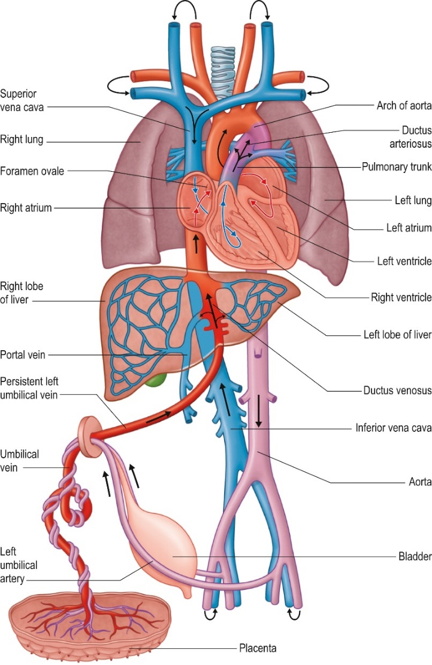
Fetal Circulation
Fig. 13.25
A plan of the fetal cardiovascular circulation: the arrows indicate the direction of blood flow. The placenta is drawn to a greatly reduced scale.
Standring, S., et al. Gray’s anatomy 42nd ed. 2021
Notes:
Recall that the fetus has a specialized circulatory system that allows for oxygenated blood to preferentially flow to the organs with the highest oxygen demand. Understanding that gestational age affects the fetus’s ability to maintain its homeostasis. We think of the fetus’s extrinsic influences of Cord, Amniotic fluid, uterus & placenta and maternal physiology providing appropriate amounts of oxygen, nutrients and disposal of waste products. While at the same time maturation of intrinsic influences of the Autonomic nervous system (sympathetic and parasympathetic), Baroreceptors, Chemoreceptors and hormonal responses to manage the ability to maintain homeostasis.

Slide 5
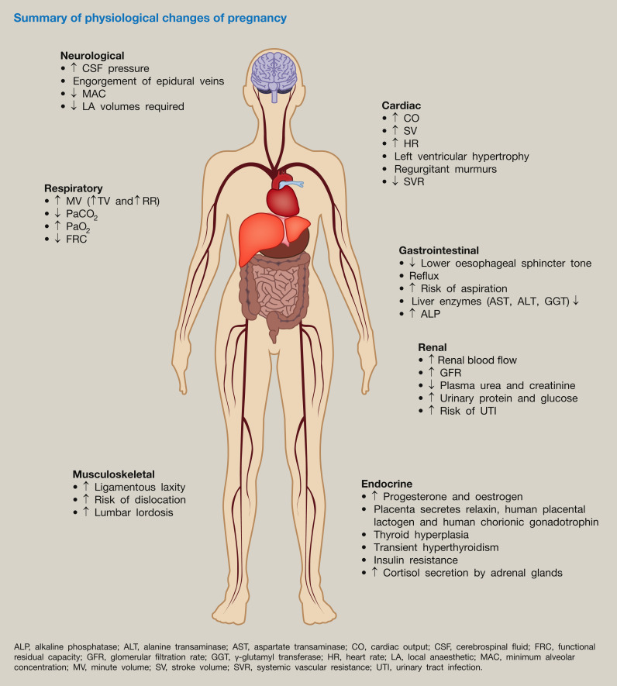
Maternal Physiology
The physiologic changes of pregnancy overall serve to support and maintain the pregnancy in a manner that encompasses almost every organ system from head to toe.
Image from: Mockridge, A. & Maclennan, K. Physiology of pregnancy. Anaesthesia and Intensive Care Medicine, 2019-07-01, Volume 20, Issue 7, Pages 397-401.

Slide 6




Maternal Conditions: Acute
Maternal & Fetal Health
Acute Event
(Cord Prolapse, Abruption, etc)
Labor + Stress
Outcomes
Physiologic Changes of Pregnancy

Slide 7

Maternal Conditions: Chronic
Pre-existing Chronic Condition(s)
Maternal & Fetal Health
Labor + Stress
Outcomes
Physiologic Changes of Pregnancy

Slide 8
Case 1:
A 29-year-old gravida 2, para 1-0-0-1, presents to labor & delivery at 30 2/7 weeks’ gestation with decreased fetal movements
  She had noted decreased fetal movement 5 days earlier and had a nonstress test the previous day that became reactive after almost 2 hours of monitoring and many attempts at fetal stimulation
  She received no other evaluation at that time
Otherwise had no complaints, and denied any contractions, vaginal bleeding, or leaking of fluid
Notes:
The patient’s obstetric history included a full-term vaginal delivery complicated by preeclampsia with severe features. The current pregnancy was complicated only by a recent maternal diagnosis of avascular necrosis of the femoral head. She had no other medical concerns. Her gynecologic history included an abnormal Pap smear with positive high-risk human papillomavirus. Her family history was notable for her brother who had a recent diagnosis of an “autoimmune clotting disorder” treated with clopidogrel and warfarin; the patient reported that her brother was doing well and had no other information regarding his diagnosis

Slide 9
Figure 1. Electronic fetal monitoring strip 1. Clear, E, Braginsky, L & Plunkett, B. NeoReviews 2018;19;e493

Slide 10
Figures 4a and 4b. Electronic fetal monitoring strip 3.
Notes:
Findings on EFM strip 3 are as follows:
• Variability: Absent
• Baseline rate: 140 beats/min
• Episodic pattern: Sinusoidal
• Uterine contractions: None
• Interpretation: Category III
• Differential diagnosis: Fetal anemia, fetal hypoxemia
• Action: Urgent primary cesarean delivery
A sinusoidal heart rate tracing is a category III tracing and, as such, requires urgent action. It is characterized by its sinusoidal appearance and smooth contours with lack of variability. It is a sign of severe fetal anemia. Because of the concern about worsening fetal status, the obstetric team performed an urgent primary cesarean delivery. The surgery was uncomplicated, with the delivery of a female infant weighing 2,570 g. Neonatology was present at the delivery, and
the infant’s Apgar scores were 6, 8, and 8 at 1, 5, and 10minutes, respectively. The infant appeared extremely pale and required intubation immediately after delivery because
of apnea. She was given a blood transfusion in the operating room via an umbilical line for a hematocrit of 9%. She was transferred to the special care nursery in stable condition. The
infant’s coagulation studies were abnormal, with elevated prothrombin and partial thromboplastin times, increased international normalized ratio, and a decreased fibrinogen
level, but her platelet counts were normal. Brain ultrasonography 2 days after birth showed a marked amount of complex extra-axial fluid and moderate ventriculomegaly, as well as an abnormal appearance of the gyri and sulci with cystic encephalomalacia of the left parietal lobe, hemorrhagic ischemic changes in the left parietal, occipital, and temporal lobes (Figs 5 and 6). The neonatology team evaluated the infant for an infection with blood and cerebrospinal fluid testing, results of which were negative for cytomegalovirus (CMV), parvovirus, and herpes simplex virus. A fetal MRI revealed large bilateral hemispheric parenchymal hemorrhages within the parietal, occipital, and posterior temporal lobes; large intraventricular hemorrhages; and bilateral multiseptated subdural hemorrhages over the entire cerebral hemisphere and posterior superior cerebellum (Fig 7). The infant underwent successful extubation and is currently undergoing continued hematologic evaluation and monitoring in the special care nursery.
Fetal Intracranial Hemorrhage
In utero fetal intracranial hemorrhage is very rare, with an incidence of 1 to 2 in 100,000. The most common type of intrauterine cerebral hemorrhage is intraventricular, but bleeding can occur in other locations, such as the cerebellum, subdural, or subarachnoid space, or within the cerebral parenchyma. (1)Cerebral hemorrhages can occur because of trauma, fetal coagulopathy, alloimmune thrombocytopenia, infection, vascular malformation, tumor, hypoxic-ischemic stroke, and certain genemutations with a predisposition to hemorrhage. (2) Most cases of fetal intracranial hemorrhage occur in the early third trimester because of the immaturity of the germinal matrix and its susceptibility to changes in cerebral blood flow.
(3) Typically, in utero intracranial hemorrhages are classified in grades, with increasingly poor prognoses accompanying the higher grades of hemorrhage. (2) • Grade I is isolated to the germinal matrix at the caudothalamic groove. • Grade II is an intraventricular hemorrhage without ventricular dilation. • Grade III involves ventricular dilation. • Grade IV includes periventricular hemorrhagic infarction. (2) These grades can be determined with ultrasonography. (1)
There are several other causes for cerebral injury, which may lead to, and ultrasonographically mimic, fetal intracranial hemorrhage, including fetal hypoxic-ischemic stroke, intrauterine infection, and intracranial neoplasm. Similar to intracranial hemorrhage, the appearance of a fetal stroke is variable, though it initially appears as increased cerebral echogenicity. (5) The lesion may later progress to microcephaly, cystic intraparenchymal lesions, and cortical malformations. (5) Fetal infection, particularly CMV infection, may also mimic intracranial hemorrhage on ultrasonography

Slide 11
Zoom in on the end of the previous strip
Figures 4a and 4b. Electronic fetal monitoring strip 3.
Notes:
Findings on EFM strip 3 are as follows:
• Variability: Absent
• Baseline rate: 140 beats/min
• Episodic pattern: Sinusoidal
• Uterine contractions: None
• Interpretation: Category III
• Differential diagnosis: Fetal anemia, fetal hypoxemia
• Action: Urgent primary cesarean delivery
Fetal Intracranial Hemorrhage
In utero fetal intracranial hemorrhage is very rare, with an incidence of 1 to 2 in 100,000. The most common type of intrauterine cerebral hemorrhage is intraventricular, but bleeding can occur in other locations, such as the cerebellum,
subdural, or subarachnoid space, or within the cerebral parenchyma. (1)Cerebral hemorrhages can occur because of trauma, fetal coagulopathy, alloimmune thrombocytopenia, infection, vascular malformation, tumor, hypoxic-ischemic stroke, and certain genemutations with a predisposition to hemorrhage. (2) Most cases of fetal intracranial hemorrhage occur in the early third trimester because of the immaturity of the germinal matrix and its susceptibility to changes in cerebral blood flow. (3) Typically, in utero intracranial hemorrhages are classified in grades, with increasingly poor prognoses accompanying the higher grades of hemorrhage. (2) • Grade I is isolated to the germinal matrix at the caudothalamic
groove. • Grade II is an intraventricular hemorrhage without ventricular dilation. • Grade III involves ventricular dilation. • Grade IV includes periventricular hemorrhagic infarction. (2) These grades can be determined with ultrasonography. (1)
There are several other causes for cerebral injury, which may lead to, and ultrasonographically mimic, fetal intracranial hemorrhage, including fetal hypoxic-ischemic stroke, intrauterine infection, and intracranial neoplasm. Similar to intracranial hemorrhage, the appearance of a fetal stroke is variable, though it initially appears as increased cerebral echogenicity. (5) The lesion may later progress to microcephaly, cystic intraparenchymal lesions, and cortical malformations.
(5) Fetal infection, particularly CMV infection, may also mimic intracranial hemorrhage on ultrasonography

Slide 12
Outcome
Post Delivery:
Abnormal coagulation studies:
  elevated PT & PTT, INR; decreased fibrinogen level; Normal platelet counts
Brain ultrasound 2 days after birth
  showed a marked amount of complex extra-axial fluid and moderate ventriculomegaly, as well as an abnormal appearance of the gyri and sulci with cystic encephalomalacia of the left parietal lobe, hemorrhagic ischemic changes in the left parietal, occipital, and temporal lobes
Negative for CMV, parvovirus, & HSV
Fetal MRI revealed large bilateral hemispheric parenchymal hemorrhages within the parietal, occipital, and posterior temporal lobes; large intraventricular hemorrhages; and bilateral multiseptated subdural hemorrhages over the entire cerebral hemisphere and posterior superior cerebellum
The infant underwent successful extubation and is currently undergoing continued hematologic evaluation and monitoring in the special care nursery.
Urgent primary cesarean delivery, Neonatology was present at the delivery
Female infant
  Weight: 2,570 g
  Apgar: 6, 8, and 8
  The infant appeared extremely pale and required intubation immediately after delivery
  She was given a blood transfusion in the operating room via an umbilical line for a hematocrit of 9%.
She was transferred to the special care nursery in stable condition.
Notes:
Rare (Incidence: 1-2/100,000)
The most common type of intrauterine cerebral hemorrhage is intraventricular, but bleeding can occur in other locations (cerebellum, subdural, or subarachnoid space, or within the cerebral parenchyma)
Cerebral hemorrhages can occur because of trauma, fetal coagulopathy, alloimmune thrombocytopenia, infection, vascular malformation, tumor, hypoxic-ischemic stroke, and certain gene mutations with a predisposition to hemorrhage.
Most cases of fetal intracranial hemorrhage occur in the early third trimester because of the immaturity of the germinal matrix and its susceptibility to changes in cerebral blood flow
Typically, in utero intracranial hemorrhages are classified in grades, with increasingly poor prognoses accompanying the higher grades of hemorrhage.
There are several other causes for cerebral injury, which may lead to, and ultrasonographically mimic, fetal intracranial hemorrhage,
Fetal hypoxic-ischemic stroke / intrauterine infection / intracranial neoplasm
Similar to intracranial hemorrhage, the appearance of a fetal stroke is variable, though it initially appears as increased cerebral echogenicity. The lesion may later progress to microcephaly, cystic intraparenchymal lesions, and cortical malformations. Fetal infection, particularly CMV infection, may also mimic intracranial hemorrhage on ultrasonography
Fetal Intracranial Hemorrhage
In utero fetal intracranial hemorrhage is very rare, with an incidence of 1 to 2 in 100,000. The most common type of intrauterine cerebral hemorrhage is intraventricular, but bleeding can occur in other locations, such as the cerebellum,
subdural, or subarachnoid space, or within the cerebral parenchyma. (1)Cerebral hemorrhages can occur because of trauma, fetal coagulopathy, alloimmune thrombocytopenia, infection, vascular malformation, tumor, hypoxic-ischemic stroke, and certain genemutations with a predisposition to hemorrhage. (2) Most cases of fetal intracranial hemorrhage occur in the early third trimester because of the immaturity of the germinal matrix and its susceptibility to changes in cerebral blood flow. (3) Typically, in utero intracranial hemorrhages are classified in grades, with increasingly poor prognoses accompanying the higher grades of hemorrhage. (2)
• Grade I is isolated to the germinal matrix at the caudothalamic groove.
• Grade II is an intraventricular hemorrhage without ventricular dilation.
• Grade III involves ventricular dilation.
• Grade IV includes periventricular hemorrhagic infarction.(2)
These grades can be determined with ultrasonography. (1)
There are several other causes for cerebral injury, which may lead to, and ultrasonographically mimic, fetal intracranial hemorrhage, including fetal hypoxic-ischemic stroke, intrauterine infection, and intracranial neoplasm. Similar to
intracranial hemorrhage, the appearance of a fetal stroke is variable, though it initially appears as increased cerebral echogenicity. (5) The lesion may later progress to microcephaly, cystic intraparenchymal lesions, and cortical malformations.
(5) Fetal infection, particularly CMV infection, may also mimic intracranial hemorrhage on ultrasonography

Slide 13
Case 2:
40-year-old gravida 3, para 1-0-0-1-1 at 39 4/7 weeks’ gestation with a history of prior cesarean delivery for a large-for–gestational age infant arrived in labor and delivery desiring a trial-of-labor-after-cesarean
She presented with contractions, SVE: 1-2 CM
She denied leaking of fluid or vaginal bleeding and reported normal fetal movement.
Her history included fibroids and sexual abuse in the distant past.
Her most recent ultrasonographic scan performed 1 week ago showed an estimated fetal weight of 3,768 g.
Admission vital signs: T - 98.2°F HR - 75 bpm BP - 124/89 mmHg RR- 18
Prenatal laboratory findings were within normal limits, GBS negative
Druzin, M & Peterson, P. NeoReviews 2017;18;e75
Notes:
Because the woman was in early labor, the plan was to observe and reassess for cervical change in 2 hours, and augment with oxytocin if necessary. The fetal heart rate (FHR) monitor was applied externally and the following tracing was obtained (Fig 1).

Slide 14
Figure 1. Electronic fetal monitoring strip 1. Druzin, M & Peterson, P. NeoReviews 2017;18;e75
Notes:
Variability: Moderate
Baseline rate: 150 beats per minute
Episodic patterns: Accelerations
Periodic patterns: None
Uterine contractions: Irregular, 3 to 5 minutes apart, mild by palpation
Interpretation: Category I tracing, reflective of fetal wellbeing and absence of metabolic acidosis
Differential diagnosis: Early labor, TOLAC
Action: After several hours, a cervical examination revealed no change and augmentation with oxytocin was recommended. At first the patient was amenable to the plan, but then changed her mind and refused oxytocin and any other interventions and wished to go home. The physician discussed the concerns of the patient and her husband, and informed them of the risk of uterine rupture with her history of a prior cesarean
delivery with a macrosomic infant. The patient and husband verbalized their understanding but again refused treatment, signed a discharge form, and left the hospital.

Slide 15
After several hours, a cervical examination revealed no change and augmentation with oxytocin was recommended.
At first the patient was amenable to the plan, but then changed her mind and refused oxytocin and any other interventions and wished to go home.
The physician discussed the concerns of the patient and her husband, and informed them of the risk of uterine rupture with her history of a prior cesarean delivery with a macrosomic infant.
The patient and husband verbalized their understanding but again refused treatment, signed a discharge form, and left the hospital.

Slide 16
3 Days Later
Patient returns to labor & delivery with painful contractions that she rated as 8 out of 10, and requested pain relief.
SVE: 2/30%/-3
She considered taking an epidural but was hesitant to do so, because she believed it was the reason she had a cesarean delivery the first time, when she did not progress past 3 cm after epidural placement.

Slide 17
Figure 2. Electronic fetal monitoring strip 1. Druzin, M & Peterson, P. NeoReviews 2017;18;e75
Notes:
Variability: Minimal
Baseline rate: 170 beats per minute, fetal tachycardia
Episodic patterns: None
Periodic patterns: One late-appearing deceleration
Uterine contractions: Every 2 to 3 minutes; palpate for
intensity and frequency
Interpretation: Category II, indeterminate
Differential diagnosis: As previously noted
Action: In addition to continuous fetal monitoring, lateral repositioning, and hydration to improve fetal oxygenation, the staff need to remain hypervigilant for potential complications of TOLAC and watch for signs associated with uterine rupture such as fetal bradycardia, increased uterine contractions, vaginal bleeding, loss of fetal station, or new onset of intense uterine pain. (3)

Slide 18
1 hour later SVE: 3/50%/-3, IUPC Placed
Discussion of continued augmentation v/s repeat C/S, Pt & husband wish to continue with augmentation
Figure 3. Electronic fetal monitoring strip 1. Druzin, M & Peterson, P. NeoReviews 2017;18;e75
Notes:
Findings on EFM strip 3 were as follows:
Variability: Moderate
Baseline rate: 165 beats per minute
Episodic patterns: None
Periodic patterns: None
Uterine contractions: Every 2 minutes, moderate per palpation
Interpretation: Category II, indeterminate
Differential diagnosis: As previously noted
Action: Category II tracings require continued surveillance and reevaluation. The patient was repositioned and reexamined. The cervix was still 3 cm dilated but swollen and 50% effaced, with vertex at -3 station. An intrauterine pressure catheter (IUPC) was placed to determine uterine strength and was used to rule out arrest of labor when a lack of progress was noted. However, the VBAC guidelines of the American College of Obstetricians and Gynecologists state that there is no evidence to suggest that an IUPC can assist in the diagnosis of uterine rupture. (3)
A discussion took place with the patient and her husband about the options of continued augmentation with oxytocin versus proceeding with repeat cesarean delivery in light of the swollen cervix, fetal tachycardia, and macrosomic infant expected. The patient and her husband decided to continue with augmentation.

Slide 19
1 hour later
To OR
Figure 4. Electronic fetal monitoring strip 1. Druzin, M & Peterson, P. NeoReviews 2017;18;e75
Notes:
One hour later, the FHR demonstrated periods of minimal variability and recurrent prolonged decelerations, and the following tracing was seen (Fig 4).
Findings on EFM strip 4 are as follows:
Variability: Unable to determine
Baseline rate: Unable to determine
Episodic patterns: Recurrent prolonged decelerations
Periodic patterns: None
Uterine contractions: No documentation of uterine status
Interpretation: Category II.
Differential diagnosis: Rule out cord compression, cord prolapse, uterine rupture
Action: A decision was made to proceed with a repeat cesarean delivery for fetal intolerance of labor and concern of increased risk of uterine rupture. The anesthesiologist, neonatologist, and operating room (OR) teams were standing by and the patient was taken to the OR for an urgent cesarean delivery. The final tracing 3 minutes later in the OR is shown in Fig 5.

Slide 20
Final Tracing in OR
Figure 5 Electronic fetal monitoring strip 1. Druzin, M & Peterson, P. NeoReviews 2017;18;e75
Notes:
Findings on EFM strip 5 were as follows:
Variability: Absent
Baseline rate: Bradycardia, 65 to 80 beats per minute
Episodic patterns: Unable to determine
Periodic patterns: Unable to determine
Uterine contractions: No documentation of uterine status
Interpretation: Category III, predictive of abnormal fetal acid-base status
Differential diagnosis: Same as before
Action: Nonreassuring FHR patterns are often the predominant sign preceding a uterine rupture and requires immediate evaluation and delivery.
In the OR, the patient continued to have severe decelerations and received general anesthesia for the urgent delivery of the infant.
Outcome
Upon entering the abdominal cavity, the placenta was noted to be completely separated from the uterus, consistent with uterine rupture. The uterus was empty and contracted down, and the fetus and placenta were found in the left upper quadrant superior and behind the uterus. The head was delivered without incident, followed by the torso within 2 minutes. The cord was clamped, cut, and a viable pale, floppy, apneic female infant was delivered and handed to the NICU team. Apgar scores were 1 and 8 at 1 minute and 5 minutes, respectively. The birthweight
was 4 kg (8.8 lb). Samples were sent to the laboratory for cord gases. The infant received positive pressure ventilation for 2 minutes, with a rapid improvement in heart rate. The infant started to breathe spontaneously and cried. Deep suction yielded copious amounts of bloody fluid. She was taken to the NICU and had an uneventful course.

Slide 21
Outcome
Upon entering the abdominal cavity
  Placenta was noted to be completely separated from the uterus
  Uterus was empty and contracted down
  Fetus and placenta were found in the left upper quadrant superior and behind the uterus.
  The head was delivered, followed by the torso within 2 minutes.
Female Infant
  Viable pale, floppy, apneic female infant was delivered and handed to the NICU team.
  Birthweight was 4 kg (8.8 lb)
  Apgars: 1 and 8
  The infant received positive pressure ventilation for 2 minutes, with a rapid improvement in heart rate
  The infant started to breathe spontaneously and cried. Deep suction yielded copious amounts of bloody fluid
  Cord Gas: pH: 6.9 pCO2: 104.9 pO2: 9.0 BE: –10
She was taken to the NICU and had an uneventful course.
Druzin, M & Peterson, P. NeoReviews 2017;18;e75

Slide 22
Case 3:
This case involves a 35-year-old, gravida 6 para 5005 who presented to the emergency department at 38 4/7 weeks’ gestation with contractions every 10 minutes
She had not received any prenatal care with this current pregnancy, and her obstetric history was significant for:
  G1: gestational diabetes (medication dependent)
  G4: gestational diabetes (nonmedication dependent)
  G5: gestational diabetes (nonmedication dependent)and preeclampsia with induction of labor at 37 weeks’ gestation
She denied headache, visual changes, right upper quadrant pain, or shortness of breath.
BP - 210-220/110s mmHg HR - 56 bpm RR – Normal
SVE: 3 cm/ 30% / –3
Bedside ultrasonography confirmed a viable fetus in the vertex presentation with measurements consistent with a gestational age of 35 weeks
NeoReviews Vol.16 No.9 September 2015 e564
Notes:
In the emergency department, her blood pressure was 211/99 mm Hg, confirmed on repeat measurement. The obstetric team was notified, and the patient was immediately transferred to the labor and delivery department. On presentation to the labor and delivery department, the patient reported decreased fetal movement, without vaginal bleeding or leaking of fluid. She denied headache, visual changes, right upper quadrant pain, or shortness of breath. Her vital signs were significant for severe hypertension, with a blood pressure of 210-220/110s mm Hg, a pulse of 56 beats per minute, and a normal respiratory rate. A cervical examination found her to be 3 cm dilated, 30% effaced, and vertex at –3 station.
Bedside ultrasonography confirmed a viable fetus in the vertex presentation with measurements consistent with a gestational age of 35 weeks. An external fetal monitor was placed (Figure 1).

Slide 23
Figure 1. NeoReviews Vol.16 No.9 September 2015
Notes:
Findings on Figure 1 were as follows:
• Variability: Minimal
• Baseline rate: 120 beats per minute
• Episodic patterns: Unable to determine
• Periodic patterns: None
• Uterine contractions: None noted, palpate the uterus for frequency and intensity
• Interpretation: Category II
• Differential diagnoses: An indeterminate FHR pattern is not reliably predictive of abnormal acid base status. However, minimal variability without accelerations is concerning for ongoing hypoxia and the possible development of metabolic acidosis. Placental insufficiency is often present
in patients with a diagnosis of severe gestational hypertension and/or severe preeclampsia.
• Action: The criteria for diagnosis of severe preeclampsia include new-onset hypertension with blood pressures of ‡160 mm Hg systolic or ‡110 mm Hg diastolic for more than 15 minutes and proteinuria (>0.3 g of protein in 24 hours) or, in the absence of proteinuria, new-onset hypertension with signs and symptoms of any of the following: thrombocytopenia, impaired liver function, progressive renal insufficiency, pulmonary edema, and new onset cerebral or visual disturbances. (1) Even though this patient did not have any of these findings, her severe range of blood pressures confirmed a diagnosis of severe preeclampsia and severe gestational hypertension, which warranted intravenous antihypertensive treatment
within 60 minutes of recognition to decrease the risk of stroke. In addition, intravenous magnesium sulfate was indicated for seizure prophylaxis with a diagnosis of severe preeclampsia and severe gestational hypertension.
Appropriate interventions to improve fetal oxygenation should focus on maximizing uteroplacental perfusion. Maneuvers should include placing the mother in a lateral position, intravenous fluid bolus of lactated Ringer solution, and maternal oxygen administration via a nonrebreather mask. In addition, continuous fetal monitoring and adjusting the tocodynamometer to pick up uterine contractions should be implemented.

Slide 24
An intravenous catheter was placed, and magnesium sulfate for seizure prophylaxis and hydralazine for blood pressure control was administered
Laboratory studies for evaluation of preeclampsia were performed, a Foley catheter was inserted, and cesarean delivery consent was obtained
Obstetric anesthesia and neonatal care unit team was notified of the patient and fetal status
Patient’s blood pressures decreased to 150s/70s mm Hg with 2 doses of hydralazine.
Decision was made to begin labor augmentation with oxytocin while awaiting the laboratory results.

Slide 25
45 Minutes later
Figure 2. NeoReviews Vol.16 No.9 September 2015
Notes:
An intravenous catheter was placed, and magnesium sulfate for seizure prophylaxis and hydralazine for blood pressure control was administered. Laboratory studies for evaluation of preeclampsia were performed, a Foley catheter was inserted, and cesarean delivery consent was obtained.
In addition, the obstetric anesthesia and neonatal care unit team was notified of the patient and fetal status. The patient’s blood pressures decreased to 150s/70s mm Hg with 2 doses of hydralazine. Given the fact that the patient was a grand multipara, in early labor, with a reasonable likelihood of successful vaginal delivery, a decision was made to begin labor augmentation with oxytocin while awaiting the laboratory results.
Forty-five minutes later, the fetal tracing shown in Figure 2 was obtained.
The findings on Figure 2 were as follows:
• Variability: Minimal to absent
• Baseline rate: 120 beats per minute
• Episodic patterns: None
• Periodic patterns: Unable to determine due to inability to pick up contractions
• Uterine contractions: None documented. Requires palpation for intensity and tone and readjustment of monitor to effectively document contractions.
• Interpretation: Category II, with concern for progression to category III.
• Differential Diagnosis: No change.
• Action: Despite performing all the appropriate interventions mentioned above to improve uteroplacental perfusion, the FHR showed no signs of improvement and continued to show a baseline rate of 120 beats per minute with minimal to absent variability and occasional decelerations, some with late and variable characteristics. The main focus at the time was to maintain maternal blood pressure below 160 mm Hg systolic and 110 mm Hg diastolic, assess the airway, and make preparations for safely performing a cesarean section. Ten minutes later the fetal tracing show in Figure 3 was obtained.

Slide 26
10 minutes later
Figure 3. NeoReviews Vol.16 No.9 September 2015
Notes:
The findings on Figure 3 were as follows:
• Variability: Minimal to Absent
• Baseline rate: 120 beats per minute
• Episodic patterns: None
• Periodic patterns: Decelerations, difficult to interpret due to inability to pick up contractions
• Uterine contractions: Palpate for intensity and tone and readjust the monitor
• Interpretation: Category II, with concern for progression to category III
• Differential diagnosis: No change.
• Action: Given the abnormal tracing, an amniotomy was performed and a fetal scalp electrode was placed. Despite the patient’s initial favorable response to hydralazine, the patient’s blood pressure again returned to the severe range, with concern for development of a cerebrovascular accident. Preeclampsia laboratory results included a platelet count of 119 103/mL (to convert to 109/L, multiply by 1), normal liver function and coagulation profiles, and proteinuria (þ2). These findings were further confirmation of the diagnosis of severe preeclaa based on blood pressure criteria, proteinuria, and thrombocytopenia.

Slide 27
15 minutes later
Figure 4. NeoReviews Vol.16 No.9 September 2015
Notes:
• Variability: Absent
• Baseline rate: 120 beats per minute
• Episodic patterns: None
• Periodic patterns: Recurrent late decelerations
• Uterine contractions: Every 2 to 3 minutes, verified with palpation
• Interpretation: Category III
• Differential diagnosis: Severe preeclampsia with evolving fetal hypoxia and significant risk of acidosis
• Action: Because of evidence of evolving fetal acidosis, as indicated by absent variability and recurrent late decelerations, a decision was made to proceed with a cesarean delivery. The persistent severe range of blood pressures, despite antihypertensive therapy, was an added indication for immediate delivery. The neonatal intensive care unit team was notified, and the patient was transported to the operating room with the fetal scalp electrode in place. In the operating room, spinal anesthesia was administered, and the fetus was monitored continuously during the procedure.

Slide 28
Outcome
Cesarean Delivery of infant 2-3 minutes after skin incision
Male infant
  Weight 3,036 g was delivered within
  APGARS: 0 / 0 / 0 /0 / 0
  vigorous neonatal resuscitative efforts, no HR was noted for more than 20 minutes
After discussion with the family, resuscitation efforts were stopped.
Arterial Cord Blood:
pH: 6.822
pO2: 14
PCO2: 84
BE: -20
NeoReviews Vol.16 No.9 September 2015
Notes:
Given the severity of her illness on presentation to the hospital and the metabolic acidosis revealed by the cord gases, it appears likely that the infant had been exposed to significant hypoxia and evolving metabolic acidosis before labor. On the basis of the mother’s history of preeclampsia in a prior pregnancy, she most likely had preeclampsia superimposed on chronic hypertension. Women with chronic hypertension, diagnosed before pregnancy, generally have worse perinatal and maternal outcomes than those with gestational hypertension (diagnosed during pregnancy).
This is probably related to preexisting vascular hyperreactivity and resultant major maternal end organ damage.

Slide 29
Case 4:
Healthy, 25 year old G1P0
Presents to Labor & Delivery with contractions every 4 minutes apart.
SVE: 3-4/90/0
+ SROM, clear fluid

Slide 30
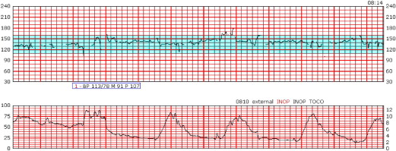
FIGURE 2. Neilson. Signal ambiguity and unexpected outcome with external fetal heart rate monitoring. Am J Obstet Gynecol 2008.

Slide 31
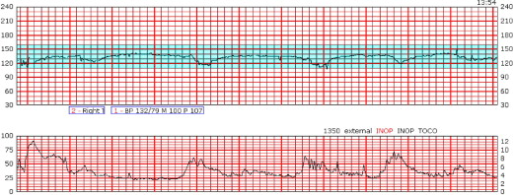
FIGURE 3. Neilson. Signal ambiguity and unexpected outcome with external fetal heart rate monitoring. Am J Obstet Gynecol 2008.

Slide 32
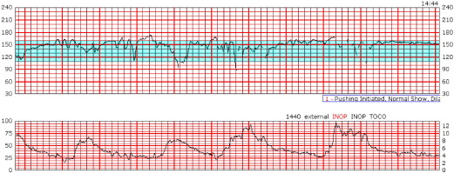
45 minutes later
FIGURE 4. Neilson. Signal ambiguity and unexpected outcome with external fetal heart rate monitoring. Am J Obstet Gynecol 2008.

Slide 33
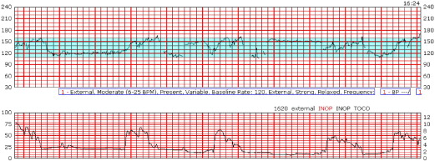
FIGURE 5. Neilson. Signal ambiguity and unexpected outcome with external fetal heart rate monitoring. Am J Obstet Gynecol 2008.

Slide 34
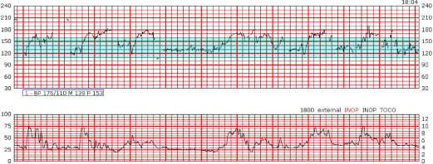
FIGURE 1. Neilson. Signal ambiguity and unexpected outcome with external fetal heart rate monitoring. Am J Obstet Gynecol 2008.
Notes:
comes attributable to this process.
Figure 1 illustrates the monitor tracing immediately prior to delivery of a stillborn infant. This neonate had no response to resuscitation efforts, indicating death at least some minutes before
the actual delivery, implying that the heart rate tracing in the minutes before birth is entirely maternal, although the staff had interpreted it as fetal. This tracing demonstrates regular persistent
heart rate accelerations during second stage bearing-down efforts. Figures 2-5 show representative tracings from the earlier parts of the labor demonstrating the expected FHR reactivity of a healthy fetus at the start and typical responses to changing conditions during the labor.
The transition to the pure maternal tracing at the end of labor (Figure 1) is not evident at any point in the record, although Figure 5 demonstrates a possible point, evidenced by the shifting baseline. The mother was tachycardic during the last several hours of labor, ultimately with a rate between contractions of 120 beats per minute.

Slide 35
Outcome
Stillborn infant
No response to resuscitation efforts
What happened?
  Signal Ambiguity (Maternal heart rate recorded as fetal heart rate)

Slide 36
Outcome
Upon arrival in the operating room, the patient is intubated and prepped for a cesarean section
B/P 70 - 80/30 - 40 mm Hg
An incision is initiated 5 minutes after arrival in the operating room
  Bloody & malodorous amniotic fluid
  200 ml placental clot
  12 – 13 minutes of fetal bradycardia
Viable 3,440-g female is delivered 3 minutes later.
  Apgars 2 /7
  Cord Gas
    pH: 6.9
    pCO2: 112
    pO2: <5
    BE: 10
After closure of uterus
  Diffuse intra-abdominal bleeding
  Diffuse oozing from multiple areas
  JP drain placed
2500ml intraoperative blood loss
  Mass transfusion protocol activated
  Additional 500 ml blood loss from uterus & 650 ml from JP drain
  Total Post-op blood loss 1500 ml
  Receives 14 units PRBC, 6 FFP, 10 Cryo
Transferred to ICU
  Discharged from ICU on PP day 1
  Placental Pathology report: Acute chorioamnionitis
  Diagnosis of Amniotic Fluid Embolism
NeoReviews Vol.12 No.2 February 2011 e111
Notes:
Operative findings include bloody amniotic fluid, a
200-mL placental clot, and malodorous amniotic fluid.
After closure of the uterus, diffuse intra-abdominal bleeding occurs, suggestive of DIC. There is also diffuse oozing from multiple areas along the rectus muscle,
omentum, and subcutaneous tissue. A JP drain is placed.
Estimated intraoperative blood loss is 2,500 mL, and the massive transfusion protocol is activated.
After closure, another 500 mL of blood is expressed from the uterus and another 650 mL drained from the
JP. Interventions include the use of carboprost, medical antishock trousers, and a Bakri balloon (catheter that contains a large central lumen and a 500-mL balloon that
can be inflated once the device is inserted in the uterus to tamponade bleeding) in an attempt to stabilize the bleeding. Postoperative blood loss is estimated at 1,500
mL. DIC should be managed initially by transfusion of packed red cells to maintain tissue oxygenation. Therapy should be guided by the clinical condition of the patient
and laboratory evidence of continuing coagulopathy.
This patient receives 14 units of packed red blood cells, 6 units of fresh frozen plasma, 10 units of cryopreciptate, and 45 g/kg of factor VII. She is transported to the
intensive care unit, where she is treated with ampicillin, gentamicin, and clindamycin and subsequently does well. She remains afebrile and is extubated and discharged
from the intensive care unit on postoperative day 1. On postoperative day 4, she develops premature ventricular contractions. Her electrolyte values are normal,
except for low magnesium, which is replaced. She also has a superficial wound hematoma that is evacuated, and wound care is initiated. The patient is discharged with
her baby on postoperative day 5, and both mother and baby do well. Placental pathology reveals acute chorioamnionitis and moderate-to-severe umbilical vein vasculitis
consistent with an amniotic fluid infection. No evidence of an abruption is found.
AFE is a rare, unpredictable, and unpreventable obstetric emergency that requires prompt recognition of the signs and symptoms, aggressive resuscitation efforts,
and supportive therapy. This case exemplifies the importance of simulation training for obstetrics/neonatal multidisciplinary teams to improve outcomes and patient
safety. This rare life-threatening event requires a rapid response and clear, concise communication in a very short period of time. There is no doubt that this mother
and baby survived intact because of a highly functioning multidisciplinary team.

Slide 37


What Happened to Baby?
Antepartum & intrapartum healthcare providers must consider the impact of events occurring in the antepartum and postpartum period on not just the fetal tracing and maternal/intrauterine interventions but on the neonatal outcomes.
  Were there red flags that we should have intervened?
  Were there opportunities that interventions could have made a difference?
  Did we drop the ball?

Slide 38

What can you do?
Be vigilant in fetal & maternal assessment
  Compare maternal & fetal heart rate
Think about physiology of the placenta – what affects function?
  Age of placenta – post date
  Affect of co-morbidities on placental perfusion
If we move to the OR, what is the fetal heart rate?
  How long between being off monitor & incision time?
  How can I spot check fetal heart rate during surgical preparations?
How do medications affect the fetal heart rate?
  Magnesium Sulfate
  Blood pressure medications

Slide 39
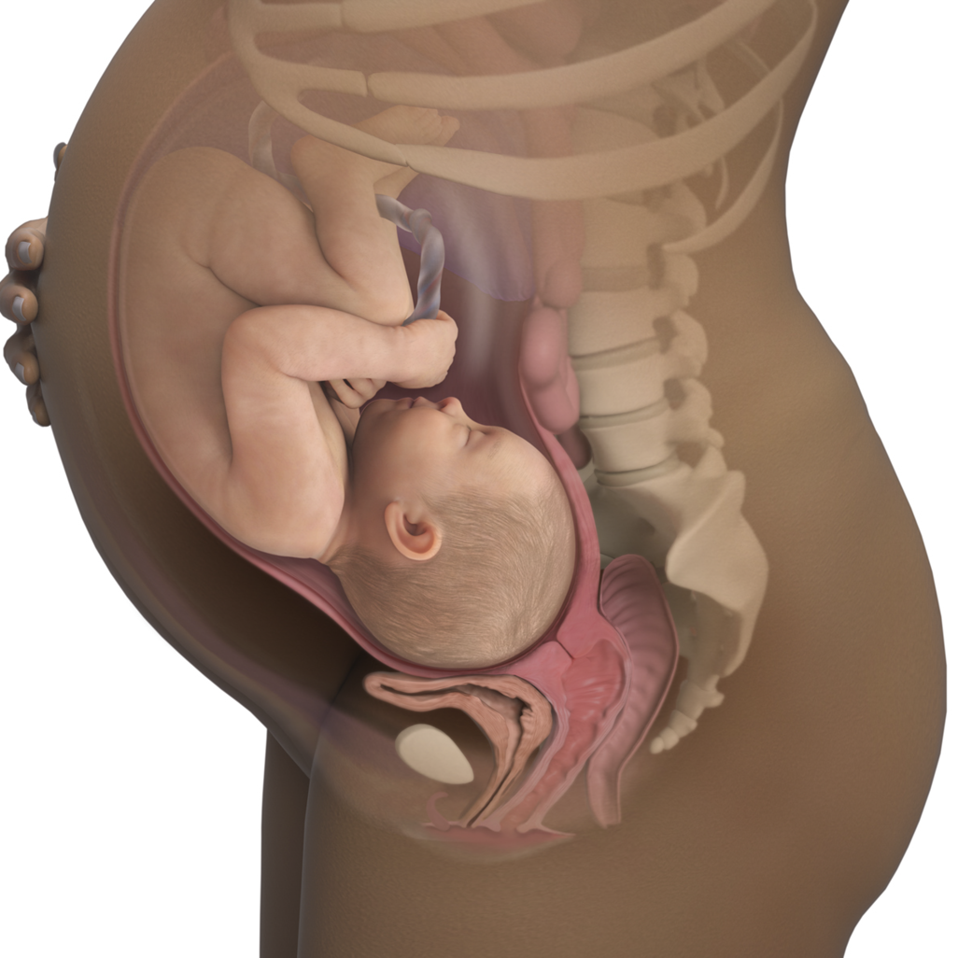
Consider:
Maternal history
  Previous pregnancy
  Previous deliveries
Maternal adaptation to pregnancy
  Chronic condition
  Acute conditions
Extrinsic influences
  Umbilical cord
  Uterus/Placenta
  Amniotic Fluid
  Maternal

Slide 40


Consider
Gestational Age
Intrinsic influences
  Autonomic Nervous System
  Baroreceptors
  Chemoreceptors
  Hormonal Response
What about baby’s backpack?

Slide 41


In Summary
What is the tracing telling us?
What are we looking for?
What should be considered?
Are you considering the “whole picture”?
Images from: https://www.rd.com/list/everyday-objects-close-up/

Slide 42
Project ECHO South Carolina Pregnancy Wellness
Visit Our Website:
https://sctelehealth.org/services/pregnancy-wellness
1st & 3rd Wednesday/Month 12:15 pm – 1:00 pm
Hot Topics September 29, 2021 Isoimmunization Johnson/Campbell

Slide 43
To Request a Copy of today’s
Didactic Video Presentation
Contact
Rachel Grater, Program Coordinator
grater@musc.edu

