Slide 1
Project ECHO SC Pregnancy Wellness:
Fetal Heartbeat and Protection from Abortion Act
Tricia Seal, MD FACOG

Slide 2
Disclaimer
I am not a legal professional
This is my interpretation of the new law

Slide 3

SC Abortion Landscape Pre-Dobbs
21w6d gestational age limit
Not covered by State insurance or Medicaid
3 clinics providing abortion services
  <14 week gestation
Restrictions on private offices
  Need to register as an abortion clinic if exceed 5 abortions in a month or perform any second trimester abortion
Mandatory education, 24 hour waiting period with written attestation
Mandatory reporting to DHEC
Functionally, any second trimester abortion care is hospital-based

Slide 4

Methods of Abortion
Medication
  Mifepristone + Misoprostol
  Misoprostol alone
  Second trimester induction
Procedural
  Uterine aspiration/ D&C (first trimester)
  Dilation and evacuation (D&E) (second trimester)
Self-managed Abortion
  Medication abortion with pharmaceuticals obtained outside of typical medical care (typically online- AidAccess, Plan C, etc.)

Slide 5
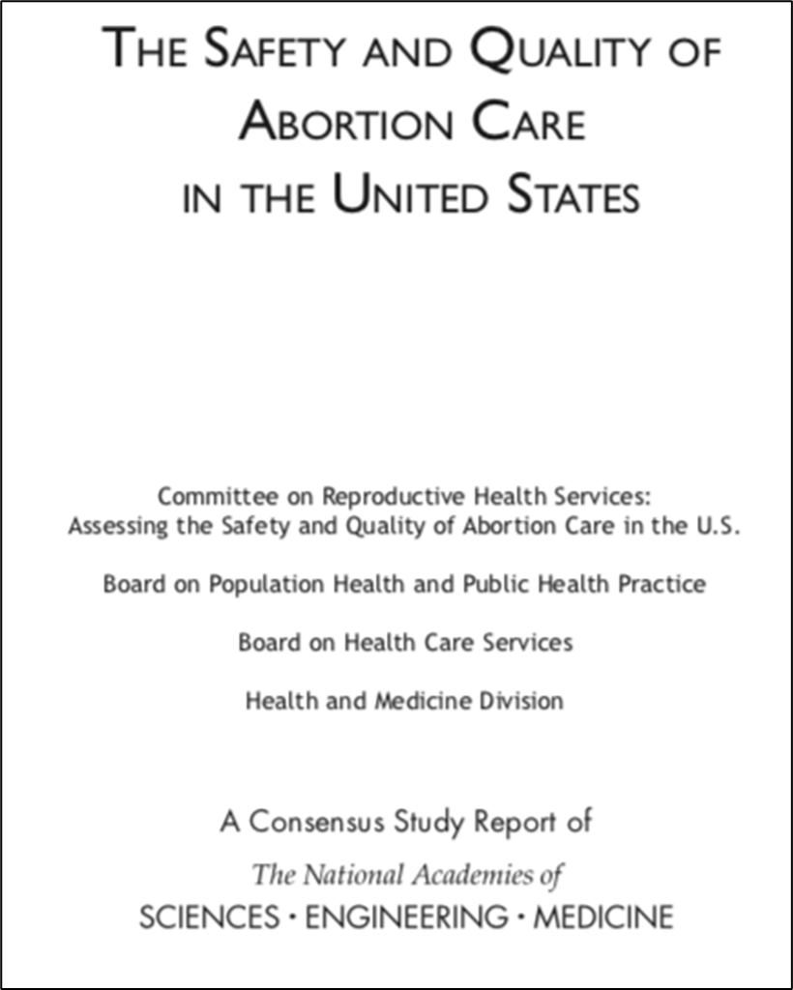
Complications of Abortion
Most common complications include bleeding, infection, and retained products of conception
88-91% of the women who obtain abortions are less than 13 weeks pregnant
  97% report no complications
  2.5% have minor complications that can be handled at the medical office or abortion facility
  < 0.5% have more serious complications that require some additional surgical procedure and/or hospitalization.
Early medical abortions (the first 9 weeks of pregnancy)
  Serious complications occurring in <0.5% of cases

Slide 6


Slide 7
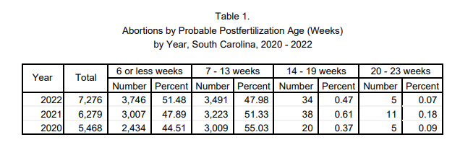

Slide 8
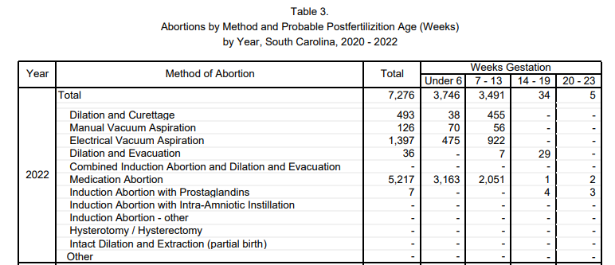

Slide 9
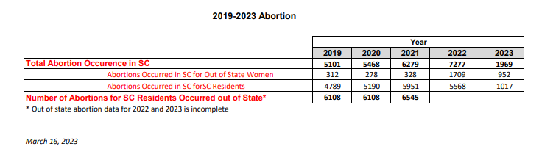

Slide 10
2021 SOUTH CAROLINA FETAL HEARTBEAT AND PROTECTION FROM ABORTION ACT (A1, R2, S1)
Bans abortion after fetal cardiac activity
Exceptions for rape, incest, fatal fetal anomalies, maternal medical emergency to 20 weeks post-conception
Signed into law Feb 2021
Temporary injunction Feb 2021
Dobbs v. Jackson Women’s Health June 24, 2022
SC S1 re-enjoined and goes to the SC Supreme Court
Jan 2023 Deemed unconstitutional in a 3-2 vote (Kaye Hearn majority opinion)
  “infringes on a woman’s right of privacy and bodily autonomy”

Slide 11
2023 Fetal Heartbeat and Protection from Abortion Act (A70, R88, S474)
Passed through special legislative session, signed into law 5/25/2023
Abortion is illegal after detection of “fetal heartbeat”
Criminal consequences and fines for abortion providers, patients are protected
4 Exceptions
  Rape (12 weeks EGA)
  Incest (12 weeks EGA)
  “Fatal Fetal Anomaly”
  Maternal “Medical Emergency”
Enjoined, goes to the SC Supreme Court, 8/23/23 deemed constitutional
  South Carolina Constitution prohibits only ‘unreasonable invasions of privacy’
  “reasonable policy decision” that individuals’ right of privacy “does not outweigh the interest of the unborn”

Slide 12
Ultrasound
>60 minutes prior to procedure
Must be physically present in the same room with patient
Review “the nature and risks of undergoing or not undergoing the proposed procedure that a reasonable patient would consider material to making a knowing and wilful decision of whether to have an abortion”
Gestational age via ultrasound
“view the live ultrasound images and hear the unborn child's fetal heartbeat, if present, at her request during or after the ultrasound procedure and to have them explained to her”
“…physician shall inform the pregnant woman in writing that the unborn child the pregnant woman is carrying has a fetal heartbeat. The physician shall further inform the pregnant woman, to the best of the physician's knowledge, of the statistical probability, absent an induced abortion, of bringing the human fetus possessing a detectable fetal heartbeat to term based on the gestational age of the human fetus or, if the director of the department has specified statistical probability information, shall provide to the pregnant woman that information.”

Slide 13
Attestation Statements
"You have the right to review printed materials prepared by the State of South Carolina which describe fetal development, list agencies which offer alternatives to abortion, and describe medical assistance benefits which may be available for prenatal care, childbirth, and neonatal care. You have the right to view your ultrasound image." This form must be signed and dated by both the physician who is to perform the procedure and the pregnant woman upon whom the procedure is to be performed.
The woman must certify in writing, before the abortion, that the [ultrasound] information … has been furnished her, and that she has been informed of her opportunity to review the information referred to [above].

Slide 14
Contraceptives
"Contraceptive" means a drug, device, or chemical that prevents ovulation, conception, or the implantation of a fertilized ovum in a woman's uterine wall after conception.
All individual and group health insurance and health maintenance organization policies in this State shall include coverage for contraceptives. ... This section does not apply if an individual or entity asserts a sincerely held religious belief regarding the use of contraception.
The Public Employee Benefit Authority and the State Health Plan shall cover prescribed contraceptives for dependents under the same terms and conditions that the Plan provides contraceptive coverage for employees and spouses. The State Health Plan shall not apply patient cost sharing provisions to covered contraceptives.

Slide 15
Child Support
A biological father of a child has a duty to pay the mother of the child the following financial obligations beginning with the date of conception:
  child support payment obligations in an amount determined pursuant to Section 63-17-470;
  fifty percent of the mother's pregnancy expenses
  The duties imposed by this section accrue at the time of conception and must be applied retroactively when paternity is contested, and medical evidence establishes the paternity of the child. Interest accrues…
If rape/incest
  “responsible for the full cost of any expenses incurred by the mother for mental health counseling arising out of the rape or incest”

Slide 16
Physician Consequences
Criminal
  … no person shall perform or induce an abortion on a pregnant woman with the specific intent of causing or abetting an abortion if the unborn child's fetal heartbeat has been detected in accordance with Section 44-41-330(A). A person who violates this subsection is guilty of a felony and, upon conviction, must be fined ten thousand dollars, imprisoned for not more than two years, or both.
Licensing
  In addition to any other penalties imposed by law, a physician or any other professionally licensed person who intentionally, knowingly, or recklessly violates the prohibition on abortion contained in this article commits an act of unprofessional conduct. A physician's license to practice in this State immediately shall be revoked by the State Board of Medical Examiners, after due process according to the board's rules and procedures. Any other licensed person's professional license shall be immediately revoked by the appropriate licensing board, after due process according to that board's rules and procedures. A complaint may be originated by any person or by the board sua sponte. A licensing board acting pursuant to this section may assess costs of the investigation, fines, and other disciplinary actions as it may deem appropriate.

Slide 17
Layperson Consequences
Any person, except as permitted by this chapter, who provides, supplies, prescribes or administers any drug, medicine, prescription or substance to any woman or uses or employs any device, instrument or other means upon any woman, with the intent to produce an abortion shall be deemed guilty of a felony and, upon conviction, shall be punished by imprisonment for a term of not less than two nor more than five years or fined not more than five thousand dollars, or both.
the provisions of this item shall not apply to any woman upon whom an abortion has been attempted or performed.

Slide 18
Medical Judgement
"Reasonable medical judgment" means a medical judgment that would be made by a reasonably prudent physician who is knowledgeable about the case and the treatment possibilities with respect to the medical conditions involved.

Slide 19
Medical Emergency
"Medical emergency" means in reasonable medical judgment, a condition exists that has complicated the pregnant woman's medical condition and necessitates an abortion to prevent death or serious risk of a substantial and irreversible physical impairment of a major bodily function, not including psychological or emotional conditions. A condition must not be considered a medical emergency if based on a claim or diagnosis that a woman will engage in conduct that she intends to result in her death or in a substantial and irreversible physical impairment of a major bodily function.

Slide 20
a risk of death or serious risk of a substantial and irreversible physical impairment of a major bodily function of a pregnant woman, not including psychological or emotional conditions: molar pregnancy, partial molar pregnancy, blighted ovum, ectopic pregnancy, severe preeclampsia, HELLP syndrome, abruptio placentae, severe physical maternal trauma, uterine rupture, intrauterine fetal demise, and miscarriage. However, when an unborn child is alive in utero, the physician must make all reasonable efforts to deliver and save the life of an unborn child during the process of separating the unborn child from the pregnant woman, to the extent that it does not adversely affect the life or physical health of the pregnant woman, and in a manner that is consistent with reasonable medical practice

Slide 21
Fatal Fetal Anomaly
"Fatal fetal anomaly" means that, in reasonable medical judgment, the unborn child has a profound and irremediable congenital or chromosomal anomaly that, with or without the provision of life-preserving treatment, would be incompatible with sustaining life after birth.
Document:
  the presence of a fatal fetal anomaly;
  the nature of the fatal fetal anomaly;
  the medical rationale for making the determination that with or without the provision of life-preserving treatment life after birth would be unsustainable.

Slide 22
Rape/ Incest
Must report the allegation of rape or incest to the sheriff in the county in which the abortion was performed. The report must be made no later than twenty-four hours after performing or inducing the abortion, may be made orally or otherwise, and shall include the name and contact information of the pregnant woman making the allegation. Prior to performing or inducing an abortion, a physician who performs or induces an abortion based upon an allegation of rape or incest must notify the pregnant woman that the physician will report the allegation of rape or incest to the sheriff. The physician shall make written notations in the pregnant woman's medical records that the abortion was performed pursuant to the applicable exception, that the doctor timely notified the sheriff of the allegation of rape or incest, and that the woman was notified prior to the abortion that the physician would notify the sheriff of the allegation of rape or incest.

Slide 23
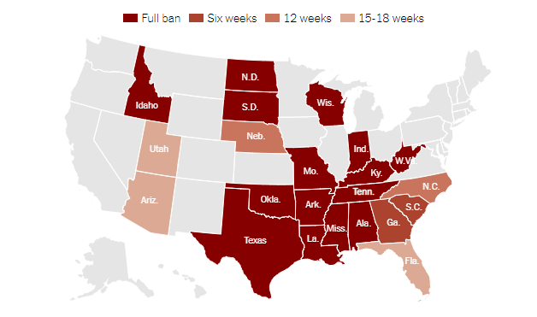
What does this all mean?

Slide 24
What does this all mean?
“Reasonable medical judgement”
  Take care of women in dire situations
  Can always speak to perinatal referral networks
Get acquainted with hospital legal, risk management
  Vetted EMR phrases for law exceptions
  Risk of felony- criminal defense attorney
We may see more self-managed abortion patients in the ER and offices
Closest accessible abortion care for patients is NC (12 week ban), FL (15 week ban)
Closest second trimester abortion care for patients is VA (hospital-based), DC (hospital- or clinic-based), MD (hospital- or clinic-based)

Slide 25
Q&A

Slide 26
Case Presentation 1
Ms. B is a 24yo G2P1001 at 16w5d by L/10 presenting with leaking of fluid for 2 days. There is fetal cardiac activity on ultrasound. She is hospitalized for pre-viable PPROM. On hospital day 2, she becomes febrile to 101.6F, has a tender uterus and purulent discharge. She is started on antibiotics. Blood cultures are collected that result as enterococcus. Her creatinine increases from 0.7 to 2.0.
“prevent death or serious risk of a substantial and irreversible physical impairment of a major bodily function”
She is induced with misoprostol 800mcg, followed by 400mcg q3hrs. Broad spectrum antibiotics are continued.

Slide 27
Case Presentation 1
No 24hr waiting period, mandatory education, or patient offered to view ultrasound
Documentation: ”A physician who performs a medical procedure … shall declare, in a written document maintained with the woman's medical records, that the medical procedure was necessary, the woman's medical condition necessitating the procedure, the physician's rationale for his conclusion that the procedure was necessary, and that all reasonable efforts were made to save the unborn child in the event it was living prior to the procedure. The declaration required by this item must be placed in the woman's medical records not later than thirty days after the procedure was completed. A physician's exercise of reasonable medical judgment in relation to a medical procedure undertaken pursuant to this subsection is presumed to be within the applicable standard of care.”
Must maintain medical records for 7 years, or hospital must if hospital-owned
Reporting: “Any abortion performed in this State must be reported by the performing physician on the standard form for reporting abortions to the State Registrar, Department of Health and Environmental Control, within seven days after the abortion is performed”

Slide 28
Case Presentation 2
Ms. K is a 19yo G0 presenting with a missed period. Her UPT is positive. She is surprised and does not want to continue the pregnancy and desires medication abortion.
Transvaginal ultrasound shows a 5w4d gestational sac without a fetal pole or cardiac activity. She is offered the opportunity to see the ultrasound. You give her information about the likelihood of the pregnancy progressing to term, information about state resources and education (DHEC Fetal & Embryonic Development) and sign an attestation with her. You document that you have done these things and scan the signed attestation into the chart.
You advise her that she can request child support from the biological father. You advise her to come back in 24 hours with her signed Women’s Right to Know form, and you will have her sign another attestation that she has the right to review her ultrasound, and that she received educational materials from you. At that point you will give her mifepristone to start the abortion process.

Slide 29
Case Presentation 2
She misses her appointment and comes back 10 days later. She states that she has been under a lot of stress because this pregnancy was the result of a sexual assault at a campus party. When you mentioned child support at her last visit she was afraid because she does not want to contact her assaulter.
Her repeat ultrasound shows a 7 week fetal pole with cardiac activity. You have her view the ultrasound and doppler waveform of the cardiac activity. She is sure she wants to proceed with termination of pregnancy.
“the pregnancy is the result of rape, and the probable gestational age of the unborn child is not more than twelve weeks”

Slide 30
Case Presentation 2
You notify her that because there is cardiac activity and she is alleging rape, you are obligated to report to the Sheriff no later than 24 hours after she takes mifepristone, including her name and contact information.
She is afraid that this process will notify her assaulter of her pregnancy. She does not want police involvement, and declines your services. She finds an abortion clinic in North Carolina who can take her in three weeks.
You DO NOT need to report, as you are not the “physician who performs or induces an abortion on a pregnant woman based on an exception contained in this section must report the allegation of rape or incest to the sheriff in the county in which the abortion was performed.”

Slide 31
Q&A

