Slide 1
Getting Patients into Treatment
Claire Smith, MD
Assistant Clinical Professor
MUSC Department of Reproductive Psychiatry

Slide 2
DAODAS
South Carolina government agency charged with ensuring quality services to prevent or reduce the negative consequences of substance use and addictions.
Coordinates a statewide system of local substance abuse agencies that provide prevention, treatment, and recovery services.
Can search associated treatment programs by city (301 Centers).
Treatment (including medication) covered for unfunded patients by federal dollars
https://www.daodas.sc.gov/

Slide 3
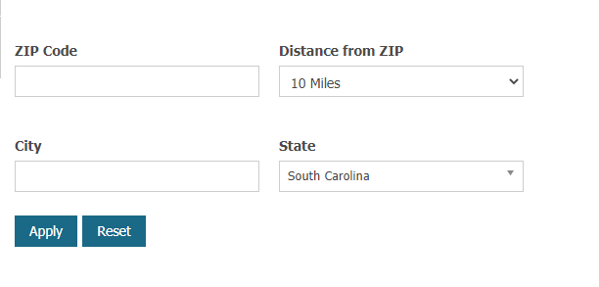
Suboxone Provider Search Tool
https://www.samhsa.gov/

Slide 4
Charleston Center (downtown)
Services: Outpatient, Intensive Outpatient, Inpatient detox
MAT: Methadone, Buprenorphine
Accepts: Private insurance, Medicaid, Payment plan (uninsured)
New Life Program (inpatient)
For women who are pregnant or with small children. Can have up to two children under the age of 5yo
*Not accepting walk-ins due to COVID, assessments are by appointment (843-722-0100)
https://www.charlestoncounty.org/departments/charleston-center/

Slide 5
LRADAC (Columbia area)
Services: Outpatient, Intensive outpatient, Inpatient detox
Serves those in Lexington and Richland counties
MAT: Buprenorphine
Accepts: Private insurance, Medicaid, Medicare, Payment plans
Maternal Outreach Management Services (MOMS)
Resource for pregnant women
Partners with OBGYN offices, social services, patenting agencies, and community resources
Website has information re: appointments, walk-in times, referral form
https://lradac.org/

Slide 6
Shoreline Behavioral Health (Conway)
Services: Outpatient, Intensive outpatient
MAT: Buprenorphine
Accepts: Private insurance, Medicaid, Payment plans
Tele partnership with our program at MUSC for MAT/med management
Women’s Recovery Center
Residential treatment service that provides comprehensive treatment services to women with substance abuse problems who are at risk of losing their children to foster care.
Women’s Intensive Outpatient Program
Group based program tailored to needs of women with substance use issues. Multiple times per week
*call Shoreline at: (843) 365-8884 or visit facility during open access hours M-W from 10am-2pm and Fridays from 9:30am-12:30pm, no appointment necessary.
https://shorelinebhs.org/

Slide 7
Additional Residential Treatment for Pregnant and Postpartum Women
Serenity Place
Chrysalis Center
A part of Phoenix Center in Greenville
Pregnant women or mothers with their preschool-age children (up to 2 kids)
Offer MAT
(864) 467-3881
http://www.phoenixcenter.org/women-residential.php?PageID=48
A part of Circle Park in Florence
Pregnant women or women with children up to age 10
Offer MAT
(843) 673-0660
https://www.chrysaliscenter.com/

Slide 8
MUSC
General services: Outpatient, Intensive outpatient, Inpatient (dual diagnosis unit). No detox or purely substance inpatient treatment
Accepts: Private insurance, Medicaid
Women’s Reproductive Behavioral Health Clinic (us!)
We treat pregnant and postpartum women for the spectrum of mental health issues, including substance use disorders
MAT: Buprenorphine
Opportunities to be involved in clinical research
Do not need to be a patient at MUSC
Able to see a physician within ~1 week
https://medicine.musc.edu/departments/psychiatry/divisions-and-programs/divisions/postpartum

Slide 9
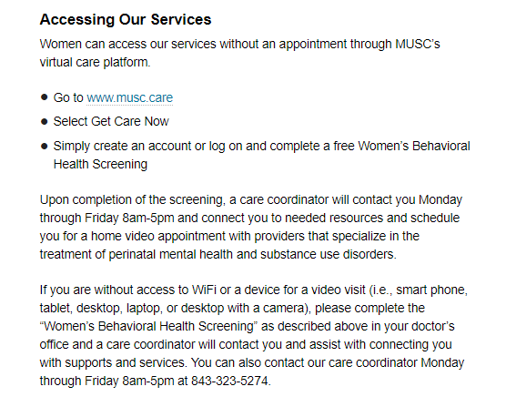

Slide 10
Pregnant Women with OUD
Call 843-614-9510 to speak with a team member
Evaluation and Treatment
Assess eligibility for ongoing clinical trial (MOMs)
Bup SL vs Bup XL in pregnant women with OUD

Slide 11
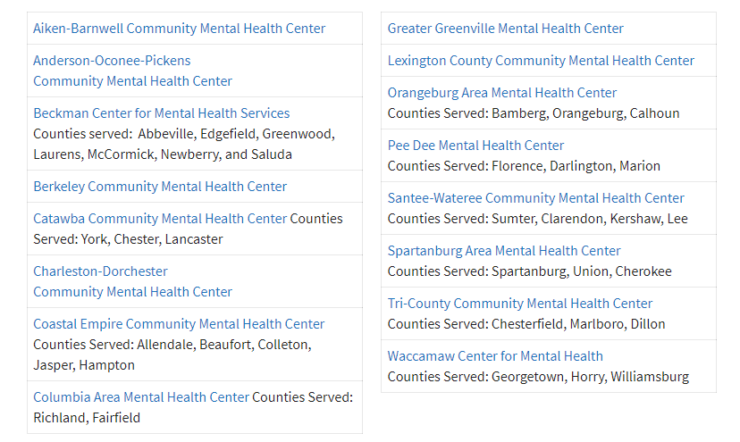
SC Mental Health Centers by County

Slide 12
Suboxone Providers & Methadone Centers
Easily searchable!
Clinics and programs will vary but most have information readily available online for walk-in times, referral forms if needed, etc.
Patients or providers can call

Slide 13
In context of comprehensive treatment program, similar maternal and delivery outcomes for methadone and buprenorphine.
Methadone considerations:
Previous success on Methadone*
Previously requiring high dose of Methadone
Severe addiction
Would benefit from structure and support of daily monitoring
Unsuccessful abstinence on Buprenorphine
Buprenorphine considerations:
Agonist therapy naïve
Able to adhere to less structured outpatient program
Breastfeeding recommended for both .

Slide 14
Tele-Mentoring Programs in South Carolina
Project ECHO Opioid Use Disorders
Medical Director
Dr. Karen Hartwell, MUSC
Program Coordinator: Rachel Grater, grater@musc.edu
Website: www.scmataccess.org
1st and 3rd Friday of each month
12-1 pm
Project ECHO Pregnancy Wellness
Co-Medical Directors
Dr. Berry Campbell, USC and Dr. Donna Johnson, MUSC
Program Coordinator: Rachel Grater, grater@musc.edu
Website: www.pregnancywellnesssc.com
1st and 3rd Wednesday of each month
12:15-1 pm
Southeast Viral Hepatitis Interactive Case Conference
Medical Director
Dr. Divya Ahuja, USC
Program Coordinator: Adrena Harrison, adrena.harrison@uscmed.sc.edu
Website: http://schivtc.med.sc.edu/
1st and 3rd Wednesday of each month 12-1pm
4th Wednesday of each month 1-2pm

