Slide 1
GROUP B STREPTOCOCCUS
Donna D. Johnson, M.D.

Slide 2
GBS
Physiological component of the GI and vaginal microbiome
Colonization may be intermittent, transitory, or persistent
Prevalence: 10-30% of pregnant women
Regan, Obstet Gynecol, 1991
Campbell, Obstet Gynecol, 2000

Slide 3
GBS
Is the leading cause of neonatal infection
1990’s 1.8 per 1000 births
2015 0.23 per 1000 births
Naduri, JamaPediatrics, 2018

Slide 4
GBS INFECTION
Early onset: within 7 days
  Vertical transmission
Late onset: Occurs 7-89 days of life
  Horizonal transmission
Very late onset: occurs beyond 3 months of life
Dudek, Ped Infectious Dis, 2016

Slide 5
EARLY ONSET GBS (GBS EOD)
50% of colonized women pass it to the newborn
1-2% of newborns infected
72% occur in term infants
Mortality higher in preterm infants
  19.2 vs 2.1%
ACOG, CO 797

Slide 6
RISK FACTORS FOR GBS EOD
Vaginal–rectal colonization
Gestational age less than 37 weeks
VLBW
Prolonged rupture of membranes
Intraamniotic infection
Young maternal age
Maternal black race
Heavy colonization (positive urine culture)
Prior affected infant
ACOG, CO 797

Slide 7
UNIVERSAL ANTEPARTUM SCREENING
Culture: lower third of vagina and rectum
36 0/7–37 6/7 weeks of gestation
Culture good for 5 weeks
May consider rescreening if goes past 41 weeks
Exception: GBS bacteriuria or GBS + infant

Slide 8
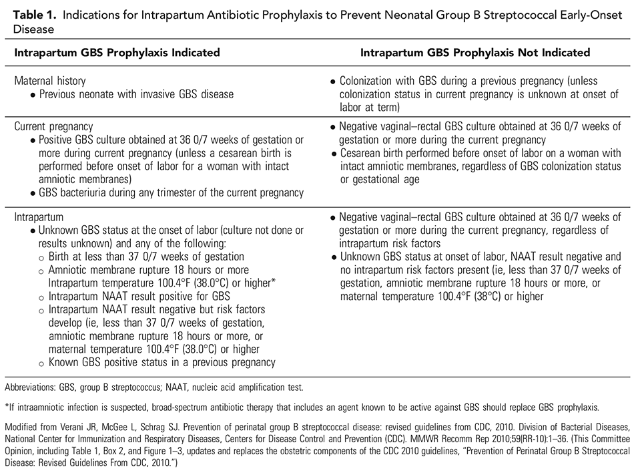
ACOG CO 797

Slide 9
TREATMENT OF CHOICE
Penicillin
Ampicillin

Slide 10
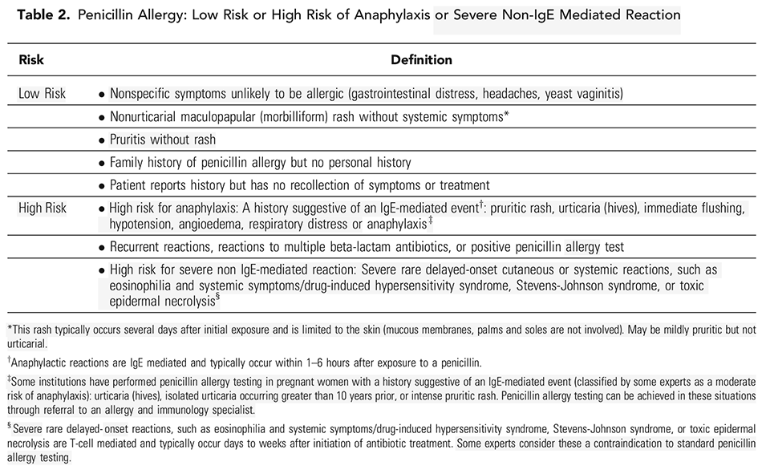
ACOG CO 797

Slide 11
