Slide 1
HEMOGLOBINOPATHIES
Donna D. Johnson, MD

Slide 2
ADULT HEMOGLOBIN

Slide 3
COMPLETE BLOOD COUNT
Hemoglobin
Hematocrit
Mean corpuscular volume
Mean red blood cell size
Microcytic (<80 fl): iron deficiency anemia or hemoglobinopathies
Macrocytic (>100 fl): B 12 or folate deficiency

Slide 4
HEMOGLOBINOPATHIES
CBC
Hemoglobin electrophoresis
A1 (96-97%), A2 (<3.5%), and F (<1%)
Sickle Dex
Should NOT be ordered
Only looks for sickling

Slide 5
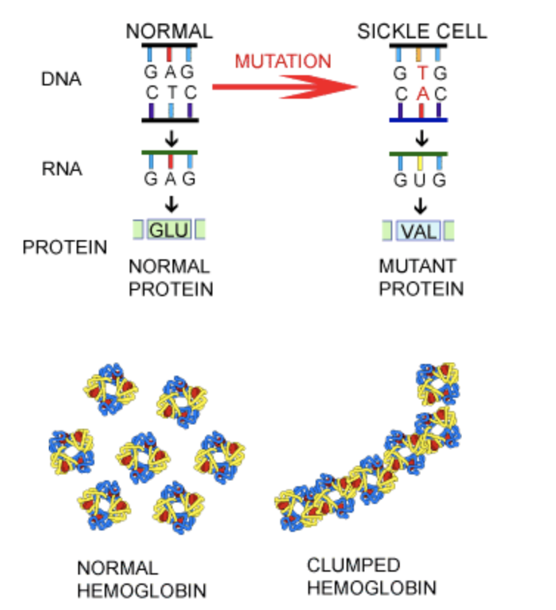
SICKLE CELL
Defect in Beta hemoglobin
Point mutation
MCV is usually normal
Reticulocytes

Slide 6
TYPES OF SICKLE CELL DISEASE
Hemoglobin SS
Hemoglobin SC
Hemoglobin SB+

Slide 7
SICKLE CELL
HbSS: primarily Hgb S
HbSC: About half S and about half C
HbSB+: about half S, increased Hgb A2 and increased Hgb F

Slide 8
BETA THALASSEMIA
African, Asian, Greek, Italian and Middle Eastern
Low MCV
Hemoglobin electrophoresis: ↓A1,↑A2, and ↑ F
Three types:
Minor
Intermediate
Major (Cooley’s anemia)
Transfusion
Independent
Dependent

Slide 9
BETA THALASSEMIA
Muncie, Am Fam Physician, 2009

Slide 10
ALPHA THALASSEMIA
Africa, the Middle East, India, Southeast Asia, southern China
Low MCV
Normal hemoglobin electrophoresis
Diagnosis: DNA testing

Slide 11
TYPES OF ALPHA THALASSEMIA
Alpha thalassemia silent carrier. One gene is missing
Alpha thalassemia carrier. Two genes are missing
Hemoglobin H disease. Three genes are missing
Alpha thalassemia major. All 4 genes are missing
Hemoglobin Bart’s: incompatible with life

Slide 12
TYPES OF ALPHA THALASSEMIA

Slide 13
ANEMIA
Muncie, Am Fam Physician, 2009

Slide 14
Project ECHO South Carolina Pregnancy Wellness
Visit Our Website: https://sctelehealth.org/services/pregnancy-wellness
1st & 3rd Wednesday/Month Postpartum Hemorrhage 12:15 pm – 1:00 pm
Date | Topic
11/17/21 | Thyroid Disease

