Slide 1
Induction of Labor
Berry Campbell, MD

Slide 2
Induction of Labor
Goal: achieve a vaginal delivery by inducing contractions before spontaneous onset of labor
When? ≥ 39 weeks OR when medically indicated (preeclampsia, FGR, etc)
Risks? Failed induction and cesarean section; uterine rupture; prolonged labor and chorioamnionitis, pp hemorrhage, endometritis

Slide 3
Cervical ripening
Facilitate cervix softening, thinning, dilatation to reduce failed inductions and shorten induction to delivery time
Attempt to mimic the natural process of cervix remodeling: collagen breakdown, increase cytokines when unfavorable cervix

Slide 4
Bishop score
≤ 6 score is considered unfavorable
> 8 score, the probability of vaginal delivery after IOL is similar to spontaneous labor
When unfavorable, methods to make cervix favorable (“ripen”) used

Slide 6
Ripening methods
Mechanical: Hygroscopic
Osmotic dilators (laminaria)
Foley balloon
Medical: Misoprostol (PGE1)
Dinoprostol (PGE2)
Oxytocin

Slide 7
Foley balloon/Cook balloon system
Inexpensive
Effective
May use with oxytocin
No increased risk tachysystole

Slide 10
Misoprostol (PGE1)
Approved to treat gastric ulcers
Works extremely well to soften, efface and dilate
Inexpensive
100 mcg pills—split to 25 mcg doses: administer q 3-6 hours
Equally effective orally OR vaginally; Sublingual also used
SE: uterine tachysystole with or without FHR changes (IVF, position changes, SQ terbutaline)
Less tachysystole/FHR abnormalities with oral administration
Contraindicated with prior uterine scar

Slide 11
Dinoprostol (PGE2)
Intracervical, intravaginal gel 0.5 mg (q 6-12 hours, 3 doses) or vaginal insert (depot with 10 mg, slow release-one every 12 hours)
Equally effective as misoprostol
Much more expensive
Lower risk of tachysystole—if occurs, can remove the insert
Contraindicated with prior uterine scar

Slide 12
IOL
Oxytocin is the mainstay
Intravenous – initial response 3-5 minutes, steady state after 40 minutes
Low dose, high dose protocols—institution based (1x1x30; 4x4x15)
More responsive with advancing GA—plateau at 32 weeks-term.
Most effective with favorable cervix
Goal ctx every 2-3 minutes (tachysystole is >5 ctx/10 min averaged over 30 minutes)

Slide 13
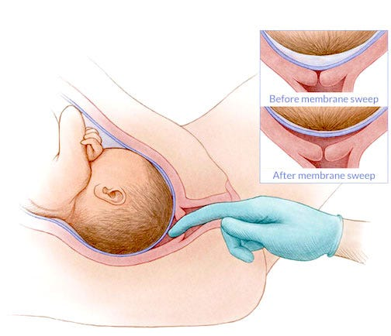
IOL Other
Stripping of membranes: requires some dilatation, increases likelihood of labor within 48 hours

Slide 14
IOL Other
Amniotomy: Adjunct to enhance labor with favorable cervix
Not necessarily as effective alone w/o ctx and/or oxytocin
Nipple stimulation: Adjunct to enhance labor with favorable cervix

Slide 15
ARRIVE Trial
N= 6106 randomized low risk G1 at 41 facilities
39 week induction vs expectant
Primary outcomes: PNM&M no difference; CS rate lower in induction group (18.6 vs 22.2%)
Secondary outcomes: Induction lower GHTN/preecl rate (9.1 vs 14.1%); lower need for neonatal support. No difference among any ethnic, racial groups
NEJM Aug 8, 2018

Slide 16
ARRIVE Trial
Offering elective IOL at 39 weeks should take into account:
Pt preference
Resources available (including personnel)and space
Allow longer latent phases (up to 24 hours+)
Use oxytocin for ≥ 18 hours after ROM before calling failed induction

Slide 17
Analysis of Obstetric Outcomes by Hospital Location, Volume, and Teaching Status Associated With Non–Medically Indicated Induction of Labor at 39 Weeks JAMA Open. Hersh, AR st al 2023; 6 (4): e239167
N= 24,272 nonmedically IOL
Lower CS rates with induction in medium and large hospital delivery services; no difference in small hospitals
Chorioamnionitis and pp hemorrhage lower in IOL group
Neonatal outcomes better in IOL group

Slide 18
IOL Special considerations
Management of fetal demise
Management of fetal demise in the mid-trimester with and without uterine scar
--High dose oxytocin
--High dose misoprostol

