Slide 1
ISOIMMUNIZATION
Donna D. Johnson, MD

Slide 2
PREVENTION
Rh D immune globulin (rhogam) introduced in 1970’s
↓ the rate from 13–16% to 0. 5–1.8%
↓ the rate to 0.14–0.2% with antepartum administration
ACOG, PB 181, 2017

Slide 3
WHO SHOULD GET RH D IMMUNE GLOBULIN?
Chorionic villus sampling, amniocentesis, cordocentesis
Threatened miscarriage or miscarriage
Ectopic pregnancy
Evacuation of molar pregnancy
Medical or surgical termination of pregnancy
Antepartum hemorrhage
Abdominal trauma
Intrauterine fetal demise
External cephalic version
Delivery
ACOG, PB 181, 2017

Slide 4
DOSE OF RH D IMMUNE GLOBULIN
50 µgm (5 ml) < 12 weeks
120 µgm (12 ml) < 12 weeks
300 µgm (30 ml) > 12 weeks

Slide 5
DO Du POSITIVE PATIENTS
NEED RH D IMMUNE GLOBULIN?
Historically: no
American Association of Blood Banks (AABB): rh negative
Now: Yes

Slide 6
SHOULD I GET AN ANTIBODY SCREEN PRIOR TO 28 week RH D IMMUNE GLOBULIN?
Most guidelines: yes
Cost vs. risk

Slide 7
I FORGOT THE RH D IMMUNOGLOBULIN PP
Ideally, <72 hours after delivery
Suggested up to 28 days after delivery
ACOG, PB 181, 2017

Slide 8
ISOIMMUNIZATION
Positive antibody screen
Identify the antibody
Take a history re: pregnancies & blood transfusions
Take a history about affected children
Quantify the antibody screen

Slide 9
PATERNAL STATUS
Discuss paternity with the patient alone
Check the father of the baby for the antigen status
Determine homozygosity vs heterozygosity
Mother has an anti D antibody
  FOB DD or Dd
  100% of children has D antigen with DD genotype
  50% of children had D antigen with Dd genotype

Slide 10
QUANTITATE THE ANTIBODY
1:1
1:2
1:4
1:8
1:16
1:32

Slide 11
QUANTITATE THE ANTIBODY
< 1:8: repeat monthly
> 1:8: refer to MFM
EXCEPTION: Kell

Slide 12
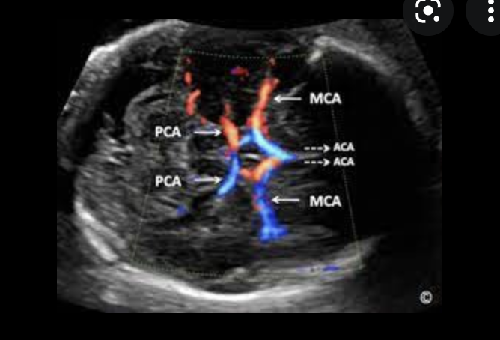
MIDDLE CEREBRAL ARTERY DOPPLER:
PEAK SYSTOLIC VELOCITY
glowm.com

Slide 13
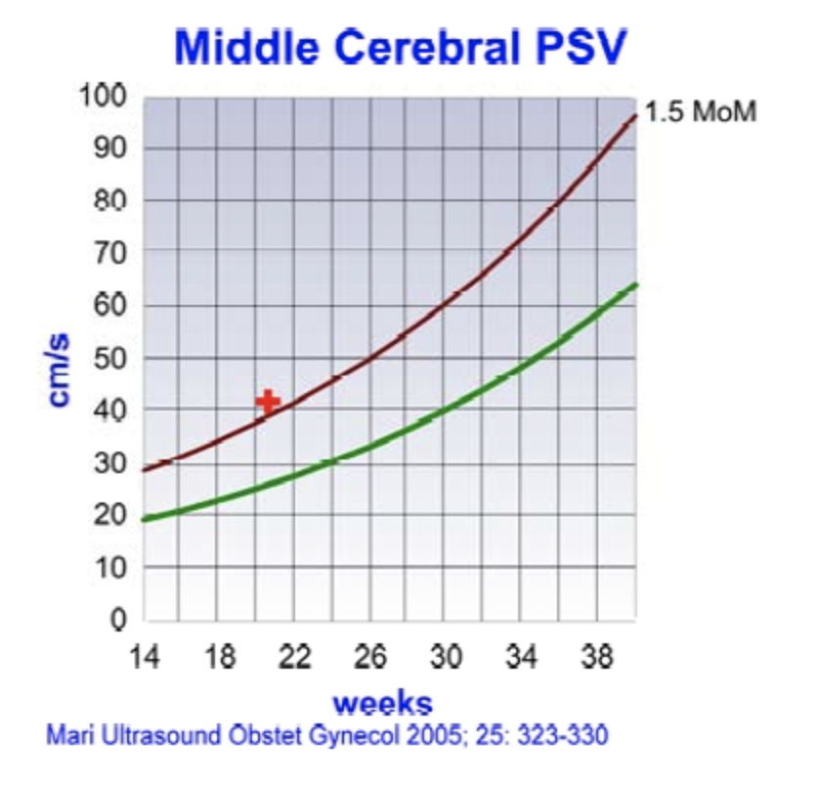
MARI CURVE

Slide 14
Project ECHO South Carolina Pregnancy Wellness
Visit Our Website: https://sctelehealth.org/services/pregnancy-wellness
1st & 3rd Wednesday/Month Postpartum Hemorrhage 12:15 pm – 1:00 pm
Date | Topic
11/3 | Hemogobinopothies

