Slide 1
Fetal Growth Restriction
Eric H. Dellinger, MD
Maternal-Fetal Medicine
USCSOM-Greenville

Slide 2
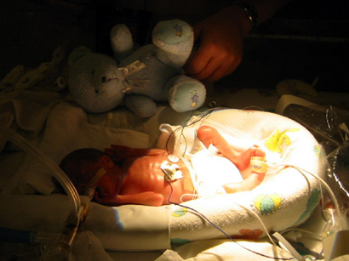

Slide 3
FGR: Introduction
FGR 2nd leading contributor to PNM rate after prematurity
PNM rate increased 6 -10 fold
PNM rate 8/1000 background:
  120/1000 for all FGR
  80/1000 when anomalies excluded

Slide 4
FGR: Introduction
40% of stillbirths have FGR
  53% of preterm stillbirths
  26% of term stillbirths
Intrapartum asphyxia reported in up to 50% of FGR fetuses
> 60% of FGR fetuses with FHR tracing abnormalities have hypoxia/acidosis
        Pardi, NEJM 328:692, 1993

Slide 5
FGR: PNM and EFW

Slide 6

When is small, too small? Defining FGR

Slide 7
FGR: Definition
Birth weight < 10th percentile used to define growth restriction at birth
Definition carried over to fetuses using ultrasound measurements
SMFM-ACOG-AIUM updated:
  AC or EFW <10th centile for GA
            Obstet Gynecol. 2021;137(2):e16

Slide 8
Birthweight: Definitions
Very small for gestational age (VSGA; <3rd percentile)
Small for gestational age (SGA; <10th percentile)
Average for gestational age (AGA; 10th to 90th percentile)
Large for gestational age (LGA; >90th percentile)

Slide 9

FGR: Diagnosis
The Fundal Height Myth:
  Best from 20-32 weeks: lightening
  Lag of 4 cm or more suspicious
  Sensitivity of 27%, PPV of 18%
Fundal height of limited value
  Risk factors more predictive
  Price is right?

Slide 10
FGR: Etiology
Fetal / Placental Maternal
Chromosomal / Genetic History of FGR
Twins Hypertension
Congenital malformation Diabetes
Infectious disease MSAFP increase
CMV APS
Toxoplasmosis Chronic illness
Rubella Weight < 90% IBW
Placental pathology Hemoglobinopathy
Previa Substance abuse
Abruption Anemia/Hypoxia
Mosaicisms
Infarction

Slide 11
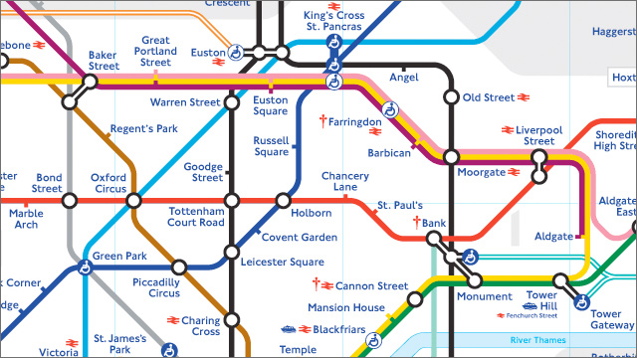
Strategy

Slide 12
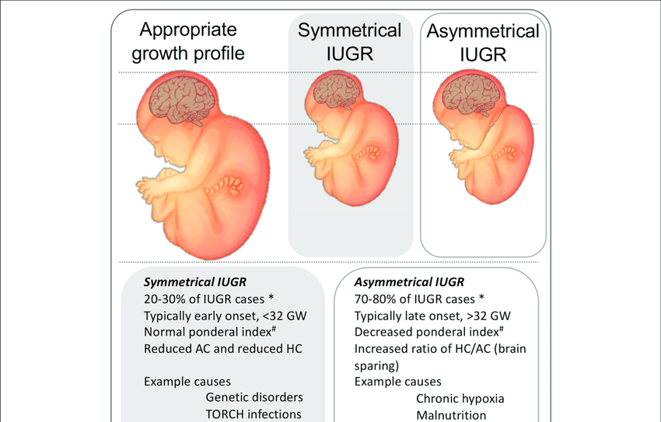
FGR Categories: Symmetric/Asymmetric

Slide 13
FGR: HC/AC Ratios
Asymmetric Symmetric
HC
HC
HC/AC
HC/AC
AC
AC

Slide 14
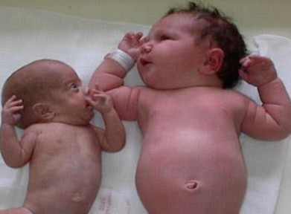
Asymmetric FGR
Asymmetric FGR Normal

Slide 15
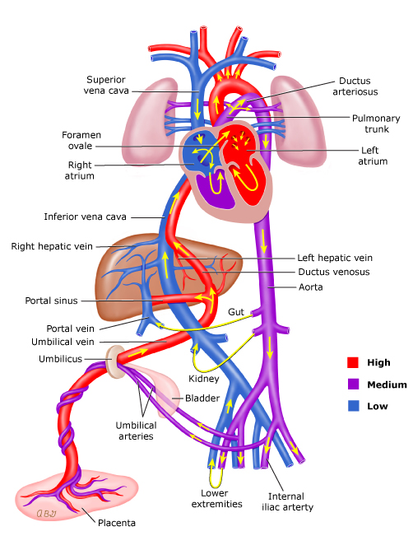
Why asymmetric?
Preferred organs:
Brain
Heart
Adrenal glands
Others deprived
NICU complications

Slide 16
FGR: Etiology
Fetal / Placental Maternal
Chromosomal / Genetic History of FGR
Twins Hypertension
Congenital malformation Diabetes
Infectious disease MSAFP increase
CMV APS
Toxoplasmosis Chronic illness
Rubella Weight < 90% IBW
Placental pathology Hemoglobinopathy
Previa Substance abuse
Abruption Anemia/Hypoxia
Mosaicism
Infarction

Slide 17
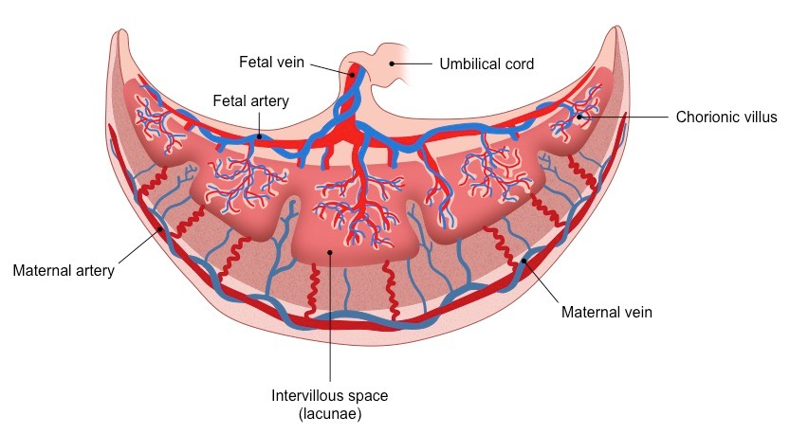
FGR: Etiology
Fetal / Placental Maternal

Slide 18
Uteroplacental Insufficiency
How bad is the placenta?
Is it affecting the fetus?
Is the fetus sick?

Slide 19

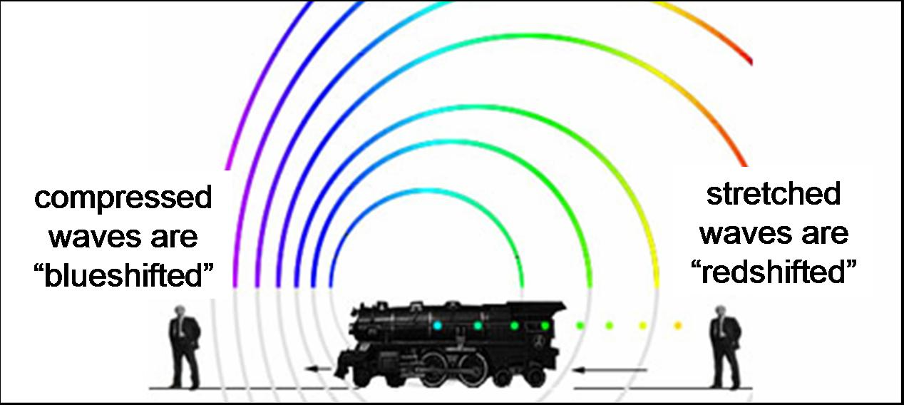
Doppler

Slide 20
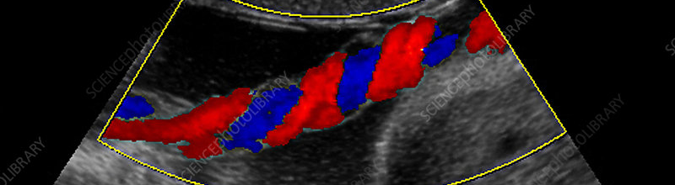
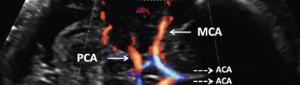
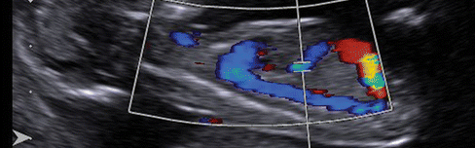
Uteroplacental Insufficiency
How bad is the placenta? Umbilical Artery
Is it affecting the fetus? Middle Cerebral Artery
Is the fetus sick? Ductus Venosus

Slide 21
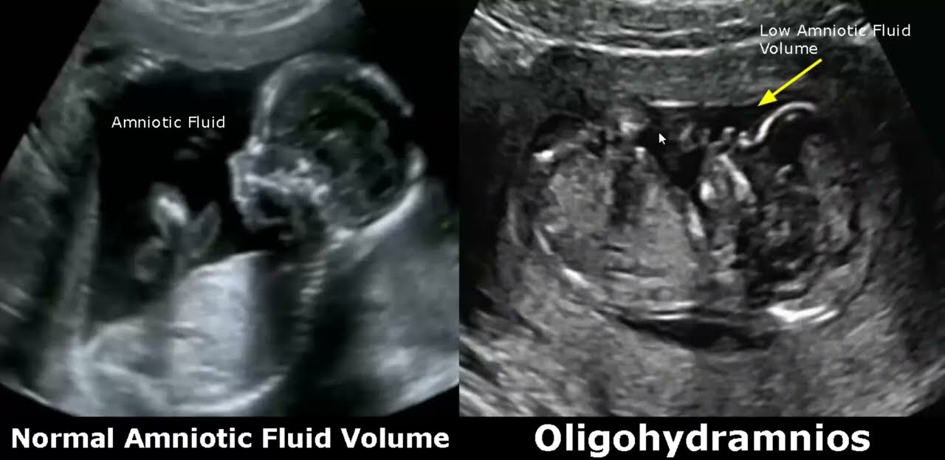
Uteroplacental Insufficiency
Placental perfusion - Doppler
Water transfer – Amniotic fluid volume
Fetal status – NST, BPP, OCT

Slide 22
FGR: Oligohydramnios
Initial harbinger of doom
  FGR, preeclampsia
  may precede abnormal HC/AC
Fluid pocket of BPP:
  >2 cm 6% FGR
  1-2 cm 20% FGR
  <1 cm 39% FGR
  also predicts intrapartum distress

Slide 23
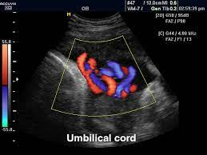
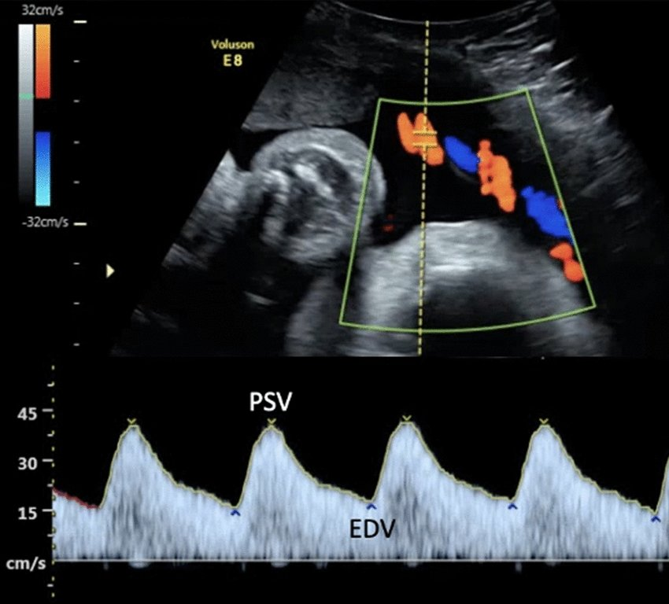
Uteroplacental Insufficiency
Placental perfusion - Doppler

Slide 24
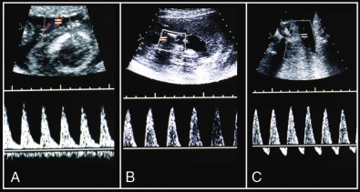
Uteroplacental Insufficiency
Umbilical Artery Doppler

Slide 25
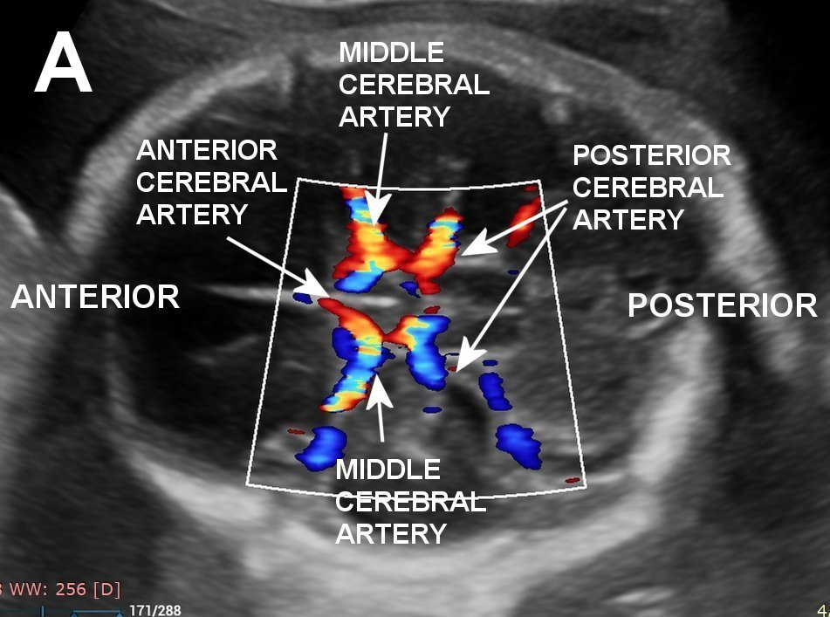
Uteroplacental Insufficiency
Assess fetal status - MCA Doppler

Slide 26
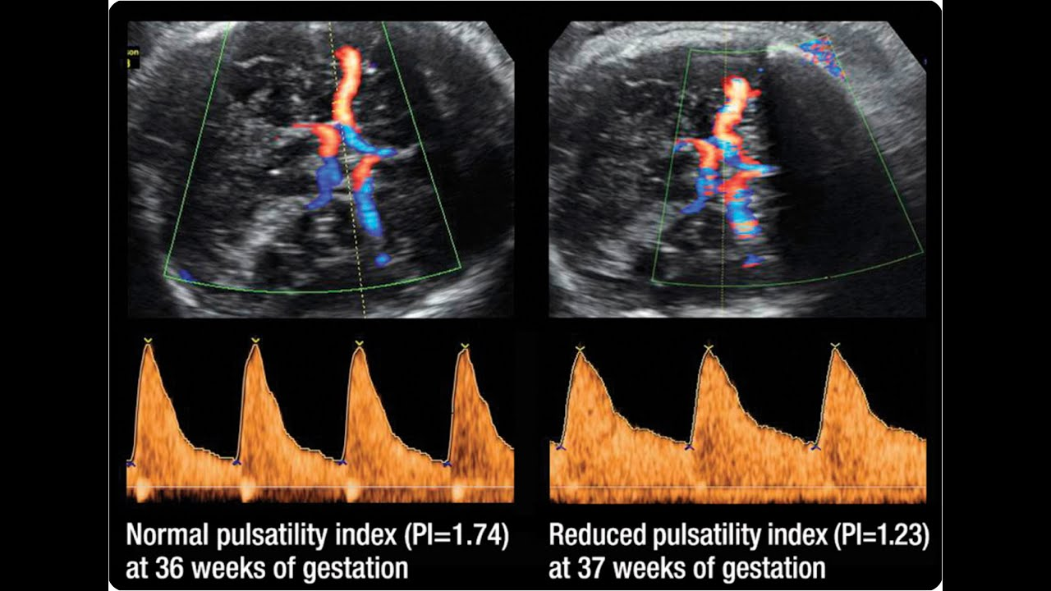
FGR: Middle Cerebral Doppler
Normal MCA
Abnormal MCA

Slide 27
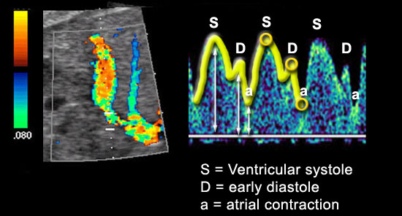
Ductus Venosus
Doppler flow waveforms
  Fetal venous system has characteristic pulsations which reflect CVP – proximity to heart

Slide 28
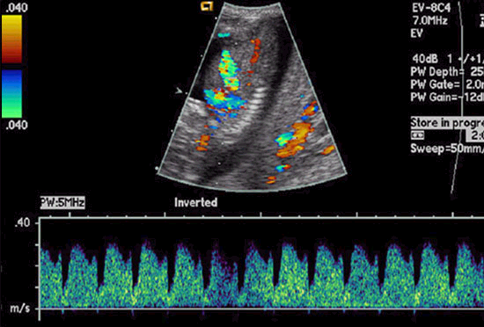
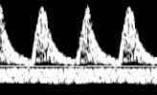
Normal Venous Dopplers
DV
UV

Slide 29
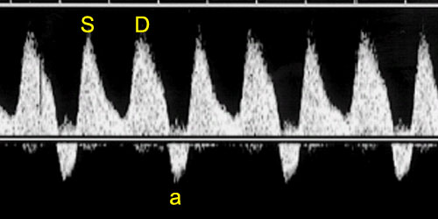
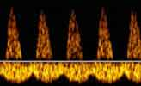
Abnormal Venous Dopplers
DV
UV

Slide 30
FGR: Value of Doppler
FGR fetuses with:
  Normal AFV
  Normal UmA S/D
  Normal MCA Dopplers
  >97% NPV for major negative perinatal sequalae
        Fong et al., Radiology 213:681, 1999.

Slide 31
Umbilical Artery Absent/Reversed EDV Doppler
80% will have FGR
36% PNM rate
REDV: >70% placental arteries obliterated
Mean time to delivery 7 days (0-49)
Management:
  BMS, hospital bed rest, intensive monitoring, liberal delivery
  venous Dopplers

Slide 32
FGR: Venous Dopplers
AEDV + umbilical vein pulsations = 54% mortality
AEDV - umbilical vein pulsations = 10% mortality
Indik, Obstet Gynecol 77:551, 1991
Venous atrial back flow waves are suggestive of metabolic
Acidemia documented by PUBS
Hecher et al., Am J Obstet Gynecol 173:10, 1995

Slide 33
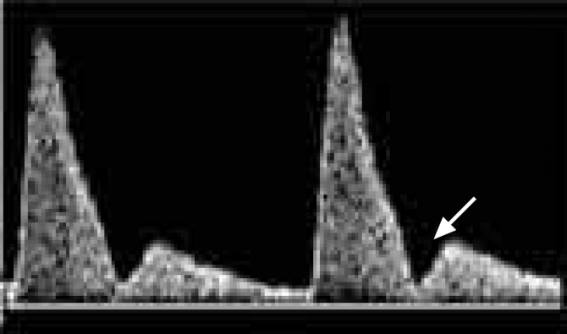
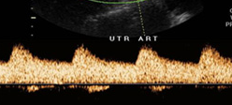
FGR: Maternal Doppler
Uterine artery:
  S/D > 2.6 associated with FGR, IUFD
  Elevated resistance index and FGR:
    70.6% sensitive
    33.3% PPV

Slide 34
FGR: Therapy
Aspirin
  ASA + dipyridamole from 16 weeks in women with Hx of FGR
  Treatment: 13% FGR, no severe FGR
  No Tx: 61% FGR, 27% server FGR
        Wallenburg, Am J Obstet Gynecol 157:1230, 1987
  Meta-analysis on 50-100 mg ASA
    significant reduction of FGR noted
        Br J Obstet Gynecol 104:450, 1997

Slide 35
FGR: Management
Twice weekly fetal reassurance testing
  NSTs, BPPs
  Weekly AFI
Growth scans every 3 weeks
Deliver at 39 weeks if EFW 3 – 10%
Deliver at 37 weeks if EFW < 3%
Steroids if potential preterm delivery
Watch for S/Sx of Preeclampsia

Slide 36

Kick Counts

Slide 37
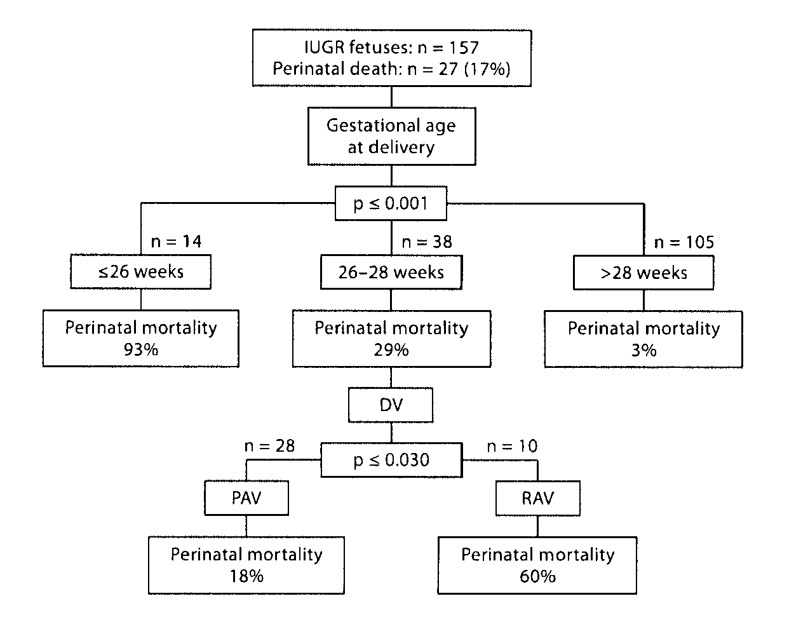
Fetal Diagn Ther. 2012;32(1-2):116-22

Slide 38
FGR: Long Term Morbidity
The potential for normal long term growth is positive
  late developing FGR: excellent
  early, prolonged FGR: risk of suboptimal size (e.g. 50% with small HC have HC < 10th percentile at 8 years).

Slide 39
FGR: Neurologic Outcome
Depends:
  degree of FGR, especially small HC
  timing of onset
  GA at delivery
  postnatal care
CP risk is increased 4-6 times, for FGR between 32-42 weeks
      Jarvis, Lancet. 2003 Oct 4;362(9390):1106-11

Slide 40
FGR: Adult Disease
Barker Hypothesis
  England/Wales 1901-1910, areas with high infant mortality correlated with CAD in men aged 35-74 in the 1960s-70s
  Theory: LBW survivors might have more CAD
  Birth records:
    BW < 5.5 lbs.: 3 times number of deaths from CAD
    HTN and CVA also increased
    Greatest risk: LBW, small HC, short, small placentas
    Also more: abdominal obesity, AODM, hyperlipidemia
    Cause: pancreatic/adrenal insuff, sympath. dysfx?

Slide 41


