Slide 1
MANAGEMENT OF OBSTETRICAL PATIENTS WITH A PRIOR COVID INFECTION
Donna D. Johnson, MD

Slide 2
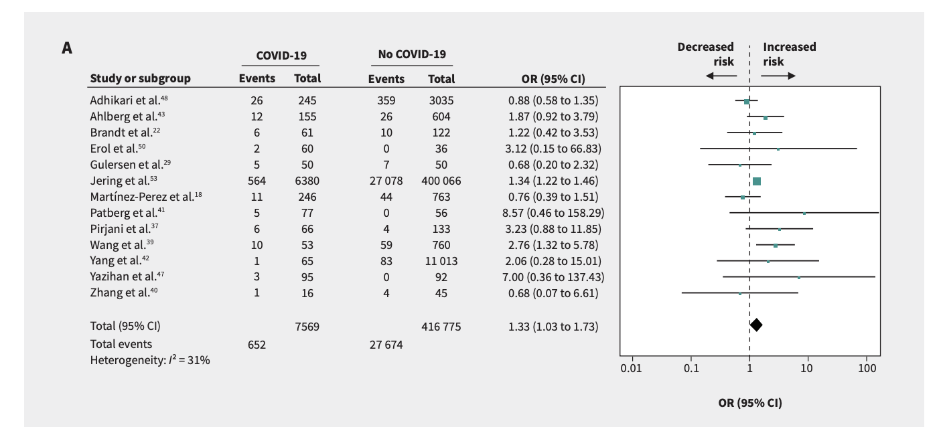
PREECLAMPSIA
Wei, CMAJ, 2021

Slide 3
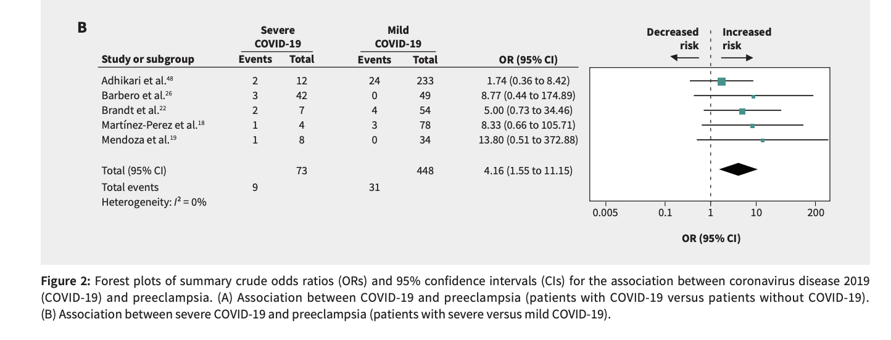
PREECLAMPSIA
Wei, CMAJ, 2021

Slide 4
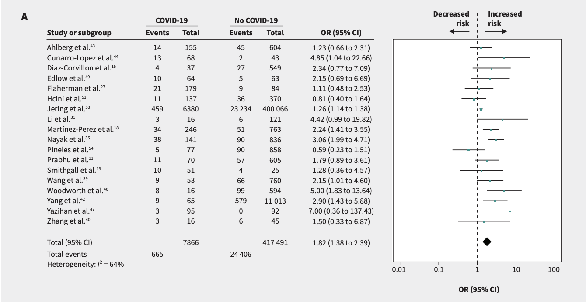
PRETERM BIRTH
Wei, CMAJ, 2021

Slide 5
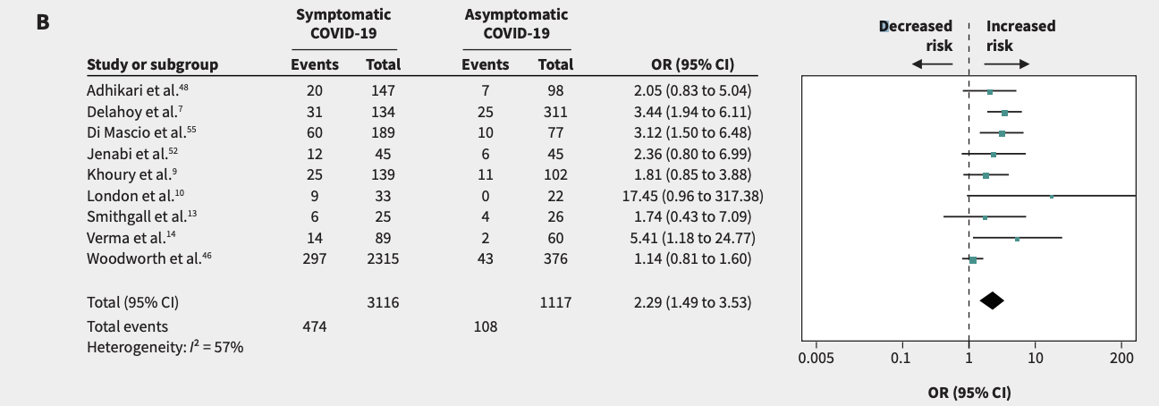
PRETERM BIRTH

Slide 6
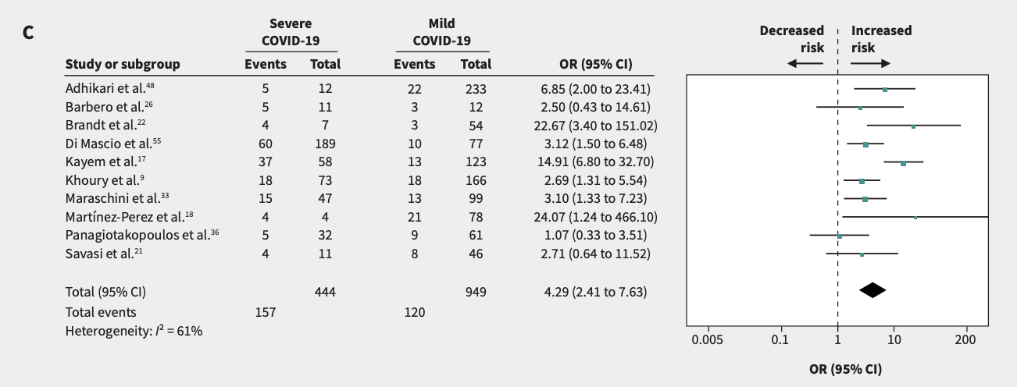
PRETERM BIRTH
Wei, CMAJ, 2021

Slide 7
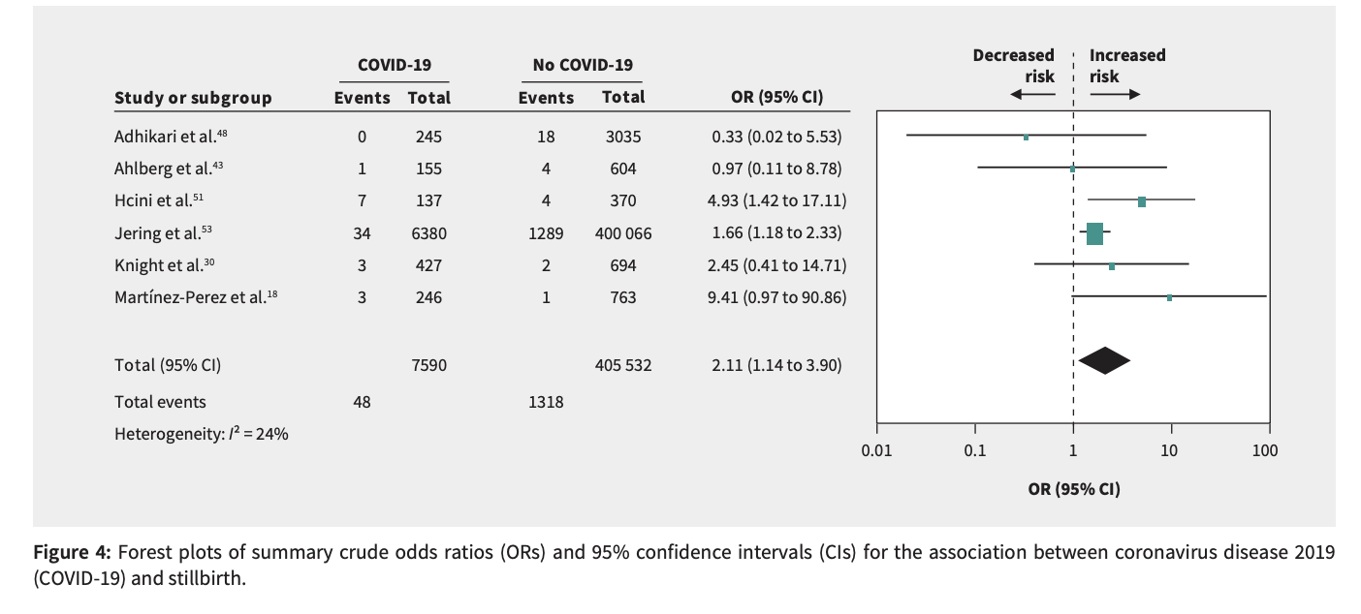
STILLBIRTH

Slide 8
PLACENTA
Fibrin deposits
Death of cells in the trophoblast
Chronic histiocytic intervillositis.
Schwartz, Arch of Path & Lab Med, 2022

Slide 9
MANAGEMENT
Antenatal testing
Growth ultrasound
Delivery by 40 weeks

Slide 10
PREVENTION
Vaccinate
Vaccinate
Vaccinate

