Slide 1


Management of
Pre-Term Labor
Eric Dellinger, MD
Division of Maternal-Fetal Medicine
USC School of Medicine - Greenville

Slide 2

Definition of Labor
Regular and painful uterine contractions that cause progressive dilation and/or effacement of the cervix.

Slide 3
Benefits of Identifying PTL
Antenatal corticosteroid therapy
Group B streptococcal infection prophylaxis
Magnesium sulfate for neuroprotection
Transfer to a facility with an appropriate level of newborn care
Avoids unnecessary and costly interventions
  50% of suspected preterm labor subsequently give birth at term without tocolytic therapy *
* Obstet Gynecol. 2009;113(3):585.

Slide 4
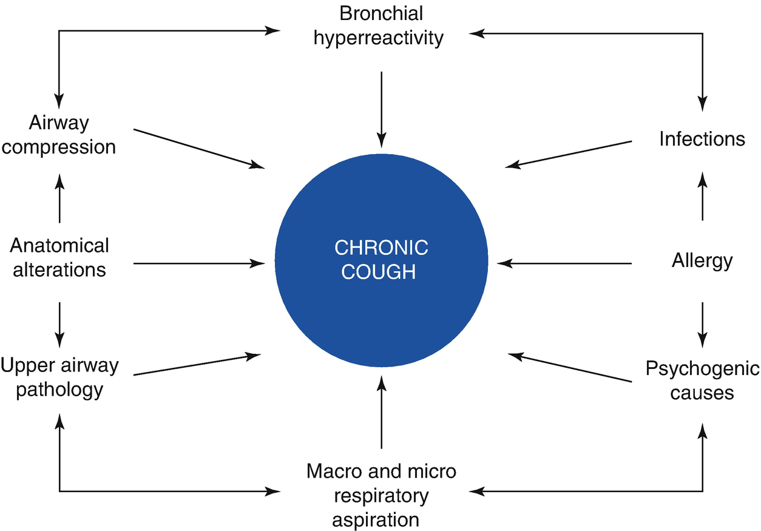
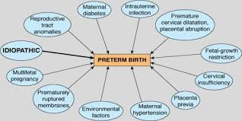

Slide 5
PATHOGENESIS OF PRETERM LABOR
Premature activation of the maternal or fetal hypothalamic-pituitary-adrenal axis
Inflammation and infection
Decidual hemorrhage
Pathological uterine distention

Slide 6
CLINICAL FINDINGS
Menstrual-like cramping
Mild, irregular contractions
Low back ache
Pressure sensation in the vagina or pelvis
Vaginal discharge of mucus, which may be clear, pink, or slightly bloody (mucus plug, bloody show)
Spotting, light bleeding

Slide 7
DIAGNOSTIC EVALUATION
History and physical:
  Focused on known risks for PTL, signs and symptoms of PTL
  Uterine activity
  Review FHR tracing
Speculum exam
  Assess dilation, bleeding, PPROM, cultures, fFN (if indicated)
Digital exam (once previa excluded), > 3 cm supports PTL diagnosis
OB Ultrasound
  Assess fetal anatomy, position, EFW, AFV, placenta, cervix

Slide 8
Laboratory Evaluation
Specific to PTL evaluation:
GBS culture (if not done in the previous 5 weeks)
Urine culture (asymptomatic bacteriuria linked to an increased risk of PTL and birth
STD panel
fFN (rare, but may have select indications)

Slide 9
Management: 34 wks or more
Admit for observation:
  Not in labor after 4-6 hrs - Discharge to home, PTL precautions given
  In labor –
    Manage as normal labor
    Consider BMS, but no tocolysis
    Evaluate for GBS prophylaxis

Slide 10
Management: Less than 34 wks
Admit for observation
Not in labor after 4-6 hrs - Discharge to home, PTL precautions given
If in PTL –
  Antenatal corticosteroids (rescue course if indicated)
  Tocolytics for 48 hrs (MgSO4, Nifedipine, NSAIDs, beta-2-agonists) lots of variation
  GBS antibiotic prophylaxis
  Magnesium sulfate (<32 wks) for neuroprotection against CP (NNT = 63, RR 0.68)
Antibiotics of no benefit beyond treating a documented infection or for GBS prophylaxis
Progesterone of no benefit

Slide 11
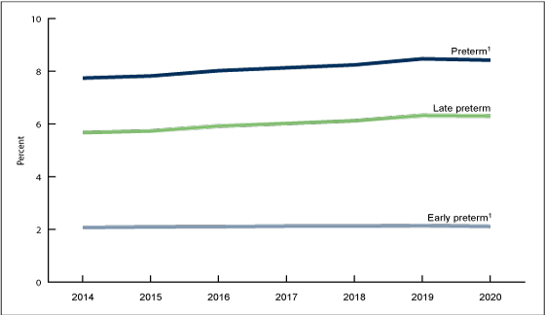
Outcome
Tocolytic therapy is more effective than placebo for delaying birth for 48 hours in randomized trials
Even when tocolytics are not administered, approximately 50 percent of patients diagnosed with preterm labor give birth at term

