Slide 1
Maternal Mental Health & Maternal Mortality
Courtney King, PhD
Liz Monter, DO
Connie Guille, MD

Slide 2
Overview
CDC: Maternal Mortality Data
Suicide Assessment
Available Resources
Mom’s IMPACTT Launch: May 2, 2022
PSI TRAINING

Slide 3
Maternal Mental Health ECHO Series
10/5/22 | Maternal Mental Health Mortality First Aid
10/19/22 | Effective Screening, Brief Intervention and Referral to Treatment: Substance Use Disorders/Opioid Use Disorder
11/2/22 | Perinatal Mood Disorders
11/16/22 | Perinatal Anxiety Disorders
12/7/22 | Postpartum Psychosis
Notes:
mental health basics can go a long way in creating balance and reducing overwhelm, but sometimes it is easy to forget (or feels out of reach). These do not have to be HUGE shifts, help suggest simple ways to add to each bucket
Especially as a new mom, all of these activities require support from others –help encourage women to create space for women to give time to these, Though it may seem impossible to find a spare minute when caring for a small infant, one of the best ways to help baby is for mom to take care of herself.
Social support is a huge factor in the ability to do that.

Slide 4
Pregnancy-Related Deaths: Data from Maternal Mortality Review Committees in 36 US States, 2017–2019
Most frequent underlying causes of pregnancy-related death — Top 6 accounted for over 75% of pregnancy-related deaths
Mental health conditions (22.7%)
Hemorrhage (13.7%)
Cardiac and coronary conditions (12.8%)
Infection (9.2%)
Thrombotic embolism (8.7%)
Cardiomyopathy (8.5%)
Trost SL, Beauregard J, Njie F, et al. Pregnancy-Related Deaths: Data from Maternal Mortality Review Committees in 36 US States, 2017-2019.
Atlanta, GA: Centers for Disease Control and Prevention, US Department of Health and Human Services; 2022.
Notes:
Pregnancy-Related Deaths: Data from Maternal Mortality Review Committees in 36 US States, 2017–2019
Data on 1,018 pregnancy-related deaths among residents of 36 states from 2017–2019 were shared with CDC through the Maternal Mortality Review Information Application (MMRIA).
Cause of Pregnancy-Related Deaths
Timing
Race

Slide 5
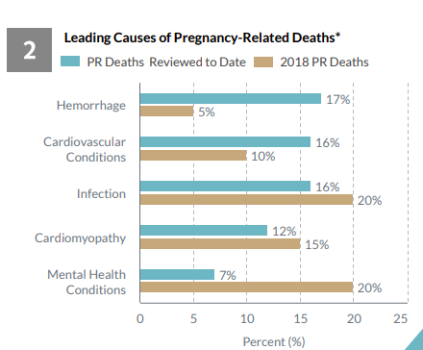
SC MMMRC SC Pregnancy Related Deaths
Notes:
SHARON KEISER

Slide 6
4 Million Births Per Year
Mental Health Problems are the Most Common Complication of Pregnancy & Childbirth
11,400 Pregnant Women in SC Annually

Slide 7
Pregnancy-Related Deaths: Data from Maternal Mortality Review Committees in 36 US States, 2017–2019
Leading Cause of Pregnancy-Related Death by Race
Non- Hispanic Black persons: Cardiac and coronary conditions
Hispanic & non- Hispanic White persons: Mental health conditions
Non-Hispanic Asian persons: Hemorrhage
Non-Hispanic American Indian or Alaska Native and non- Hispanic Native Hawaiian and other Pacific Islander (NHOPI) persons: not ranked because of small population size.
Trost SL, Beauregard J, Njie F, et al. Pregnancy-Related Deaths: Data from Maternal Mortality Review Committees in 36 US States, 2017-2019.
Atlanta, GA: Centers for Disease Control and Prevention, US Department of Health and Human Services; 2022.
Notes:
Pregnancy-Related Deaths: Data from Maternal Mortality Review Committees in 36 US States, 2017–2019
Data on 1,018 pregnancy-related deaths among residents of 36 states from 2017–2019 were shared with CDC through the Maternal Mortality Review Information Application (MMRIA).
Cause of Pregnancy-Related Deaths
Timing
Race

Slide 8
4 Million Births Per Year
Women of Color…
Experience Maternal Mental Health Conditions at 2-3 Times the Rate of White Women

Slide 9
Pregnancy-Related Deaths: Data from Maternal Mortality Review Committees in 36 US States, 2017–2019
Timing of Deaths
Pregnancy (22%)
Day of delivery- Day 6 Postpartum (25%)
7 to 42 days postpartum (23%)
43-365 days postpartum period (30%)
80% of Deaths were Determined to be Preventable
Trost SL, Beauregard J, Njie F, et al. Pregnancy-Related Deaths: Data from Maternal Mortality Review Committees in 36 US States, 2017-2019.
Atlanta, GA: Centers for Disease Control and Prevention, US Department of Health and Human Services; 2022.
Notes:
Pregnancy-Related Deaths: Data from Maternal Mortality Review Committees in 36 US States, 2017–2019
Data on 1,018 pregnancy-related deaths among residents of 36 states from 2017–2019 were shared with CDC through the Maternal Mortality Review Information Application (MMRIA).
Cause of Pregnancy-Related Deaths
Timing
Race

Slide 10
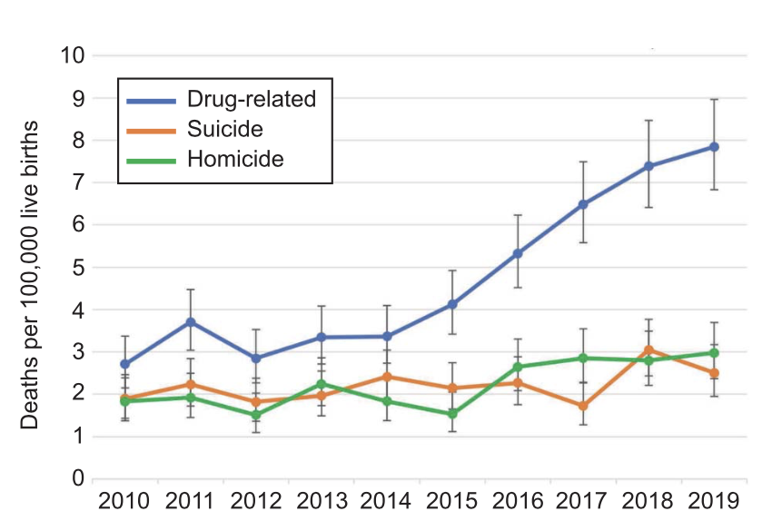
Pregnancy-Associated Deaths Due to Drugs, Suicide, and Homicide in the United States, 2010–2019
22.2% of all Maternal Deaths are due to:
Drugs (11.4%)
Suicide (5.4%)
Homicide (5.4%)
2010-2019
Drug-related deaths increased 190%
Suicide increased 30%
Homicide increased 63%
Margerison, Claire E. MPH, PhD; Roberts, Meaghan H. MA; Gemmill, Alison MPH, PhD; Goldman-Mellor, Sidra MPH, PhD Pregnancy-Associated Deaths Due to Drugs, Suicide, and Homicide in the United States, 2010–2019, Obstetrics & Gynecology: February 2022 - Volume 139 - Issue 2 - p 172-180
Notes:
11,782 pregnancy related deaths from 33 U.S. states & D.C, 2010-2019
https://oce-ovid-com.ezproxy-v.musc.edu/article/00006250-202202000-00005?sequence=1&clickthrough=y
Pregnancy-associated death ratios and 95% CIs for drug-related deaths, suicide, and homicide in 33 U.S. states and the District of Columbia, 2010–2019. The pregnancy-associated death ratio due to drug-related causes rose 190%, from 2.7/100,000 in 2010 to 7.8/100,000 in 2019 (RR 2.9, 95% CI 2.2–3.8). The pregnancy-associated death ratio due to suicide increased approximately 30% from 2010 to 2019, from 1.9/100,000 to 2.5/100,000, but this increase was not statistically significant (RR 1.3, 95% CI 0.9–1.9). The homicide pregnancy-associated death ratio increased 63% (RR 1.6, 95% CI 1.1–2.3), from 1.8/100,000 to 3.0/100,000 in 2019
Drug-related deaths increased 190%
(2.7/100,000 in 2010 to 7.8/100,000 in 2019 (RR 2.9, 95% CI 2.2–3.8).
Suicide increased 30%
1.9/100,000 to 2.5/100,000
(RR 1.3, 95% CI 0.9–1.9)
Homicide increased 63%
1.8/100,000 to 3.0/100,000 (RR 1.6, 95% CI 1.1–2.3))
Abstract
OBJECTIVE:
To estimate the prevalence of pregnancy-associated deaths due to drugs, suicide, and homicide nationwide from 2010 to 2019.METHODS:
Using U.S. death certificate records from 2010 to 2019 for 33 states plus the District of Columbia, we identified pregnancy-associated deaths using the pregnancy checkbox and International Classification of Diseases, Tenth Revision codes, calculated pregnancy-associated death ratios, and categorized deaths by cause, timing relative to pregnancy, race or ethnicity, and age.RESULTS:
Of 11,782 pregnancy-associated deaths identified between 2010 and 2019, 11.4% were due to drugs, 5.4% were due to suicide, and 5.4% were due to homicide, whereas 59.3% were due to obstetric causes and the remaining 18.5% were due to other causes. Drug-related deaths, suicide, and homicide accounted for 22.2% of pregnancy-associated deaths. All three causes of death increased over the study period, with drug-related pregnancy-associated deaths increasing 190%. Homicide during pregnancy and drug-related deaths, suicides, and homicide in the late postpartum period (43–365 days) accounted for a larger proportion of all deaths in these time periods than the contribution of these causes to all deaths among females of reproductive age. Pregnant and postpartum people identified as non-Hispanic American Indian or Alaska Native were at highest risk of drug-related and suicide death, and people identified as non-Hispanic Black were at highest risk of homicide.CONCLUSION:
Deaths due to drug use, suicide, and homicide constitute more than one fifth of all deaths during pregnancy and the first year postpartum. Drug-related deaths and homicides have increased over the past decade. Substantial racial and ethnic inequities in these deaths exist.

Slide 11
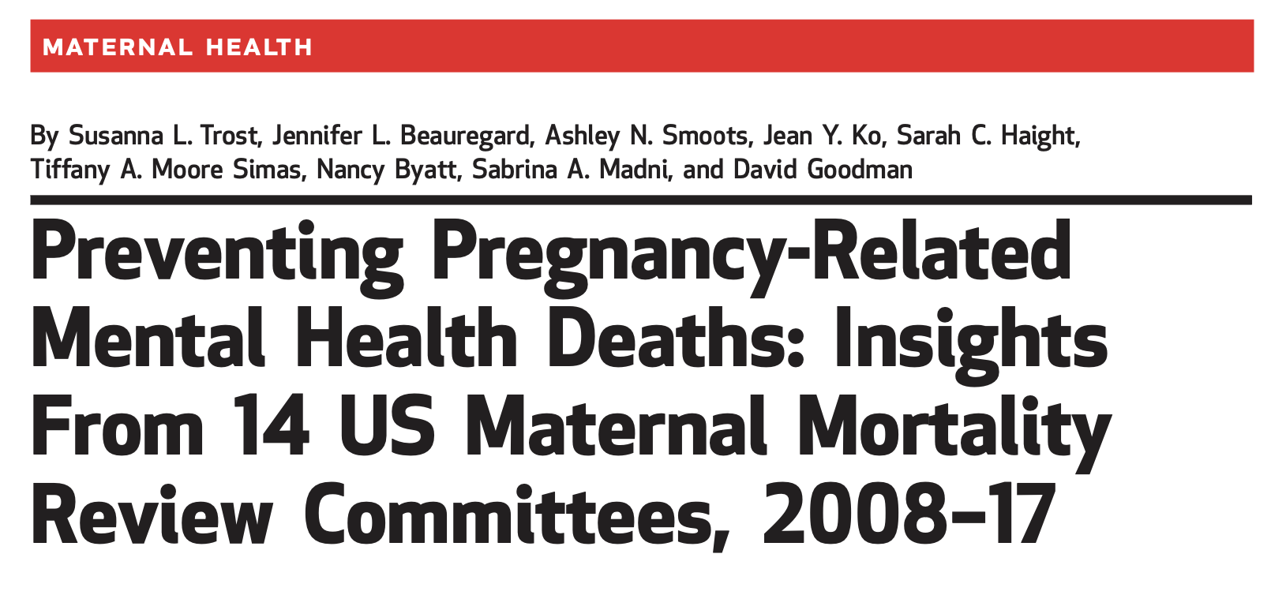
100% of Maternal Deaths due to Mental Health Conditions are Preventable
Trost, SL, Beaurard, JL, Smoots, AN, Ko, JY, Haight SC, Moore Simas AS, Byatt N, Madni SA, Goodman, D. Preventing Pregnancy-Related Mental Health Deaths: Insights From 14 US Maternal Mortality Review Committees, 2008–17. Health Affairs Vo. 40, No. 10.

Slide 12
Screen, Brief Intervention, and Referral to Treatment [SBIRT] 1 in 8 women will be screened
ECHO10/19 | Effective Screening, Brief Intervention and Referral to Treatment: Substance Use Disorders/Opioid Use Disorder
Notes:
Gold standard of care
SBIRT involves: 1) initial screening and identification of women with substance use or mental health problems; 2) for those identified, using a brief intervention to motivate women toward positive health behaviors and/or treatment; and 3) for those who require it, referral to specialty treatment [32].

Slide 13
Barriers to Successful Screening & Referral to Treatment
Patient
Stigma
Fear of social/legal consequences
Lack of available providers
Lack of access to providers due to transportation, childcare, work, insurance
Provider
Insufficient time
Unfamiliar with SBIRT
Lack of available providers
Lack of MH/SUD knowledge including risk assessment and management of SI
Healthcare System
Cost
SBIRT training and re-training due to staff turnover
Lack of care coordination across providers and health systems
Lack of available providers

Slide 14
How to talk about mental health in your practice?
Be “CIND”:
Preface conversation with mental health conditions are:
Common: 1 in 5
Impacts: Maternal and child health and development
Normalize: We are going to monitor your mood and well-being just like we are going to monitor your wt. and bp throughout pregnancy and postpartum.
Do: If there is ever a problem:
You are not alone
You are not to blame
Help is available

Slide 15
How to ask my patient about suicidal ideation?
Use Effective Screening Tools!!
Pick One Screening Scale
Edinburgh Postnatal Depression Scale (EPDS) –item 10
9 item- Patient Health Questionnaire (PHQ-9)- item 9
If SI Endorsed or Score on EDPS or PHQ-9 > 10: Ask about SI and/or Use Scale
Columbia Suicide Severity Rating Scale (CSSRS)
Passive SI: Wish to be dead
Active SI
Active SI Without Intent
Active SI With Intent But No Plan
Active SI With Intent and Plan
Prior Suicidal Behavior

Slide 16
How to ask my patient about suicidal ideation?
Passive SI: WISH TO BE DEAD
Have you wished you were dead or wished you could go to see and never wake up?
Active SI: NON-SPECIFIC
Have you had thoughts about killing yourself?
Active SI: INTENT
When you thought about ending your life, did/do you think this is something you might do?
Why, Why Not?
What is predisposing?
What is protective?
Active SI: PLAN
Have you had thoughts about how you would end your life?
Any preparation depending on method i.e., stock piling medications, picked out bridge, when

Slide 17
Suicidal Thought: Differential Diagnosis
Major Depression
Bipolar Disorder
Psychosis
POSTPATRUM OBESSIVE COMPULSIVE DISORDER!!!
Suicidal Thoughts with postpartum OCD are
Intrusive: the thought comes out of nowhere
Not inline with beliefs or values: No desire or intent to act
Distressing: very upsetting- thoughts are disturbing, often can feel embarrassed or ashamed of thoughts
Difficult to control: can’t ignore, suppress or stop

Slide 18
Suicidal Thought: Differential Diagnosis
POSTPATRUM OBESSIVE COMPULSIVE DISORDER!!!
Suicidal Thoughts with postpartum OCD are
Intrusive, not inline with beliefs or values, distressing, difficult to control
DO NOT NEED TO SEND TO ED or HX
They do not want to act on these thoughts
Reassurance & Treatment
SSRIs: Luvox, Prozac
TCAs: Clomipramine

Slide 19
How to ‘safety’ plan?
Passive SI:
WISH TO BE DEAD
Mood D/o
Refer to Treatment
Refer to Resources
Plan for if things worsen –Tell friend/family member
Call X
Postpartum Support International (PSI)
24/7/365 Hotline
Find a local provider
Moms IMPACTT
Provider support, Care coordination/referral & access to treatment
Postpartum Support Charleston
Peer support (virtual and in-person)

Slide 20
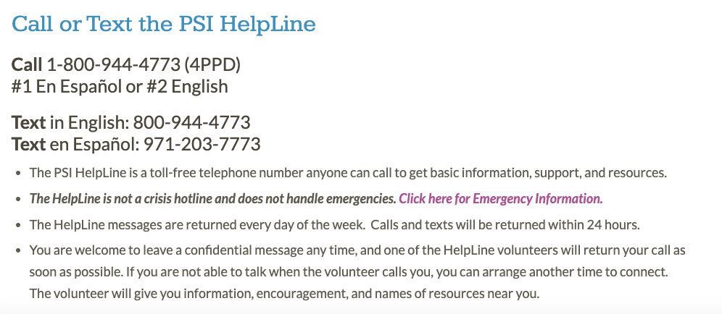

Slide 21
Suicide Hotline
Call or text: 988
Live chat on website: www.988lifeline.org
The previous Lifeline phone number (1-800-273-8255) will always remain available to people in emotional distress or suicidal crisis.

Slide 22
Domestic Violence
Call: 1.800.799.SAFE (7233)
Text: “START” to 88788
Live Chat on the website: www.thehotling.org
MSH: 843.747.4069
24/7 Crisis Line: 1.800.273.4673 (HOPE)

Slide 23
Mom’s IMPACTT IMProving Access to Maternal Mental Health and Substance Use Disorder Care Through Telemedicine and Tele-Mentoring
Connie Guille, MD
Professor, Dept. of Psychiatry and Ob/Gyn
Courtney King, PhD
Program Manager

Slide 24
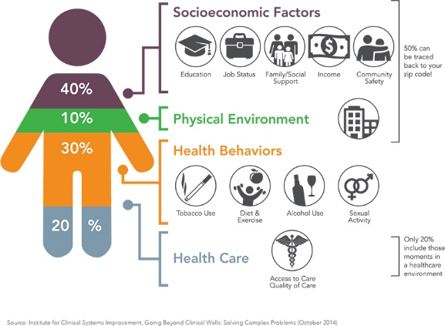
How Mom’s IMPACTT Works
[Patients]
Pregnant
Assessment
Referrals to Resources
Permission to Communicate with Provider for Care Coordination
Patient-Provider Treatment
0-12 Months Postpartum
843-792-MOMS
(843)-792-6667

Slide 25
How Mom’s IMPACTT Works
[Patients]
Text message mental health, substance use, IPV screenings
Resources/referral
Care coordination
Pregnant
Assessment
Referrals to Resources
Communication/Care Coordination
Enroll in Text-Message Monitoring System
Screenings each trimester of pregnancy, 1 month postpartum and every 3 months from delivery until 12 months postpartum.
0-12 Months Postpartum
843-792-MOMS
(843)-792-6667

Slide 26
How Mom’s IMPACTT Works
[Practices, Hospitals, Organizations]
Practices, Hospitals,
Organizations
Doulas
Midwifes
Obstetricians
Pediatricians
Psychiatrists
Community Health Workers
Advance Practice Providers
Primary Care/Family Practice
Birthing Hospital Staff
Scheduled Trainings
Tailored for Practice
Setting and Provider Type
Provider Trainings
In-Person or
Virtual
843-792-MOMS
(843)-792-6667
Notes:
For more information visit our website:
muschealth.org/momsimpactt
For a confidential consultation:
Scan this QR code or call 843-792-MOMS (843-792-6667)

Slide 27
How Mom’s IMPACTT Works
[PROVIDERS]
Provider-Provider Consultation
Doulas
Midwifes
Obstetricians
Pediatricians
Psychiatrists
Community Health Workers
Advance Practice Providers
Primary Care/Family Practice
Assessment
Referrals & Resources
Care Coordination
843-792-MOMS
(843)-792-6667

Slide 28
How Mom’s IMPACTT Works
PATIENTS
PROVIDERS
PRACTICES
Provider
Provider-Provider Consultation
Pregnant
Patient-Provider Treatment
Assessment
Referrals to Resources
Communication/Care Coordination
Longitudinal Assessments
Outcome Collection
0-12 Months Postpartum
Provider Trainings
843-792-MOMS
(843)-792-6667
Practices, Hospitals,
Organizations

Slide 29
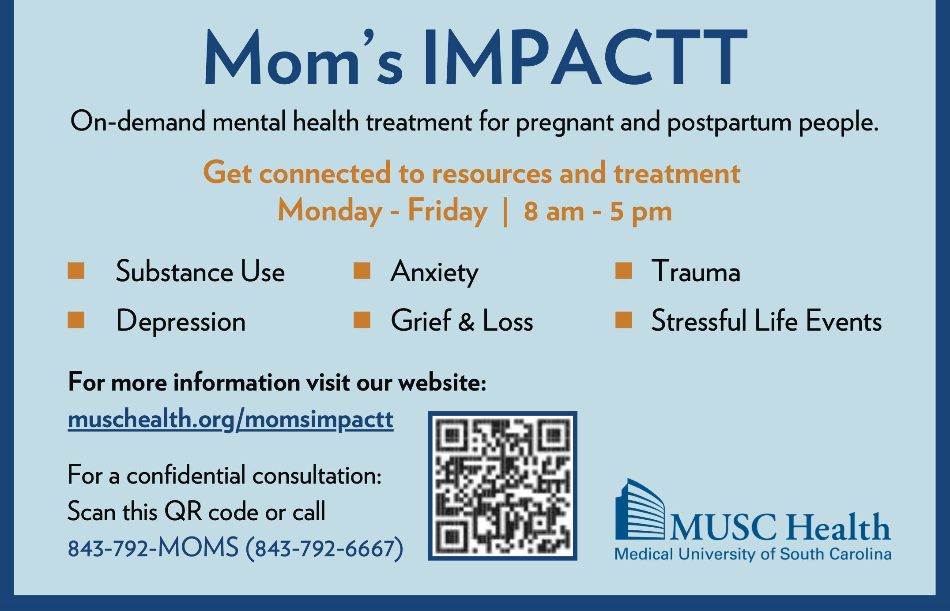

Slide 30
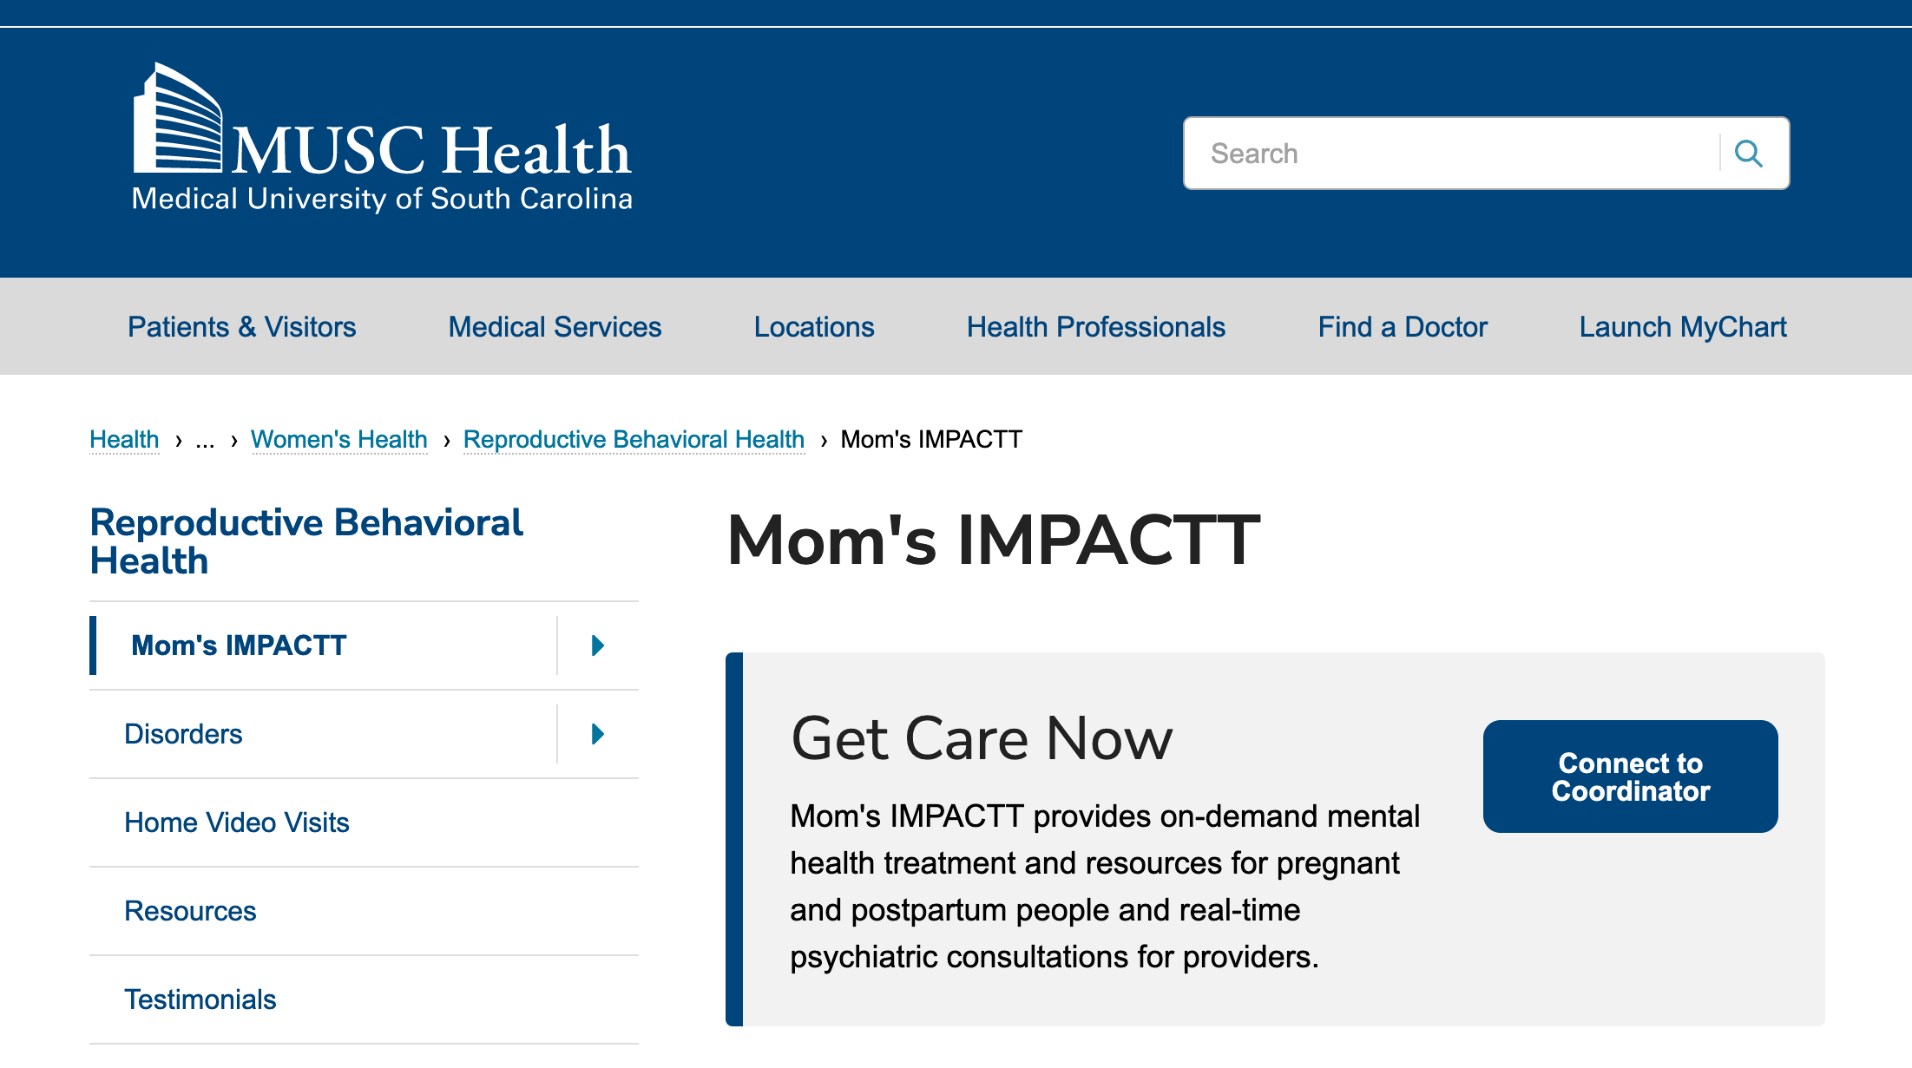

Slide 31
Notes:
Assisting Ob/Gyn, PCP, and other providers in developing the confidence and competence to assess and manage mild, and mild-to-moderate mental health problems.

Slide 32
Assisting providers in developing the confidence and competence to assess and manage mild, and mild-to-moderate mental health problems.

Slide 33
Peer Support
“Providing knowledge, experience, emotional, social or practical help"
WE ARE WITH YOU, MAMA!
Notes:
Peers share understanding and knowledge from their own unique lived experience with peripartum mental health to offer social and emotional support, education, mentoring and motivation.
-fosters understanding & trust
-offering guidance
-offering insight
-assist in developing positive community support, involving family, friends and significant others
-cultivating environmental support that enables them to function actively and independently
-empowering women to formulate and explore what works for them (by including them in experiences/groups/etc. and offering resources)
You are not a therapist or a counselor.
Helping others build “recovery capital” – the quality and quantity of internal and external resources (support system) that one can draw on to sustain wellness/recovery [helping women find things that enhance the quality of their life outside]
1. Personal –meeting basic needs, good physical health (taking care of yourself), emotional health, self-care practices, interpersonal skills, spirituality, optimism, perseverance, self-awareness, confidence, goals and sense of purpose/meaning
2. Social –relationships with friends, family, co-workers, etc. leisure & social activities (what do you do for fun?), role models
3. Community/Cultural – connection to networks/groups with shared interests, helping others (e.g. volunteering as peer, participating in something that matters to you), community support resources & access to education/training, cultivating belonging, cultural attitudes/values that support you, sense of personal choice social integration
https://www.sciencedirect.com/science/article/abs/pii/S0165032720324459?via%3Dihub
Huang R, Yan C, Tian Y, Lei B, Yang D, Liu D, Lei J. Effectiveness of peer support intervention on perinatal depression: A systematic review and meta-analysis. J Affect Disord. 2020 Nov 1;276:788-796. doi: 10.1016/j.jad.2020.06.048. Epub 2020 Jul 15. PMID: 32738663.
Abstract
Background: It has been suggested that peer support intervention may offer an alternative approach to prevent or treat perinatal depression, but little is known about its effectiveness, economics, and satisfaction in the prenatal and postpartum populations. This review summarizes available evidence on the effectiveness, economics, and satisfaction of peer support intervention on perinatal depression.
Methods: Multiple electronic databases were searched in five English databases (MEDLINE, Embase, Cochrane Library, Psyc INFO, and CINAHL) and three Chinese databases (Wang Fang, China National Knowledge Infrastructure, and Chinese Biomedical Literature Database) from inception to April 2019. Hand searching of references was also performed. Randomized controlled trials reporting peer support intervention targeting on perinatal depression were included. The quality of evidence was assessed using the Cochrane risk of bias tool.
Results: Ten randomized controlled trials met the inclusion criteria and were included in the final analysis. Peer support intervention reduced standardized mean depressive scores (-0.37, 95% CI -0.66 to -0.08) and reduced risk ratio (0.69, 95% CI 0.49-0.96) of depression.
Limitations: Clinical heterogeneity was observed among the included studies in peer support intervention, suggesting the existence of potential mediators, such as intensity, frequency, or type of peer support intervention.
Conclusion: Peer support intervention may have the potential to effectively prevent perinatal depression or reduce the harm of perinatal depression. Future studies with better design/execution and larger sample size are needed to investigate potential mediators associated with the beneficial effects of peer support intervention on perinatal depression.
Keywords: Meta-analysis; Peer support intervention; Perinatal depression; Systematic review.

Slide 34
Peer Support
Foster understanding & trust
Offer guidance & insight
Assist in developing positive community support, involving family, friends and significant others
Cultivate environmental support that enables well-being
Empowering women to formulate and explore what works for them
Notes:
Peers share understanding and knowledge from their own unique lived experience with peripartum mental health to offer social and emotional support, education, mentoring and motivation.
-fosters understanding & trust
-offering guidance
-offering insight
-assist in developing positive community support, involving family, friends and significant others
-cultivating environmental support that enables them to function actively and independently
-empowering women to formulate and explore what works for them (by including them in experiences/groups/etc. and offering resources)
You are not a therapist or a counselor.
Helping others build “recovery capital” – the quality and quantity of internal and external resources (support system) that one can draw on to sustain wellness/recovery [helping women find things that enhance the quality of their life outside]
1. Personal –meeting basic needs, good physical health (taking care of yourself), emotional health, self-care practices, interpersonal skills, spirituality, optimism, perseverance, self-awareness, confidence, goals and sense of purpose/meaning
2. Social –relationships with friends, family, co-workers, etc. leisure & social activities (what do you do for fun?), role models
3. Community/Cultural – connection to networks/groups with shared interests, helping others (e.g. volunteering as peer, participating in something that matters to you), community support resources & access to education/training, cultivating belonging, cultural attitudes/values that support you, sense of personal choice social integration

Slide 35
How to ‘safety’ plan?
Active SI:
INTENT AND/OR PLAN
TEAM Approach: Social work, provider, patient & family
Remove access to means
(guns, pills, other methods)
Plan
Who is with patient 24/7
Monitoring
Treatment
Mobile Crisis
24/7/365
Crisis and check ins
Call 911
Emergency Department

Slide 36
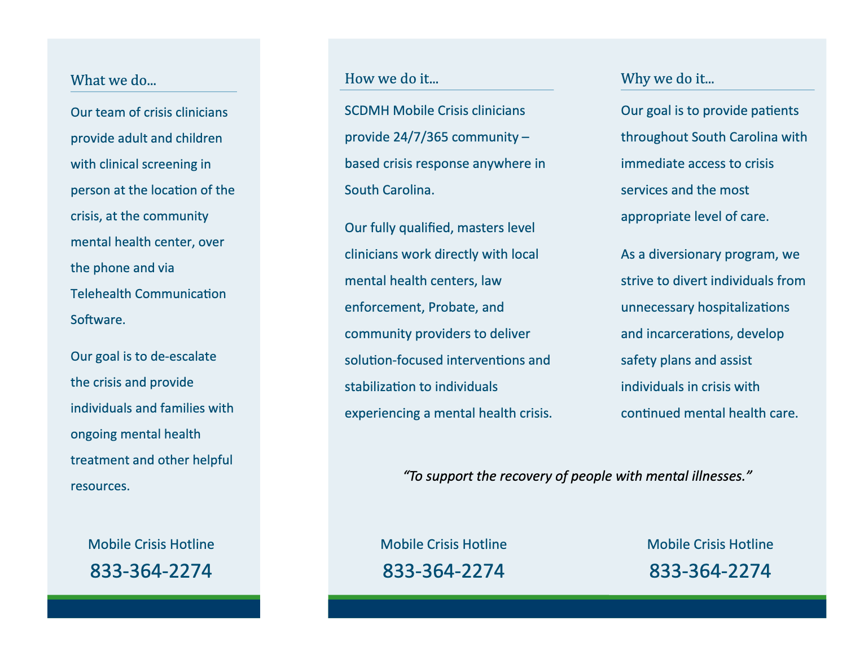
South Carolina Department of Mental Health: Mobile Crisis

Slide 37
4 Million Births Per Year
Mental health conditions are the most frequent underlying causes of pregnancy-related death (22.7%)
Mental health problems are the most common complication of pregnancy & childbirth (11,400 Pregnant Women in SC Annually)
Assist providers in developing the confidence and competence to screen, assess and manage mild, and mild-to-moderate mental health problems.
Provide access to mental health and SUD treatment and resources
Reduce Maternal Morbidity and Mortality

Slide 38
Acknowledgments
Women’s Reproductive Behavioral Health Division
Rubin Aujla, MD
Claire Smith, MD
Christina Tolbert, MD
*Liz Monter, MD
Liz Parker, LPC
Victoria Bowen, LPC
Tara Ancrum, LISW
Telemedicine COE
Dee Ford, MD
Katie King, MD, MPH
Ryan Kruis, LISW
Katie Sterba, PhD
Emily Johnson, PhD
Annie Simpson, PhD
Lizmarie Maldonado, MSPH
Rebecca Beeks, BA
Biomedical Informatics Center
John Clark, MA
Erin Quigley, BA
Tomoko Gaddard, BA
*Courtney King, PhD
Erin Phlegar, PA
Kerry Blome, LISW
Edie Douglas, MPH
Tychia Brown, BA
Allison Guill, BA
Funding
HRSA National Telehealth Center of Excellence Award. PI: Ford/King
(U66 RH31458)
NIH/NIDA PI: Guille (R34 DA046730; K23DA039318-01)
DAODAS and Duke Endowment PI: Guille (6777-SP; 6563-SP)

Slide 39
October 19, 2022
Effective Screening, Brief Intervention and Referral to Treatment
Connie, MD
CMEs and CEUs
MUSC designates this live activity for max of 1.0 AMA PRA Category 1 Credit(s)™MUSC will award 0.1 CEUs for this activity (1 contact hour = 0.1 CEU)
WEBSITE ADDRESS
https://sctelehealth.org/services/pregnancy-wellness

