Slide 1
MORBIDLY ADHERENT PLACENTA
Donna D. Johnson, MD
Medical University of South Carolina

Slide 2
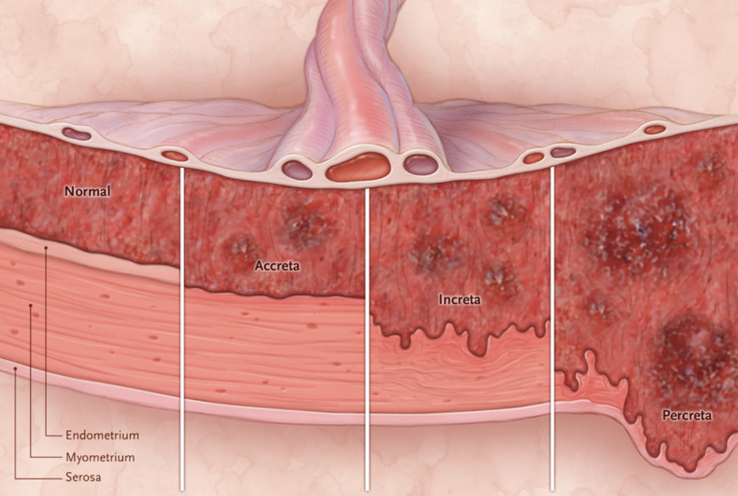
DEFINITION
Silver, NEJM

Slide 3
FREQUENCY
1970’s: 1 in 4000
1980’s: 1: 2500
Currently: 1:533- 1:730
#1: Hysterectomy

Slide 4
ETIOLOGY
Prior uterine surgery
  D & C
  Myomectomy
  Ablation
  Hysteroscopy & lysis of adhesions
Prior c/s with an anterior previa
Central previa
Uterine artery embolization

Slide 5
PREVIOUS CS AND
ANTERIOR PLACENTA PREVIA
Number of cs | Risk of an accreta (%)
One | 11
Two | 40
Three | 61
Silver, NEJM

Slide 6
ANTENATAL DIAGNOSIS
Take a history
High index of suspicion
Unexplained MSAFP

Slide 7
ANTENATAL DIAGNOSIS
Ultrasound
  Expert
  LUS bulge
  Lack of black line
  Lacunae
  Increased vascularity
MRI
  Not better
  May help with surgery

Slide 8
OBSTETRICAL MANAGEMENT
Hospital with multiple resources
Hospitalization
  Bleeding
  Remote location from the hospital
  Poor social situation
Delivery at 34-35 weeks
  Steroids

Slide 9
OPERATIVE TEAM
Anesthesia
MFM
Gyn Onc
Urology
Trauma surgery
Vascular surgery
IR aware

Slide 10
PERI-OPERATIVE MANAGEMENT
Blood products
Lines, lines and more lines
ICU reservations

Slide 11
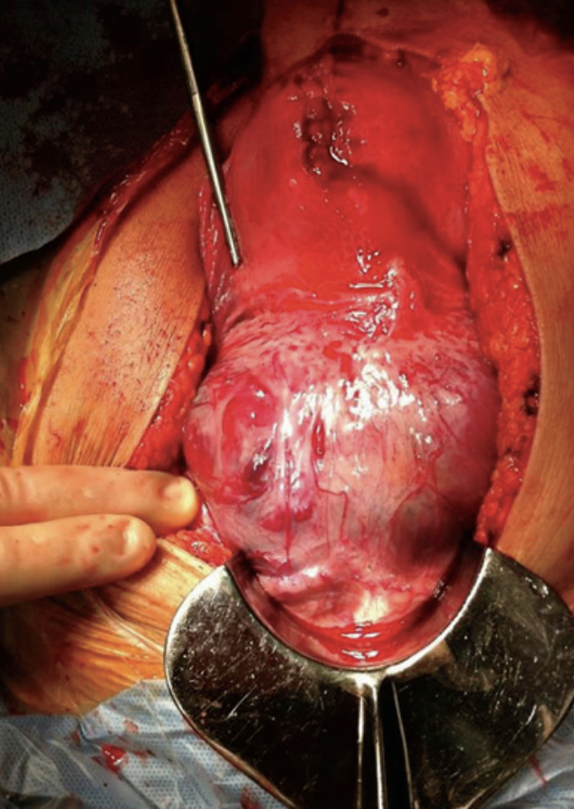
INTRAOPERATIVE MANAGEMENT

Slide 12
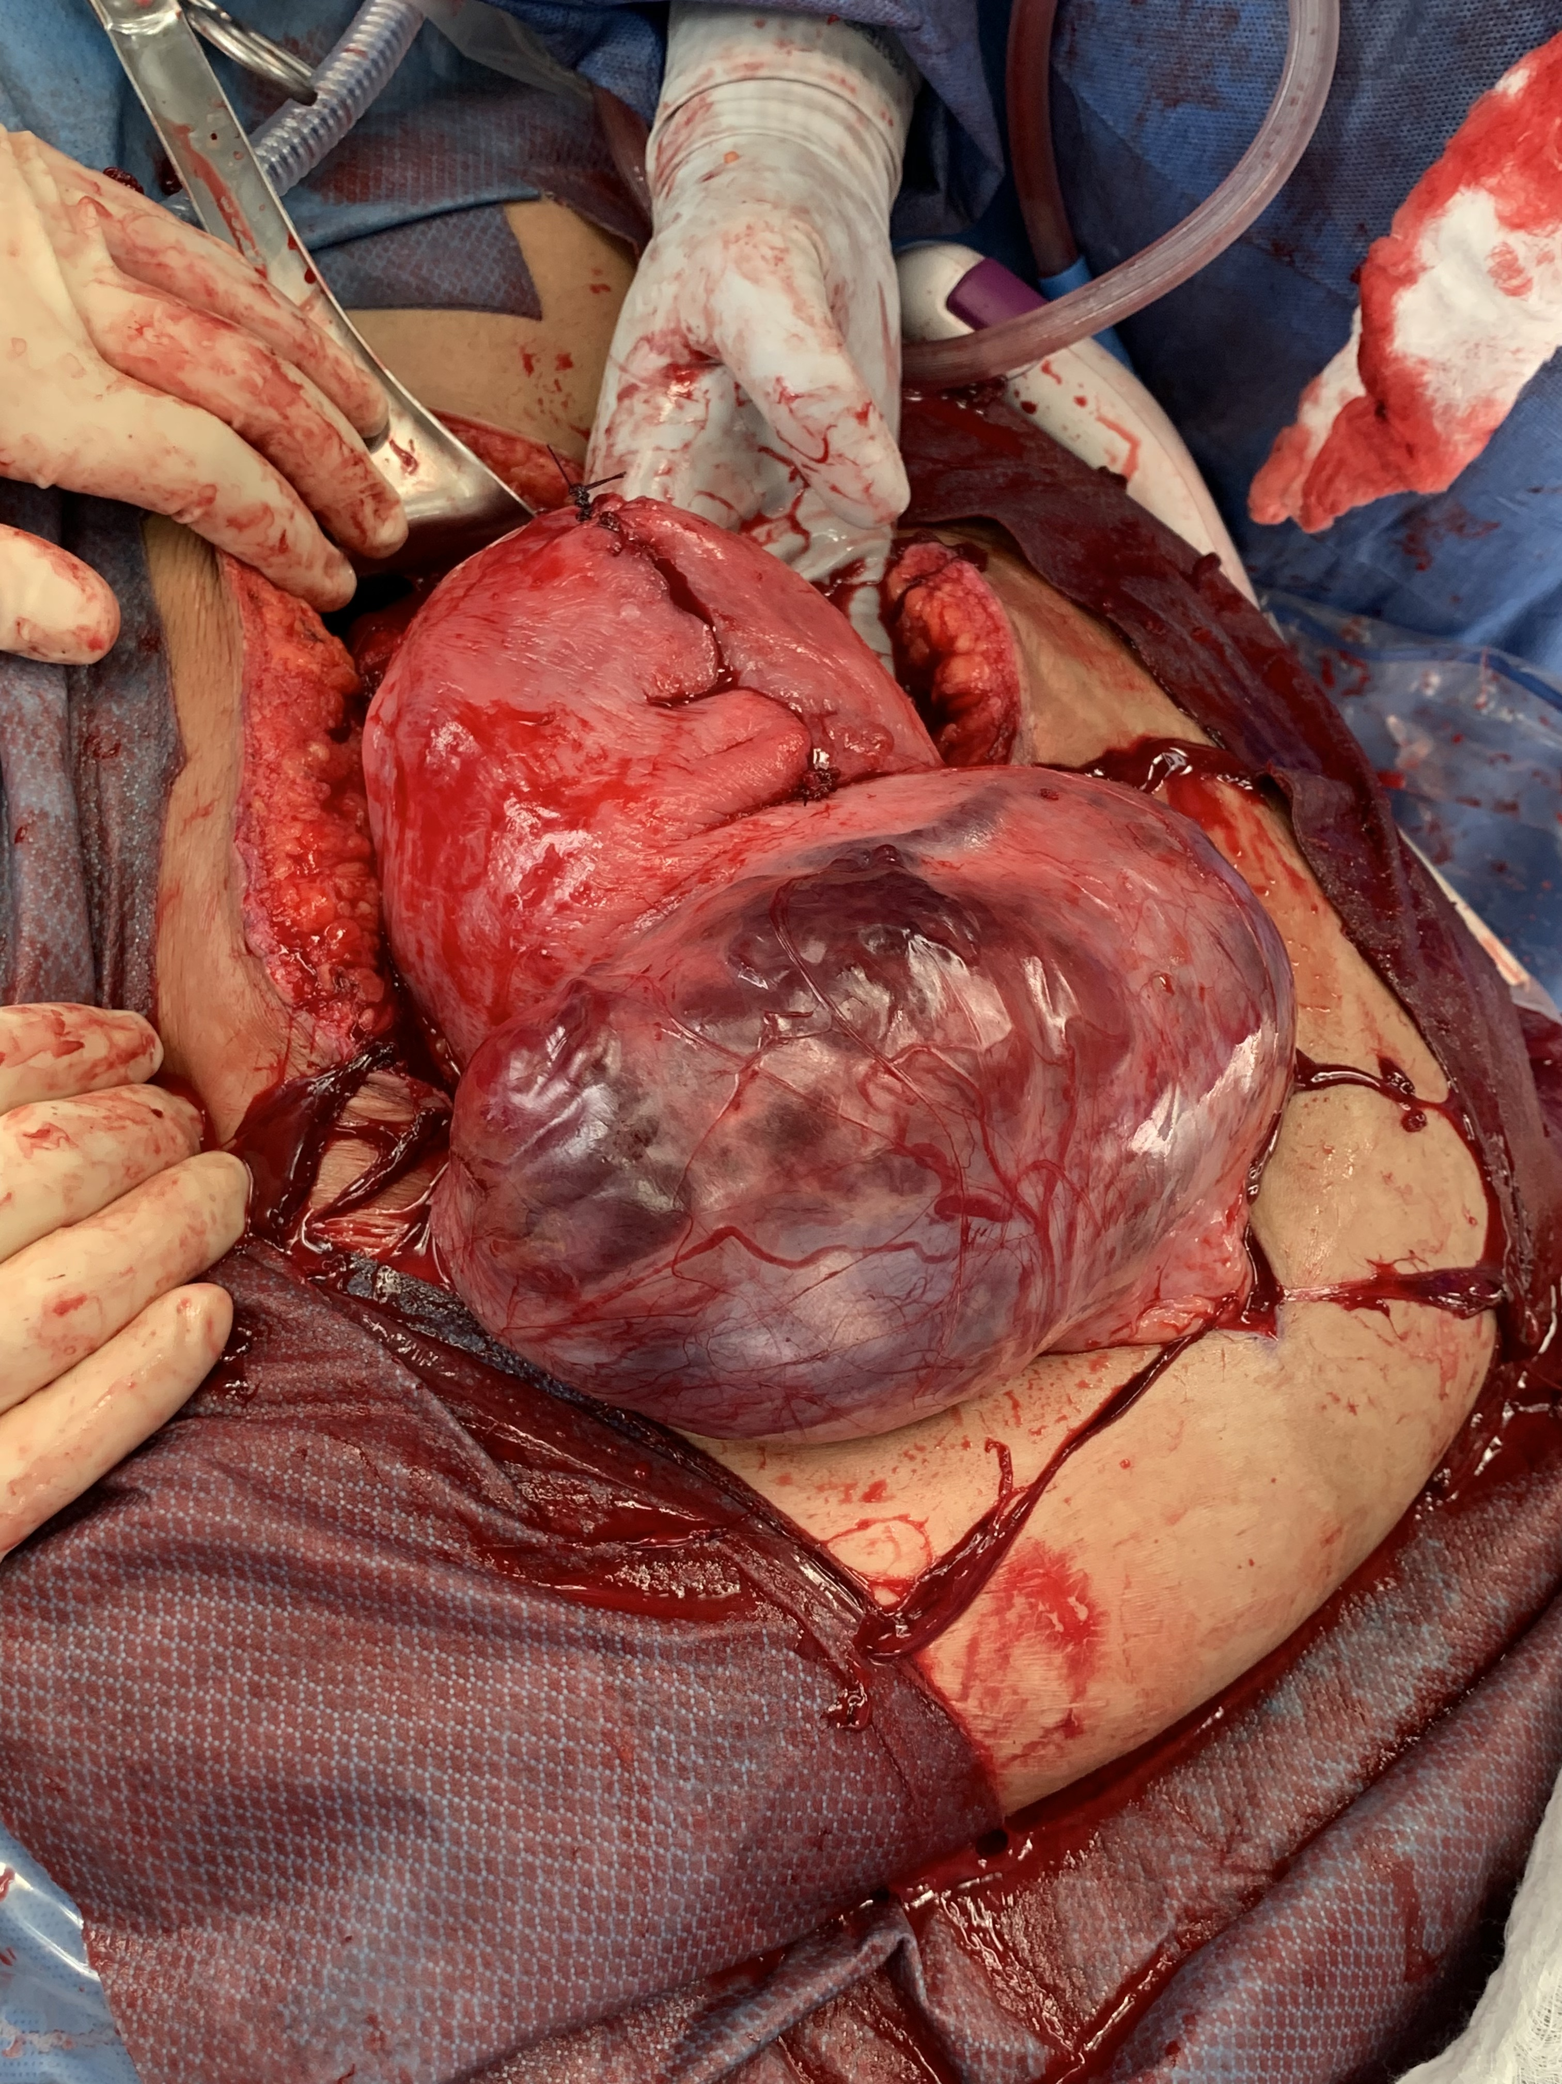
INTRAOPERATIVE MANAGEMENT

Slide 13
Project ECHO South Carolina Pregnancy Wellness
Visit Our Website: https://sctelehealth.org/services/pregnancy-wellness
1st & 3rd Wednesday/Month Postpartum Hemorrhage 12:15 pm – 1:00 pm
Date | Topic
6/2/21 | Assessing Blood Loss and Management
6/16/21 | Safety Bundles for Postpartum Hemorrhage and Hypertension

Slide 14
To Request a Copy of today’s
Didactic Video Presentation
Contact
Rachel Grater, Program Coordinator
grater@musc.edu

