Slide 1
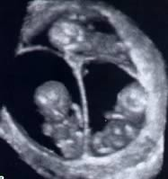
Multiple Gestations
Berry A. Campbell, MD
Maternal Fetal Medicine

Slide 2
Dizygotic Twins
Fraternal or non-identical
Fertilization of two separate eggs
Two genetically distinct individuals
Risk factors:
  race (blacks > whites > Asians)
  age (increase with age)
  parity (increase with greater parity)
  use of assisted reproduction techniques
  ALL HAVE DICHORIONIC PLACENTAS

Slide 3
Monozygotic Twins
Identical
Formed from splitting of a single fertilized egg
Accounts for 30% of twin gestations
Constant rate of about 4/1000 across all populations
Almost always genetically identical
Usually share a placenta
CAN HAVE DICHORIONIC OR MONOCHORIONIC PLACENTA

Slide 4
Placentation
2/3 dizygotic
1/3 monozygotic
1/3 dichorionic diamniotic
2/3 monochorionicdiamniotic
dichorionic
diamniotic
Dizygotic twins are always dichorionic, diamniotic.
Monozygotic twins may be dichorionic or monochorionic.
Monochorionic twins are always monozygotic.

Slide 5
Monozygotic Placentation
DAY OF EGG SPLIT | PLACENTATION
2-3 | Dichorionic, diamniotic
3-8 | Monochorionic, diamniotic
8-13 | Monochorionic, monoamniotic
13-15 | Conjoined twins

Slide 6
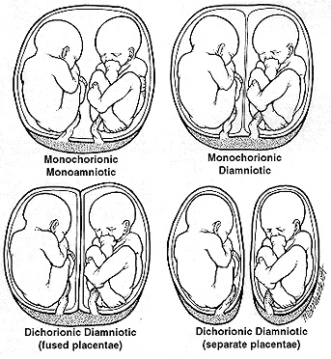
<1%
8%
92%

Slide 7
Nutrition
Require an additional 600 calories/day
Recommended weight gain 35-45lbs in normal weight patients
Iron and folic acid supplementation essential

Slide 8
Ultrasound
Second trimester detailed anatomical scan, echo
Serial ultrasounds for growth (FGR and discordance)
Documentation of chorionicity is ESSENTIAL and best done early in gestation!

Slide 9
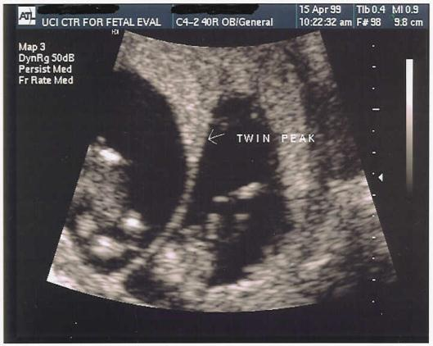
Twin Peak Sign

Slide 10
Multiples: Ultrasound
Monochorionic
Dichorionic

Slide 11
Complications
Preterm Labor
Gestational Diabetes
Preeclampsia
FGR
Anemia
Fetal anomalies
Twin-to-twin transfusion (Mo-di, mo-mo twins)
Postpartum hemorrhage
Identical >> non-identical

Slide 12
Multifetal Morbidity/Mortality
 | Twins | Triplets | Quads
Birthweight | 2347g | 1687g | 1309g
EGA (weeks) | 35.3 | 32.2 | 29.9
IUGR (%) | 14-25 | 50-60 | 50-60
NICU (%) | 25 | 75 | 100
% < 34 weeks | 19.5 | 63 | 83
Major Handicap | ? | 20 | 50
Risk of CP | 4x | 17x | ?
Risk of NND | 7x | 20x | ?

Slide 13
Multiple Gestation
Higher rate birth defects
Higher rate aneuploidy
Serum multiple marker accurate
Noninvasive prenatal testing accurate
Nuchal translucency (TTTS, heart defects, aneuploidy)

Slide 14
Multiple Gestation
Preeclampsia (20%+ twins, 60% triplets & quads)
Occurs earlier, more severe, more atypical
Specialty care availability essential
Low dose ASA not proven but trend toward benefit.

Slide 15
Preterm Labor
Average delivery 36 weeks gestation twins
Screening with transvaginal cervical length, serial digital exam
Prophylactic use of cerclage, bed rest, pessary, progesterone not proven useful
Vaginal progesterone for Cx <25 mm mixed data
Cerclage for short cervix in twins: “insufficient evidence for or against”
Exam indicated cerclage in 2nd trimester more likely to be beneficial
Treatment same as singleton (steroids; magnesium sulfate < 32 wks)

Slide 16
Growth Restriction/Discordance
Discordance > 20% difference
Particularly in di-zygotic, discordant sizes doesn’t impact outcome if AGA
FGR definition same as singletons (<10%tile)
FGR management same as singleton

Slide 17
Antenatal Testing
BPP or NST 1-2 times weekly
Dichorionic uncomplicated: start 36 weeks
Monochorionic diamniotic uncomplicated: start 32 weeks
Twins increasing risk stillbirth with advancing GA:
Monochorionic > dichorionic

Slide 18
Next ECHO
Twin twin transfusion
Delivery timing
Delivery route
Asynchronous delivery

Slide 19
Multiple Gestation

Slide 20
Twin-twin transfusion syndrome (TTTS)
Multifetal Morbidity/Mortality
Affects 10-15% of monochorionic gestations
Vascular anastomoses in the placenta (AV)
Ultrasound findings typically develop between 16-26 weeks: US screening every 2 weeks
Treatment with serial amnio-reduction or laser ablation

Slide 21
Twin-twin transfusion syndrome
Donor Twin
Recipient Twin
  Growth restricted
  Oligohydramnios or anhydramnios
  Poor renal perfusion, absent bladder on u/s
  Anemic, volume depleted
  Usually better outcome
  Plethoric, large
  Polycythemic
  Polyhydramnios
  Volume overloaded, cardiac issues
  Hydrops
  Usually worse outcome

Slide 22
TTTS
10-15% of mo-di twins
AV anastomosis with too few AA anastomosis
Quintero staging:
Donor bladder visible, normal Doppler
Donor bladder not visible, normal Doppler
Donor bladder not visible, abnormal Doppler
Hydrops
IUFD one or both fetuses

Slide 23
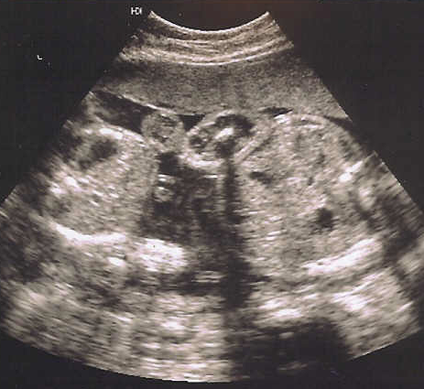
TTTS
DONOR
RECIPIENT

Slide 24
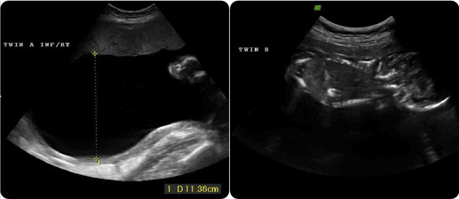
Twin Twin Transfusion Syndrome
RECIPIENT
DONOR

Slide 25
TTTS
Stage I disease – 70% remains stable or regresses
Stage II or higher at < 26 weeks – laser therapy recommended
Stage II or greater – 80-100% mortality
Earlier diagnosis, worse prognosis
May occur late as well

Slide 26
Selective Growth Restriction
10-15% mo-di twins
High rate cord abnormalities
Normal fluid
Cord Doppler may be normal or elevated
Prognosis worse with early onset and abnl cord Doppler
Expectant care

Slide 27
Twin Anemia-Polycythemia Sequence (TAPS)
Isolated occurrence in 3-5% mo-di twins
13% incidence post laser treatment of TTTS
Etiology: presence of a few small AV anastomosis (slow, gradual transfusion)
Diagnosis: Donor MCA > 1.5 mom
Recipient MCA < 0.8 mom
Postnatal Diagnosis: Hb < 11g% donor and
Hb > 20g% recipient
US: normal AF; occurs later than TTTS, abnormal MCA suggests
Rx: Expectant vs Transfusion
Survival 75-100%

Slide 28
Death of Co-Twin
Common in first trimester, “vanishing twin” (36%)
Low maternal and fetal risk in dizygotic twins
Potential for IUFD of remaining twin due to exsanguination in monochorionic twins
  Fetal hypotension in co-twin with death of co-monochorionic twin
  Risk for permanent neurologic injury even in surviving twin

Slide 29
In-Utero Death of One Fetus
Mo-di placentation, 15% risk other fetal demise
Di-di placentation, 3% risk.
Mo-di placentation with 18-26% risk significant neurologic sequelae in survivor
Di-di placentation, very low risk (1%).
Neurologic risk seen with loss as early as 13 weeks.
Greatest risk if demise 28-33 weeks, less if > 34 weeks.
Hillman et al, ObGyn 2011, 118 (928)

Slide 30
Delivery
About 80% deliver vaginally if vertex/vertex
  No improvement in outcome with cesarean delivery
Controversy if vertex/nonvertex
  Vaginal delivery ok if > 1500 gm birthweight
  Breech extraction of 2nd twin has higher success than external cephalic version
Cesarean if twin A nonvertex
  Interlocking heads

Slide 31
Breech Extraction of Twin B
No increased risk of neonatal mortality or morbidity
Decreased maternal morbidity compared to c/s, ECV or vaginal vertex delivery attempt

Slide 32
Candidates for Breech Extraction
Experienced physician
Ability to perform immediate cesarean
Adequate anesthesia for maneuvers
Flexed fetal head
EFW >1800 g; > 32 weeks

Slide 33
DICHORIONIC DIAMNIOTIC
TWINS
Deliver uncomplicated, well dated twin gestations electively at 38 weeks gestation

Slide 34
Monochorionic Diamniotic Twins
Risk of sudden unexplained death after 32 weeks up to 5%
Given potential devastating neurologic sequelae with fetal demise of one twin delivery after 34 weeks is considered
Counsel patient re: risks, individualize
delivery time 34-37 weeks.

Slide 35
Monoamniotic Twins
1% all pregnancies
Historically 50% mortality rate
More recently 7-20% (2.5% if exclude anomalies)
Delivery 32-34 weeks

Slide 36
ASYNCHRONOUS DELIVERY
Delivery of one of multiples with retention of other(s) to allow maturation.

Slide 37
ASYNCHRONOUS DELIVERY
38 twin, 12 triplet pregnancies
First delivery < 25 weeks
High ligation cord, trim cord and membranes
Copious chlorhexidine irrigant
Tocolysis
Antibiotics
No cerclage
Arabin et al 2009

Slide 38
ASYNCHRONOUS DELIVERY
9 of 18 second twins survived (50%)
2 of 14 retained triplets survived (14%)
Arabin et al 2009

Slide 39
ASYNCHRONOUS DELIVERY
Exclusions
Intra amniotic infection
Monochorionicity
Abruptio
Preeclampsia

Slide 41
Monoamniotic Twins Management
87 sets
43 patients admitted 24-26 weeks, testing 2-3 times daily
44 patients managed outpatient, 1-3 times weekly testing
No stillbirths in-patient group
14.8% (13) stillbirths out-patient group
Hexborne et al, AJOG 2005

Slide 42
Monoamniotic Twins Management
Admit 24-26 weeks
Monitor 2-3 times daily
Steroids admission, repeat before delivery
Delivery 32-34 weeks

Slide 43
ASYNCHRONOUS DELIVERY

Slide 44
cases

Slide 45
25 yo G1 at 18 weeks gestation with twins presents for ultrasound. Twin A is noted to have polyhydramnios with a deepest amniotic fluid pocket of 10cm. A dividing membrane cannot be seen. Twin B is crowded into the upper part of the uterus and is not moving freely. A bladder cannot be identified on Twin B. Twin A is measuring 2 weeks larger than Twin B. Which of the following is true about this pregnancy?
a. This is most consistent with ruptured membranes of Twin B.
b. This is most likely a monoamniotic twin gestation.
c. These findings are most consistent with TTTS.
d. Outcome in this setting is good without further intervention.
e. Twin B most likely has a structural anomaly.

Slide 46
A 30 yo G2P1 is 35 weeks gestation with dichorionic twins. Her pregnancy has been uncomplicated to date. The twins are presenting vertex/transverse. The patient would like to attempt a vaginal delivery. Which of the following statements are correct when counseling her regarding risks?
a. Breech vaginal delivery of twin B carries greater risk of neonatal morbidity than ECV
b. Vaginal delivery of twins carries greater maternal risks than cesarean section
c. Delivery of Twin B by external cephalic version is less likely to result in vaginal delivery than breech extraction
d. Vaginal delivery of twins carries greater risk of hemorrhage

Slide 47
A 35 yo G3P2 with twins at 36 weeks presents complaining of headache. Her BP is 152/92 with 1+ proteinuria. She is contracting every 10 minutes and her cervix is dilated 2 cm and 80% effaced. Fetal heart rate tracings are reassuring. Ultrasound confirms vertex/vertex presentation with EFW twin A: 3250g and twin B: 3600g. Which of the following is not an appropriate next step in her management?
a. Observation only
b. Magnesium sulfate seizure prophylaxis
c. Amniotomy
d. Oxytocin augmentation

Slide 48
What is the most common placentation for identical twins?
  a. monochorionic/diamniotic
  b. dichorionic/diamniotic
  c. monochorionic/monoamniotic

Slide 49
Board Answers
How would you counsel a patient with twins about what to expect from her pregnancy?
I counsel my patients that the average age of delivery for twins is 36 weeks. The reasons for early delivery include preterm labor and pregnancy complications such as preeclampsia or diabetes.
I perform an ultrasound in the first trimester if I suspect twins in order to establish chorionicity. 30% of twins are monochorionic and have a 15% risk of twin twin transfusion syndrome. If the twins are monochorionic, I follow them with ultrasound every 2 weeks to check amniotic fluid and assess for TTTS.
I test all twins for diabetes and anemia at 24-28 weeks and perform an anatomy survey at 18-20 weeks gestation. I also recommend an increase of 600 calories/day.

Slide 50
Board Answers
For delivery, I counsel my patients that there is no benefit to cesarean section if both twins are cephalic.
If the first twin is nonvertex, I recommend cesarean section to avoid the complication of interlocking twin heads.
If the first is cephalic and the second is nonvertex, I recommend cesarean section if the gestational age is < 32 weeks or if the EFW is < 1500-1800g.
If the patient chooses vaginal delivery, I recommend delivery in an operating room with epidural anesthesia in the event an emergency cesarean section is necessary. I have a portable ultrasound available to assist in identifying the position of the second twin after delivery of the first.
I explain the possible complications from delivery of twins vaginally include: failure to deliver either twin vaginally, need for emergency cesarean for twin B due to cord prolapse, abruption, nonreassuring FHR, and injury to the baby such as nerve damage or fracture to the arm or clavicle.

Slide 51
Board Answers
If twin B is not cephalic following delivery of A, I explain that I will perform a breech extraction by immediately reaching into the uterus, grasping the fetus by the ankle(s) and applying gentle continuous traction. Once the baby is delivered as much into the vaginal canal as possible, I rupture membranes. I continue traction and gently rotate the baby so that it is facing downward. My assistant will apply suprapubic pressure to maintain head flexion.
Once the baby is delivered to the armpits, I rotate the baby so one shoulder is anterior and place my finger in front of the elbow to flex and deliver the arm. If the arm is unable to be grasped because it is nuchal, I rotate the baby in the opposite direction to deliver the opposite arm in a similar manner. Once the arms are delivered, I elevate the body of the baby and place my fingers on the maxilla to flex the head until it is delivered.

Slide 52
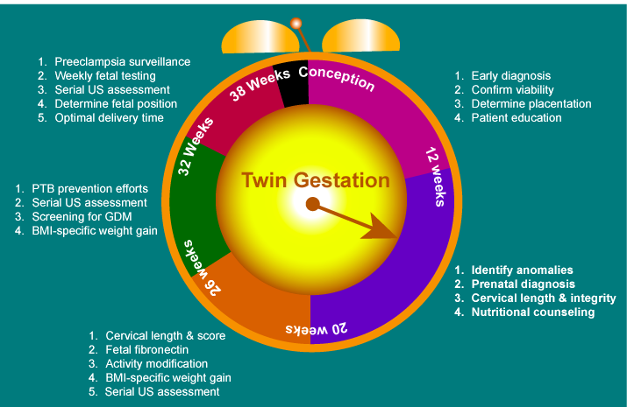

Slide 53
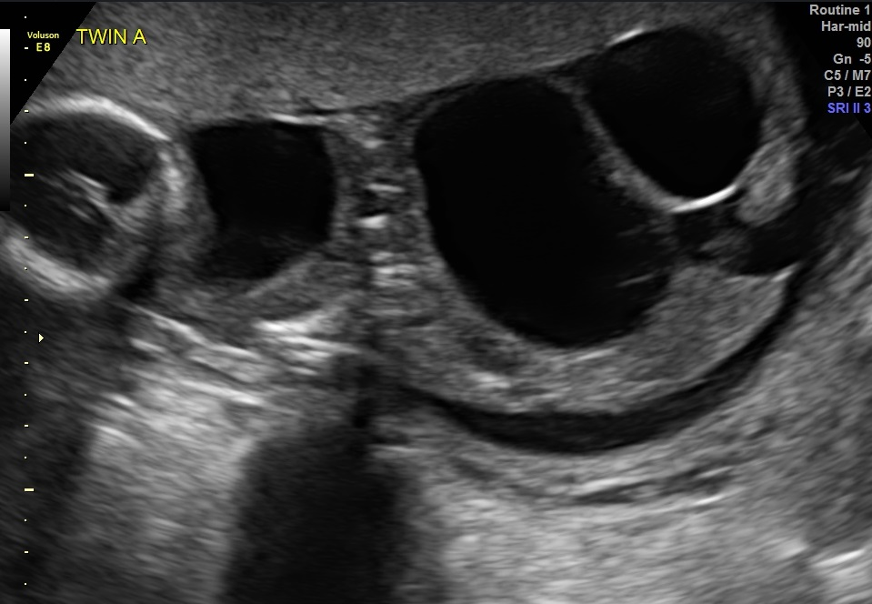

Slide 54
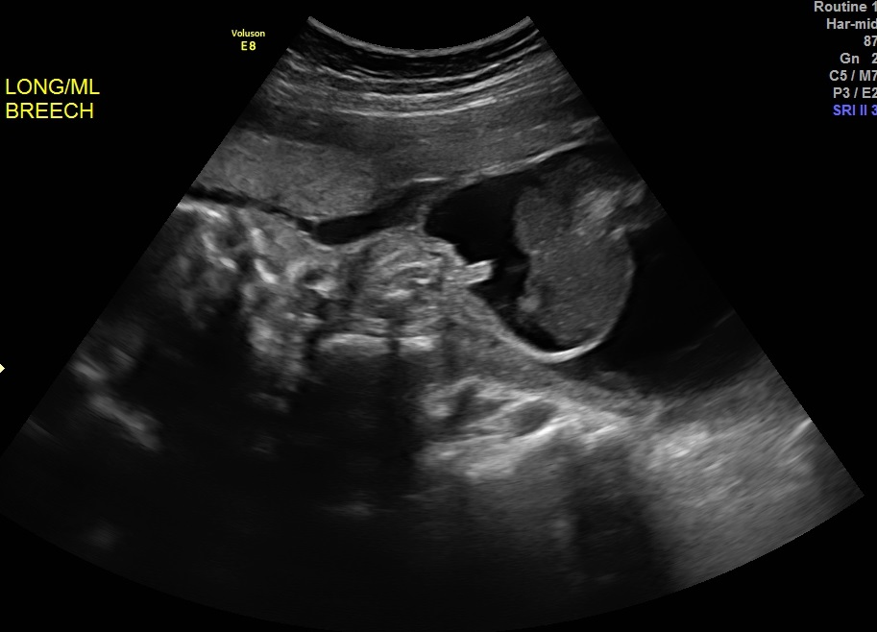

Slide 55
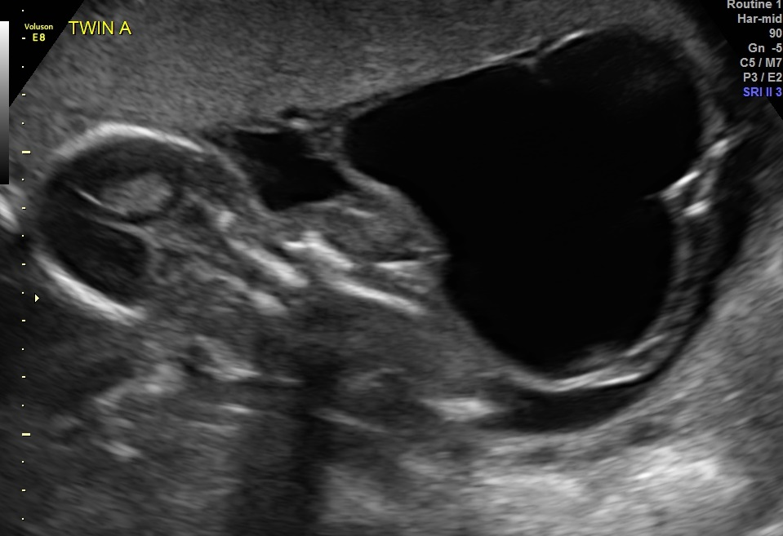

Slide 56
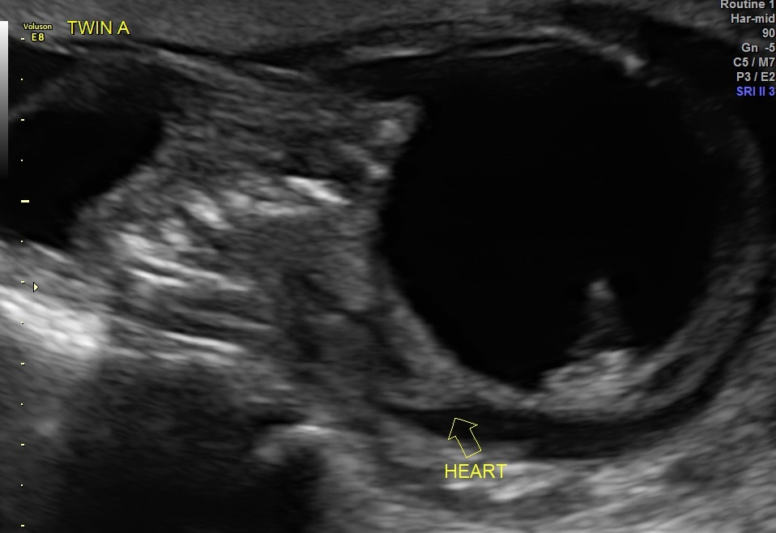

Slide 57
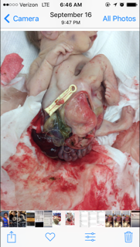

Slide 58
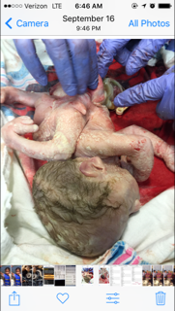

Slide 59
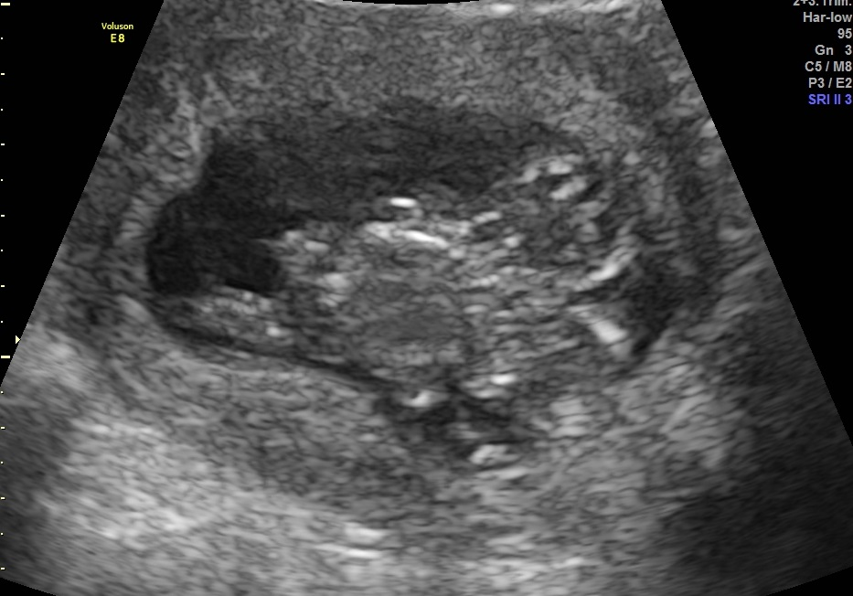

Slide 60
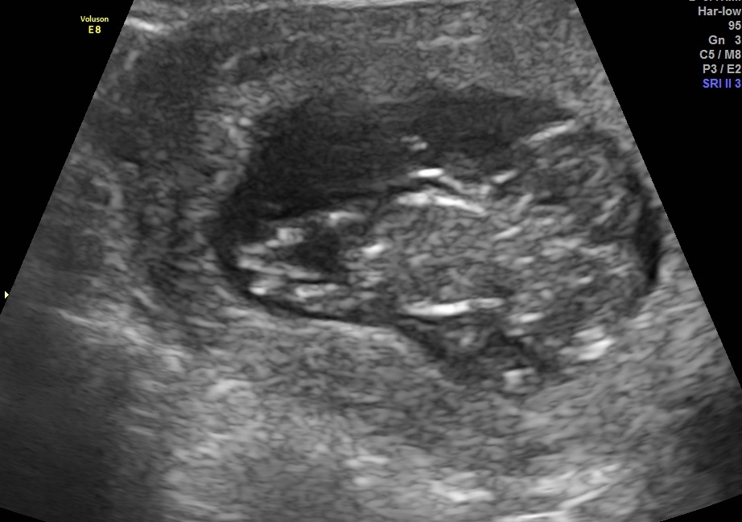

Slide 61
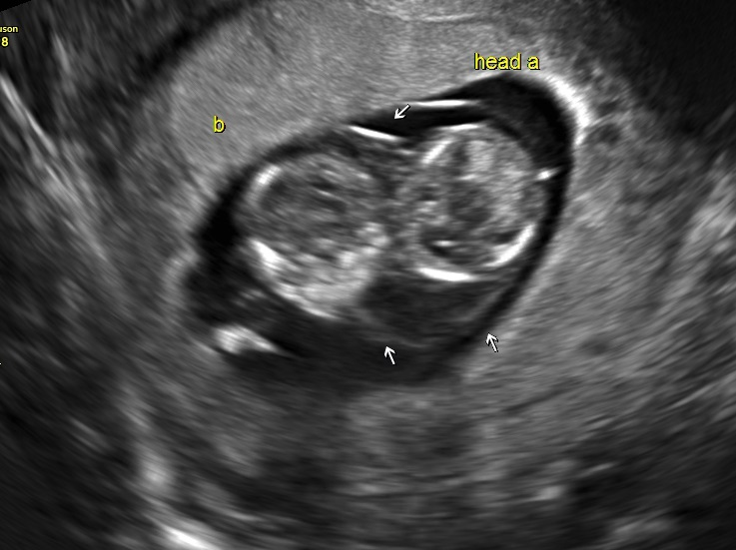

Slide 62
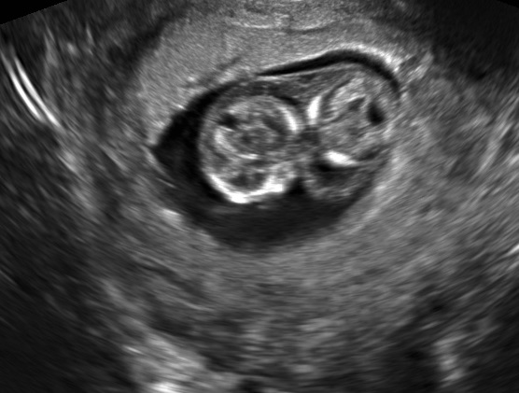

Slide 63
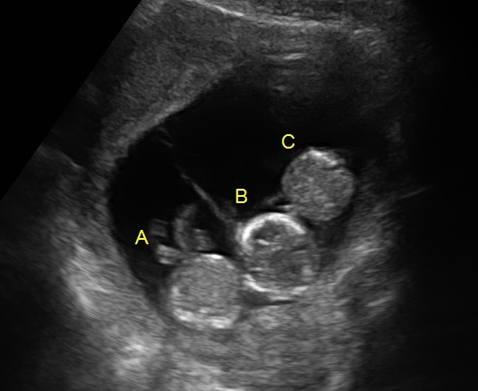

Slide 64
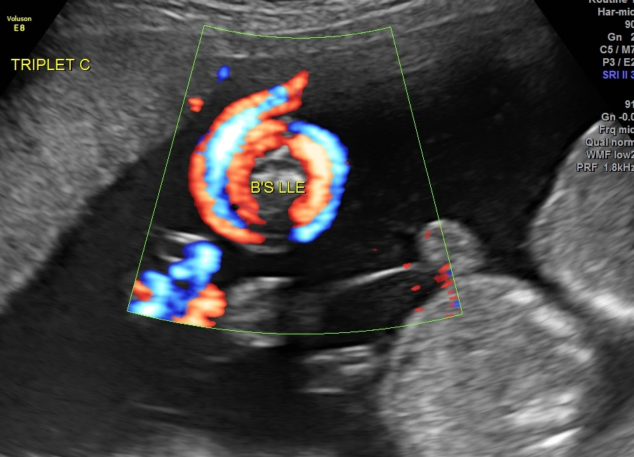

Slide 65
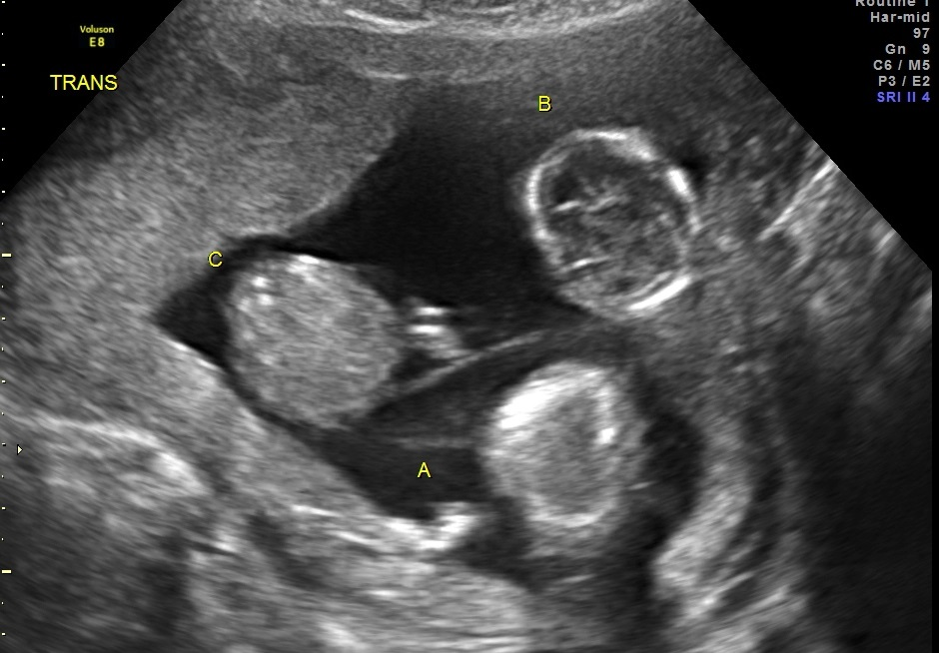

Slide 66
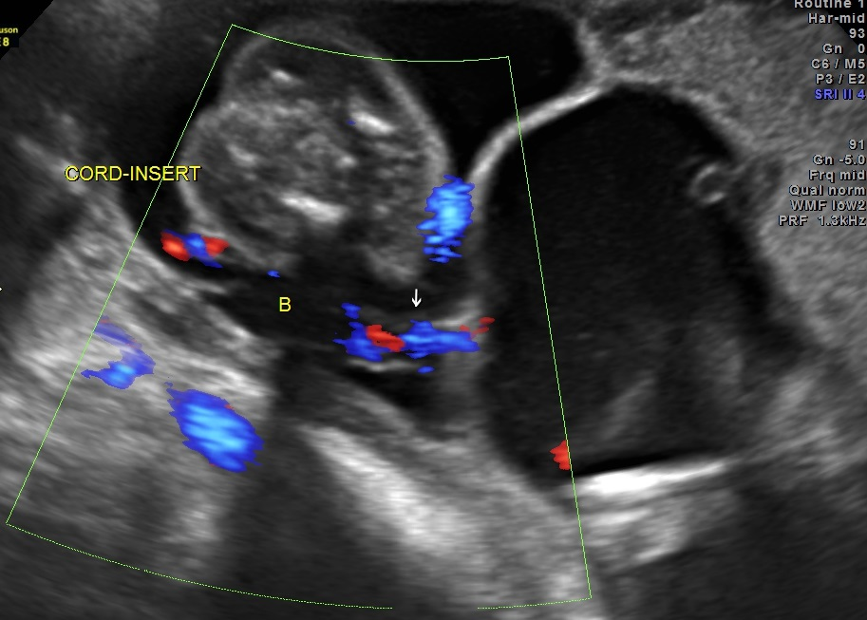

Slide 67
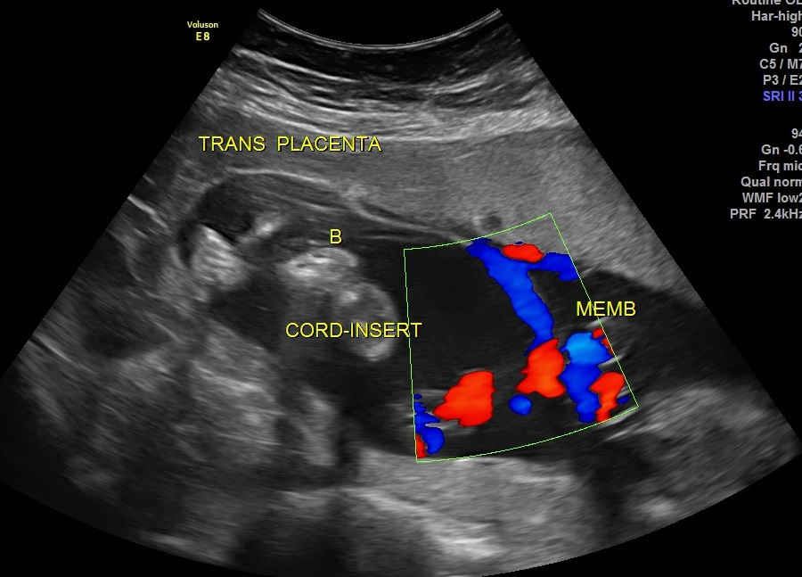

Slide 68
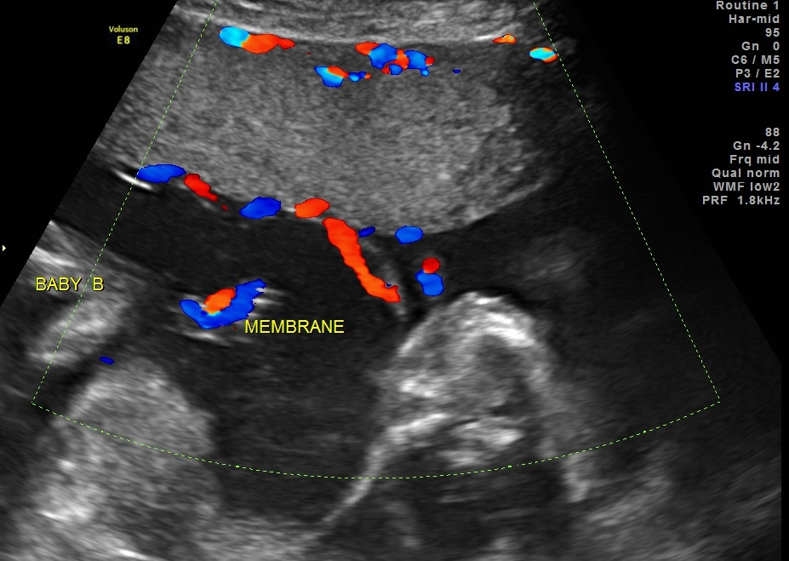

Slide 69
