Slide 1
NAUSEA & VOMITING OF PREGNANCY
Donna D. Johnson, MD

Slide 2
INCIDENCE
Nausea: 50-80%
Vomiting: 15-81%

Slide 3
DEFINITION
PB 189, 2018

Slide 4
HYPEREMESIS GRAVIDARIUM
Complicates 0.3-3% of pregnancy
Persistent vomiting
Evidence of starvation
Large ketonuria
Weight loss (5-10%)
Electrolyte, liver, and thyroid abnormalities
2nd most common cause of hospitalizations

Slide 5
RISK FACTORS
Multiple gestation
Motion sickness
Migraines
Family history
Hyperemesis in a prior pregnancy

Slide 6
MATERNAL OUTCOMES
Death
Wernicke’s encephalopathy
Splenic avulsions
Esophageal rupture
Mallory Weiss tears
Pneumothorax
ATN
PB, 189, 2018

Slide 7
NONPHARMACOLOGICAL TREATMENT
Ginger
Stop prenatal vitamins and give folate
Small frequent meals
Bland food
Sea bands at P6 or Neiguan point

Slide 8
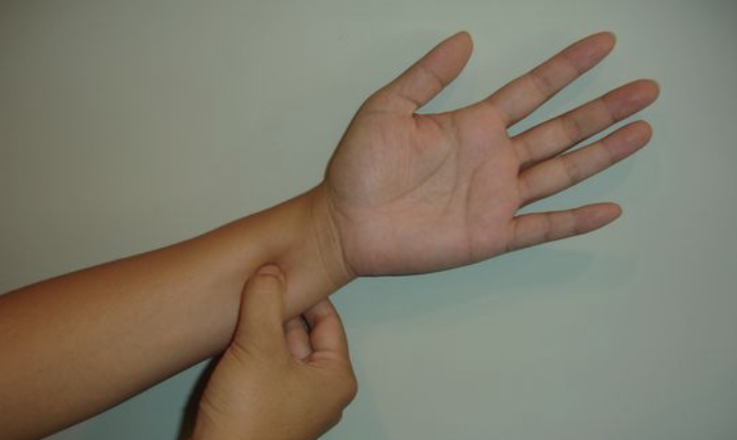
P6 or NEIGUAN POINT

Slide 9
SEA BANDS

Slide 10
NAUSEA & VOMITING
Start early
First line therapy
Vitamin B6 (pyroxidine) 10-25 mg every 6-8 hours
Doxylamine 12.5 mg
Diclegis
Bendectine

Slide 11
NAUSEA & VOMITING
Diphenhydronate (Dramamine)
Diphenhydramine (Benadryl)
Prochlorperazine (Compazine)
Promethazine (Phenergan)

Slide 12
NAUSEA & VOMITING
Metoclopramide (Reglan)
Ondansetron (Zofran)
Trimethobenzamide (Tigan)
Methylprednisilone
16 mg every 8 hours x 3 days
Then taper over 2 weeks
Do not continue >6 weeks
Lorazepam (Ativan)

Slide 13
ONDANSETRON
Anomalies
Use > 10 weeks
PB 189 2018

Slide 14
PUMPS
Zofran
Reglan

Slide 15
ENTERAL vs. PARENTAL
Half of women will not tolerate enteral
50-66% complications with parental feeding
Infection due to PICC line

Slide 16
LABS
Liver enzymes ↑
Amylase ↑
Lipase ↑
Bilirubin ↑
TSH ↓

