Slide 1


Non-Invasive Prenatal Screening (NIPS) Part I
Jessica M. Fairey, MS, CGC
Assistant Director, Clinical Assistant Professor
USC Genetic Counseling Program
Prenatal & Adult Genetic Counseling Services
Prisma Health Department of ObGyn

Slide 2
Conflict of Interest Statement
No conflicts to declare
Discussion of labs is based on personal clinical experience

Slide 3
Learning Objectives
Describe non-invasive prenatal screening (NIPS)
Discuss considerations when selecting a test
Identify helpful language in disclosing results
Recognize limitations of technology

Slide 4
Birth Defect Etiologies
97%
Normal
40–60%
3%
Defects
20–25%
10–15%
8–12%
2–10%
Adapted from Stevenson, RE and Hall, J. Human Malformations and Related Anomalies, 2nd ed. Oxford University Press, Oxford, 2006
Notes:
Of the 3% of babies with congenital anomalies, the vast majority are multifactorial, teratogenic or unknown. Of the genetic causes for birth defects, up to 10% will be due to a single gene disorder and another 15% due to a chromosome abnormality.

Slide 5
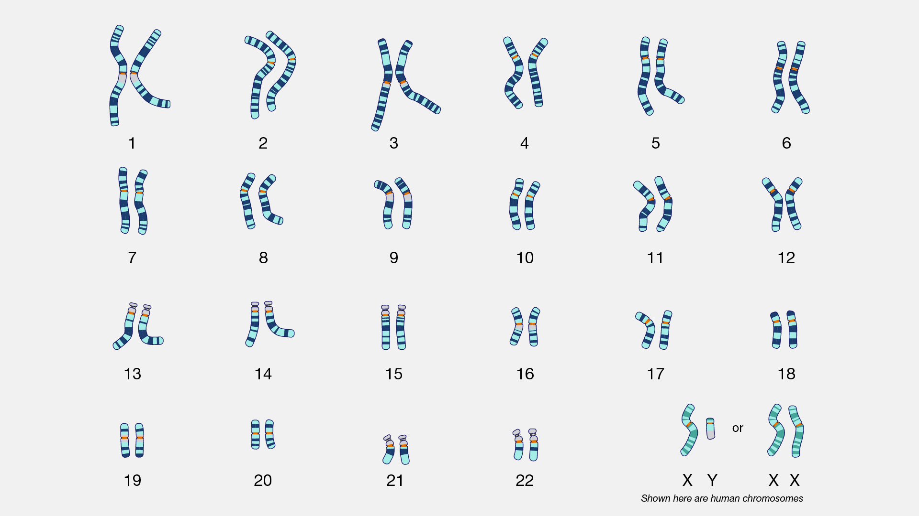
Notes:
Chromosomes 21, 13 and 18 are the chromosomes of interest that have been interrogated thru various screening methods such as the first trimester screen, sequential screen, quad screen, etc. . These common trisomies are the ones that are most likely to be viable and continue in a pregnancy, whereas other chromosome abnormalities often result in early pregnancy loss.
The sex chromosomes have not historically been analyzed thru traditional screening methods until the development of NIPS technology.

Slide 6
History of NIPS ¹
1997
Lo et al. discovered the presence of cell-free fetal DNA in maternal plasma
2008
Lo et al. analyzed cell-free fetal DNA for the detection of trisomy 21 (T21) in the fetus
Subsequent studies established that cell-free fetal DNA was of placental origin
2011
Commercially available in the United States
Today
Cost of NIPT has significantly decreased since its introduction in 2011
Insurance coverage
Financial assistance available
Notes:
Cell free DNA are fragments of DNA released from the nucleus of cells that are undergoing programmed cell death, or apoptosis.
NIPS is now covered by most commercial insurance companies for the average risk patient. Medicaid is accepted by almost all laboratories that perform this screening test and Financial assistance is available and often generous. I work with a population of patients who are uninsured, I am able to offer this testing with the assurance they can quality for these FAP programs which take into account number of household members and monthly income to receive a reduced cost, which is often zero. Happy to provide additional information on this for any of you who are interested.

Slide 7
Noninvasive Prenatal Screening (NIPS)
Most sensitive and specific screening test for common aneuploidies
Lowest false positive rate
Only screening test for fetal sex aneuploidies
Early gestational age allows for optimal patient decision making
Risk assessment – NOT diagnostic
Notes:
The early gestational age at which this test can be performed can provide results as early as 11 weeks.
As a reminder, NIPS is NOT diagnostic as it is not generating a karyotype from fetal cells and any positive result should be confirmed with a prenatal or postnatal diagnosis.

Slide 8
Society Guidelines: NIPS in All Risk Population
ACOG Practice Bulletin 226, May 2016, Reaffirmed 2018
ISPD 2015
ACMG 2016
All pregnant women, regardless of maternal age or aneuploidy risk, should be offered prenatal genetic screening [including NIPS] and diagnostic testing
All pregnant women should be offered cfDNA screening as a primary test
All pregnant women should be informed that NIPS is the most sensitive screening option for the common trisomies 13,18,21 (i.e., Patau, Edwards and Down syndrome)
Notes:
Turning to our guidelines, the consensus among ACOG, the American College of Genetics and Genomics and the International Society for Prenatal Diagnosis is that NIPS be offered to ALL women regardless of aneuploidy risk.

Slide 9
Deletions & Expanded Aneuploidy
Various laboratories offer deletion analysis of relatively well described conditions such as 22q11.2, Prader Willi and Angelman syndromes, Williams syndrome, etc.
Current guidelines do not recommend NIPS deletion screening as sensitivity/specificity/PPV are difficult to estimate.
Chromosomal Microarray (CMA), performed on CVS or amnio sample, can detect deletions and duplications which occur in approximately 1.5% of all pregnancies, regardless of maternal age.
Notes:
In addition to the conditions mentioned, various laboratories offer deletion analysis as well as expanded aneuploidy analysis of all 23 chromosomes.
Microdeletions that are often on these panels include 22q deletion syndrome, Prader Willi, Angelman, Williams, Cri du Chat and Wolf Hirschorn.
Utilizing NIPS for the screening of microdeletions is not recommended because test performance is difficult to estimate.
If you have a patient who is motivated to understand all possible information about their pregnancy, chromosomal microarray analysis performed on a prenatal diagnosis sample would provide the most comprehensive information.

Slide 10
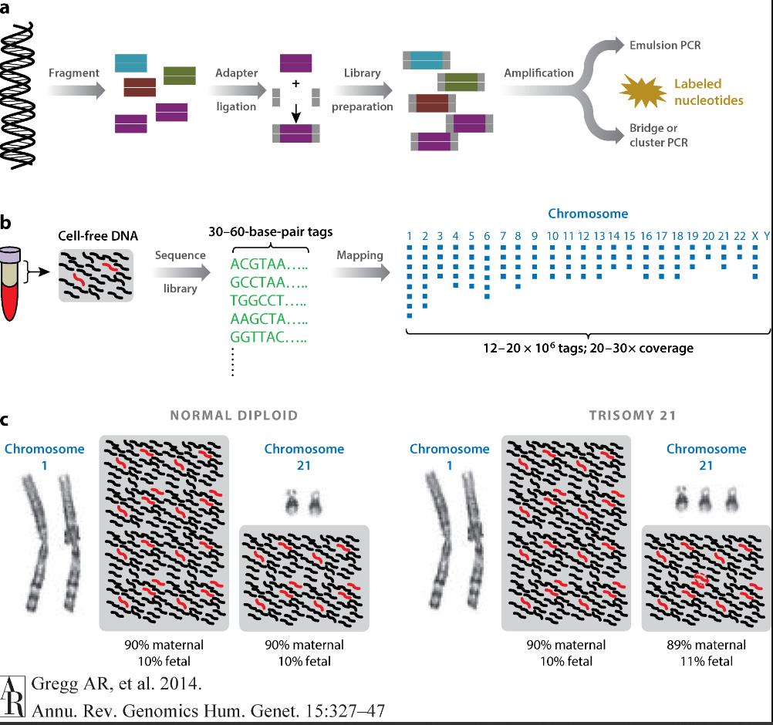
NIPS Technology
Counting Method via Massively Parallel Sequencing
  See Figure
  Most common NIPS platform used
  LabCorp, Otogenetics, Myriad, Invitae, …
SNP based methodology
  Compares SNP sequences from maternal DNA and cell free DNA
  Difference in allele types provide the fetal genotype
  Allows for screening of triploidy
  Determination of zygosity in twin pregnancy
  Natera
Notes:
NIPS utilizes next generation sequencing and employs various methodologies for analysis. All of which rely on the fetal fraction.
Figure A is demonstrating the basic principle of massively parallel sequencing which is taking DNA of interest, breaking it down into smaller fragments, attaching adaptors and building a sequence library.
For cell free DNA MPS, show in Figure B, cell free DNA is already present in smaller fragments and can then be used to build a sequence library with fluorescent tags that map to specific chromosomes. These tags can then be counted. Because fetal DNA and maternal DNA will have different methylation patterns, it is possible to determine the maternal vs the fetal contribution.
In this case, if we look in Figure C, 90% of the cell-free DNA from each chromosome pair is maternal and 10% is fetal. So for all chromosome pairs, each maternal copy contributes 45% and each fetal copy contributes 5% to the total number of sequence tags that originate from those chromosomes. In the case of fetal trisomy 21, there is a small excess of sequences originating from chromosome 21 (∼5%) that come from the third copy of the fetal chromosome 21. A specific cutoff algorithm for the tested chromosome (in this case, chromosome 21) is then used to report whether the number of obtained sequences deviates from the expected number.
Another NIPS methodology utilizes single nucleotide polymorphisms or SNPs. SNPs are the most common type of genetic variation among people, occurring in almost 1 in every 1000 nucleotides.
Natera’s Panorama screen uses SNP based technology while all other NIPS utilize the counting method.

Slide 11
Fetal Fraction (FF) = fetal component of cell-free DNA (cfDNA) in maternal circulation
Fetal cfDNA
------------------------------------
Fetal cfDNA + maternal cfDNA
Maternal cfDNA derived from adipocytes + WBCs
Fetal cfDNA derived from placental trophoblasts
cfDNA fragments are derived from cells undergoing apoptosis in maternal circulation
FF in maternal plasma ranges from 10-15% between 10-20 weeks²
FF is lower at early GA and increases ~ 0.1% weekly from 13-20 weeks ²
Notes:
NIPS technology depends upon the amount of fetal fraction, or the fetal component of the cell free DNA from the maternal circulation. As a reminder, cell free DNA are fragments of DNA released from the nucleus of cells that are undergoing programmed cell death, or apoptosis.
The fetal portion of this cell free DNA is from placental trophoblasts. The maternal portion is from adipocytes or fat cells as well as white blood cells.
The fetal fraction is calculated by determining the proportion of fetal cell free DNA to total cell free DNA.
Studies have consistently shown that fetal fractions tend to average around 10% to 15% in the first trimester and early second trimester.
FF is lower at earlier gestation due to placental size and increases by about 0.1% weekly from 13 to 20 weeks at which time the amount of ff increases by about 1% per week.
The minimum FF threshold for adequate performance varies by assay but is typically between 2% and 4%. With a higher FF, there is greater statistical separation of aneuploid and euploid pregnancies, providing greater confidence in the final result.

Slide 12
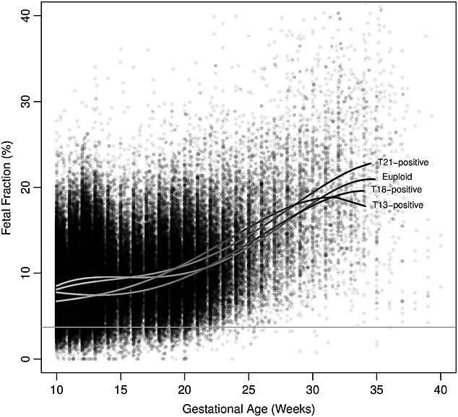
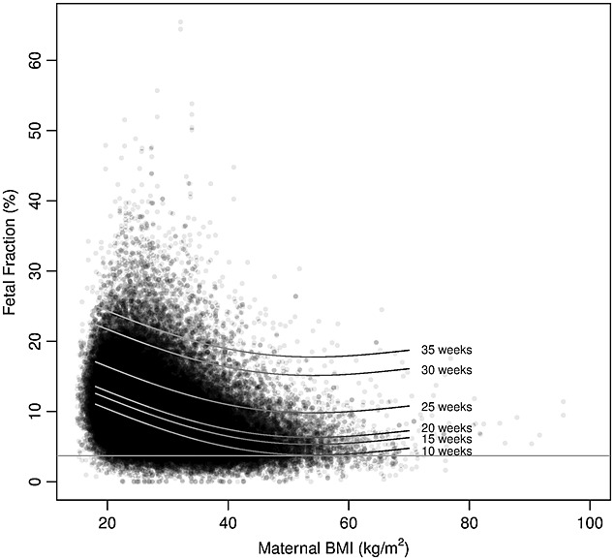
Common Factors Affecting FF
Prenatal Diagnosis, Volume: 35, Issue: 8, Pages: 816-822, First published: 26 May 2015, DOI: (10.1002/pd.4625)
Notes:
A low fetal fraction can result in a “no call” result where analysis is not performed. There are several factors that affect fetal fraction. Gestational age is one already mentioned and has a linear relationship with fetal fraction while maternal BMI has an inverse relationship.
Studies have shown that obese patients have increased apoptosis in their adipose cells, resulting in elevated levels of maternal cfDNA. Remembering our calculation of fetal fraction, if maternal cell free DNA is greatly increased, the proportion of fetal cell free DNA will be diluted, resulting in a decreased fetal fraction.
For my patients whose weight is greater than 270/280 pounds, I have the discussion with them about the possibility of a nonreportable result due to a low fetal fraction.

Slide 13
Additional Factors Affecting FF
Placental Size ³⁻⁶
Maternal Factors
Aneuploidy ^{3,9}
Multiple gestation ^{9,10}
Studies have found an association b/w low FF and placental dysfunction including preclampsia and FGR
FF is decreased in trisomies 13, 18, triploidy
Test failures due to low FF are generally higher in twins
Varies by chorionicity and cfDNA platform
HBB Hemoglobinopathies ^{6,7}
Active autoimmune disease
Anticoagulation Therapy ^{10, 11}
Notes:
There are additional factors that can affect fetal fraction including the size of the placenta. Recent studies have shown an association b/c low fetal fraction and placental dysfunction including preclampsia and fetal growth restriction.
Maternal factors play a role including carrier and disease status as well as certain medications.
Women with an HBB hemoglobinopathy, which would include sickle cell disease, beta thalassemia or hemoglobin C disease as well as carriers for these conditions are more likely to have a lower fetal fraction and higher no call rate. It is speculated that there is increased maternal cell necrosis which again dilutes the fetal cell free DNA.
Women treated with LMWH tend to have lower fetal fractions and higher no call rates due to reduction of placental apoptosis. Heparin has been demonstrated to reduce trophoblast apoptosis and enhance trophoblast survival.
Fetal fraction has been consistently lower in pregnancies affected with aneuploidy. ******** In the group with no results (n=488) on cfDNA testing, there were 13 aneuploidies: 3 with trisomy 21, 1 with trisomy 18, 2 with trisomy 13, 4 with triploidy, 1 with trisomy 16 mosaic, 1 with deletion 11p, and 1 with a structurally abnormal chromosome. The prevalence of aneuploidy in this group (1 in 38 [2.7%]) is higher than the prevalence of 1 in 236 (0.4%) in the overall cohort (P<0.001). Specifically, for women with a fetal fraction of less than 4%, 9 in 192 (4.7%) had aneuploidy. Among the women with the six common aneuploidies for which there was no result on cfDNA testing, each case was detected on standard screening, with risks ranging from 1 in 26 to 1 in 2.
Both dichorionic and monochorionic pregnancies, have lower “per fetus" FFs than singletons. However, total fetal cfDNA would only be relevant in monochorionic twins because they are almost always monozygotic with expected concordance.

Slide 14
Considerations for NIPS selection
Maternal history
Patient weight
Medications
Medical condition(s)
Pregnancy history
Multiples or vanished twin
Recurrent first trimester loss
Family history
Prior affected child
Carrier test results
Insurance
Consanguinity
Notes:
Testing technologies each have their own benefits and limitations. Selection of an NIPS depends upon clinical scenario.
If patient is >250 lbs, I typically will send to a lab that utilizes the counting method where the threshold for fetal fraction is lower than the SNP based method.
If a patient is on lovenox, counsel her of the

Slide 15
Pre-Test Counseling
Possibility of THREE test results
  Low Risk, High Risk, Uninformative
Non-Diagnostic
Allows for fetal sex prediction based on presence/absence of Y chromosome
Positive screening results are recommended to have diagnostic follow up
  Prenatal diagnosis
  Maternal karyotype

Slide 16
Post-Test Counseling
Limited scope of screening test
Discuss screening results in terms of Residual Risk and Positive Predictive Value (PPV)
Offer MSAFP-only after 15w
Interpretation should always be in the context of clinical findings
Results may represent chromosomal changes from…
  Mother
  Placenta
  Fetal mosaicism
  Vanished twin
Notes:
When returning results to your patients, there are several concepts to keep in mind as well as to highlight:
Reminding a patient that this screening has a limited scope and that a negative result, while reassuring, is not diagnostic.
PPV should be disclosed for any positive result
Anyone receiving NIPS should also be offered MSAFP ONLY analysis in the second trimester.
All results should be interpreted in the context of clinical findings. For example if NIPT is negative but multiple abnormalities are seen on US, patient may still need invasive testing/microarray/etc/possible molecualar analysis if suspicious for a single gene disorder.
High Risk results from NIPS may represent chromosomal changes from any of the following:
The mother herself may be mosaic for a sex chromosome abnormality
The result may be indicative of confined placental mosaicism with a normal fetus
The result may represent fetal mosaicism in which a full trisomy is not present
Or in the case of a vanished twin, the result may represent the non-viable conception rather than the viable fetus.
In order to discern these possibilities, prenatal diagnosis is recommended. In some cases, we also offer blood chromosome analysis to the mother if we suspect she may be mosaic.

Slide 17
Low Risk Result
A low risk or negative result greatly reduces the chances for these chromosome conditions in your pregnancy but does not eliminate them.
This screening test evaluated 5 chromosomes [13,18,21,X and Y]. For information on the other 18 chromosomes, prenatal diagnosis remains an option.
Notes:
Here is some suggested language for returning a low risk or negative result.
READ SLIDE
I find that patients feel very reassured by this information and generally do not request prenatal diagnosis at this juncture.
I often get the follow up question: So this means that everything is ok with the baby?
My response: This is certainly very reassuring in regards to the conditions looked for. Remember you will have an anatomy scan around 20 weeks. If there is anything of concern, additional testing via prenatal diagnosis remains an available option.

Slide 18
High Risk Result
Your NIPS result shows an increased risk for______ in your pregnancy. This is not a diagnosis.
The chance that the baby is truly affected is ____% (calculate PPV), with ____% chance baby does not have this condition.
The only way we can be sure is by prenatal diagnosis or testing after birth
  Available options (CVS vs Amniocentesis)
Next Steps:
  Genetic Counseling/MFM Referral to review these results and help you decide next steps
  Targeted ultrasound
Notes:
Here is some suggested language for disclosing a positive result to a patient.
READ SLIDES
Any positive NIPS result is typically a concerning result based on the fact the screening test is identifying extra chromosomal material whether is be from the baby, placenta or mom.

Slide 19
Positive Predictive Value (PPV)
For a test with known sensitivity and specificity, you can project the PPV for a specific population (with a known or estimated prevalence) using maternal age as apriori risk
Contrast the PPV of trisomy 21 at 16 weeks by maternal age
23 @ EDD PPV 50%
33 @ EDD PPV 71%
43 @ EDD PPV 97%
Consider calculating PPV on your patient’s results integrating specificity and sensitivity reported on the lab report and using a published calculator such as:
https://www.perinatalquality.org/Vendors/NSGC/NIPT/
Chance that the fetus is truly affected given a positive result
Notes:
For high risk or positive results, a positive predictive value should be provided to patients to help them understand the chance the fetus is truly affected.
PPV is a calculation that is possible when we have the performance characteristics of a given screening test and when we can estimate a prevalence for the condition that is screened for.
In this example, we can determine the PPV for a screen positive DS result using maternal age as the apriori risk and an incidence rate of 1 in 700 for trisomy 21 in the population.
In this example, you can appreciate the increasing PPV with increasing maternal age. For someone who is 23 years old with a screen positive NIPS for Down syndrome, the chance the fetus is truly affected is 50%. If this patient were 43 years old, the chance her baby is truly affected is 97%.
PPV can be a really powerful tool for helping patients with decision making regarding prenatal or postnatal diagnosis.
ACMG has recommended that all NIPS results include PPV on the reports. Not all do, so I would encourage each of you to become familiar with a published PPV calculator.

Slide 20
Beware the Uninformative Result!
Low Fetal Fraction
  Redraw?
Atypical Finding
  May suggest chromosome abnormality outside scope of NIPS
  May suggest maternal chromosome aberration
Consider calling lab for additional information
Refer to genetic counseling/MFM for consideration of diagnostic testing and possible maternal workup
Notes:
Uninformative Results or “No Call” Results largely fall into two categories
Low Fetal Fraction. Some labs will suggest a redraw for the first failed attempt. Use your clinical judgement for whether a redraw is appropriate.
If a patient has a high BMI, then a redraw is appropriate and waiting a couple of weeks may allow time for the fetal fraction to increase. In circumstances where there are two failed NIPS in an obese patient, prenatal diagnosis should be considered and possibly a traditional screening methods if the patient is adverse to a diagnostic test.
If a patient does not have a high BMI and does not have any maternal conditions, and especially if a patient is advanced maternal age, offering prenatal diagnosis as the next step should be considered because we know those low fetal fractions are associated with a fetal aneuploidy risk. Ultimately up to the patient.
Atypical Finding – this is a result that usually is able to report on some of the aneuploidies but will say “Atypical Finding associated with chromosome 21” for example.
These findings are highly suspicious for an abnormality involving either the fetus, mother or both.
It may be that a chromosome abnormality is suspected that is outside the scope of the NIPS. Calling the laboratory is usually helpful because they can provide additional information from raw data, pointing you in a direction (maternal vs fetal)
Referral to genetic counseling is recommended for any atypical finding and should be considered for any low fetal fraction, especially in the absence of maternal condition or high BMI.

Slide 21
If ultrasound findings corroborate the NIPS result, is prenatal or postnatal dx still necessary?

Slide 22
Yes!
Confirmation of diagnosis and cytogenetic nature of test result
Chromosomal rearrangement vs trisomy vs mosaicism
Allows for determination of prognosis/management
Allows for estimation of recurrence risk in subsequent pregnancies
May inform family history
Notes:
If ultrasound findings corroborate the positive NIPS result, is a diagnostic test needed?
Confirming the diagnosis and the cytogenetic nature of the test result. Remember that NIPS is only identifying the presence of additional chromosomal material but does not tell us where or even how much is present. A karyotype will differentiate between a chromosomal rearrangement such as a translocation or inversion, a trisomy, a copy number variant such as a deletion or duplication and can detect mosaicism.
If pregnancy is affected with any rearrangement or copy number variant, we would then need parental testing to determine if parent is a carrier. If so, risk of recurrence would be increased based upon the etiology. In this situation, a patient could then consider IVF with preimplantation genetic testing for a future testing. This information would also inform other family members and their reproductive decision making.

Slide 23
References
Ravitsky, V., Roy, M., Haidar, H., Henneman, L., Marshall, J., Newson, A.J., Ngan, O., Nov-Klaiman, T. The Emergence and Global Spread of Noninvasive Prenatal Testing 2021 Oct. Annu. Rev. Genom. Hum. Genet. doi: 10.1146/annurev-genom-083118-015053
Kinnings, S. L., Geis, J. A., Almasri, E., Wang, H., Guan, X., McCullough, R. M., Bombard, A. T., Saldivar, J.-S., Oeth, P., and Deciu, C. (2015) Factors affecting levels of circulating cell-free fetal DNA in maternal plasma and their implications for noninvasive prenatal testing. Prenat Diagn, 35: 816– 822. doi: 10.1002/pd.4625.
Rolnik, D.L., da Silva Costa, F., Lee, T.J., Schmid, M. and McLennan, A.C. (2018), Association between fetal fraction on cell-free DNA testing and first-trimester markers for pre-eclampsia. Ultrasound Obstet Gynecol, 52: 722-727. https://doi.org/10.1002/uog.18993
Clapp MA, Berry M, Shook LL, Roberts PS, Goldfarb IT, Bernstein SN. Low Fetal Fraction and Birth Weight in Women with Negative First-Trimester Cell-Free DNA Screening. Am J Perinatol. 2020 Jan;37(1):86-91. doi: 10.1055/s-0039-1700860. Epub 2019 Nov 18. PMID: 31739367.
Gerson KD, Truong S, Haviland MJ, O'Brien BM, Hacker MR, Spiel MH. Low fetal fraction of cell-free DNA predicts placental dysfunction and hypertensive disease in pregnancy. Pregnancy Hypertens. 2019 Apr;16:148-153. doi: 10.1016/j.preghy.2019.04.002. Epub 2019 Apr 13. PMID: 31056151.
Morano D, Rossi S, Lapucci C, Pittalis MC, Farina A. Cell-Free DNA (cfDNA) Fetal Fraction in Early- and Late-Onset Fetal Growth Restriction. Mol Diagn Ther. 2018 Oct;22(5):613-619. doi: 10.1007/s40291-018-0353-9. PMID: 30056492.
Putra M, Idler J, Patek K, Contos G, Walker C, Olson D, Hicks MA, Chaperon J, Korzeniewski SJ, Patwardhan SC, Sokol RJ. The association of HBB-related significant hemoglobinopathies and low fetal fraction on noninvasive prenatal screening for fetal aneuploidy. J Matern Fetal Neonatal Med. 2021 Nov;34(22):3657-3661. doi: 10.1080/14767058.2019.1689558. Epub 2019 Nov 17. PMID: 31736384.
Putra M, Kaseniit KE, Hicks MA, Muzzey D, Hackney D. The impact of HBB-related hemoglobinopathies carrier status on fetal fraction in noninvasive prenatal screening. Prenat Diagn. 2022 Apr;42(4):524-529. doi: 10.1002/pd.6127. Epub 2022 Mar 23. PMID: 35224763; PMCID: PMC9311838.
Hui, L, Bianchi, DW. Fetal fraction and noninvasive prenatal testing: What clinicians need to know. Prenatal Diagnosis. 2020; 40: 155– 163. https://doi.org/10.1002/pd.5620
Bevilacqua, E., Chen, K., Wang, Y., Doshi, J., White, K., de Marchin, J., Conotte, S., Jani, J.C. and Schmid, M. (2020), Cell-free DNA analysis after reduction in multifetal pregnancy. Ultrasound Obstet Gynecol, 55: 132-133. https://doi.org/10.1002/uog.20366

Slide 24
References Cont.
Burns W, Koelper N, Barberio A, Deagostino-Kelly M, Mennuti M, Sammel MD, Dugoff L. The association between anticoagulation therapy, maternal characteristics, and a failed cfDNA test due to a low fetal fraction. Prenat Diagn. 2017 Nov;37(11):1125-1129. doi: 10.1002/pd.5152. Epub 2017 Oct 6. PMID: 28881030.
Gil MM, Quezada MS, Revello R, Akolekar R, Nicolaides KH. Analysis of cell-free DNA in maternal blood in screening for fetal aneuploidies: updated meta-analysis. Ultrasound Obstet Gynecol. 2015;45:249-266.
Gregg, A., Van den Veyver, I., Gross, S., Madankumar, R., Rink, C., Norton, M. (2014), Non Invasive Prenatal Screening by Next Generation Sequencing. Annual Review of Genomics and Human Genetics, 15:1, 327-347.
Rose, Nancy C. MD; Kaimal, Anjali J. MD, MAS; Dugoff, Lorraine MD; Norton, Mary E. MD; American College of Obstetricians and Gynecologists’ Committee on Practice Bulletins—Obstetrics Committee on Genetics Society for Maternal-Fetal Medicine. Screening for Fetal Chromosomal Abnormalities: ACOG Practice Bulletin, Number 226. Obstetrics & Gynecology: October 2020 - Volume 136 - Issue 4 - p e48-e69 doi: 10.1097/AOG.0000000000004084
Benn P, Borrell A, Chiu RWK, et al. Position statement from the Chromosome Abnormality Screening Committee on behalf of the Board of the International Society for Prenatal Diagnosis. Prenat Diagn. 2015;35(8):725-734. doi:10.1002/pd.4608.
Anthony R. Gregg, Brian G. Skotko, Judith L. Benkendorf, Kristin G. Monaghan, Komal Bajaj, Robert G. Best, Susan Klugman, Michael S. Watson. Noninvasive prenatal screening for fetal aneuploidy, 2016 update: a position statement of the American College of Medical Genetics and Genomics. Genetics in Medicine, 2016; DOI: 10.1038/gim.2016.97
Gregg AR, Aarabi M, Klugman S, Leach NT, Bashford MT, Goldwaser T, Chen E, Sparks TN, Reddi HV, Rajkovic A, Dungan JS; ACMG Professional Practice and Guidelines Committee. Screening for autosomal recessive and X-linked conditions during pregnancy and preconception: a practice resource of the American College of Medical Genetics and Genomics (ACMG). Genet Med. 2021 Oct;23(10):1793-1806.
Carrier screening in the age of genomic medicine. Committee Opinion No. 690. American College of Obstetricians and Gynecologists. Obstet Gynecol 2017;129:e35–40.
Norton ME, Jacobsson B, Swamy GK, Laurent LC, Ranzini AC, Brar H, Tomlinson MW, Pereira L, Spitz JL, Hollemon D, Cuckle H, Musci TJ, Wapner RJ. Cell-free DNA analysis for noninvasive examination of trisomy. N Engl J Med. 2015 Apr 23;372(17):1589-97. doi: 10.1056/NEJMoa1407349. Epub 2015 Apr 1. PMID: 25830321.

Slide 25

Case Presentations
Notes:
I have two cases to demonstrate the complexity of NIPS results as well as the clinical utility for patient management and referral.

Slide 26
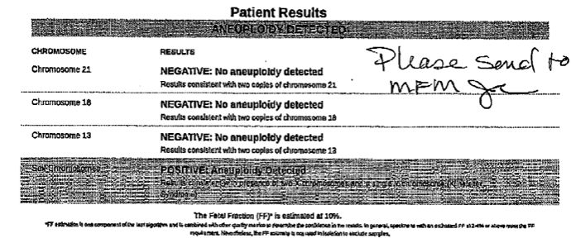
24 yo G1 Hispanic Female: NIPS Result
XXY (Klinefelter Syndrome)
Notes:
The first is a 24 year old G1 whose NIPS result was positive for XXY or Klinefelter syndrome.
Initial plan was to offer the patient prenatal diagnosis for XXY. Because she was not advanced maternal age, did consider the possibility for a confined placental mosaicism rather than an affected fetus.

Slide 27
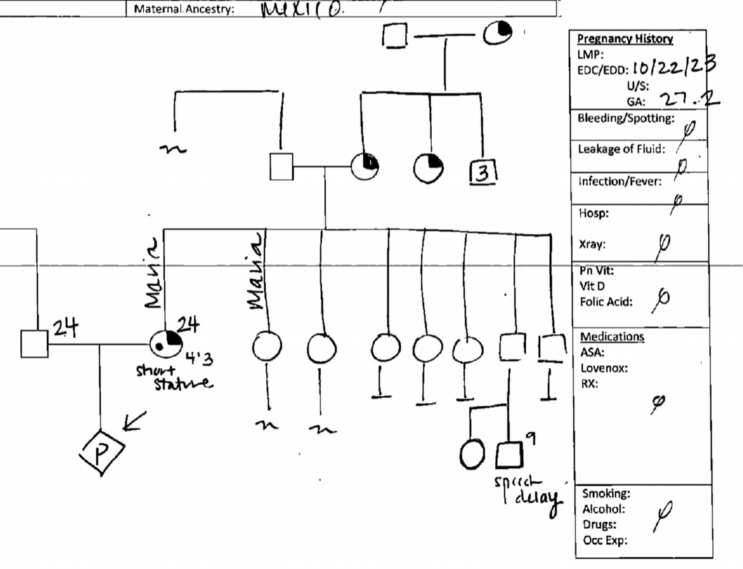
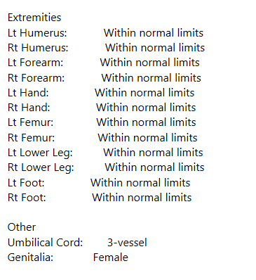
Notes:
Genetics consultation took place after ultrasound, which noted normal female genitalia. No ambiguity. This did not fit with identification of the Y chromosome, prompting a thorough family history to screen for possible translocation.
Patient was present with her full sister – they did not share any resemblance. The patient was remarkably 4’3” and her sister disclosed that the patient did not look like any of her other siblings. The family history was also notable for the number of females. Due to low health literacy and the language barrier, the patient was not able to provide a detailed family history. The patient reported she looked similar in features and in stature to her mother, maternal aunt and maternal grandmother. I would describe the patient as having coarse facial features. It was hard to discern her cognitive ability due to the low health literacy and the language barrier. She did not endorse any learning disabilities in school.
Based on the patient’s personal and family history along with normal female genitalia on ultrasound, the patient was offered a maternal karyotype to rule out suspicion of an X;Y translocation.

Slide 28
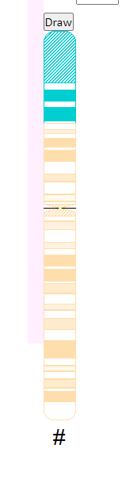
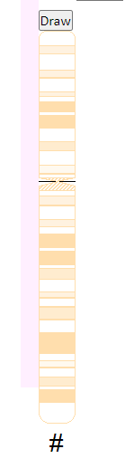
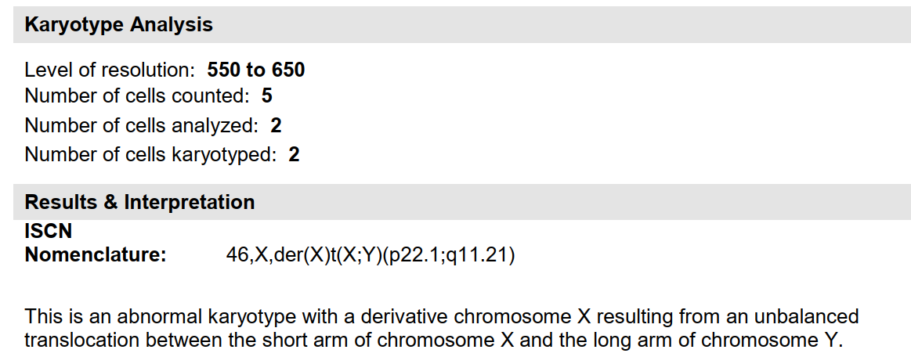
Maternal Karyotype
Yq11.21
Deletion of SHOX gene
Notes:
Blood chromosome analysis on the patient revealed an unbalanced translocation b/w the short arm of the X chromosome, p22.1, and the long arm of the Y chromosome, q11.21.
Testicular development in the patient was not present because the translocated Y segment does not contain SRY, or the sex determining region that drives testicular development. This gene is located on the short arm or P arm of the Y chromosome.
Translocated X segment contains SHOX, short stature homeobox gene, that is also deleted in the Turner syndrome phenotype, contributing to the patient’s phenotype. Due to X inactivation, the females in the family had intact fertility.
Likely male lethal if the patient were to pass on the derivative X chromosome to a son, as that conceptus would have a large deletion on the short arm of the X chromosome.

Slide 29
Post-Test Counseling
Patient has an X;Y translocation
  referral to endocrinology and
  informing GYN management
Current pregnancy has 50% chance of possessing the derivative X chromosome
  Due to X inactivation, phenotype is variable
  Postnatal karyotype recommended
Informs recurrence risk for future pregnancies
  50% chance of passing on derivative X
  Likely male lethal resulting in first trimester SAB
Allows for family testing

Slide 30
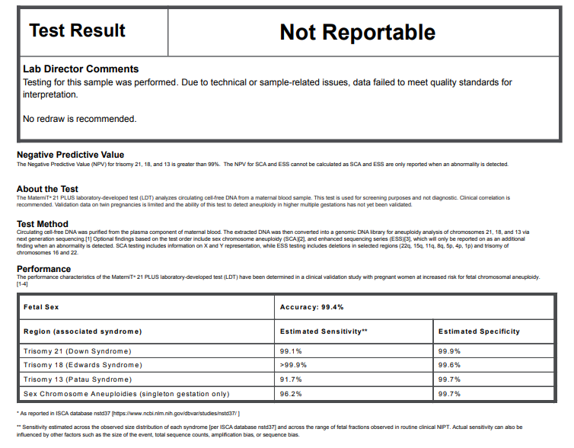
32 yo G3P2002: Nonreportable NIPS x 2
Notes:
The second case is a G3P2 with two nonreportable results.
Called the lab genetic counselor to discuss the raw data. She was able to tell me that the data involving the 13th chromosome was not unequivocally positive or unequivocally negative therefore they could not return a confident result.
This information was disclosed to the patient and she was counseled of a potential low level mosaicism in the fetus or a mosaicism confined to the placenta.
Patient elected chorionic villus sampling, understanding the possibility of a mosaic result which would require follow up amniocentesis.

Slide 31
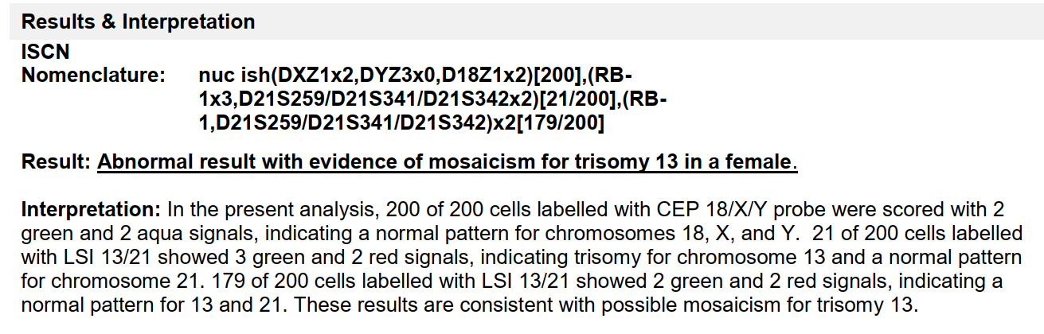
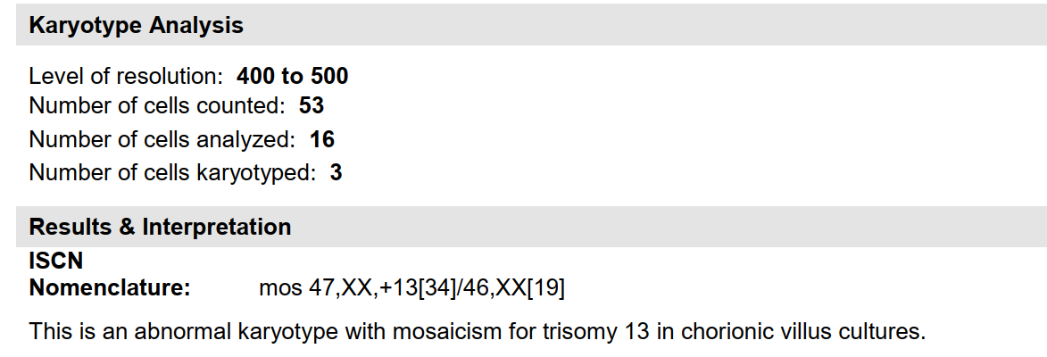
Mosaic Trisomy 13 from CVS
Notes:
FISH analysis was performed on the CVS sample and revealed 21 cells with three signals for chromosome 13 and 179 cells with two signals for chromosome 13. This is consistent with a low level trisomy 13 mosaicism. Final karyotype was consistent with FISH results indicating trisomy 13 mosaicism in villi cultures.
Because of the placental origin of the tissue, we were still not able to provide the patient a fetal diagnosis. She then elected to proceed with amniocentesis at 16 weeks.

Slide 32
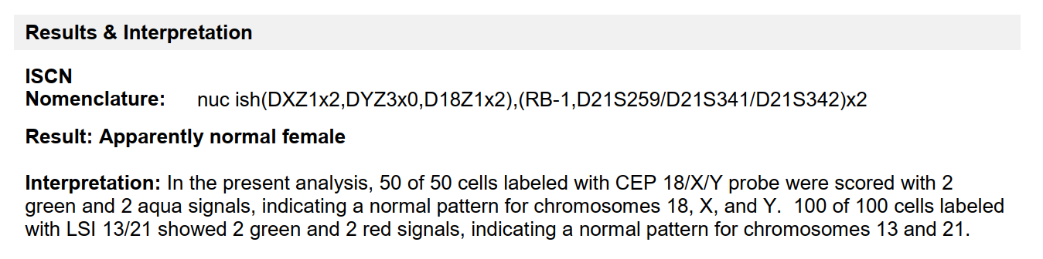
46,XX from Amniocytes
Notes:
FISH analysis on amniocentesis revealed normal female signals and final karyotype was consistent with 46,XX.

Slide 33
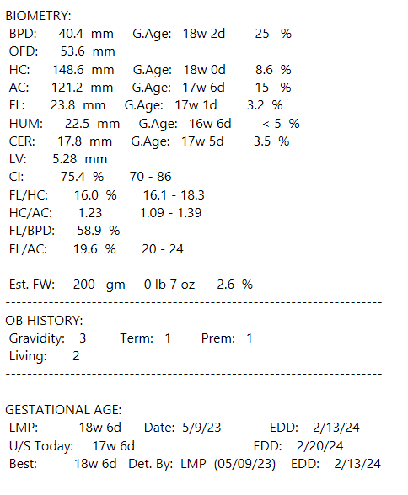
Post-Test Counseling
Trisomy 13 CPM
Increased risk for placental insufficiency and fetal growth restriction
Follow-up growth scans
NICU consult
Future antenatal testing
Notes:
With the mosaic CVS result and normal amnio result, we concluded the noninformative NIPS was suggesting a low level mosaicism as demonstrated through prenatal diagnosis. Based on this CPM we were able to counsel the patient on the increased risk for FGR due to an abnormally functioning placenta. This was appreciated on recent 18 week scan where fetal growth was 2nd %tile. Patient was then counseled by our MFM on the need for growth scans, possible future antenatal testing and NICU consult as well as the risk for fetal demise or preterm delivery.

Slide 34
Questions?
Up Next… NIPS Part II
Utilizing cffDNA technology for expanded aneuploidy screening and single gene disorders
Jessica.Fairey@uscmed.sc.edu
Office: 803-545-5746

