Slide 1
Obesity in Pregnancy
Berry Campbell, MD

Slide 2
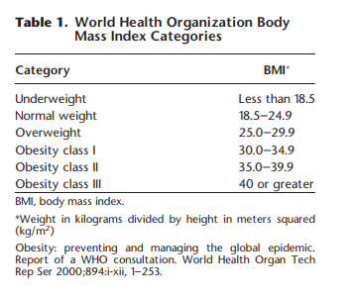
Obesity
ACOG Practice Bulletin #230, June 2021

Slide 3
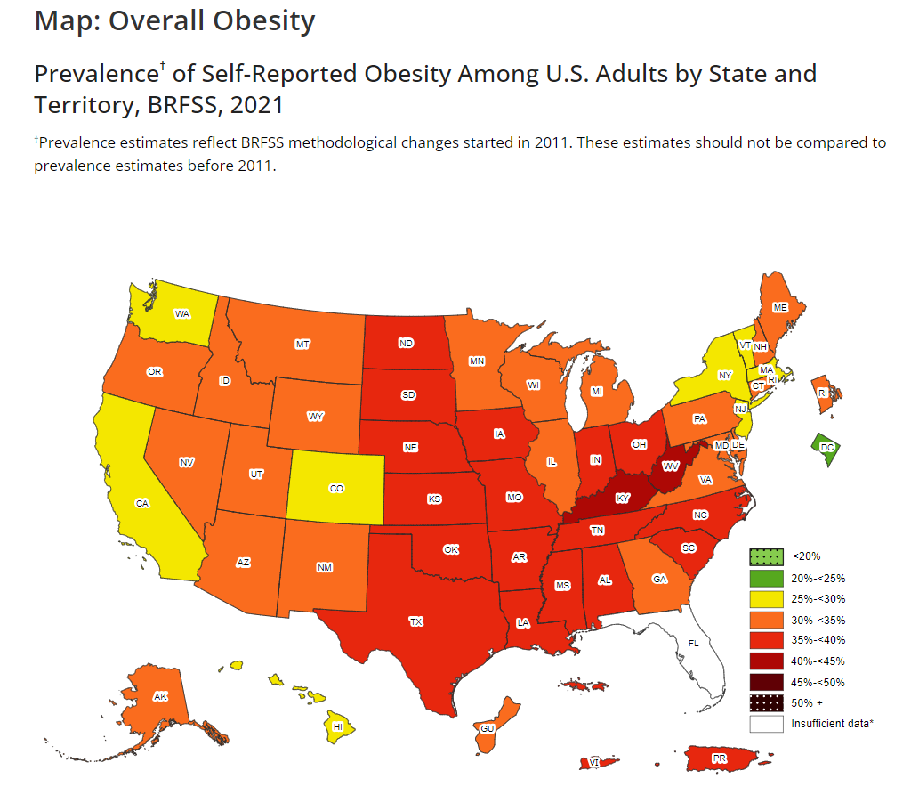
CDC: Adult Obesity Prevalence Maps|Overweight & Obesity
Notes:
South Carolina – Prevalence – 36.1; 95% CI – (34.6, 37.5)

Slide 4
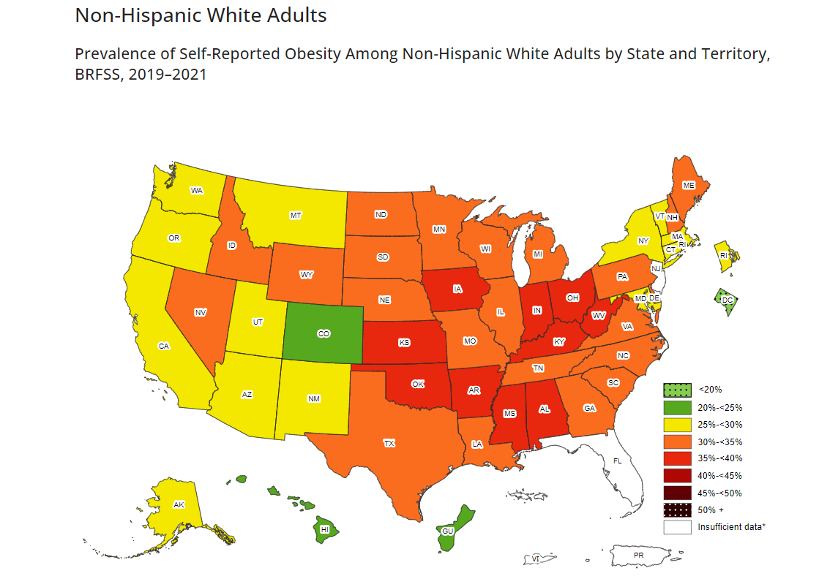
CDC: Adult Obesity Prevalence Maps|Overweight & Obesity
Notes:
South Carolina – Prevalence 32.7; 95% CI – (31.6, 33.8)

Slide 5
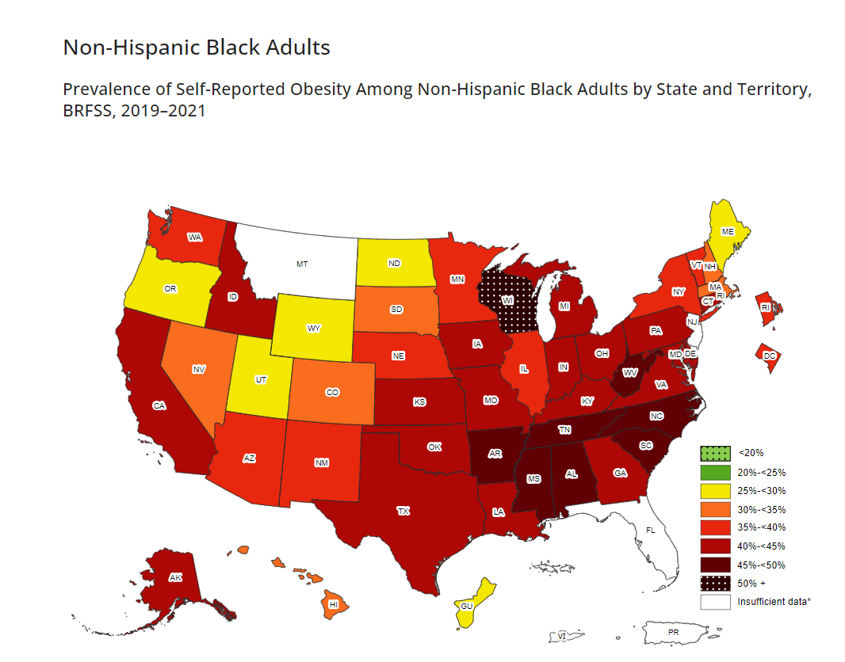
CDC: Adult Obesity Prevalence Maps|Overweight & Obesity
Notes:
South Carolina – Prevalence 45.2, 95% CI – (42.9, 47.6)

Slide 6
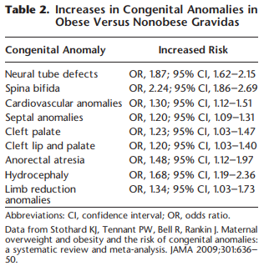
Obesity in pregnancy
Significance
Increased risk Sab (OR 1.2), recurrent loss (OR 3.5)
Increased risk birth defects
ACOG Practice Bulletin #230, June 2021

Slide 7
Obesity in pregnancy
Significance- Antepartum
Stillbirth
GDM
HTN/preeclampsia
Cardiac dysfunction
Obstructive sleep apnea

Slide 8
Obesity in pregnancy
Stillbirth
BMI 30-34.9—Hazard ratio 1.71
BMI 35-39.9—HR 2.0
BMI > 40—HR 2.48
BMI > 50—HR 3.16
Black > white (1.9 vs 1.4 HR)
Am J Obstet Gynecol 2014;201:457. e1-e9 (Level II-2)

Slide 9
Obesity in pregnancy
Stillbirth
Risk increases with advancing gestational age
BMI > 40 and > 50: 30-33 weeks-1.4 and 1.7 HR
37-39 weeks-3.2 and 3.0 HR
40-42 weeks-3.3 and 9.0 HR
Am J Obstet Gynecol 2014;201:457. e1-e9 (Level II-2)

Slide 10
Obesity in pregnancy
Significance-intrapartum
Increased risk:
-- CS
--Failed TOL
--Metritis
--Wound complications
--VTE
TOLAC-2 fold increase morbidity
Obstet Gynecol 2006;108:125-33 (Level II-2)
Notes:
TOLAC in obesity associated with 2 fold increased risk maternal morbidity and 5 fold increase risk of neonatal injury.

Slide 11
Obesity in pregnancy
Significance-Postpartum
Excess weight gain (IOM guidelines) in 46% obese pregnant patients
↑ weight retention (average in US 15lb/pregnancy)
↑ risk metabolic dysfunction, pre-pregnancy obesity
Notes:
Pregravid obesity associated with early termination of BF, pp anemia and depression.

Slide 12
Obesity in pregnancy
Uncomfortable discussion
Significant increased risk for maternal mortality (as well as perinatal)
Etiology frequently associated with obesity related co-morbidities
Suggest maternal echo and cardiology assessment if abnormal
Frequently has systolic dysfunction (preserved LVEF)
REVIEW RVSP—SHOULD BE < 30!

Slide 13
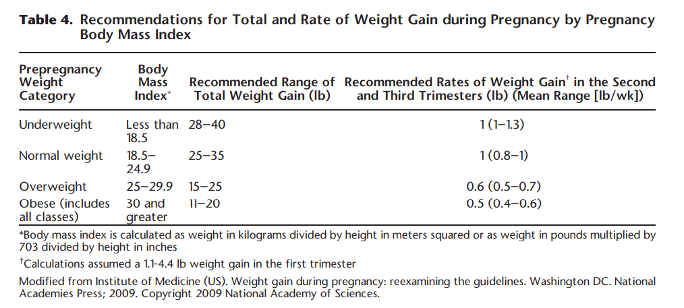
IOM Weight Gain Guidelines
ACOG Practice Bulletin #230, June 2021

Slide 14
Obesity in pregnancy
Significance-Fetal/Childhood
Macrosomia
FGR
Long-term metabolic syndrome, childhood obesity
↑ autism spectrum DO, developmental delay, attention deficit/hyperactivity DO
Pediatrics 2005;115:e290-6 (Level II-3)
Am J Clin Nutr 2009;90:1303-13 (Level II-3)
Pediatrics 2012;129:e1121-8 (Level II-2)
Notes:
Impossible to separate different prenatal and postnatal influences on these long-term complications—diet, SE status, activity, and behavior abnormalities make generalization impossible

Slide 15
Obesity in pregnancy
Significance-Logistics
Birthing beds
Monitoring equipment
BP cuffs, compression devices
OR tables
Staffing
Patient positioning concerns; physician accessibility to surgical site
Notes:
One thing often overlooked is the impact that obesity has on care for the paient.
1-must have proper quipment. Most OR table accomadate 400-450 lbs. May put 2 tables together.
2- staff MUST be allowed to add people to help positioning, etc.
3- physician, nurse injury, accessibility to sugery site
4-difficult monitory fetus and risk poor outcome
5- tough delivery
6- incision type, etc

Slide 16
Obesity in pregnancy
Significance-preconception care
Motivational interview methods promote wt loss, diet modification and exercise
Normal BMI is the goal BUT 5-7% wt loss significantly improves health
Medications may be used pre-pregnancy
Diet, exercise and behavior modification are the basics
Notes:
Motivation interviewingtechniques involve individualized pt-cetered approach toward exploring and resolving ambivalence. Helps with moving through the stages of dealing wit unhealthy behavior.
Meds—care using close to pregnancy—anorectics
Some evidence of weight control in pregnancy with diet, exercise and glycemic index low diet lessens BWt by 15%

Slide 17
Obesity in pregnancy
Significance-NIPS results
Increased incidence of low fetal fraction (10% vs <1-2%)
Wt generally agreed at higher risk is >250 lbs
(I use 275)
Panorama (Natera) has higher failure rate, Maternity 21 better (Lab Corp)
Repeat test is reasonable BUT SUGGEST USING ANOTHER TESTING PLATFORM FOR REPEAT!

Slide 18
Obesity in pregnancy
Ante care
Targeted ultrasound
--detection anomalies significantly reduced with increasing BMI
--counsel re: limitations in detection
Cell free DNA higher no call result
Early assessment for carbohydrate intolerance (1st visit)
Assess OSA by sleep medicine specialist
--increased risk for preeclampsia (OR 2.5), cardiomyopathy
(OR 9.0), PE (OR 4.5) and in-hospital mortality (OR 5.3)
BPP/NST from 34 weeks (BMI ≥ 40) or from 37 weeks (BMI 35-39.9).
Notes:
Reduced detection by as much as 20% in superobese women
Assess DM—I use A1C early, the GTT if abnl or at 24-28 weeks.

Slide 19
Obesity in pregnancy
Significance-intrapartum care
Longer labor, higher CS risk
TOLAC is safe: weigh benefits/risks
Higher risk of pp hemorrhage
Notes:
TOLAC: entire clinical picture. Obese and unable to stat a person may need discussion

Slide 20
Obesity in pregnancy
Significance: operative/post-operative
Anesthesia: consider pre-delivery consult
--high-regional and hypoxia, hypotension, FHR decelerations
--failure of regional higher
--difficult intubation, equipment
Antibiotic prophylaxis
--alter dose (cefazolin 2 g unless ≥ 120 kg or 265 lbs and increase to 3g)
Notes:
Plan predelivery consult if they have other significant comorbidities (particularly OSA – at risk for hypoxemia and sudden death-, heart disease or prior anesthesia difficulties) and consider with all super obese pts. Difficulty with regional is the rule—access, lying patient down and loss of accessory muscles leading to hypoxia/sudden death--; failure of control of pain; possible intubation issues are a real concern as well. Equipment has to be considered and if at a hospital with limited resources, decision with anesthesia on best place to deliver

Slide 21
Obesity in pregnancy
Significance: operative/post-operative
Incision type: data is limited
--vertical skin vs low transverse skin
--case by case and operator decision
Postoperative VTE prophylaxis
--definite early ambulation and intraop/postop mechanical devices
--medical prophylaxis weight range based (40-60 BMI-40 mg bid; > 60 BMI -60 mg bid) VS weight based 1 mg/kg split into 2 doses (0.5 mg/kg bid)

Slide 22
Obesity in pregnancy
Significance: WRAP UP
Best time to assess for pregnancy risk/counsel—preconception
Carefully assess for co-morbidities (OSA, cardiac dysfunction, DM, etc)
Consider MFM consultation if present
Involve the entire team before delivery if possible
Refer for delivery at Perinatal Center if concerns identified--EARLY

Slide 23
Obesity is associated with higher rates of diabetes, hypertension, high cholesterol, stroke, heart disease, certain types of cancer, and surgical complications such as wound infections and venous thromboembolism. Obesity in pregnancy is associated with an increased risk of early pregnancy loss, prematurity, stillbirth, fetal anomalies, fetal macrosomia and low birth weight, gestational diabetes, hypertension, preeclampsia, cesarean delivery, and postpartum weight retention.
ACOG Comm Opinion, 2019 #763

Slide 24
Obesity in pregnancy
Uncomfortable discussion
Significant increased risk for maternal mortality (as well as perinatal mortality)
Etiology frequently associated with obesity related co-morbidities, undiagnosed cardiac disease

Slide 25
Next up: Ethical Considerations
How do we approach obesity management in the care of our patients?

Slide 26
35 yo

Slide 27
Obesity, reproductive age women
Age 20-39
1999 prevalence 28.4%
2010 prevalence 34%
Asian 17%
Non-Hispanic white 40%
Hispanic 44%
Non-Hispanic black 57%
NCHS data 2020

Slide 28
Obesity in pregnancy
Weight gain in pregnancy: IOM
ACOG Practice Bulletin #230, June 2021
Notes:
Due to poor data available, lower wt gain targets were not recommended for larger BMI categories.

Slide 29
Obesity in pregnancy
Significance—weight gain restriction
Should we encourage < 11 lbs weight gain in the super-obese?
< 11 lbs gained in obese—9.6% SGA vs 4.9% in > 11 lbs gained
Other studies confirm with slight increased risk of FGR <3%tile
Am J Obstet Gynecol 2014;211:137.e1-e7. (Level II-2)
PLoS One 2015;10:e0132650 (Meta-analysis)
Notes:
I used to be vigilant about weight restriction in these patients if >40 BMI.
Due to the recent data, I now work with the patient and try to use the motivational discussion re: wt retention and have them consider seeing our DM educators for diet teaching. If truly motivated, I am encouraging of limited wt gain. If they are struggling with the idea, I really point out the IOM guides and repeatedly discuss wt gain and praise them for efforts they make.

Slide 30
Obesity in pregnancy
Significance-Logistics
Birthing beds
Monitoring equipment
BP cuffs, compression devices
OR tables
Staffing
Patient positioning concerns; physician accessibility to surgical site
Notes:
One thing often overlooked is the impact that obesity has on care for the paient.
1-must have proper quipment. Most OR table accomadate 400-450 lbs. May put 2 tables together.
2- staff MUST be allowed to add people to help positioning, etc.
3- physician, nurse injury, accessibility to sugery site
4-difficult monitory fetus and risk poor outcome
5- tough delivery
6- incision type, etc

Slide 31
Obesity in pregnancy
Significance-preconception care
Motivational interview methods promote wt loss, diet modification and exercise
Normal BMI is the goal BUT 5-7% wt loss significantly improves health
Medications may be used pre-pregnancy
Diet, exercise and behavior modification are the basics
Notes:
Motivation interviewingtechniques involve individualized pt-cetered approach toward exploring and resolving ambivalence. Helps with moving through the stages of dealing wit unhealthy behavior.
Meds—care using close to pregnancy—anorectics
Some evidence of weight control in pregnancy with diet, exercise and glycemic index low diet lessens BWt by 15%

