Slide 1
OBESITY IN PREGNANCY
Donna D. Johnson, MD

Slide 2
CLASSIFICATION OF OBESITY
ACOG PB 156, 2021

Slide 3
OBESITY IN SOUTH CAROLINA

Slide 4
OBESITY IN SOUTH CAROLINA
Americashealthranking.org

Slide 5
OBESITY IN SOUTH CAROLINA
Americashealthranking.org

Slide 6
OBESITY IN SOUTH CAROLINA
Americashealthranking.org

Slide 7
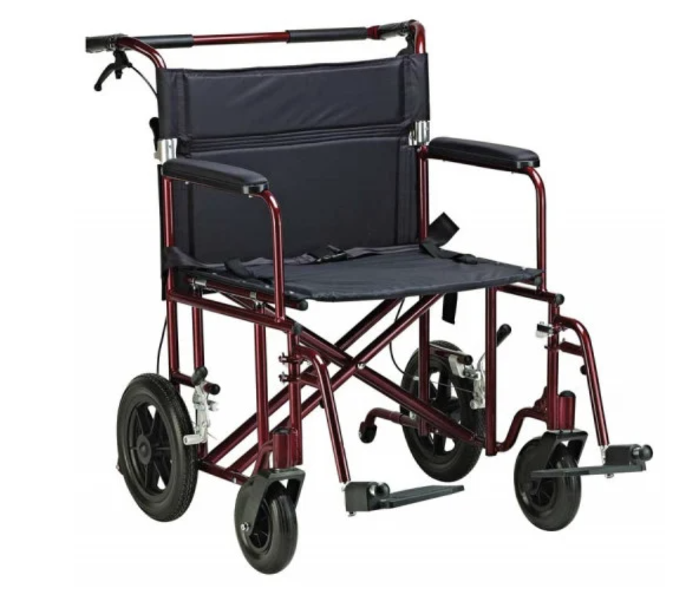
EQUIPMENT CONSIDERATIONS
Chairs
Wheel chairs
Scales
Commodes
Gurneys
Tables
Examining
Ultrasound
L & D
Postpartum
OR

Slide 8
PREGNANCY COMPLICATIONS
ACOG PB 156, 2021

Slide 9
ULTRASONOGRAPHY IN OBESE PATIENTS

Slide 10
CELL FREE SCREENING TESTS
Requires a minimal fetal fraction
Failure to report is associated with ↑ abnormalities
↑ BMI: ↓ Fetal fraction
10% of women >250 pounds have < minimal fraction
ACOG PB 156, 2021

Slide 11
ANTEPARTUM COMPLICATIONS
Cardiac dysfunction
Proteinuria
Sleep apnea
Nonalcoholic fatty liver disease
Gestational diabetes mellitus
Preeclampsia
Stillbirth

Slide 12
ANTEPARTUM COMPLICATIONS

Slide 13
ANTENATAL TESTING
BMI >35 <40: 37 weeks
BMI > 40: 34 weeks
Weekly testing is recommended

Slide 14
ANTEPARTUM WEIGHT GAIN

Slide 15
INTRAPARTUM
Long labor
↑ of cesarean section
↑ of anesthesia complications
↑ of perioperative complications
Consider increasing dose of antibiotics
Avoid vertical skin incision
Subcutaneous skim close
No drains

Slide 16
POSTPARTUM
Pharmacologic thromboprophylaxis
Encourage weight loss
Increase activity
Diet modifications

Slide 17
UPCOMING SESSION WEDNESDAY 4/20/22
LATE TERM STEROIDS IN PREGNANCY

