Slide 1
OBESITY IN PREGNANCY
Berry Campbell, MD

Slide 2
OBESITY
Diagnosis (use of BMI appropriate?)
Terminology

Slide 3
OBESITY
OTHER METHODS OF DIAGNOSIS
Metropolitan Life Insurance actuarial table pre-70’s
BMI -1980’s
Waist measures
Waist/hip ratio
Problems: poorly standardized measures

Slide 4
OBESITY: DIAGNOSIS
Percentage body fat excessive women >30-35%; men >20-25%
Methods: too complex (water immersion plethysmography) or inaccurate (skinfold)
Less complex but expensive although accurate: DEXA, multi-frequency bioimpedance, air displacement plethysmography
Notes:
Accurate methods are used in gyms but not widely studied or applied in medical arena

Slide 5
OBESITY: DIAGNOSIS
BMI
Developed over 200 years ago by mathematician
Weight (kg)/height (M²)
Developed for population study creating an “ideal body weight”
Caucasian derived
Notes:
Recognized that in normal framed people, th weight was proportiona;l to ht squared. Epidiomio;ogic tstudies in 1972 started using the BMI and in 1995, WHO set the dx by BMI we use today.

Slide 6
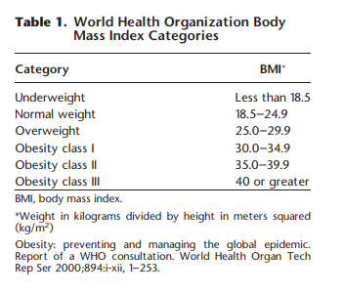
OBESITY
ACOG Practice Bulletin #230, June 2021

Slide 7
BMI: DRAWBACKS
Simplicity led to widespread application to general population
Ignores waist size
No allowance for bone, muscle mass
AMA J Ethics: Apr 2010; Lopez-Jimenez F et al.
Notes:
No data to suggest that W/H ratio and Waist alone or together are any better than BMI at predicting morbidity and mortality

Slide 8
BMI
40-50% false negative (labeled normal with excess body fat and at risk)
8-10% false positive (labeled obese incorrectly—high muscle mass)
BMI does not take into account fat distribution
Notes:
Visceral fat is associated with central obesity—it is the most metabolically active fat causing insulin resistance and high lipids. Confirmed by dexa scans, CT and MRI
THIS IS A SCREENING TOOL AND SHOULD BE USED AS SUCH!!

Slide 9
BMI: PROS
Cheap and easy
Already universally utilized

Slide 10
AMA STATEMENT
BMI should not be used as a sole criterion to deny appropriate insurance reimbursement
BMI classification can be misleading
BMI classification is flawed, harmful to communities of color

Slide 11
TERMINOLOGY: OBESITY
Chronic condition/disease
VS
Risk factor for disease

Slide 12
OBESITY
Tainted with negativity, blame and bias
Change approach with patients and/or change name?

Slide 13
NAME GAME
Diabetes vs People living with diabetes
Obesity vs People living with obesity
Believed to create less stigma, negativity

Slide 14
LANCET DIABETES & ENDOCRINOLOGY COMMISSION ON DEFINITION AND DX OF CLINICAL OBESITY
Obesity so stigmatized, need to change name
60 member commission
Report expected this fall

Slide 15
Adiposity-based chronic disease (ABCD)—already adopted by AACE
Clinical obesity
Notes:
Speaks to physiology but doesn’t tell us what the disease is

Slide 16
Chronic relapsing disease which in turn acts as a gateway to a range of other non-communicable diseases
AMA 2013

Slide 17
OBESITY AND BIAS
Counsel all on diet, weight gain—NOT just obese
Focus on overall health and medical risks
Patient centered counseling
Understand obesity is a medical condition
UNDERSTAND: most of these patients have had a negative experience with health care providers—approach with sensitivity understanding stigma with obesity
One slide doesn’t do justice:

Slide 18
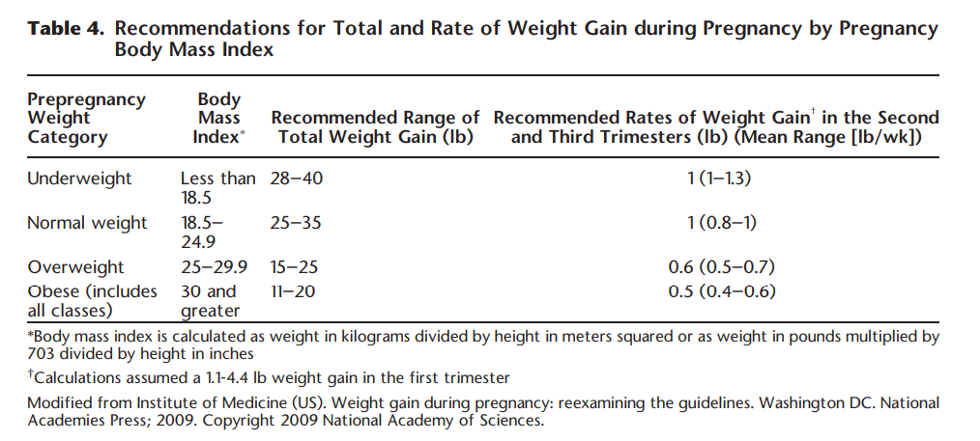
OBESITY IN PREGNANCY
WEIGHT GAIN IN PREGNANCY: IOM
ACOG Practice Bulletin #230, June 2021
Notes:
Due to poor data available, lower wt gain targets were not recommended for larger BMI categories.

Slide 19
OBESITY IN PREGNANCY
SIGNIFICANCE—WEIGHT GAIN RESTRICTION
Should we encourage < 11 lbs weight gain in the super-obese?
< 11 lbs gained in obese—9.6% SGA vs 4.9% in > 11 lbs gained
Other studies confirm with slight increased risk of FGR <3%tile
Am J Obstet Gynecol 2014;211:137.e1-e7. (Level II-2)
PLoS One 2015;10:e0132650 (Meta-analysis)
Notes:
I used to be vigilant about weight restriction in these patients if >40 BMI.
Due to the recent data, I now work with the patient and try to use the motivational discussion re: wt retention and have them consider seeing our DM educators for diet teaching. If truly motivated, I am encouraging of limited wt gain. If they are struggling with the idea, I really point out the IOM guides and repeatedly discuss wt gain and praise them for efforts they make.

Slide 20
OBESITY IN PREGNANCY
SIGNIFICANCE-LOGISTICS
Birthing beds
Monitoring equipment
BP cuffs, compression devices
OR tables
Staffing
Patient positioning concerns; physician accessibility to surgical site
Notes:
One thing often overlooked is the impact that obesity has on care for the paient.
1-must have proper quipment. Most OR table accomadate 400-450 lbs. May put 2 tables together.
2- staff MUST be allowed to add people to help positioning, etc.
3- physician, nurse injury, accessibility to sugery site
4-difficult monitory fetus and risk poor outcome
5- tough delivery
6- incision type, etc

Slide 21
OBESITY IN PREGNANCY
SIGNIFICANCE-PRECONCEPTION CARE
Motivational interview methods promote wt loss, diet modification and exercise
Normal BMI is the goal BUT 5-7% wt loss significantly improves health
Medications may be used pre-pregnancy
Diet, exercise and behavior modification are the basics
Notes:
Motivation interviewingtechniques involve individualized pt-cetered approach toward exploring and resolving ambivalence. Helps with moving through the stages of dealing wit unhealthy behavior.
Meds—care using close to pregnancy—anorectics
Some evidence of weight control in pregnancy with diet, exercise and glycemic index low diet lessens BWt by 15%

Slide 22
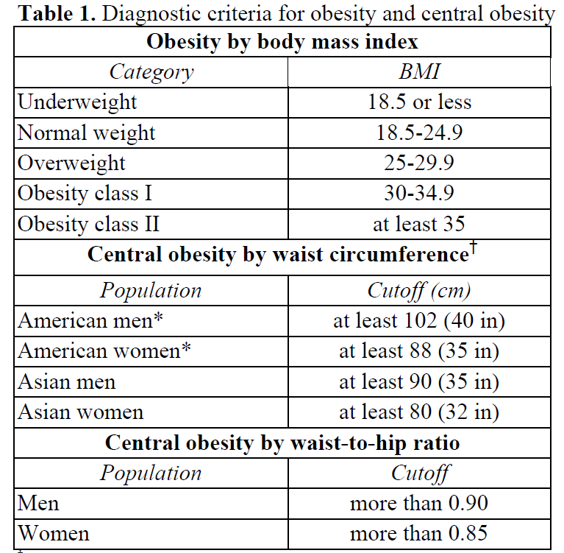

Slide 23
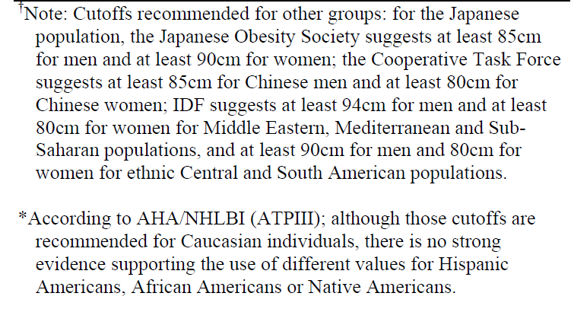
Table 1: Note

Slide 24
