Slide 1
POSTPARTUM MANAGEMENT OF HYPERTENSION AND FUTURE RISK
Donna D. Johnson, MD
Medical University of South Carolina

Slide 2
POSTPARTUM HYPERTENSION
Best blood pressure: At rest
Be aggressive
Follow up in 1 week

Slide 3
BREASTFEEDING
Calcium channel blockers
Beta blockers
Methyldopa
HCTZ
Furosemide
ACE inhibitors & ARBs X

Slide 4
LIFESTYLE MODIFICATION
Weight loss
Diet
Physical activity
Alcohol moderation

Slide 5
PREECLAMPSIA
Chronic hypertension
Renal disease
? CV

Slide 6
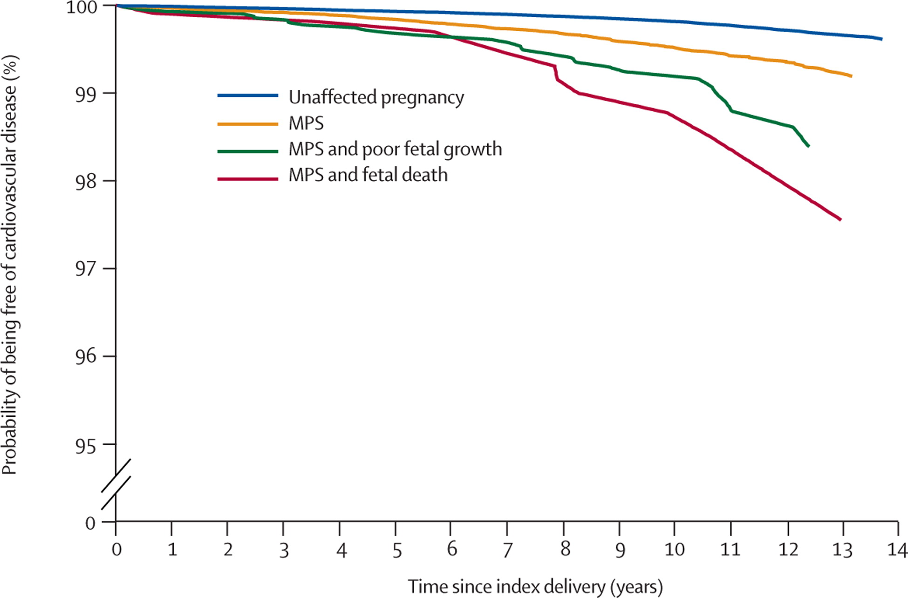
MATERNAL PLACENTAL SYNDROME
Lancet, 2005

Slide 7
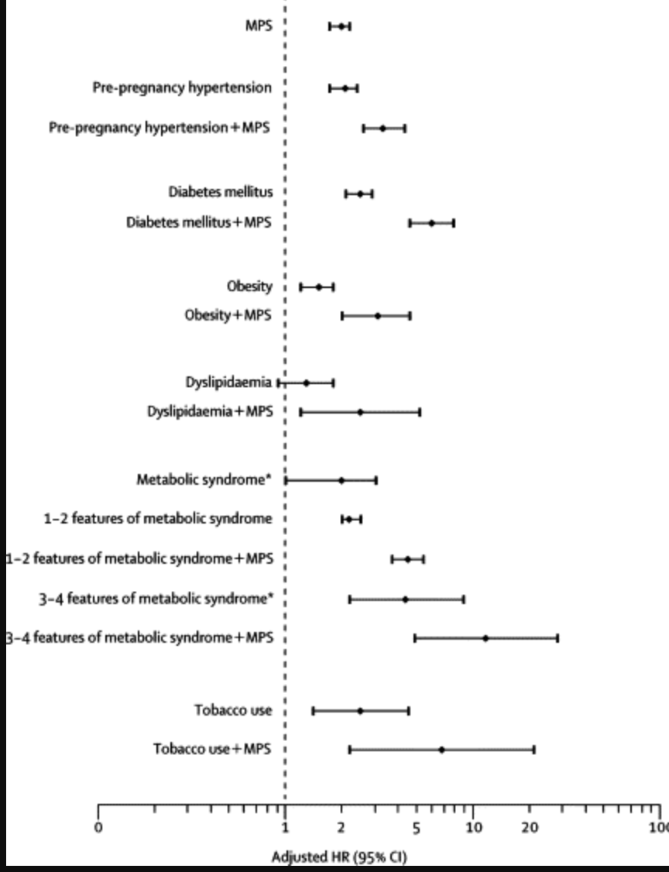
Lancet, 2005

Slide 8
SUGGESTIONS
Yearly exam
Blood pressure
Lipids
Diabetes screening
Normal BMI
Exercise

