Slide 1
Postpartum psychosis
Connie Guille MD
Professor
Medical university of south Carolina

Slide 2
Postpartum psychosis
Overview
Clinical Presentation
Risk Factors
Screening/Assessment
Differential Diagnosis
Treatment

Slide 3
Postpartum Psychosis
Overview
Prevalence
1-2/ per 1,000 women
Psychiatric Emergency
Requires immediate hospitalization and treatment
Onset
Sudden
Within the first 1-2 weeks Postpartum

Slide 4
Postpartum Psychosis
Distinctive Clinical Characteristics
“Delirium-like waxing and waning of consciousness, disorganization and confusion, depersonalization, bizarre delusions (often concerning child)”
Early symptoms: insomnia, anxiety, irritability, or mood fluctuation.
Mood symptoms: mania (can be irritable or elevated), depressive symptoms, or mixed symptoms.

Slide 5
Postpartum Psychosis – Clinical features
Clinical Features of Postpartum Psychosis
Disorganization
Disoriented
Confusion
Depersonalization
Insomnia
Irritability
Abnormal Though Content (Delusions and/or Hallucinations)
Abnormal Mood (Mania, or Agitation; Depression; Mixed)

Slide 6
Postpartum Psychosis- risk factors
Risk Factors
Personal history of bipolar disorder
Family history of bipolar disorder
Prior episode of postpartum psychosis
Primiparity
Sleep loss
Notes:
Pre-eclampsia- mixed results
Immune (thyroiditis)
Hormones/ Case reports
Hypo parathyroiditis
Sheehan

Slide 7
Postpartum Psychosis- Assessment
Screening Questions (Patient and/or Family)
Prior psychiatric illness, episodes of depression, mania or both?
Family history of bipolar disorder?
Use of substances? (Intoxication/ Withdrawal)
History of autoimmune disease? (Thyroid, Lupus)
Thoughts of harming herself or child: “It can be very overwhelming to be a new mom. Sometimes women have scary thoughts; they might think about hurting themselves or their babies. Has that ever happened to you?”
Notes:
– Important Screening Questions for Patient and/or Family
Is this the patient’s first psychiatric presentation?
If she has a psychiatric history, is it of depression, mania, or both?
Is there any family history of bipolar disorder?
Has the patient been using any substances?
Does the patient have thoughts of harming herself or the child? Important to ask this in a non-judgmental fashion, for example: “It can be very overwhelming to be a new mother. Sometimes women have scary thoughts; they might think about hurting themselves, or hurting their babies. Has that ever happened to you?”

Slide 8
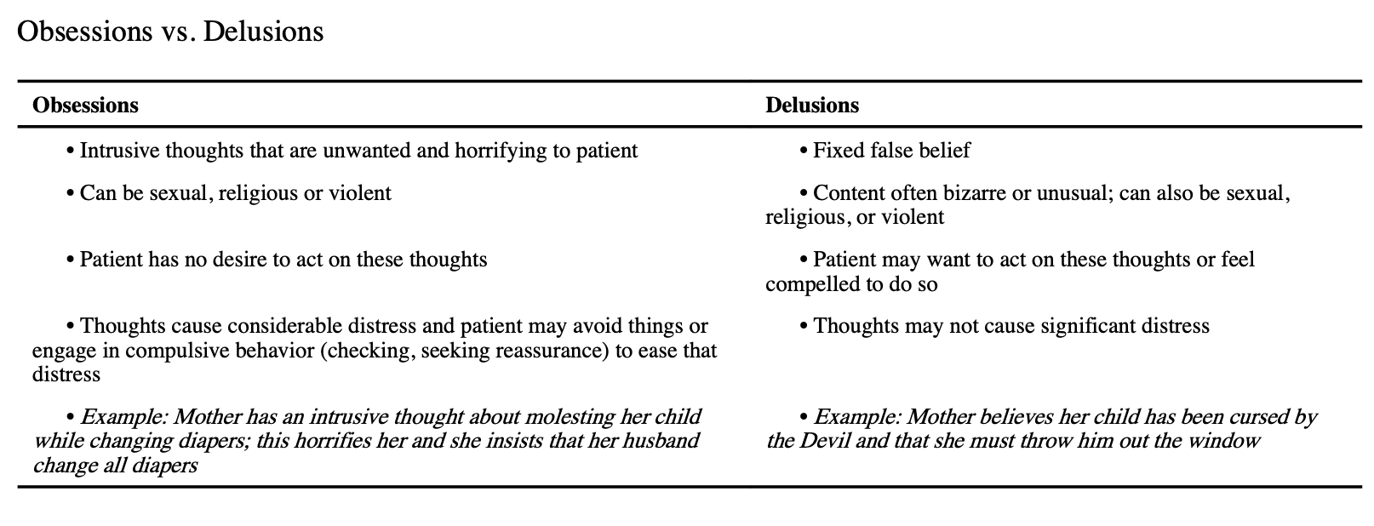
Postpartum Psychosis- Assessment
Notes:
– Important Screening Questions for Patient and/or Family
Is this the patient’s first psychiatric presentation?
If she has a psychiatric history, is it of depression, mania, or both?
Is there any family history of bipolar disorder?
Has the patient been using any substances?
Does the patient have thoughts of harming herself or the child? Important to ask this in a non-judgmental fashion, for example: “It can be very overwhelming to be a new mother. Sometimes women have scary thoughts; they might think about hurting themselves, or hurting their babies. Has that ever happened to you?”

Slide 9
Postpartum Psychosis- ASSESSMENT
(differential diagnosis)
Physical Exam + Neurological Exam
(r/o focal neurological deficit, extrapyramidal symptoms [anti-NMDAR antibodies- encephalitis])
Comprehensive Metabolic Panel
(metabolic derangement, hypocalcemia [hypoparathyroidism])
Complete Blood Count (r/o infection, significant anemia)
Urinalysis (r/o infection)
Urine Toxicology Screen (r/o intoxication, review potential for withdrawal)
Thyroid stimulation hormone, Free T4, TPO antibodies (thyroid autoimmune disease)
Ammonia level
Brain imaging (focal deficit, Sheehan, limbic encephalitis)
Notes:
– Important Screening Questions for Patient and/or Family
Is this the patient’s first psychiatric presentation?
If she has a psychiatric history, is it of depression, mania, or both?
Is there any family history of bipolar disorder?
Has the patient been using any substances?
Does the patient have thoughts of harming herself or the child? Important to ask this in a non-judgmental fashion, for example: “It can be very overwhelming to be a new mother. Sometimes women have scary thoughts; they might think about hurting themselves, or hurting their babies. Has that ever happened to you?”

Slide 10
Postpartum Psychosis- Treatment
Acute Postpartum Psychosis
Benzodiazepine (lorazepam 0.5-1.5mg TID)
Antipsychotic (high potency haloperidol 2-6mh or olanzapine 10-15mg)
Lithium (to achieve serum level of 0.8-1.2mmol/L)
Taper benzodiazepine and antipsychotic once symptom remission achieved
Continue Lithium for 9 months (can lower dose to achieve serum level 0.6-0.8mmol/L after symptom remission achieved if severe side effects)
Future Pregnancy
Begin prophylactic Lithium monotherapy immediately postpartum
Notes:
Treatment Recommendations for Acute Postpartum Psychosis
Benzodiazepine (lorazepam 0.5-1.5 mg TID)
Antipsychotic (high potency preferred, haloperidol 2-6 mg or olanzapine 10-15 mg)
Lithium (to achieve serum level of 0.8-1.2 mmol/L)
Taper benzodiazepine and antipsychotic once symptom remission achieved
Continue Lithium monotherapy for 9 months (can lower to achieve serum level of 0.6-0.8 after symptom remission if severe side effects)
For future pregnancies, begin prophylactic Lithium monotherapy during pregnancy or immediately postpartum

Slide 11
If you have a patient with postpartum psychosis, get them to an ED. You or ED or Hx attending can then call Moms IMPACTT for assistance with management.

