Slide 1

“Sepsis Bundle”
≈
Sepsis Toolkit
Project ECHO
September 1, 2021
Michelle Flanagan, BSN, RNC-OB, C-EFM

Slide 2
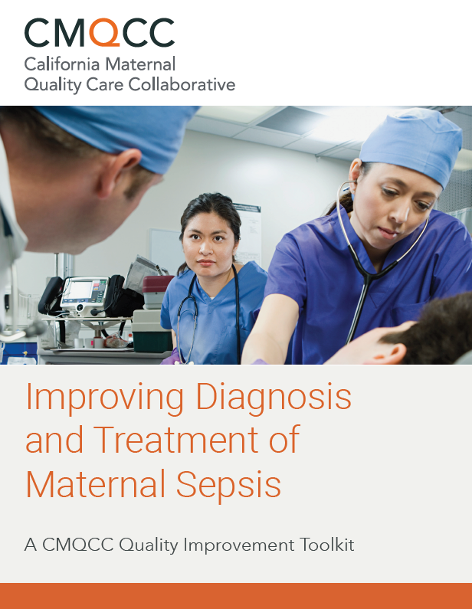
Toolkit/Bundle
Currently have CMQCC Toolkit
  January 2020
  https://www.cmqcc.org/resource/improving-diagnosis-and-treatment-maternal-sepsis
AIM Sepsis Bundle
  ? 2022

Slide 3

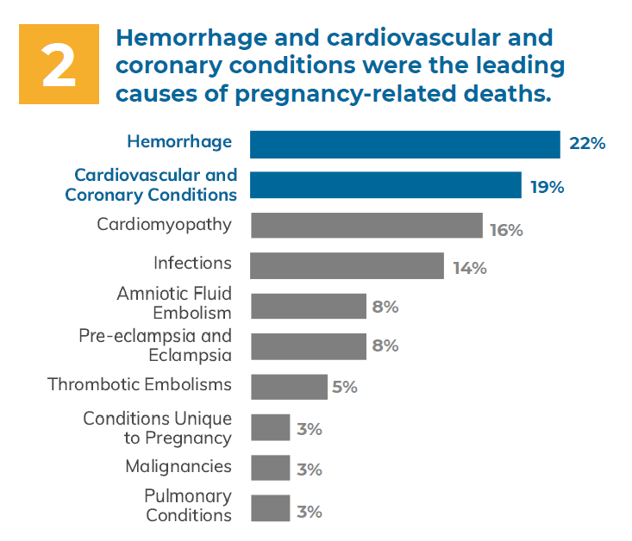
Why Sepsis Toolkits & Bundles?
“Sepsis is a leading cause of maternal morbidity and mortality. The Centers for Disease Control and Prevention notes that the proportion of U.S. maternal deaths from sepsis (12.7%) is similar to the proportion of deaths from obstetric hemorrhage (11.4%) and hypertensive disorders (7.4%).”
-CMQCC Sepsis Toolkit
SC MMRC Data
  March 2020 Legislative Report*
*Between 2016 and 2019, there were 27 maternal deaths reviewed.
SC MMRC Data
  March 2021 Legislative Report**
**Between 2016 and 2020, there were 63 maternal deaths
reviewed. Of which, 60 were within the scope of case
review.
Notes:
Clinical quality improvement toolkits for hemorrhage and hypertension have been instrumental in driving reductions
in maternal mortality and morbidity, and there are similar opportunities for improving outcomes for women who
experience maternal sepsis. We have created simple and practical approaches to care that make adoption of our CMQCC
toolkits much more likely to succeed. Here, we present a two-step approach for the diagnosis of sepsis that is designed to
reduce false-positive and false-negative cases. In addition, we provide practical implementation aids for support bundles,
antibiotic choices, and navigation through the Centers for Medicare and Medicaid Services (CMS) Sepsis-1 protocols.10

Slide 4
Table 1. Leading Causes of Maternal Sepsis
Antepartum | Intrapartum/ Immediate Postpartum | Post-discharge
Septic abortion | Chorioamnionitis / Intraamniotic Infection | Pneumonia / Influenza
Chorioamnionitis / Intraamniotic Infection | Endometritis | Pyelonephritis
Pneumonia / Influenza | Pneumonia / Influenza | Wound Infection / Necrotizing Fasciitis
Pyelonephritis | Pyelonephritis | Mastitis
Appendicitis | Wound Infection/ Necrotizing Fasciitis | Cholecystitis
Adapted from: Table 1 - Improving Diagnosis and Treatment of Maternal Sepsis A CMQCC Quality Improvement Toolkit
Notes:
Here, we present a two-step approach for the diagnosis of sepsis that is designed to
reduce false-positive and false-negative cases. In addition, we provide practical implementation aids for support bundles,
antibiotic choices, and navigation through the Centers for Medicare and Medicaid Services (CMS) Sepsis-1 protocols.10

Slide 5
CMQCC Quality Improvement Toolkit
“Improving Diagnosis and Treatment of Maternal Sepsis”
PART I
1
Screening and Diagnosis of Sepsis
PART II
2
Assessment and Treatment of Maternal Sepsis: Care Bundles
PART III
3
Assessment and Treatment of Maternal Sepsis: Antibiotics and Source Control
PART IV
4
Obstetric Considerations in the Case of Maternal Sepsis
PART V
5
Discharge Education
Notes:
PART I. Screening and Diagnosis of Sepsis 10-18
PART II. Assessment and Treatment of Maternal Sepsis: Care Bundles 19-23
PART III. Assessment and Treatment of Maternal Sepsis: Antibiotics and Source Control 24-33
PART IV. Obstetric Considerations in the Case of Maternal Sepsis 34-35
PART V. Discharge Education 36-38

Slide 6
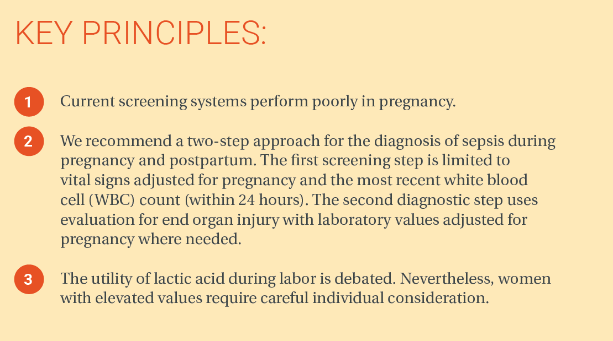
PART 1:
Screening and Diagnosis of Sepsis
“The World Health Organization (WHO) has defined maternal sepsis simply as a life-threatening condition with organ dysfunction resulting from infection during pregnancy, childbirth, post-abortion, or the postpartum period (up to 42 days). Defining the criteria for sepsis and organ dysfunction during pregnancy and labor has been challenging.”
Notes:
There is considerable controversy about both the definition of sepsis and what criteria to use to screen for sepsis in non-pregnant adults.
Notably, studies that evaluated sepsis criteria specifically excluded pregnant women. This limits their utility for maternal sepsis given the significant vital sign changes that occur during pregnancy.
The World Health Organization (WHO) has defined maternal sepsis simply as a life-threatening condition with organ dysfunction resulting from infection during pregnancy, childbirth, post-abortion, or the postpartum period (up to 42 days).6 Defining the criteria for sepsis and organ dysfunction during pregnancy and labor has been challenging.

Slide 7


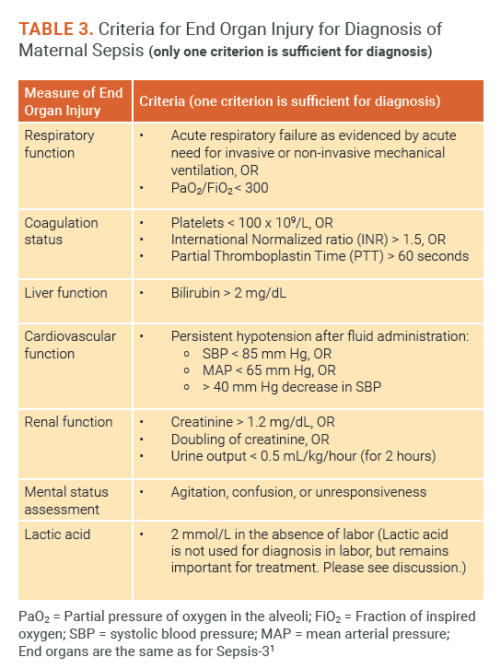
2 Step Screening Process:
  Initial Sepsis Screen for All Patients with Suspected Infection (POSITIVE if two (2) or more criteria are met)
    Oral temperature < 36°C (96.8°F) or ≥ 38°C (100.4°F)
    Heart rate > 110 beats per minute and sustained for 15 minutes
    Respiratory rate > 24 breaths per minute and sustained for 15 minutes
    White blood cell count > 15,000/mm3 or < 4,000/mm3 or > 10% immature neutrophils (bands)
  Confirmation of Sepsis Test to Evaluate End Organ Injury
    Laboratory values
      Complete blood count (including % immature neutrophils [bands], platelets)
      Coagulation status (prothrombin time/international normalized ratio/partial thromboplastin time)
      Comprehensive metabolic panel (specifically includebilirubin, creatinine)
      Venous lactic acid
    Bedside assessment
      Urine output (place Foley catheter with urometer)
      Pulse oximetry
      Mental status assessment
Step 1: Initial Sepsis Screen
Step 2: Confirmation of Sepsis
*See Table 3 for Criteria for End Organ Injury
Notes:
A New Two-Step Approach to Screening
The California Maternal Quality Care Collaborative (CMQCC) proposes a new two-step approach for screening of pregnant women to reduce both false-positive and false-negative cases. We take advantage of the high sensitivity of an obstetrically modified SIRS screen as a first step and then follow with the high specificity of an evaluation for end organ injury using obstetrically modified laboratory ranges.
Advantage of a Two-Step Approach for Sepsis
Patients who meet two or more criteria of the initial sepsis screen (Step 1) and also meet one or more end organ injury criteria (Step 2) receive a diagnosis of sepsis. The two-step process allows for increased sensitivity resulting in fewer missed sepsis cases and also increased specificity resulting in fewer false-positive cases. This is similar to testing for syphilis, where venereal disease research laboratory (VDRL) test is used as a screening tool followed by the much more specific Treponema pallidum particle agglutination (TPPA) assay as the diagnostic test. Other groups that have struggled with diagnostic criteria for maternal sepsis have suggested a similar approach.13 This tactic has been in routine use in the obstetric units of three major health care systems in California: Dignity Health, Sutter Health, and Kaiser-Permanente. Their experience has confirmed that approximately 2% of patients will screen positive, and these women are then followed with a second step (end organ injury evaluation) to confirm the diagnosis. In our clinical experience, this system rarely fails to identify patients with sepsis defined by end organ injury.
Step 1: Initial Sepsis Screen
Centers for Medicare and Medicaid Services (CMS) sepsis core measure and Sepsis-3 definitions of sepsis require a full evaluation for end organ injury in suspected sepsis.1 It would be costly over-intervention to initiate the complete organ injury panel of laboratory testing and interventions for every pregnant woman with a positive standard SIRS criterion; (recall the 63% of women with chorioamnionitis/ intraamniotic infection that have positive standard SIRS criteria). Therefore, we modified standard SIRS criteria to account for physiological changes of pregnancy in order to reduce false-positive cases during the initial sepsis screening. We based our approach on a recent meta-analysis of healthy pregnant women that found that two standard deviations from the mean for temperature,
heart rate, and respiratory rate were 38.1°C (100.6°F), 107 beats per minute, and 25 breaths per minute, respectively. Assuming a normal distribution, patients meeting these thresholds for each criterion would occur 2.5% of the time. It would be expected that approximately 2.5% or less (since two or more criteria are required) of patients may meet the proposed screening criteria due to physiological changes of pregnancy rather than infection.7 These criteria were rounded to ≥ 38.0°C (100.4°F), > 110 beats per minute, and 24 breaths per minute.
Step 2: Confirmation of Sepsis
If the initial sepsis screen is positive ([two or more of the four elements from Box 1] with suspicion or evidence of infection), the next step is evaluation for end organ injury including laboratory studies listed in Box 2, and prompt bedside evaluation by a physician or other clinician with the ability to escalate care. While waiting for organ injury laboratory results, therapy should be promptly initiated (ideally within one hour) for infection with administration of antibiotics targeted for the presumed site and bolus of 1-2L intravenous fluids (IV).12

Slide 8
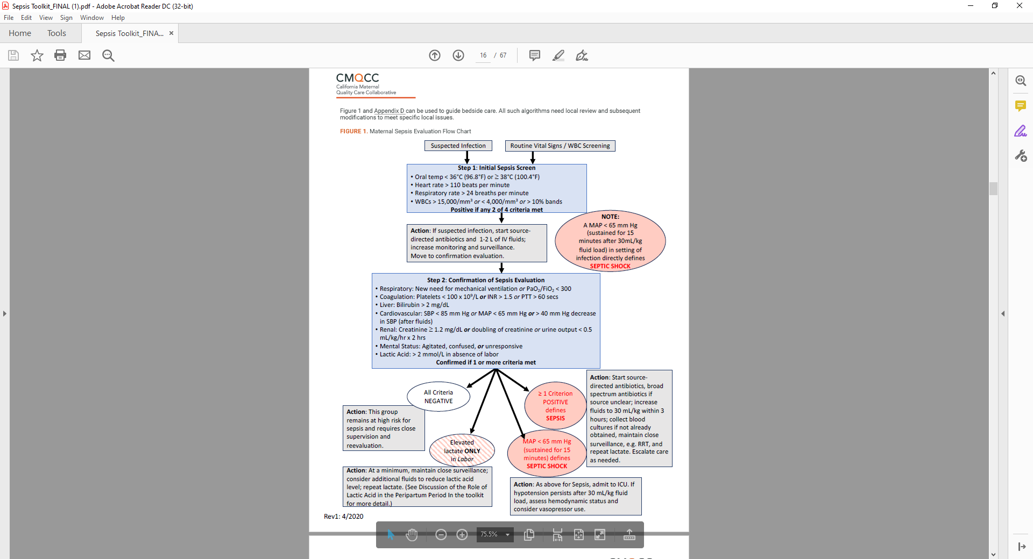
Figure 1 can be used to guide bedside care. All such algorithms need local review and subsequent modifications to meet specific local issues.
Rev 4/2020
Notes:
To detect women with impending sepsis, all members of the clinical team should maintain a high index of suspicion and embrace non-hierarchical communication. All team members should feel empowered to speak up about a concern and know that their input is valued by the care team. Effective team communication enables members to relay relevant information in a way that is clear and understood. For example, if a nurse suspects infection in a patient who screens positive for two or more modified SIRS criteria, this may be sufficient to proceed to Step 2 for further evaluation.

Slide 9
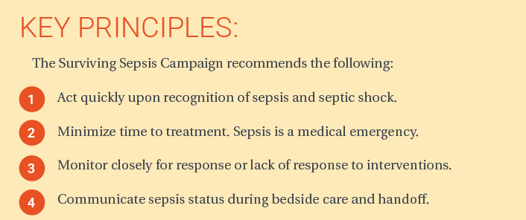
Part 2:
Assessment and Treatment of Maternal Sepsis - Care Bundles
Patient triggers positive initial sepsis screen
“TIME ZERO” starts
Follow recommended assessments

Slide 10
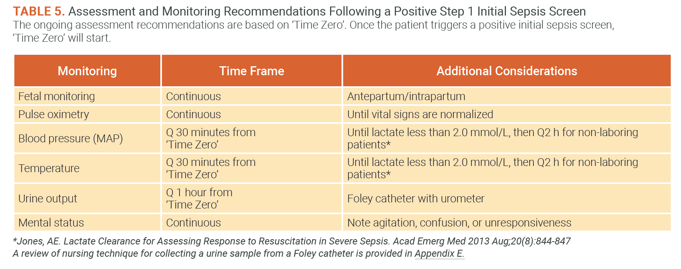
Part 2: Assessment and Treatment of Maternal Sepsis - Care Bundles
Additional Assessment:
Cultures (Blood cultures)
Fluid Management
Communication & Teamwork Tools
Rapid response Team & Escalation of Care Coordination (Patient Location / Patient Transfer to Higher Level of Care)
Distinguish Chorioamnionitis / Intraamniotic Infection from Sepsis
Notes:
Clinically unstable obstetric patients (pregnant or postpartum) at risk for rapid deterioration are usually transferred to a higher level of care. Because obstetric patients with sepsis are younger, usually with fewer comorbidities, and are generally healthier as compared to the overall population, these patients tend to withstand the challenges of sepsis for a longer time period but can then rapidly deteriorate.9 Maternal physiologic changes such as an elevated heart rate and lower blood pressure can mask some of the signs of clinical deterioration. The decision to transfer an obstetric patient to a higher level of care should be made by a multidisciplinary team, including the obstetrician, anesthesiologist, nurse, the ICU critical
care physician (and if appropriate, the neonatologist/ pediatrician). Because facilities may have different resources in their obstetric units for the support of a patient with sepsis, decisions such as a transfer to ICU should be based on the capabilities of each facility.
The diagnostic challenge arises from the fact that maternal sepsis often does not present with the symptoms typically present in the non-obstetric population. Fever may not be present at diagnosis and may never develop.13 With labor, there can be an increase in lactic acid in the second stage in the absence of infection.14 Differentiating uncomplicated chorioamnionitis/intraamniotic infection from sepsis may be more challenging. A woman with chorioamnionitis/ intraamniotic infection may be febrile and tachycardic due to infection, may have an elevated lactic acid level from labor, but not have the criteria for organ dysfunction (hence, diagnosis of sepsis). Fortunately, the initial steps for treatment of chorioamnionitis/intraamniotic infection and sepsis are similar (i.e. initiation of broad spectrum antibiotics and adequate fluid resuscitation).8 With improvements in the recognition of the source of maternal fever, appropriate treatment will be easier to implement.

Slide 11
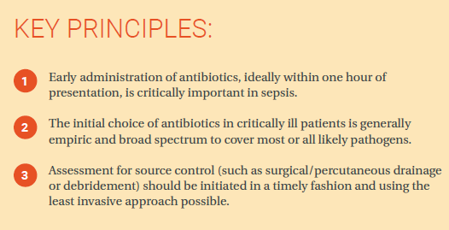
Part 3:
Assessment and Treatment of Maternal Sepsis - Antibiotics and Source Control
Antibiotics
  Ideally – administer within one hour of diagnosis of maternal sepsis
  Initial antibiotic coverage for patients with sepsis should be empiric with use of a broad-spectrum antibiotic regimen
  In the 48-72 hours following initial antibiotic administration, it is often recommended that the antibiotic regimen be narrowed as culture information becomes available and the patient stabilizes
Sepsis Order Sets
Pain Medications

Slide 12
Part 3: Assessment and Treatment of Maternal Sepsis - Antibiotics and Source Control
Source Control: If patients have no improvement with initial resuscitation with antibiotics/fluids
Patients with identified sources of infection that are amenable to percutaneous drainage should:
Patients with identified sources of infection requiring surgery should undergo consultation with:
Patients with identified sources of infection that are too small or not amenable to percutaneous drainage, or patients with undetected sources, or patients with refractory fevers despite antibiotics and supportive measures:
Gynecologic surgeon for procedures such as dilatation and curettage for retained products, hysterectomy for necrotizing GAS uterine infection, or drainage of pelvic or perineal abscess not amenable to percutaneous drainage by interventional radiology
Undergo consultation with interventional radiology and assessment for possible drainage
Consider consultation with infectious disease or maternal fetal medicine
General surgeon for procedures such as drainage of abdominal abscess, appendectomy, cholecystectomy, or debridement for necrotizing fasciitis. Early surgical consultation is strongly recommended for any concerns regarding necrotizing skin and soft tissue infections
Consider consultation with infectious disease if appropriate
Also consider imaging studies to detect occult abscess or other infections
Notes:
Source Control: If patients have no improvement with initial resuscitation with antibiotics/fluids
Patients with identified sources of infection that are amenable to percutaneous drainage should:
Undergo consultation with interventional radiology and assessment for possible drainage.
Consider consultation with infectious disease if appropriate.
Patients with identified sources of infection requiring surgery should undergo consultation with:
Gynecologic surgeon for procedures such as dilatation and curettage for retained products, hysterectomy for necrotizing GAS uterine infection, or drainage of pelvic or perineal abscess not amenable to percutaneous drainage by interventional radiology.
General surgeon for procedures such as drainage of abdominal abscess, appendectomy, cholecystectomy, or debridement for necrotizing fasciitis. Early surgical consultation is strongly recommended for any concerns regarding necrotizing skin and soft tissue infections.
Patients with identified sources of infection that are too small or not amenable to percutaneous drainage, or patients with undetected sources, or patients with refractory fevers despite antibiotics and supportive measures:
Consider consultation with infectious disease or maternal fetal medicine.
Also consider imaging studies to detect occult abscess or other infections.

Slide 13
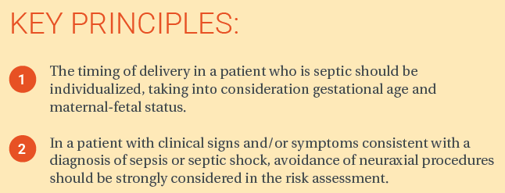
Part 4:
Obstetric Considerations in the Case of Maternal Sepsis
Indications for Delivery
Anesthetic Considerations
Screen positive patients
Sepsis/septic shock
  The Society for Maternal-Fetal Medicine (SMFM) concludes sepsis by itself “is not an immediate indication for delivery (except in cases of chorioamnionitis/intraamniotic infection)
  In patients with bacteremia, there is thought to be a theoretical increased risk of meningitis or spinal epidural abscess with neuraxial procedures due to seeding of the meninges, subarachnoid, or epidural space.
  It is ultimately the decision of the anesthesiologist whether or not to perform neuraxial procedures
  In a patient with confirmed or suspected bacteremia, a thorough assessment should be performed, including a history, physical exam, and review of laboratory values
  In a patient with clinical signs and/or symptoms consistent with a diagnosis of sepsis or septic shock, avoidance of neuraxial procedures should be strongly considered in the risk assessment
  The physiologic status of the patient with sepsis or septic shock is compromised and the cardiovascular effects of a neuraxial block technique may cause further detriment in an already critical clinical situation, with high potential for maternal (and fetal) morbidity and mortality
Notes:
Indications for Delivery
The Society for Maternal-Fetal Medicine (SMFM) concludes sepsis by itself “is not an immediate indication for delivery (except in cases of chorioamnionitis/intraamniotic infection).”1 Rather, the timing of delivery in a pregnant woman who is septic should be individualized, taking into consideration gestational age and maternal-fetal status. Because improving maternal hemodynamics often improves fetal status, cesarean delivery is usually reserved for supervening obstetric indications after the woman is stabilized by instituting appropriate supportive and antibiotic therapy. When chorioamnionitis/intraamniotic infection is the source of infection in sepsis, delivery is indicated with the mode of delivery (cesarean vs. vaginal) and exact timing determined by maternal and fetal condition. The SMFM says “corticosteroids for fetal lung maturity are not contraindicated" in sepsis.1
Anesthetic Considerations
(Refer to Part II: Distinguishing Chorioamnionitis/ Intraamniotic Infection from Sepsis) In patients with bacteremia, there is thought to be a theoretical increased risk of meningitis or spinal epidural abscess with neuraxial procedures due to seeding of the meninges, subarachnoid, or epidural space. Given the low rate at which this occurs, no study to date has been powered to exclude this possibility. We provide this information to help clinicians decide whether to provide neuraxial anesthesia. It is ultimately the decision of the anesthesiologist whether or not to perform neuraxial
procedures.
Screen positive patients
In a patient with confirmed or suspected bacteremia, a thorough assessment should be performed, including a history, physical exam, and review of laboratory values.
As previously covered, it is not uncommon for pregnant women to have elevated WBC counts or lactic acid as a result of the labor process itself.2-3 In patients diagnosed with chorioamnionitis, there is a reported incidence of bacteremia in 5-12% of patients.4 Two studies with a total of 810 patients diagnosed with chorioamnionitis receiving neuraxial procedures assess outcomes. Many patients were febrile at the time of neuraxial procedure placement without prior antibiotic therapy; both studies did not report any cases of spinal epidural abscess or meningitis.5-6 Because it is rare a neuraxial infection occurs
after a neuraxial procedure in patients with suspected bacteremia, consideration should be given to the higher risk of failed intubation in pregnant women (1 in 390).7 We recommend an anesthesiologist perform neuraxial procedures in patients at risk for bacteremia. Prior to neuraxial procedures, appropriate preprocedural antibiotic therapy should be administered and infusion(s) completed,
as research has shown that antibiotic therapy administered prior to neuraxial procedures mitigates this risk.4,8-9
Sepsis/septic shock
In a patient with clinical signs and/or symptoms consistent with a diagnosis of sepsis or septic shock, avoidance of neuraxial procedures should be strongly considered in the risk assessment. The physiologic status of the patient with sepsis or septic shock is compromised and the cardiovascular effects of a neuraxial block technique may cause further detriment in an already critical clinical situation, with high potential for maternal (and fetal) morbidity and mortality.

Slide 14


Part 5: Discharge Education
Post Sepsis Care
  Potential for cognitive impairment, psychological sequelae, re-hospitalization, recurrent infection, and death (Post-ICU syndrome)
  Refer to rehabilitation
  Screen for Depression/Anxiety/PTSD
  Follow up appointments
Discharge Instructions
  Specific to sepsis diagnosis
  Standard postpartum discharge teaching
  Include Family members/Support persons in education

Slide 15


Post Birth warning Signs
Notes:
Post Sepsis Care
Although not specifically studied in cases of maternal sepsis (a younger population), survivors of sepsis can have cognitive
impairment, psychologic sequelae, higher rates of re-hospitalization, recurrent infection and death.2 This may be similar to
the well described post-ICU syndrome. Patients should be promptly referred for rehabilitation for weakness and cognitive
impairment. All patients should be screened for depression, anxiety, and post-traumatic stress disorder and receive
prompt treatment. Patients should establish a relationship with a primary care physician to assure multi-disciplinary
follow-up and treatment. Surveys of adult sepsis survivors indicate that many patients report continuing difficulties with
anxiety, depression, fatigue and sleep disturbance indicating the need for support services during hospitalization and post
discharge.3

Slide 16
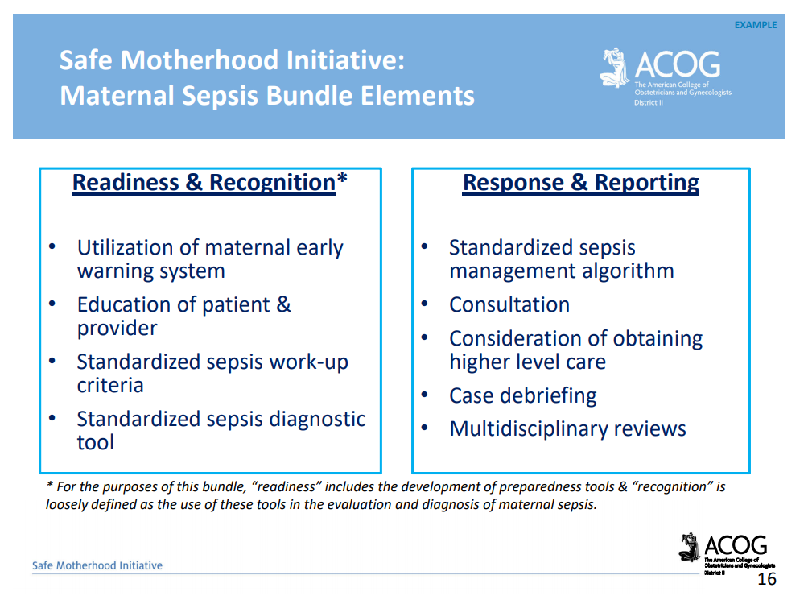
https://www.acog.org/community/districts-and-sections/district-ii/programs-and-resources/safe-motherhood-initiative

Slide 17
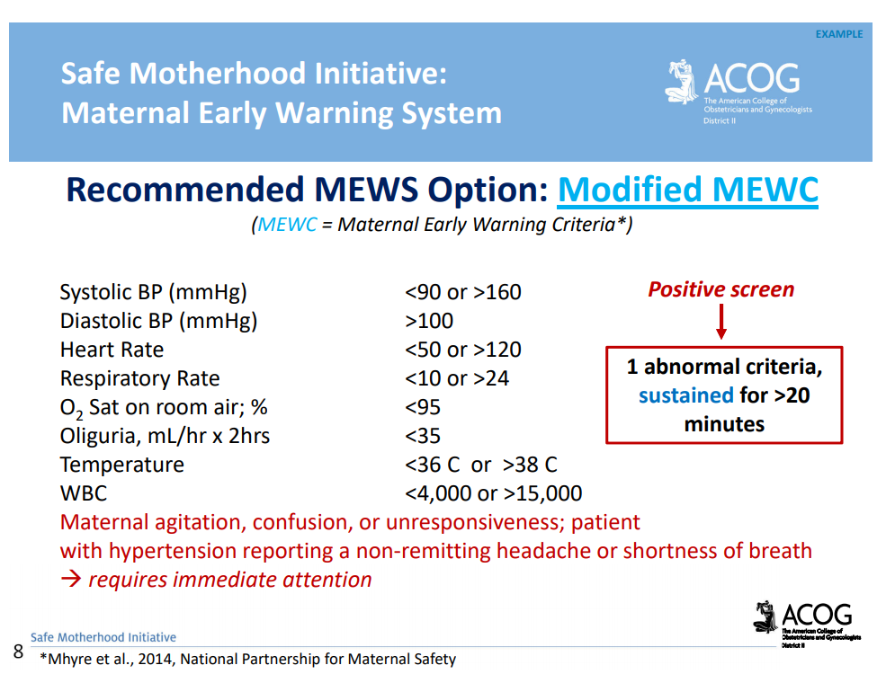
Safe Motherhood Initiative:
Maternal Early Warning System (MEWS)
Definition: Set of specific vital sign and physical exam findings that prompt a bedside evaluation and/or work-up
Action: Positive MEWS screen → Prompt provider bedside evaluation → clinical judgement, differential diagnosis leads provider to implement appropriate bundle(s)
Goal: Prompt and timely identification and treatment of women developing critical illness
smi-mews-bundle.pdf (acog.org)
Notes:
The goal of a ‘trigger-based early warning tool’ is to get a provider to
the bedside quickly to more closely evaluate the patient and
determine next steps; it is not meant to add further complexity or
diagnose illness
• Early recognition & targeted management are key to risk reduction
and successful clinical outcomes in maternal illness
• Evaluation & diagnostic criteria need to account for alterations in
maternal hemodynamics, respiratory function, and renal function due
to pregnancy physiology
• Increasing evidence indicates that standardization of care improves
patient outcomes

Slide 18
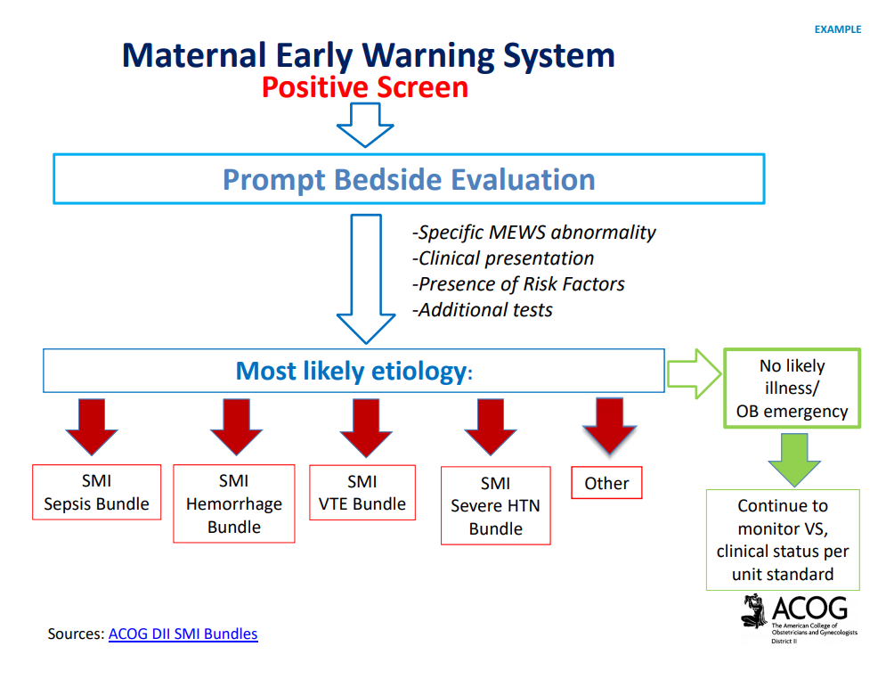
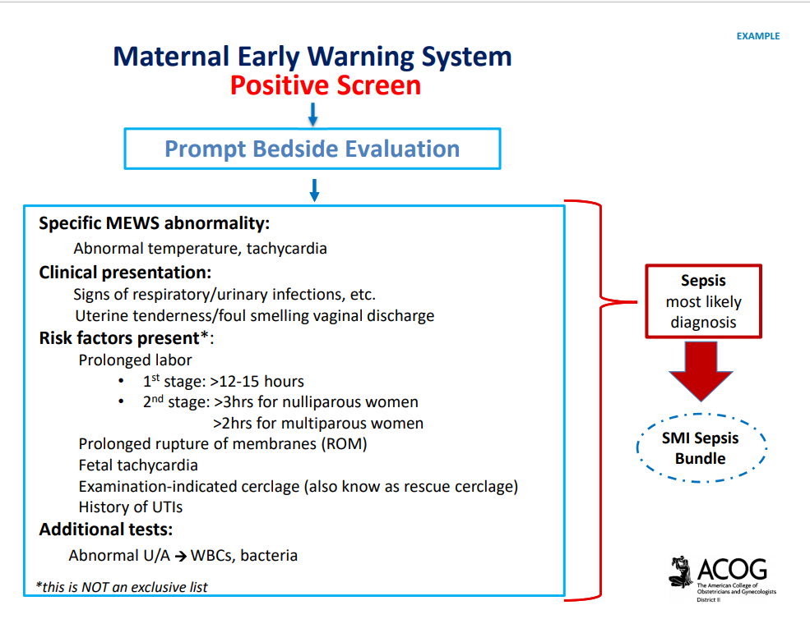
Sample Maternal Early Warning System (MEWS)

Slide 19
Case
A 24-year-old nulliparous Hispanic woman with no past medical history presented at 40 weeks of gestation in active labor.
Her antenatal course had been uncomplicated and her labor was uneventful.
Mazzeffi, M.A., Chen, K.T. Severe postpartum sepsis with prolonged myocardial dysfunction: a case report. J Med Case Reports 4, 318 (2010). https://doi.org/10.1186/1752-1947-4-318

Slide 20
Case: 12 hours after delivery
Patient complained of chills, diaphoresis, and right sided back pain.
Vitals
  T: 40°C
  HR: 110 bpm
  B/P: 136/85mmHg
  RR: 20
Exam:
  Marked right costovertebral tenderness.
  Laboratory:
    WBC: 18,000 white blood cells/μL
    Urinalysis: 3+ blood, 3+ leukocyte esterase, and 49 white blood cells per high powered field.
Our patient was started on intravenous antibiotics for presumed pyelonephritis.
Mazzeffi, M.A., Chen, K.T. Severe postpartum sepsis with prolonged myocardial dysfunction: a case report. J Med Case Reports 4, 318 (2010). https://doi.org/10.1186/1752-1947-4-318

Slide 21
Case: 36 hours after delivery
Patient complains of extreme difficulty breathing, non-productive cough, and generalized malaise.
Vitals:
  T: 40.5°C
  HR: 136 bpm
  BP: 136/82mmHg
  RR: 32 breaths per minute
  Arterial oxygen saturation 76% on room air
A chest film showed poor aeration in both lung bases and large bilateral pleural effusions.
Blood cultures and urine cultures both grew E. coli.
Mazzeffi, M.A., Chen, K.T. Severe postpartum sepsis with prolonged myocardial dysfunction: a case report. J Med Case Reports 4, 318 (2010). https://doi.org/10.1186/1752-1947-4-318

Slide 22
Case: 40 hours after delivery
Patient intubated
12-lead electrocardiogram: sinus tachycardia with no ischemic changes
Troponins levels were not elevated
Transthoracic echocardiogram:
  Ventricular ejection fraction of 35%
  Right and left ventricle appeared hypokinetic with normal end diastolic diameters
  Valvular function was normal
Chest CT with intravenous contrast
  Significant bilateral airway disease and no evidence of a pulmonary embolus
Mazzeffi, M.A., Chen, K.T. Severe postpartum sepsis with prolonged myocardial dysfunction: a case report. J Med Case Reports 4, 318 (2010). https://doi.org/10.1186/1752-1947-4-318

Slide 23
Case Continued
Postpartum day 5
  Patient was extubated
Postpartum day 8
  Cardiologist evaluated her for continued complaints of shortness of breath, orthopnea, and poor exercise tolerance
  Metoprolol and furosemide were started for systolic heart failure; however, she continued to have persistent dyspnea and poor exercise tolerance despite pharmacologic treatment
Postpartum day 10
  Second transthoracic echocardiogram which showed a persistent decreased ejection fraction of 35%.
Postpartum day 11
  Patient discharged home on oral antibiotics, furosemide, and metoprolol
Mazzeffi, M.A., Chen, K.T. Severe postpartum sepsis with prolonged myocardial dysfunction: a case report. J Med Case Reports 4, 318 (2010). https://doi.org/10.1186/1752-1947-4-318

Slide 24
Case Continued
Postpartum day 21
  Patient presented to the Emergency Department with complaints of heavy vaginal bleeding for which she received treatment with intravenous crystalloid solution
  During this visit, she reported adherence with her medications, but continued dyspnea and poor exercise tolerance.
    She could walk only one block without developing shortness of breath and was having considerable difficulty ascending three flights of stairs.
  Vital signs:
    T: 36°C
    RR: 16 breaths per minute
    HR: 57 bpm
    BP: 120/72mmHg
  She had a normal blood hematocrit and did not require blood transfusion
  She was advised to continue her diuretic and beta blocker and discharged from the emergency department with a plan to follow up as an outpatient.
    Note: Patient did not return to medical center after this visit and we were unable to contact her despite numerous attempts.
Mazzeffi, M.A., Chen, K.T. Severe postpartum sepsis with prolonged myocardial dysfunction: a case report. J Med Case Reports 4, 318 (2010). https://doi.org/10.1186/1752-1947-4-318

Slide 25
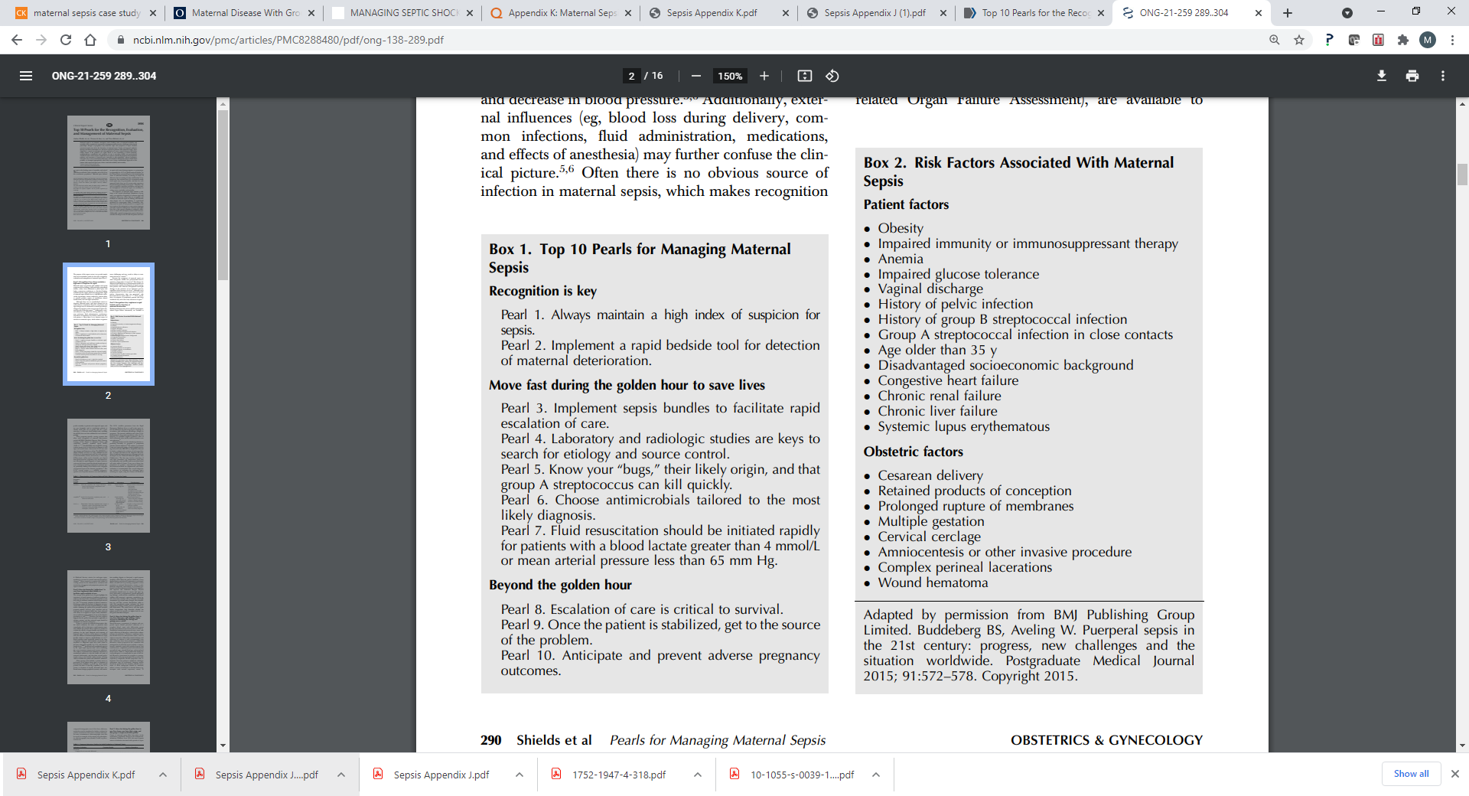
Top 10 Pearls for the Recognition, Evaluation, and Management of Maternal Sepsis
Shields et al Pearls for Managing Maternal Sepsis. VOL. 138, NO. 2, AUGUST 2021
Notes:
Maternal sepsis is a leading cause of maternal morbidity and mortality. Recognition of maternal sepsis remains a challenge for health care workers as the signs and symptoms of maternal sepsis often overlap with the normal physiologic changes of pregnancy. Implementation of a simple bedside screen with immediate evaluation if the screen is positive may aid in the early diagnosis of maternal sepsis and timely treatment. Once diagnosed, appropriate antibiotics should be initiated within the first hour, and hypoperfusion corrected. Further evaluation for end-organ damage and a search for etiologies of maternal sepsis and application of source control measures may reduce morbidity and mortality. If the patient is in septic shock or not responding to initial treatment, rapid escalation of care with multidisciplinary collaboration is necessary to optimize outcomes. Adverse pregnancy outcomes occur in association with maternal sepsis, and should be anticipated and prevented when possible or managed appropriately when they occur. In summary, early recognition, focused evaluation, and expedient treatment tailored to the most likely etiology of maternal sepsis, including aggressive source control, are necessary steps to reduce maternal morbidity and mortality from sepsis.

Slide 26
Project ECHO South Carolina Pregnancy Wellness
Visit Our Website: https://sctelehealth.org/services/pregnancy-wellness
1st & 3rd Wednesday/Month 12:15 pm – 1:00 pm
Hot Topics September 15,2021 Isoimmunization Johnson/Campbell

Slide 27
To Request a Copy of today’s
Didactic Video Presentation
Contact
Rachel Grater, Program Coordinator
grater@musc.edu

