Slide 1
Sepsis in Pregnancy/Postpartum
Berry A. Campbell, MD

Slide 2
Sepsis and pregnancy/postpartum
United Kingdom → accounted for 25% maternal deaths
In 63%, maternal sepsis deaths had substandard care (most were on OB units)

Slide 3
Sepsis in pregnancy/pp
Risk Factors
G1
AA, Medicaid
Cesarean
ART
Multiples
Comorbidities

Slide 4
Sepsis
Life-threatening organ dysfunction caused by dysregulated host response to infection

Slide 5
Septic Shock
Subset of sepsis where underlying circulation and cellular/metabolic abnormalities are profound enough to substantially increase mortality
Sepsis with persistent hypotension requiring vasopressors to maintain MAP>65 + lactate > 2mmol/L

Slide 6
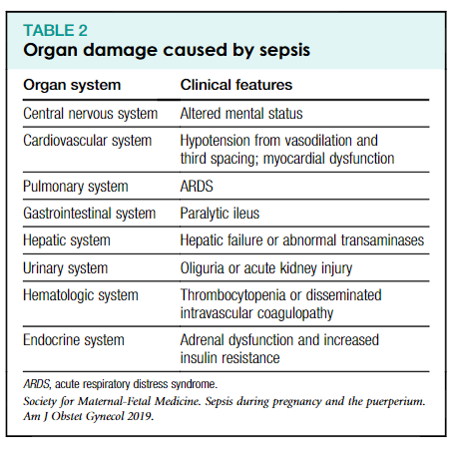
SMFM Consult Series #47, April 2019

Slide 7
Sepsis
Emphasis MUST BE ON organ dysfunction, NOT signs of infection

Slide 8
SMFM Consult Series #47, April 2019

Slide 9
Pregnancy and SOFA
Pregnancy associated with low Cr (<<1.2 normal)
MAP < 70 may be normal in midtrimester

Slide 10
Sequential Organ Failure Assessment Score (SOFA)
No baseline disease, score of 0 is normal

Slide 11
qSOFA
Bedside rapid tool
Presence of 3 clinical criteria:
Systolic<100
RR≥22
Altered mental status
(≥ 2 of these associated with ↑ risk poor outcome)

Slide 12
qSOFA
Fever NOT INCLUDED
Leukocytosis NOT INCLUDED

Slide 13
Modified SOFA
Society of OB Medicine in Australia/New Zealand (SOMANZ)
Systolic ≤ 90
RR > 25
Altered mental status
1 point for Cr > 1.02

Slide 14
Tachycardia and leukocytosis common in pregnancy and postpartum
↓↓ under-action by OB team
No perfect scoring system in OB/pp

Slide 15
Antepartum sepsis most are non-pelvic
Intra, postpartum most are pelvic
30% no source infection found

Slide 16
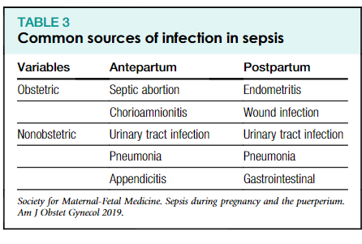
SMFM Consult Series #47, April 2019

Slide 17
Microbiology
E coli
Group A and B strep
Staph
Other gram neg bacteria
Anaerobes
Polymicrobial in >15%

Slide 18
Micro-organism found 64%
Clinical course found 74%

Slide 19
Management
Cultures
Serum lactate
Antibiotics within 1 hour of suspicion
Fluids (carefully—1-2 L)
Vasopressors

Slide 20
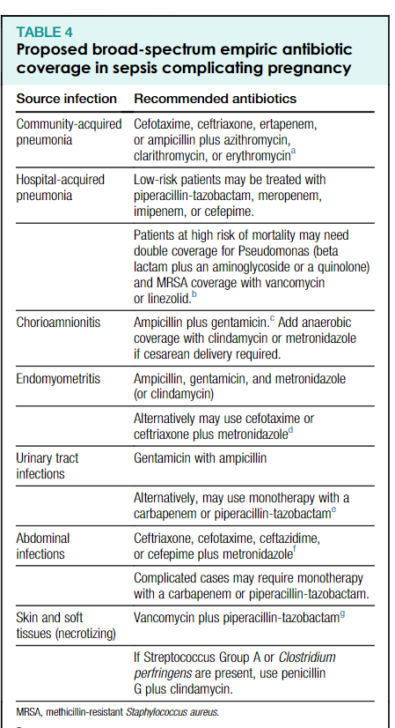
SMFM Consult Series #47, April 2019

Slide 21
Group A strep sepsis
Child-bed fever
Puerperal sepsis
Pre-antibiotic era, common cause of death
Not as common today BUT presentation is erratic and confuses
Rec: empiric abs can save lives in situations that are unclear
Full lab panels INCLUDING lactate

Slide 22
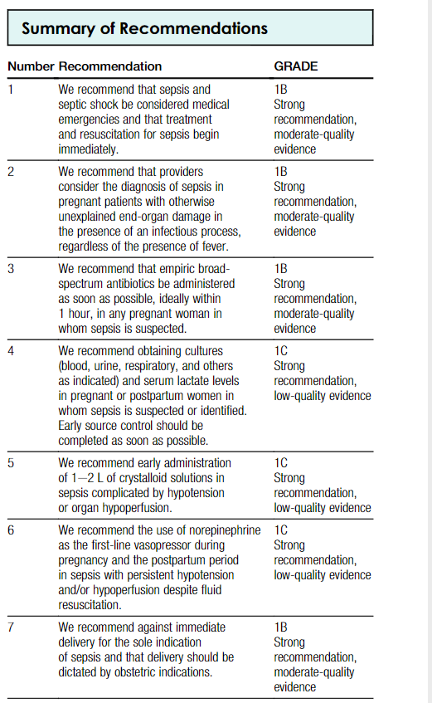
SMFM Consult Series #47, April 2019

Slide 23
Project ECHO South Carolina Pregnancy Wellness
Visit Our Website: https://sctelehealth.org/services/pregnancy-wellness
1st & 3rd Wednesday/Month 12:15 pm – 1:00 pm
Next Session September 1, 2021 Sepsis Bundle and Tool Kit Michelle Flanagan, BSN, RNC-OB, C-EFM

Slide 24
To Request a Copy of today’s
Didactic Video Presentation
Contact
Rachel Grater, Program Coordinator
grater@musc.edu

