Slide 1
Symmetric Intrauterine Growth Restriction
Eric H. Dellinger, MD
USCSOM-Greenville

Slide 2
FGR: PNM and EFW

Slide 3
FGR Types

Slide 4
IUGR: Etiology
Fetoplacental Maternal
Chromosomal History of IUGR
Genetic Hypertension
Congenital malformation Diabetes
Infectious disease MSAFP increase
CMV APS
Toxoplasmosis Chronic illness
Rubella Weight < 90% IBW
Placental pathology Hemoglobinopathy
Previa Substance abuse
Abruption Anemia/Hypoxia
Mosaiacism
Infarction
Circumvallate
Twins

Slide 5
IUGR: HC/AC Ratios
Asymmetric Symmetric
HC
HC
HC/AC
HC/AC
AC
AC

Slide 6
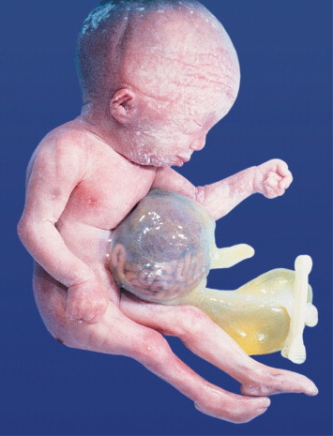
Fetal Anatomic Survey

Slide 7
Fetal Anatomic Survey
~ 10 % of FGR is associated with congenital anomalies
Am J Med Genet. 1985;20(1):63
20 - 60 % of anomalous infants are SGA
Pediatrics. 1988;82(1):83
Anomalies include omphalocele*, gastroschisis*, diaphragmatic hernia, skeletal dysplasia, and some congenital heart abnormalities
* AC measurement distorted by the anomaly
Fetal echocardiogram is indicated if there is concern about cardiac development

Slide 8
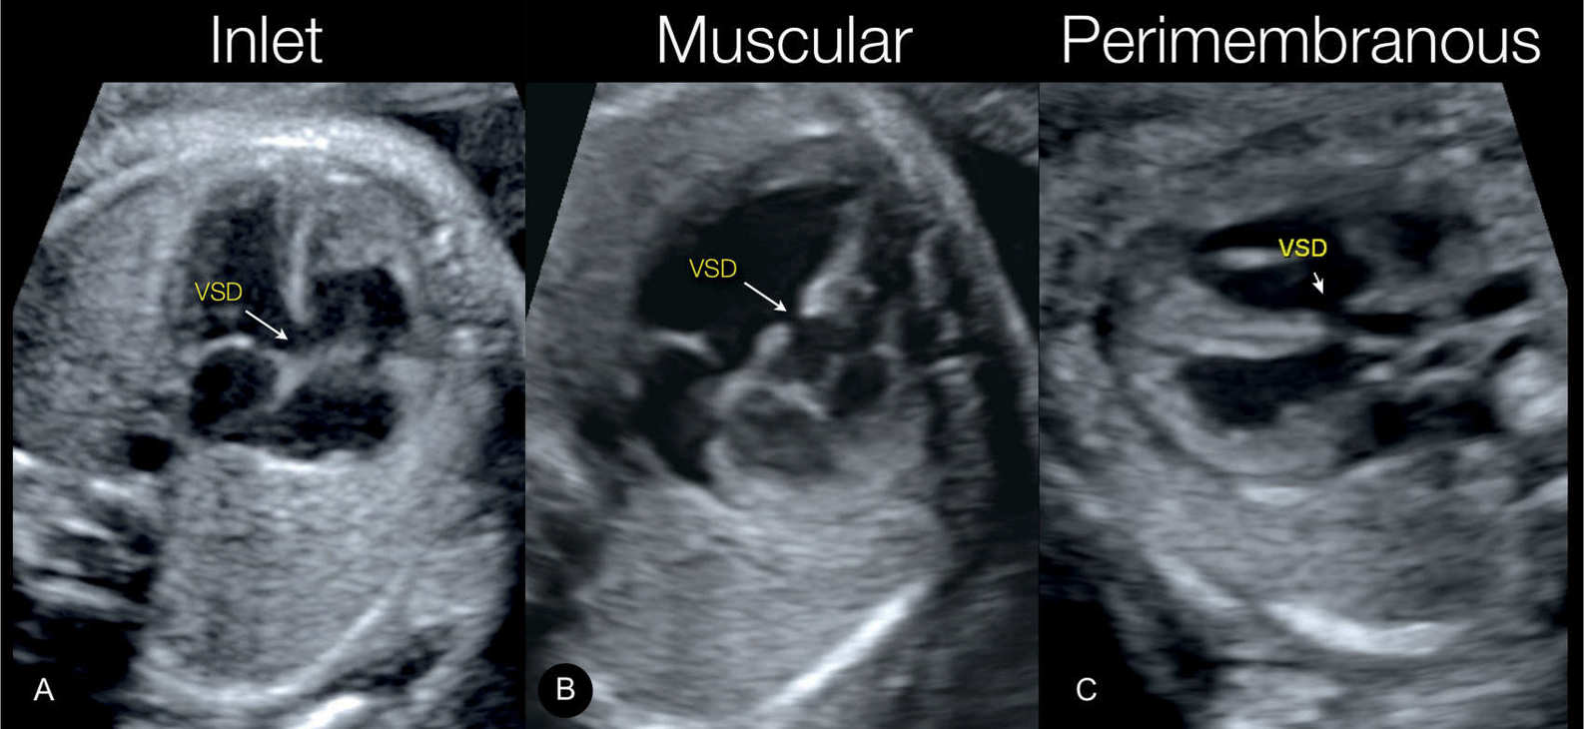
Fetal Heart

Slide 9
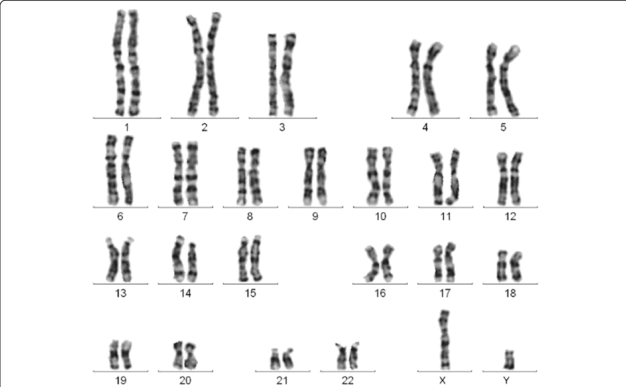
Genetics

Slide 10
Candidates For Genetic Studies
FGR before 32 weeks in the absence of an identifiable nongenetic cause
FGR with major fetal structural abnormalities or ultrasound markers of aneuploidy
FGR with polyhydramnios

Slide 11
Genetic Testing Modality
Cell-free DNA of maternal blood
Noninvasive, but not diagnostic
Microarray or conventional karyotype
Requires amniocentesis
Microarray improves yield over karyotype
4% in non-anomalous FGR
10% with anomalies
Exome and whole genome sequencing
limited incremental yield
informative in cases of skeletal dysplasia

Slide 12
IUGR and Aneuploidy
IUGR Anomalies Poly Aneuploid
X 7 %
X X 32 %
X X 27 %
X X X 47 %

Slide 13
Fetal Infections

Slide 14
Fetal Infections
Rubella
Cytomegalovirus
Varicella
Toxoplasmosis
Human immunodeficiency virus
Malaria
Zika virus
COVID-19?

Slide 15
Markers of Fetal Infection
VENTRICULOMEGALY
MICROCEPHALY
CEREBRAL CALCIFICATIONS
PERIVENTRICULAR HYPERECHOGENICITY
HEART FAILURE
CARDIOMEGALY
HEPATOSPLENOMEGALY
LIVER CALCIFICATIONS
ECHOGENIC BOWEL
HYDROTHORAX AND PERICARDIAL EFFUSION
HYDROPS AND SKIN EDEMA
PLACENTOMEGALY

Slide 16
Markers of Fetal Infection

Slide 17
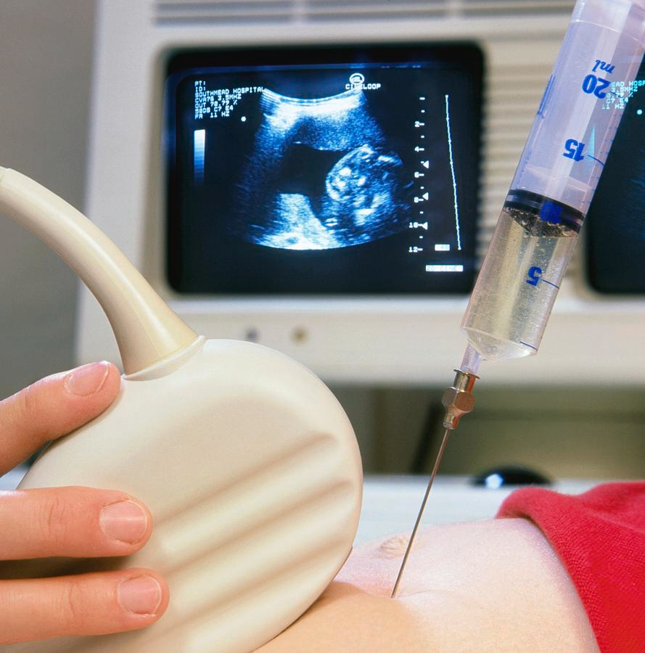
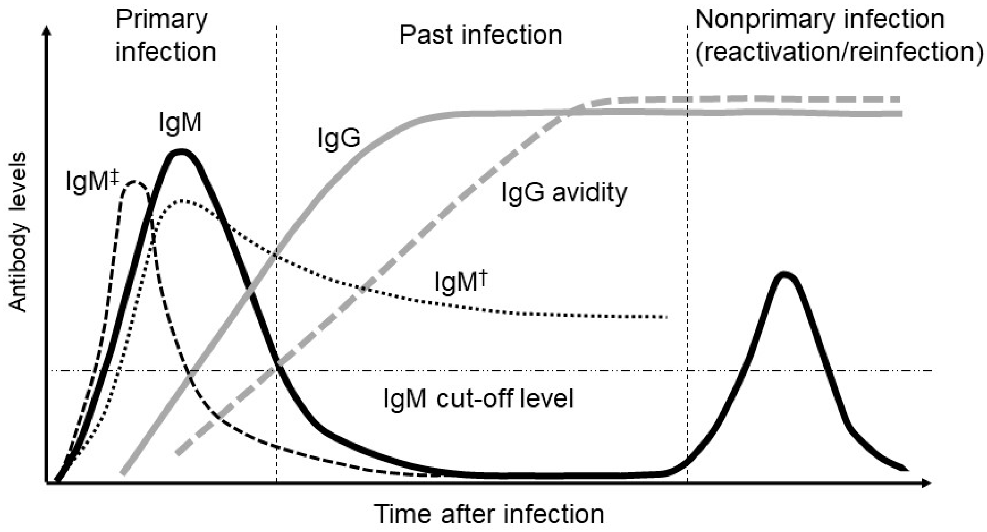
Diagnosing Infection
Amniocentesis
Serology

Slide 18
Maternal Nutrition
Leningrad siege (prolonged)
400 - 600g reduction in birth weights
Holland (6-month famine)
Birth weights declined ~10% only when undernutrition occurred in the third trimester (daily caloric intake <1500 kcal)

Slide 19
Other Causes
Oxygen lack
Median birth weight above 10,000 feet ~ 250 g less than at sea level
Cigarette smoking
Reduction of birth weight of 135 - 300 g
Alcohol, heroin, and cocaine
Drugs – Carbamazepine, hydantoin, gabapentin, beta blockers

Slide 20
FGR: Management
Twice weekly fetal reassurance testing
NSTs, BPPs
Weekly AFI
Growth scans every 3 weeks
Deliver at 39 weeks if EFW 3 – 10%
Deliver at 37 weeks if EFW < 3%
Steroids if potential preterm delivery
Treat infection?

