Slide 1
Virtual Visits amid a Pandemic
Matt Bartels, MD, FAAP, CPE
BCBSSC

Slide 2
A Rapid Transition to Telehealth
Pre-COVID adoption
Post-COVID provider utilization
Approval process
Pandemic concessions

Slide 3
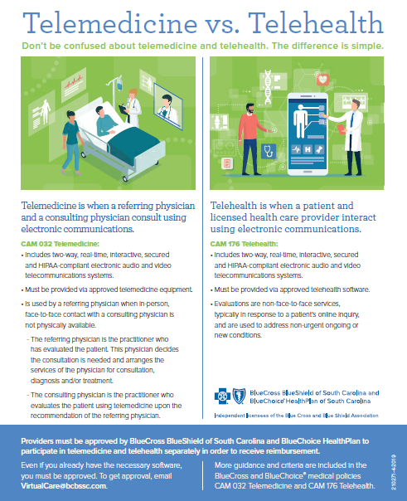

Slide 4
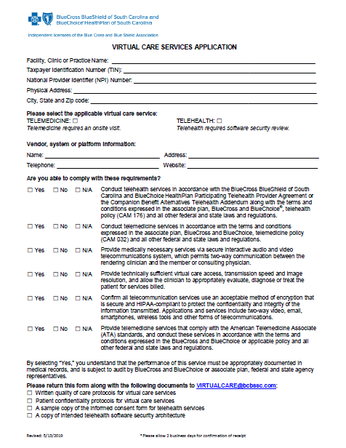

Slide 5
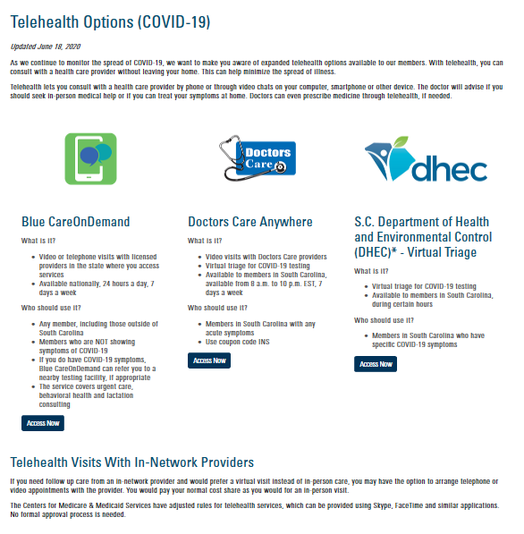

Slide 6
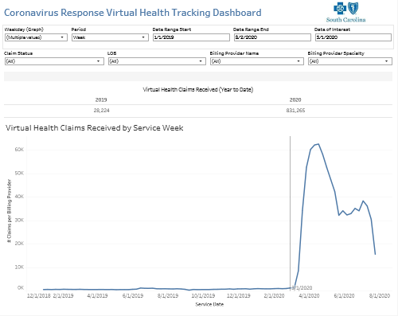
Dashboard View of Utilization

Slide 7
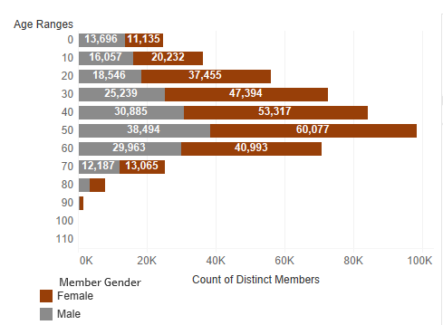
BCBSSC Age Distribution of Telehealth

Slide 8
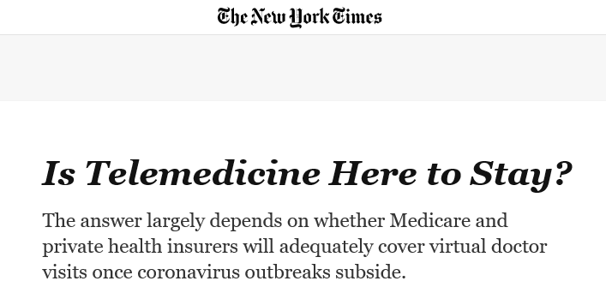
Charting the Course Forward

