Slide 1
The Three Major
Dermatoses of Pregnancy
Eric H. Dellinger, MD
USCSOM-Greenville
Greenville, SC

Slide 2
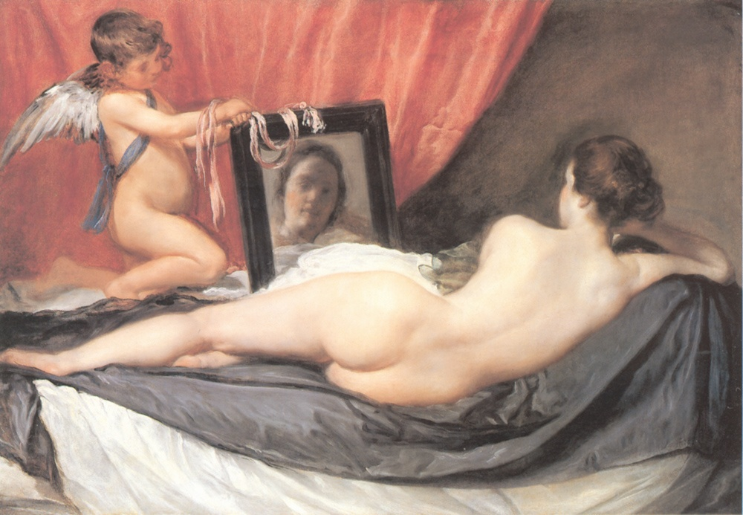

Slide 3
New Classification Synonyms
Pemphigoid gestationis (PG) Herpes gestationis
Polymorphic eruption of pregnancy Pruritic urticarial papules and (PEP) plaques of pregnancy (PUPPP)
Toxaemic rash of pregnancy
Late onset prurigo of pregnancy
Toxic erythema of pregnancy
Atopic eruption of pregnancy Prurigo of pregnancy
(AEP) Prurigo gestationis
Early onset prurigo of pregnancy
Papular dermatitis of pregnancy
Pruritic folliculitis of pregnancy
Eczema in pregnancy
Intrahepatic cholestasis of pregnancy Cholestasis of pregnancy
(ICP) Pruritus / Prurigo gravidarum
Obstetric cholestasis Jaundice of pregnancy

Slide 4
Pemphigoid Gestationis
Incidence 1 in 50,000 pregnancies
Presents most commonly in 6th-7th month
Range 9 weeks GA to 1 week postpartum
Recurs frequently in subsequent pregnancies
  Earlier
  More severe symptoms

Slide 5
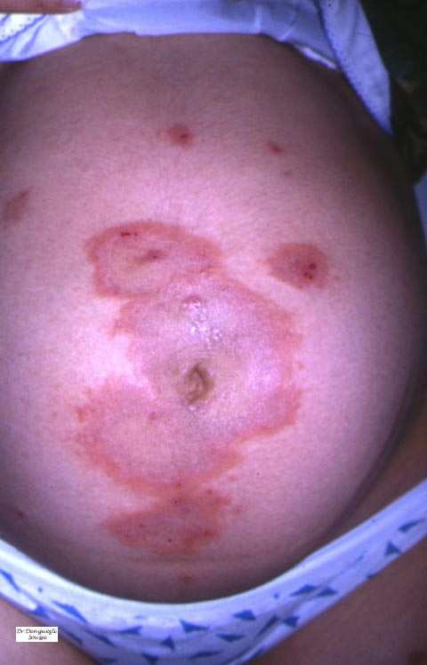
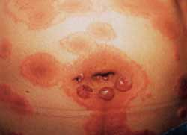

Slide 6
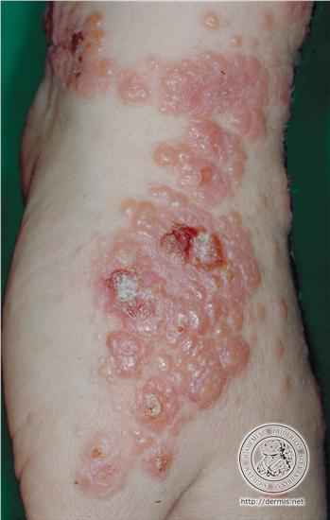

Slide 7
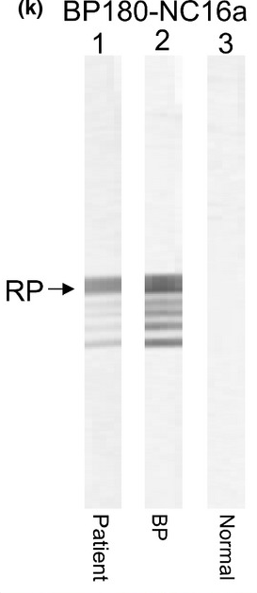
Pemphigoid Gestationis
Etiology: circulating immunoglobulin directed against the bullous pemphigoid antigen in the basement membrane of the skin.
Primary site of autoimmunity seems to be the placenta, as antibodies also bind to chorionic and amniotic epithelia

Slide 8
Pemphigoid Gestationis
Characterized by intensely pruritic eruption of erythematous papules, plaques, and vesiculobullous lesions
Periumbilical lesions initially
Spreads to trunk and extremities, palms and soles
Face and mucus membranes spared
2nd and 3rd trimesters most common
Rarely may present postpartum, but postpartum flares seen in 75%. And 25% subsequently have a flare with OCPs or during menses.

Slide 9
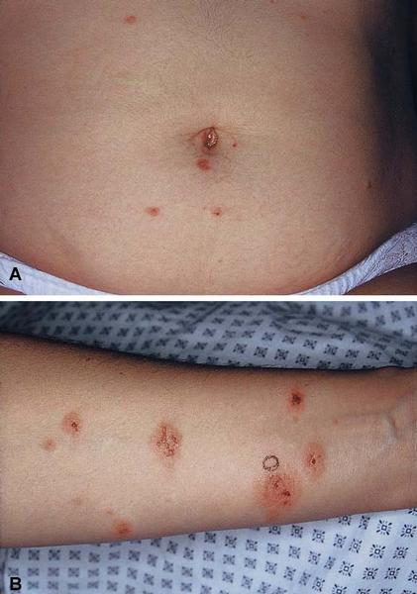
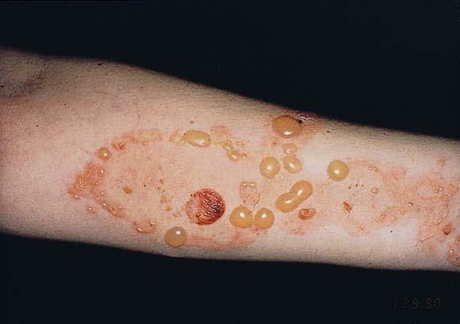

Slide 10
Pemphigoid Gestationis
Diagnosis: Skin biopsy diagnostic
  Immunofluorescence positive for complement and IgG along the basement membrane
  Serum levels of anti-BP180 antibodies (correlate with disease severity and help monitor response to treatment)
Newborn rash secondary to passive transfer of maternal IgG
5% newborns affected, resolves in 2 weeks
Increased rates of FGR and preterm delivery

Slide 11
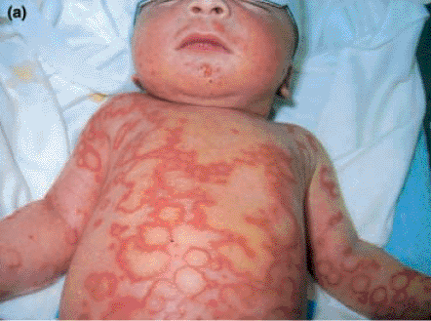

Slide 12
Pemphigoid Gestationis
Association with other autoimmune diseases:
Graves’ disease and vitiligo
Treatment:
  Topical steroids usually inadequate
  Prednisone 20-80 mg daily
  Titrate dose to control symptoms, flares
  Continue for 8-10 weeks postpartum
  Oral antihistamines may help control pruritus

Slide 13
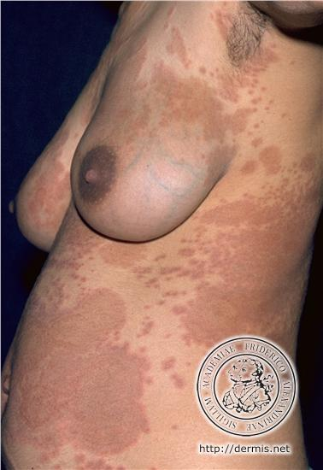
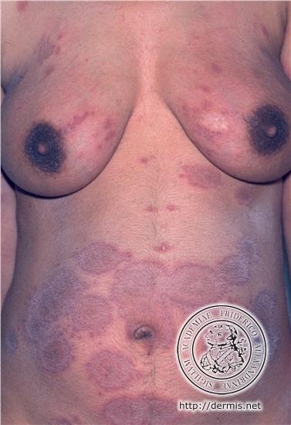

Slide 14
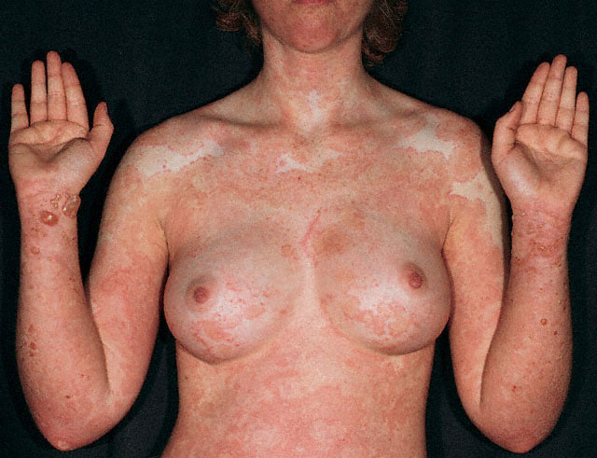

Slide 15
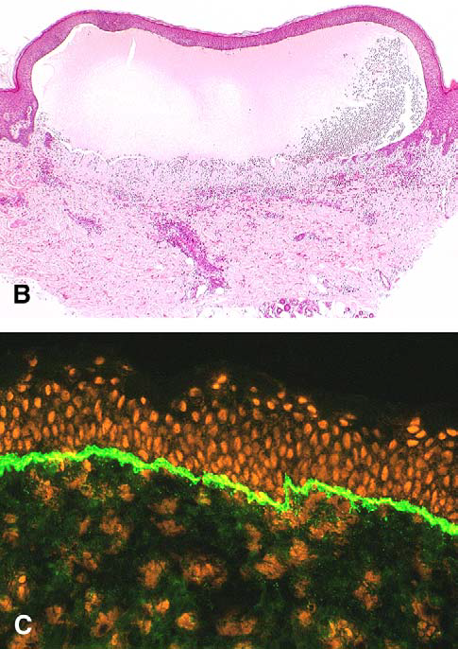
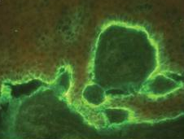
Deposition of complement 3 along the basement membrane zone.

Slide 16
Polymorphic Eruption of Pregnancy
Polymorphic eruption Pruritic urticarial papules and
of pregnancy plaques of pregnancy (PUPPP)
(PEP) Toxaemic rash of pregnancy Late onset prurigo of pregnancy
Toxic erythema of pregnancy

Slide 17
Polymorphic Eruption of Pregnancy
Incidence = 1 in 160 - 300 pregnancies
76% of cases present in primagravidas
  Generally considered non-recurrent
  24% multigravidas
Almost exclusive to the third trimester
  Usually around 36th week
  39th week most common

Slide 18
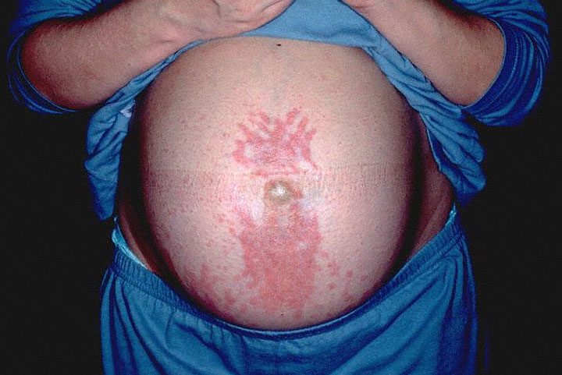

Slide 19
Polymorphic Eruption of Pregnancy
Etiology: Unknown. Skin stretching? More common twins. Immune response to circulating fetal antigens? More XY.
Usually occurs in nulliparous women late in the third trimester (mean onset 35 weeks) but may develop.
Rare reports of first or second trimester or postpartum disease.

Slide 20
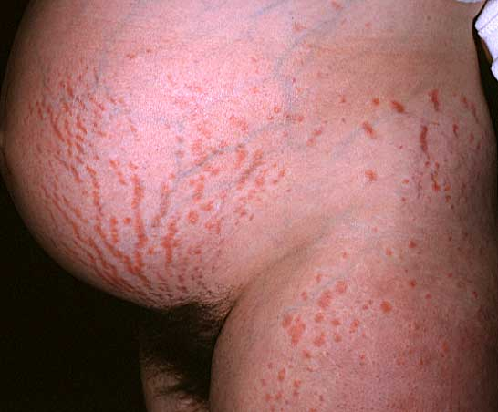

Slide 21
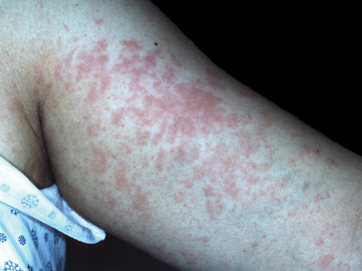
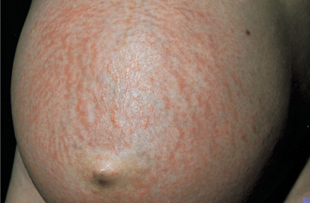
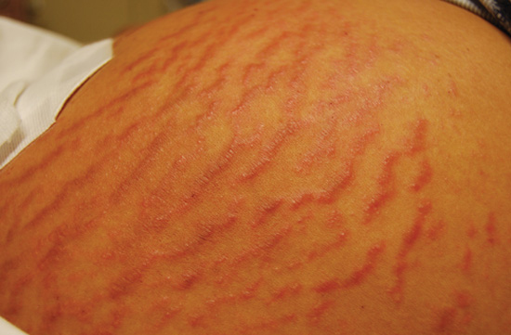

Slide 22
Polymorphic Eruption of Pregnancy
Lesions appear on abdomen first, often in striae (Koebner phenomenon) with periumbilical sparing
  Spread to arms, legs, breasts, buttocks, back
  Face, palms, and soles spared
Pruritis is intense, excoriations minimal
Eruption generally lasts 4-6 weeks and resolves within two weeks postpartum (may last longer or resolve prior to delivery)

Slide 23
Polymorphic Eruption of Pregnancy
Diagnosis: Clinical, based upon history and physical. A skin biopsy is generally not necessary (perivascular lymphocytic infiltrate containing eosinophils)
Newborns are unaffected
No increase in perinatal M&M
Treatment:
  Topical steroids initially
  Systemic steroids for failures
  Antihistamines may help control pruritus

Slide 24
Atopic Eruption of Pregnancy
Atopic eruption of pregnancy Prurigo of pregnancy
(AEP) Prurigo gestationis
Early onset prurigo of pregnancy
Papular dermatitis of pregnancy
Pruritic folliculitis of pregnancy
Eczema in pregnancy

Slide 25
Atopic Eruption of Pregnancy
Most common dermatoses of pregnancy: 50% of cases
Benign, self-limited pruritic disorder of pregnancy
Personal and/or family history of atopy (seasonal rhinitis, asthma, or atopic dermatitis)
Etiology: immune changes of pregnancy (changes in T helper cell cytokines) lead to eczema
Clinically presents as eczematous lesions (2/3 of cases) or prurigo lesions (1/3 of cases) or rarely pruritic folliculitis

Slide 26
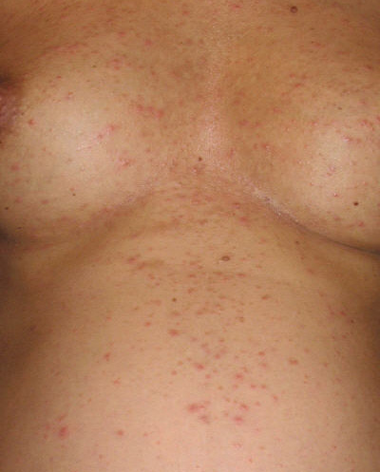

Slide 27
Atopic Eruption of Pregnancy
Lesions found on face, neck, breast cleavage, and flexor surfaces (typical atopy areas)
Diagnosis: usually clinical in a patient with a personal or family history of atopy. Skin biopsy generally not helpful (nonspecific). Biopsy if suspicion of pemphigoid gestationis
Treatment: Moisturizers (emollient creams and ointments), topical steroids, oral steroids (prednisone). Antihistamines may be tried: chlorpheniramine, loratadine, cetirizine
Prognosis: No adverse effects on the fetus. Usually resolves prior to delivery or within two weeks postpartum. May recur in pregnancy.

Slide 28
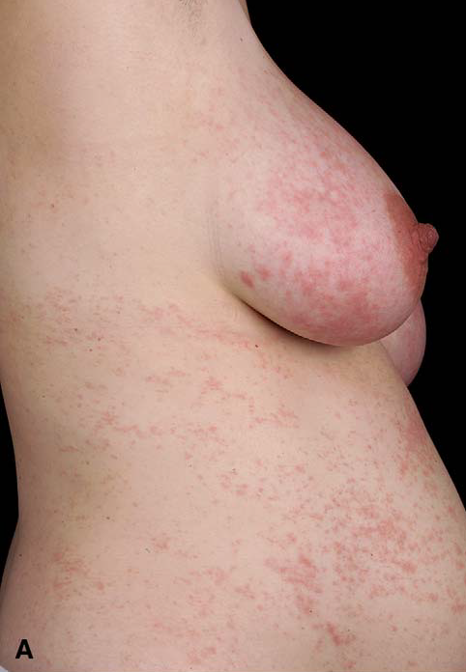

Slide 29
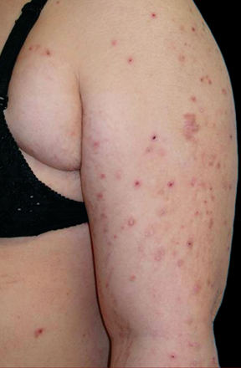
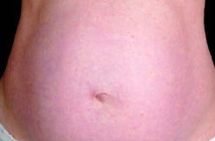
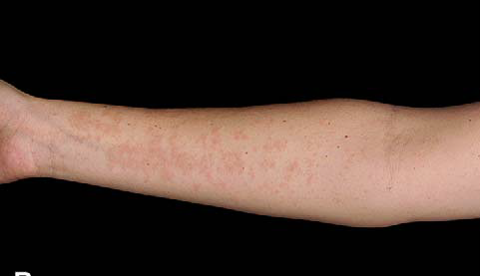

Slide 30
Differences in
Clinical Characteristics (n=401)
PG PEP AEP
(n=21) (n=109) (n=256)
Primiparous women, % 48 73 44
Identical skin lesions in previous pregnancies, % 9 7 34
Early presentation (<third trimester), % 29 3 75
Recurrence in another pregnancy Yes No Yes
Location: abdominal involvement, % 95 98 68
Fetal risk FGR, PTL, No No
Rash (10%)
J Am Acad Dermatol. 2006 Mar; 54(3):395-404.

Slide 31
