Slide 1
Thromboembolism Prophylaxis
Pregnancy/Postpartum
Berry A. Campbell, MD
Project ECHO-Women’s Wellness
Prisma Health Midlands/UofSC School of Medicine Columbia

Slide 2
Learning Objectives
Understand the different schemes for VTE prophylaxis
Understand how weight may alter recommendations for prophylaxis
Understand the importance of repeated assessment of risk factors leading to prophylaxis with LMWH

Slide 3
Thromboembolism Prophylaxis
Pregnancy/Postpartum
Risk factor assessment
Pre-pregnancy
Early pregnancy
Admission to hospital
Pregnancy complication

Slide 4
Thromboembolism Prophylaxis
Pregnancy/Postpartum
Mechanical
Lateral decubitus
Graduated elastic compression hose
Pneumatic compression devices
Medical
Unfractionated heparin
Low molecular weight heparin
(orals: warfarin, dabigatron, rivaroxaban, etc.)

Slide 5
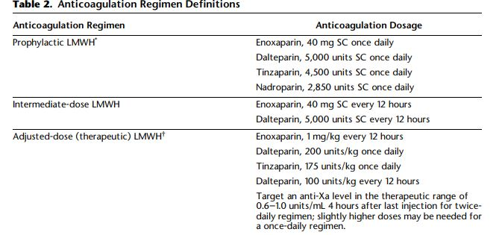

Anticoagulation Regimen Definitions
ACOG Practice Bulletin, Vol. 132, No. 1, July 2018

Slide 6
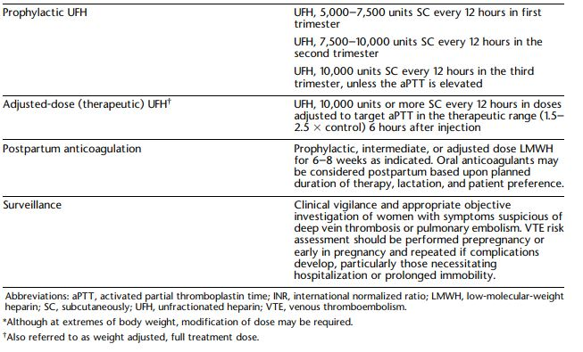
Anticoagulation Regimen Definitions

Slide 7
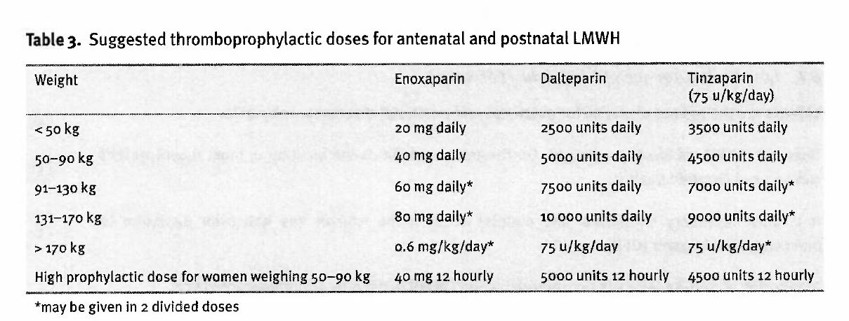
Suggested thromboprophylactic doses for antenatal and postnatal LMWH
Royal College of Ob/Gyn, April 2015

Slide 8
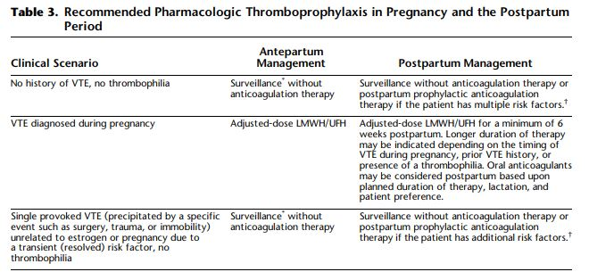
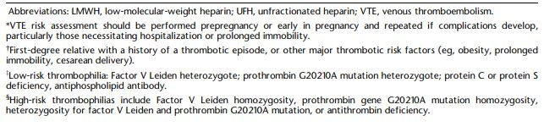
Recommended Pharmacologic Thromboprophylaxis in Pregnancy and the Postpartum Period

Slide 9
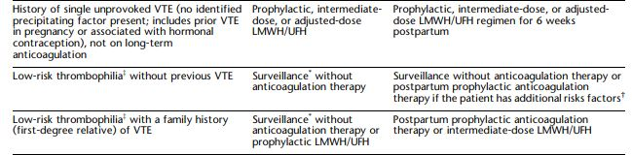
Recommended Pharmacologic Thromboprophylaxis in Pregnancy and the Postpartum Period

Slide 10
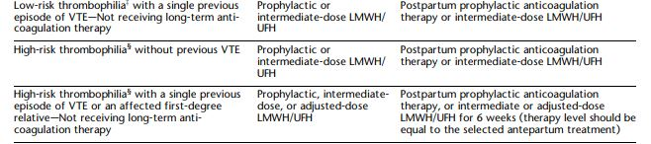
Recommended Pharmacologic Thromboprophylaxis in Pregnancy and the Postpartum Period

Slide 11
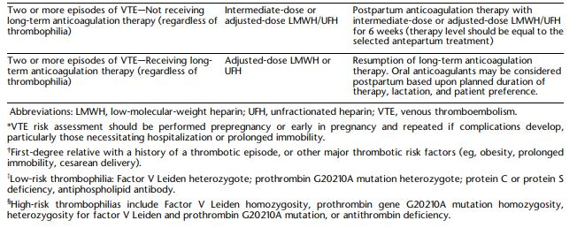
Recommended Pharmacologic Thromboprophylaxis in Pregnancy and the Postpartum Period

Slide 12
High risk thrombophilias
F5LM homozygous
Prothrombin gene G20210 mutation homozygous
Heterozygous for both the above
Antithrombin deficiency

Slide 13
Planned vaginal delivery or CS
Epidural hematoma risk
Hold prophylactic dose ≥ 12 hours
Hold therapeutic dose ≥ 24 hours
Hold dose if having contractions at scheduled dosing time

Slide 14
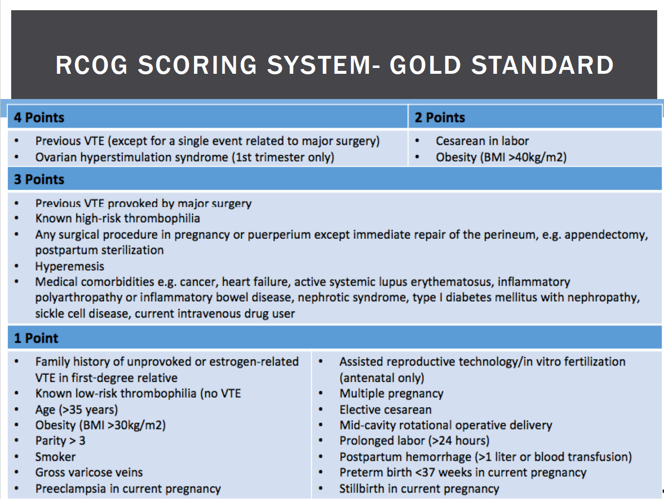
RCOG.org

Slide 15
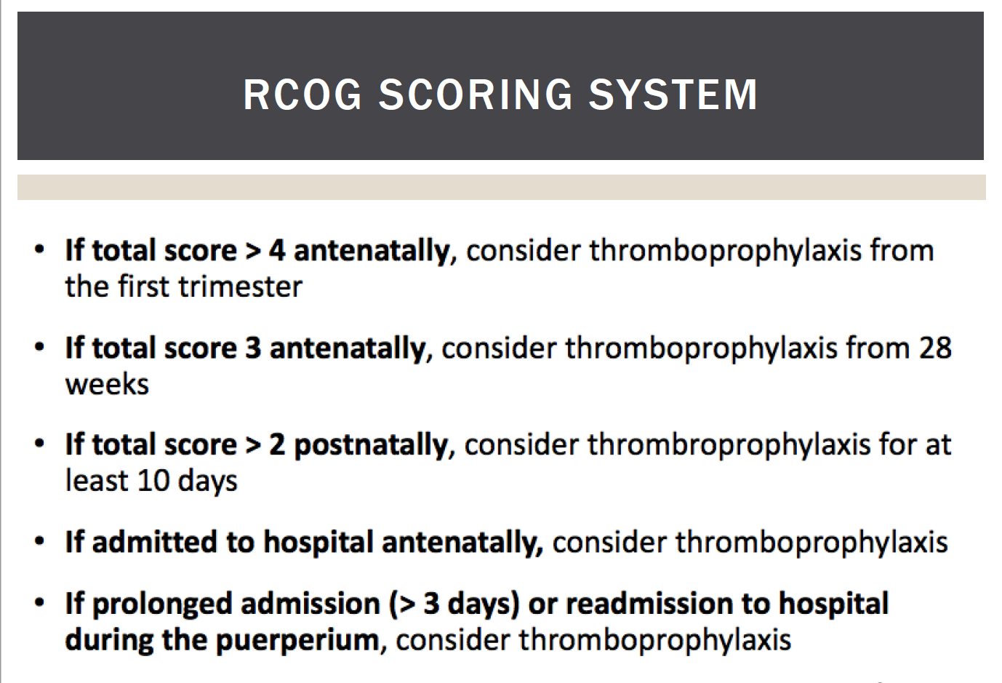
RCOG.org

