Slide 1
THYROID DISEASE IN PREGNANCY
Donna D. Johnson, MD

Slide 2
THYROID GLAND REGULATION
Online Science, 2021

Slide 3
THYROID GLAND
Absolute Health & Wellness

Slide 4
CHANGES DURING PREGNANCY
TSH: → except first trimester
Lower level of TSH can be reduced by 0.4 milliunits/L
Upper level of TSH can be reduced by 0.5 milliunits/L
Total T4: ↑
Total T3: ↑
Free T4: →
Free T3: →
Thyroid Binding Globulin (TBG): ↑↑

Slide 5
HYPERTHYROIDISM
Nervousness and tremors
Tachycardia and palpitations
Excessive sweating and heat intolerance
Weight loss
Goiter
Insomnia
Hypertension
Ophthalmopathy (lid lag and lid retraction)
Dermopathy (signs include localized or pretibial myxedema).

Slide 6
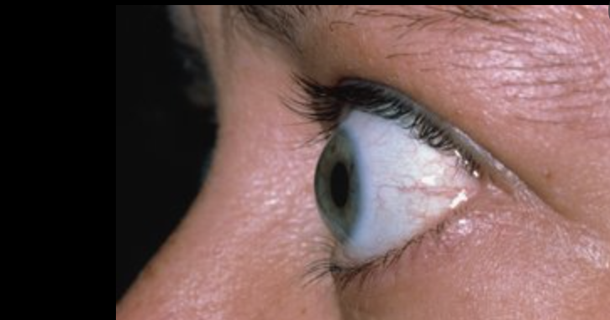
HYPERTHYROIDISM

Slide 7
FETAL EFFECTS
Preterm delivery
Low birth weight
Miscarriage
Stillbirth

Slide 8
HYPERTHYROIDISM
TSH: Decreased
Free T4: Increased
Propylthiouracil (PTU)
Methimazole (Tapazole)
Avoid first trimester: Cutaneous aplasia &
Propranolol
ACOG PB #223, 2020

Slide 9
HYPOTHYROIDISM
Fatigue
Constipation
Cold intolerance
Muscle cramps
Weight gain
Edema
Dry skin
Hair loss
Prolonged relaxation phase of deep tendon reflexes.

Slide 10
HYPOTHYROIDISM
Low birth weight
Impaired neuropsychologic development

Slide 11
HYPOTHYROIDISM
TSH: ↑
Free T4: ↓
Synthroid: consider using only name brand

Slide 12
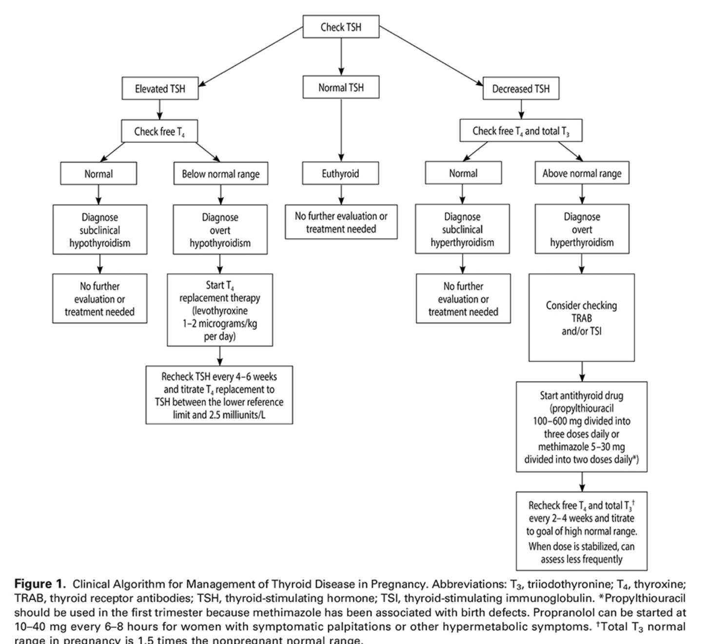
ACOG PB #223, 2020

Slide 13
THYROID SCREENING IN PREGNANCY
Universal screening is NOT recommended
No screening in hyperemesis gravidarium
At risk individuals:
Type 1 diabetes
Family or personal history of thyroid disease
Advancing age
Low iodine intake

Slide 14
THYROID STORM
Fever
Tachycardia
Cardiac dysrhythmia
Central nervous system dysfunction
Heart failure

