Slide 1

Understanding Safety Bundles
Project ECHO
June 16, 2021
Michelle Flanagan, BSN, RNC-OB, C-EFM

Slide 2
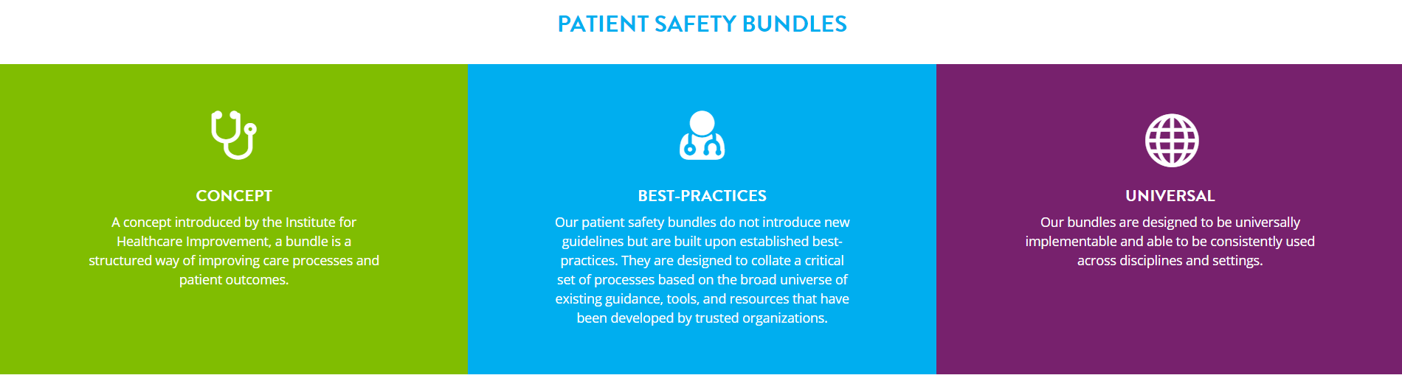
What is a Bundle?
https://safehealthcareforeverywoman.org/council/getting-started/
Notes:
The Institute for Healthcare Improvement describes patient safety bundles as, “…a structured way of improving the processes of care and patient outcomes: a small, straightforward set of evidence-based practices — generally three to five — that, when performed collectively and reliably, have been proven to improve patient outcomes.”
The bundle structure does not introduce new practice guidelines or concepts, but offers a standardized approach for delivering well-established, evidence-based practices to be implemented with complete consistency, for every patient, every time – resulting in improved patient outcomes.
STANDARDIZATION IS KEY!

Slide 3
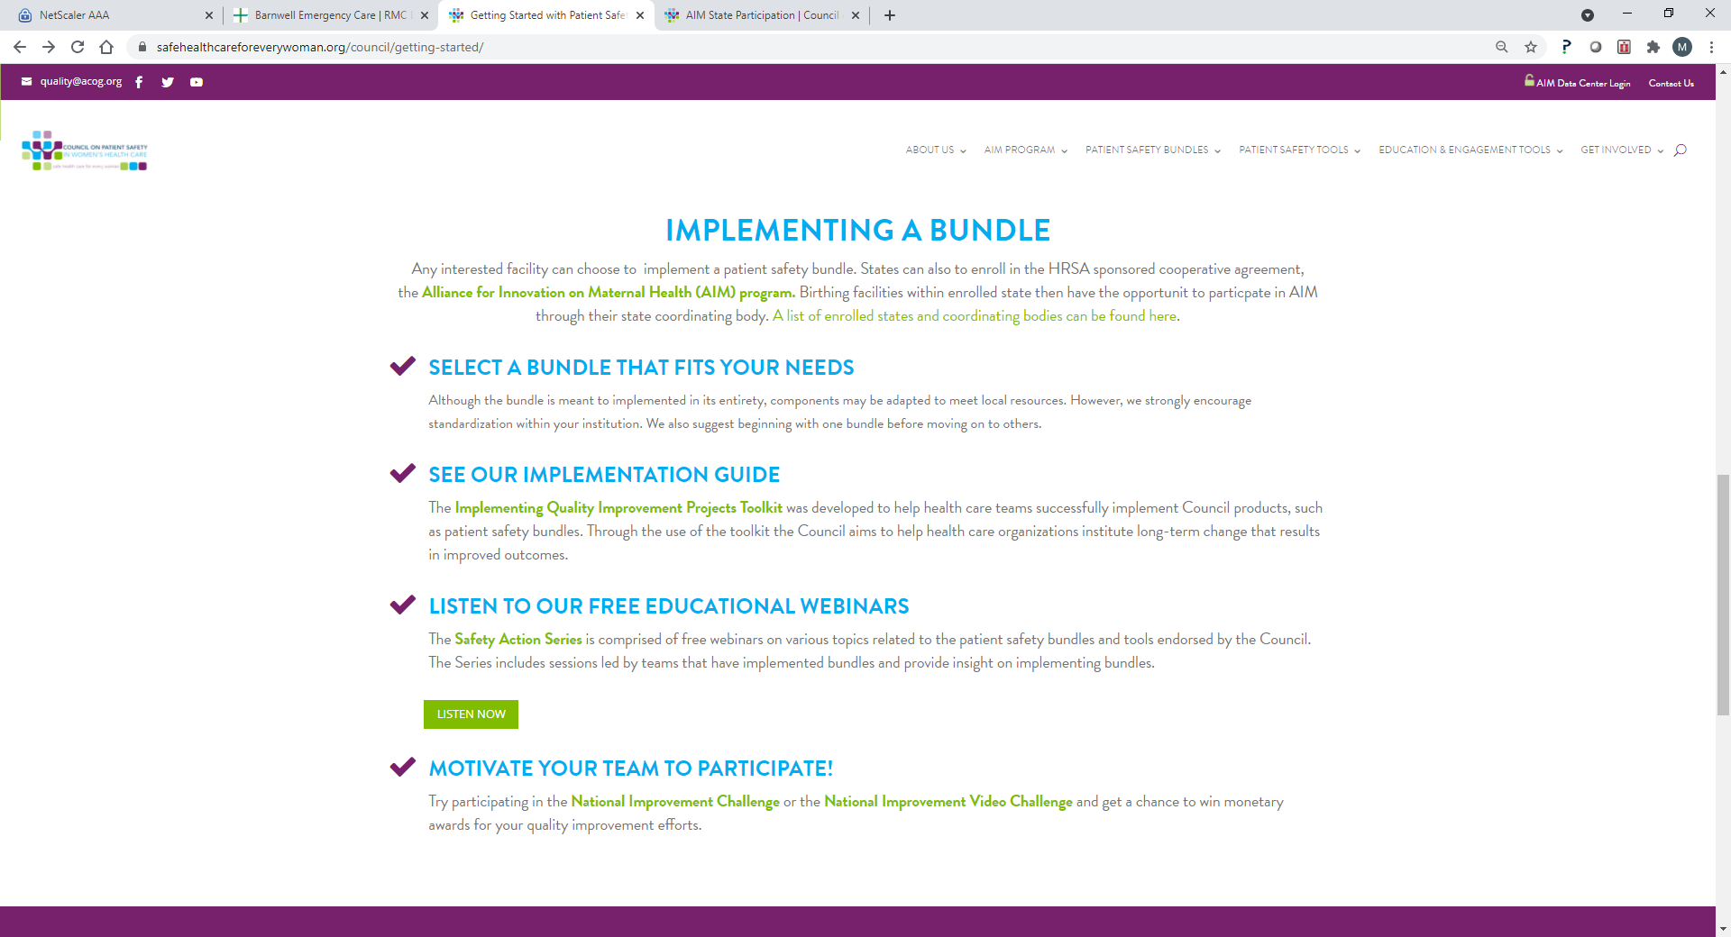

Slide 4
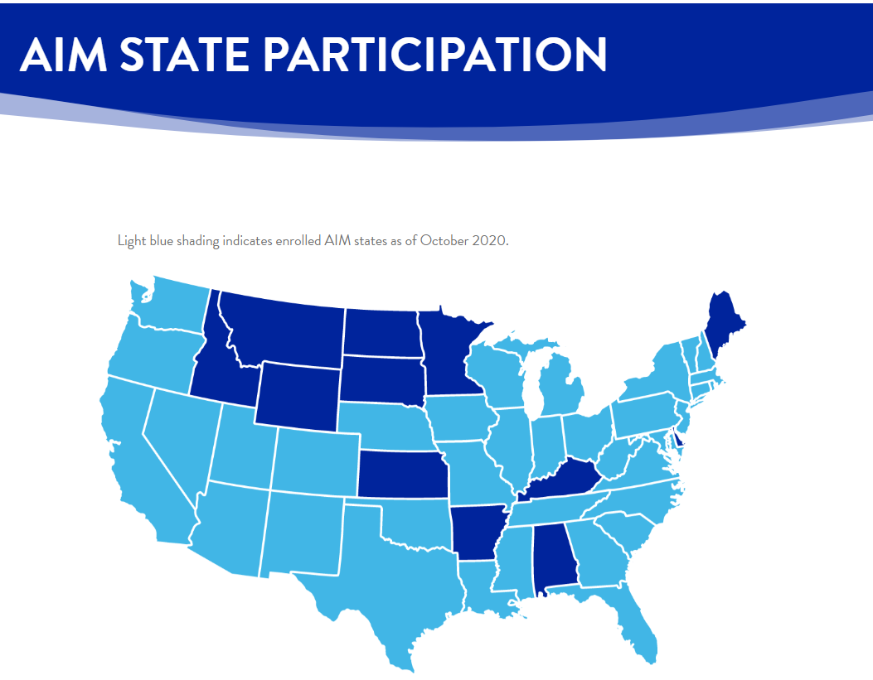
South Carolina & AIM

Slide 5
The 4 R’s
Readiness
Recognition & Prevention
Response
Reporting/Systems Learning
R
R
R
R

Slide 6
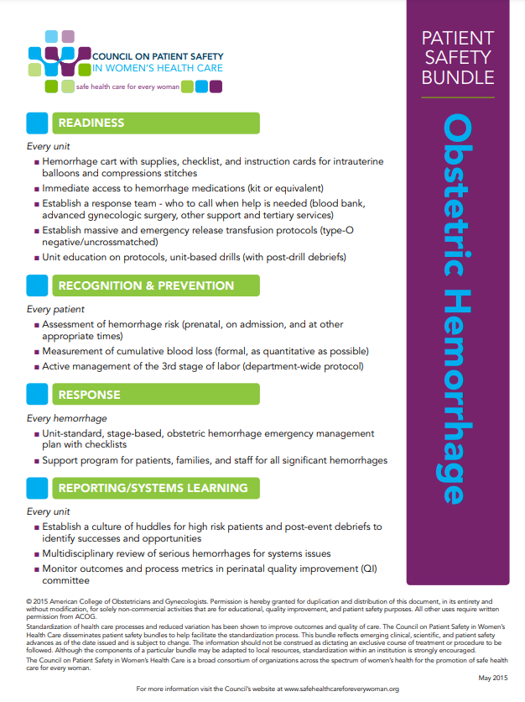

Slide 7
READINESS – Every Unit
Hemorrhage cart with supplies, checklist, and instruction cards for intrauterine balloons and compressions stitches
Immediate access to hemorrhage medications (kit or equivalent)
Establish a response team – who to call when help is needed (blood bank, advanced gynecologic surgery, other support and tertiary services)
Establish massive and emergency release transfusion protocols (type-O negative/uncrossmatched)
Unit education on protocols, unit-based drills (with post-drill debriefs)

Slide 8
RECOGNITION – Every Patient
Assessment of hemorrhage risk (prenatal, on admission, and at other appropriate times)
Measurement of cumulative blood loss (formal, as quantitative as possible)
Active management of the 3rd stage of labor (department-wide protocol)
Notes:
RECOGNITION & PREVENTION
Every Patient
Assessment of hemorrhage risk (prenatal, on admission, and at other appropriate times)
Measurement of cumulative blood loss (formal, as quantitative as possible)
Active management of the 3rd stage of labor (department-wide protocol)

Slide 9
RESPONSE - Every Hemorrhage
Unit-standard, stage-based, obstetric hemorrhage emergency management plan with checklists
Support program for patients, families, and staff for all significant hemorrhages
Notes:
RESPONSE
Every Hemorrhage
Unit-standard, stage-based, obstetric hemorrhage emergency management plan with checklists
Support program for patients, families, and staff for all significant hemorrhages

Slide 10
REPORTING/SYSTEMS LEARNING -
Every Unit
Establish a culture of huddles for high risk patients and post-event debriefs to identify successes and opportunities
Multidisciplinary review of serious hemorrhages for systems issues
Monitor outcomes and process metrics in perinatal quality improvement (QI) committee
Notes:
REPORTING/SYSTEMS LEARNING
Every Unit
Establish a culture of huddles for high risk patients and post-event debriefs to identify successes and opportunities
Multidisciplinary review of serious hemorrhages for systems issues
Monitor outcomes and process metrics in perinatal quality improvement (QI) committee

Slide 11
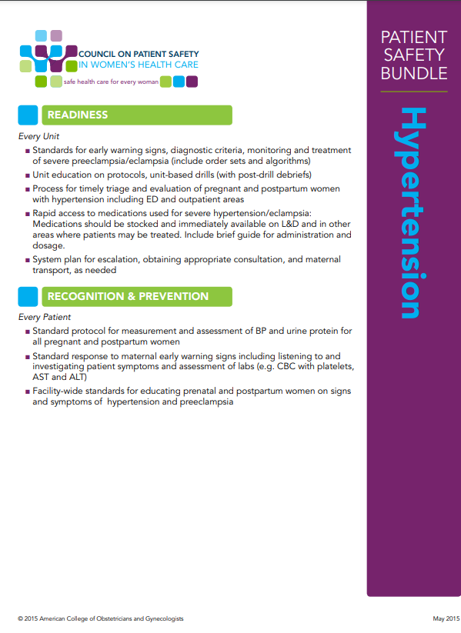
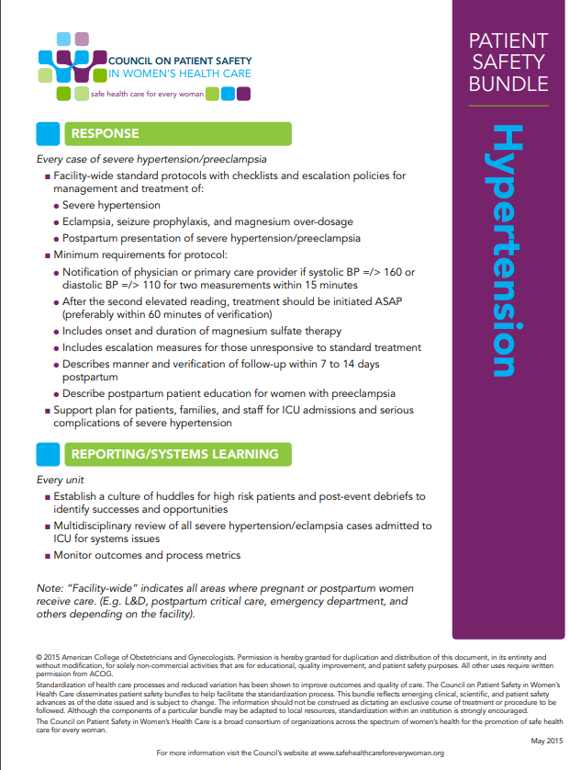

Slide 12
READINESS – Every Unit
Standards for early warning signs, diagnostic criteria, monitoring and treatment of severe preeclampsia/eclampsia (include order sets and algorithms)
Unit education on protocols, unit-based drills (with post-drill debriefs)
Process for timely triage and evaluation of pregnant and postpartum women with hypertension including ED and outpatient areas
Rapid access to medications used for severe hypertension/eclampsia: Medications should be stocked and immediately available on L&D and in other areas where patients may be treated. Include brief guide for administration and dosage.
System plan for escalation, obtaining appropriate consultation, and maternal transport, as needed
Notes:
Standards for early warning signs, diagnostic criteria, monitoring and treatment of severe preeclampsia/eclampsia (include order sets and algorithms)
Unit education on protocols, unit-based drills (with post-drill debriefs)
Process for timely triage and evaluation of pregnant and postpartum women with hypertension including ED and outpatient areas
Rapid access to medications used for severe hypertension/eclampsia: Medications should be stocked and immediately available on L&D and in other areas where patients may be treated. Include brief guide for administration and dosage.
System plan for escalation, obtaining appropriate consultation, and maternal transport, as needed

Slide 13
RECOGNITION – Every Patient
Standard protocol for measurement and assessment of BP and urine protein for all pregnant and postpartum women
Standard response to maternal early warning signs including listening to and investigating patient symptoms and assessment of labs (e.g. CBC with platelets, AST and ALT)
Facility-wide standards for educating prenatal and postpartum women on signs and symptoms of hypertension and preeclampsia
Notes:
Standard protocol for measurement and assessment of BP and urine protein for all pregnant and postpartum women
Standard response to maternal early warning signs including listening to and investigating patient symptoms and assessment of labs (e.g. CBC with platelets, AST and ALT)
Facility-wide standards for educating prenatal and postpartum women on signs and symptoms of hypertension and preeclampsia

Slide 14




RESPONSE –
Every case of severe hypertension / preeclampsia
Facility-wide standard protocols with checklists and escalation policies for management and treatment of:
  Severe hypertension
  Eclampsia, seizure prophylaxis, and magnesium over-dosage
  Postpartum presentation of severe hypertension / preeclampsia
  Minimum requirements for protocol:
    Notification of physician or primary care provider if systolic BP =/> 160 or diastolic BP =/> 110 for two measurements within 15 minutes
    After the second elevated reading, treatment should be initiated ASAP (preferably within 60 minutes of verification)
    Includes onset and duration of magnesium sulfate therapy
    Includes escalation measures for those unresponsive to standard treatment
    Describes manner and verification of follow-up within 7 to 14 days postpartum
    Describe postpartum patient education for women with preeclampsia
    Support plan for patients, families, and staff for ICU admissions and serious complications of severe hypertension
Notes:
Every case of severe hypertension/preeclampsia
Facility-wide standard protocols with checklists and escalation policies for management and treatment of:
Severe hypertension
Eclampsia, seizure prophylaxis, and magnesium over-dosage
Postpartum presentation of severe hypertension/preeclampsia
Minimum requirements for protocol:
Notification of physician or primary care provider if systolic BP =/> 160 or diastolic BP =/> 110 for two measurements within 15 minutes
After the second elevated reading, treatment should be initiated ASAP (preferably within 60 minutes of verification)
Includes onset and duration of magnesium sulfate therapy
Includes escalation measures for those unresponsive to standard treatment
Describes manner and verification of follow-up within 7 to 14 days postpartum
Describe postpartum patient education for women with preeclampsia
Support plan for patients, families, and staff for ICU admissions and serious complications of severe hypertension

Slide 15
REPORTING/SYSTEMS LEARNING -
Every Unit
Establish a culture of huddles for high risk patients and post-event debriefs to identify successes and opportunities
Multidisciplinary review of all severe hypertension/eclampsia cases admitted to ICU for systems issues
Monitor outcomes and process metrics in perinatal quality improvement (QI) committee
Notes:
REPORTING/SYSTEMS LEARNING
Every Unit
Establish a culture of huddles for high risk patients and post-event debriefs to identify successes and opportunities
Multidisciplinary review of all severe hypertension/eclampsia cases admitted to ICU for systems issues
Monitor outcomes and process metrics

Slide 16
Upcoming Session
Date | Topic | Presenter
7.7 | Diagnosis & Management of Abuptio Placenta and Previa | Berry Campbell, MD

