Slide 1
Perinatal Depression
Rubin Aujla, MD MPH
Clinic director, MUSC Women’s reproductive behavioral health clinic
Assistant Professor, MUSC Department of Behavioral health

Slide 2
I have nothing to disclose

Slide 3
Objectives
Diagnosis
Prevalence
Risk factors
Maternal, fetal, newborn and child impact
Treatment
Referral to WRBH Clinic

Slide 4
PPD vs PMAD
PPD: Postpartum Depression
PMAD: Perinatal Mood and Anxiety Disorders
  Depression, Anxiety, OCD, PTSD/trauma, Bipolar, Psychosis, Eating disorders, ADHD…
  Substance Use disorders
  Perinatal loss, infertility

Slide 5
Perinatal Depression
  Episode of Major Depressive Disorder (MDD)
    Same Specifiers… with anxious distress
    Additional Specifier: in perinatal/postpartum setting
    Pregnancy
    Postpartum
          4 wks vs 1 yr after delivery

Slide 6
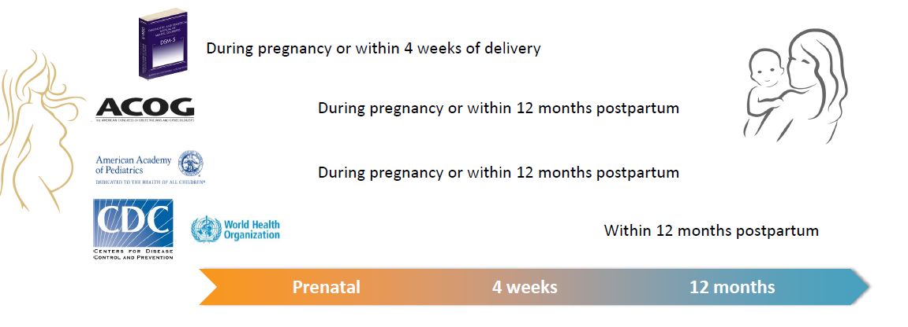
Peripartum Depression
Onset Varies Across Guidelines

Slide 7
Perinatal Depression is the most common complication of childbirth

Slide 8
Screening in Pregnancy and Postpartum
  EDPS: review item 10; Score 10/13 +
  PHQ-9: review item 9; Score 10 +

Slide 9
Risk Factors for Perinatal Depression
    History of Depression, Anxiety
        Prior to or during pregnancy
    Stressful Life Event/Neonatal Diagnosis
    Traumatic Birth
    NICU Admission
    Poor Marital/Partner Relationship
    Poor Social Support
    Low Socioeconomic Status
    History of Traumatic Experience(s)
        Domestic Violence, Childhood Sexual Abuse

Slide 10
Potential Impact of Untreated Depression
Patient
Obstetric/Fetal
Child Development

Slide 11
Suicide
    Suicide (especially in combination with drug OD) is the leading cause of perinatal mortality
    Is strongly associated with depressive symptoms, however, can be associated with other mood/anxiety disorders, substance use, etc
    3.3% of women hospitalized with a postpartum psychiatric illness complete suicide

Slide 12
Passive vs Active Suicidal Ideation (SI):
Passive SI
“Are you having thoughts about just wanting to go to sleep and not waking up?”
Active SI with a plan
“Have you thought of ways that you would end your life? If so, how?”
“Have you started preparing to do that?”
“Do you have the means to do that?” (e.g., access to gun, pills etc.)

Slide 13
Impact on Intimate Partner Relationship
PPD increases the risk for
  Problems in relationships
    PPD precedes problems/conflict in relationship
  Paternal depression
    25-50% of men whose partners have PPD
    2.5 times more likely in individual whose partners have PPD

Slide 14
Obstetric/Fetal Impact
    Poor Self-care, Nutrition & Prenatal Care
    Alcohol, Drugs and Nicotine Use
    Nausea, Vomiting, Hyper-emesis
    Spontaneous miscarriage
    Pre-eclampsia
    Unplanned C-section
    Preterm Birth (higher risk with depression severity)
    Low Birth Weight (higher risk with depression severity)
    Lower APGAR scores

Slide 15
In comparison to children of parents without PPD, children of parents with PPD are significantly more likely to:
3 Weeks
4 Months
Infant behaviors (difficulty sleeping, demanding, difficult to comfort)
6 Months
Unintentional injury
12 Months
Impaired mother-infant bonding
18 Month
Worse communication skills
4 Years
Decrease in cognitive and fine motor development
6 Years
Emotional, conduct, and behavioral difficulties
10 Years
Attenuated growth
18 years
Psychological difficulties
Adolescent depression

Slide 16
Risks of Untreated Perinatal Depression:
Patient
  Poor health habits
  Relationships
  Severity of illness/Suicide
Obstetric/Fetal
  C-section
  LBW (OR 1.96)
  PTB (OR 1.56)
Child Development
  Less likely to breastfeed
  Child Development:
    Sleep, mother-infant bonding, communication, cognition, fine motor, behavioral, academics, psychiatric

Slide 17
Treatment:
Cognitive Behavioral Therapy, Interpersonal Psychotherapy
Medications (Antidepressants)
Brain Stimulation: rTMS
Zulresso IV infusion
Bright Light Therapy, Yoga, Exercise, Mindfulness, Acupuncture, Omega 3 Fatty Acids, Group Therapy

Slide 18
Antidepressants
Risks in pregnancy
PTB – 3 day shorter gestational age
LBW – 75 grams (2.6 ounces) lower birth weight
NAS
PPHN

Slide 19
Neonatal Adaptation Syndrome (NAS)
~ 30% of newborns exposed to SSRIs
  Onset after delivery, peak 2-3 days
  Symptoms short-term, full recovery by 2 weeks postpartum
Symptoms:
  Irritability, tremors, jitteriness, muscle tone
  Trouble feeding, agitation, respiratory distress and poor sleep
  Less common: abnormal posturing and shivering
  Rare: seizure

Slide 20
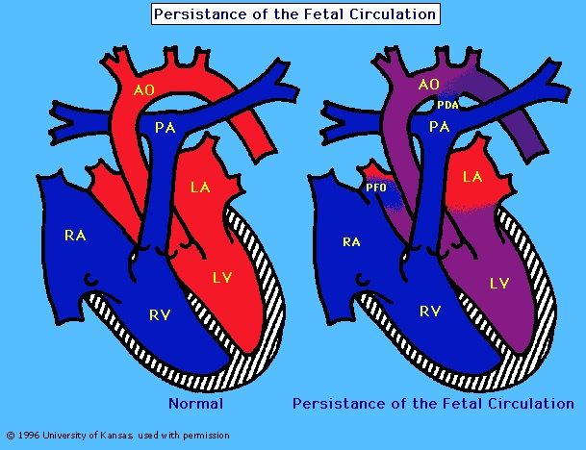
Persistent Pulmonary HTN of the Newborn (PPHN)
Persistence of Fetal Circulation
Population rate: 1-2/1000
Risk with SSRI’s: 3/1000
Mortality Rate: 6-12%

Slide 21
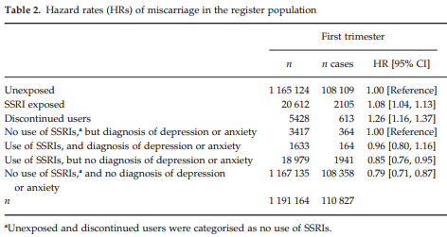
SSRI & Miscarriage Risk

Slide 22
SSRI & Malformation Risk
Once controlling for confounders, no clinically increased significant risk for malformation
No consistent malformation that stands out
Exception: Paxil: Black Box warning for risk for cardiac malformation

Slide 23
Additional potential SSRI Risks:
Apgar Score? <1/2 point
Autism spectrum? Non-significant risk once controlling for confounders including maternal mental illness
Child Development: Slightly lower psychomotor scores on Bayley Scales of Infant Development, however resolved with age

Slide 24
In comparison to children with in-utero exposure to SSRIs, children exposed to SSRIs are NOT more likely to demonstrate differences in…
15
Months
24 Months
cognitive, language, behavioral development
48 Months
speech or motor development ?
71 Months
neuropsych testing
72 Months
cognitive, language, behavioral development
neuropsych testing
18 Months
externalizing, internalizing behaviors
36 Months
externalizing, internalizing behaviors

Slide 25
Risk vs Risk Summary
Risks of Perinatal Depression:
Women
  Poor health habits
  Relationships
  Severity of illness/Suicide
Obstetric/Fetal
  C-section
  LBW (OR 1.96)
  PTB (OR 1.56)
Child Development
  Less likely to breastfeed
  Child Development:
    Sleep, mother-infant bonding, communication, behavior, academics, cognition, fine motor, psychiatric
Risks of Perinatal SSRI Use:
Women
Obstetric/Fetal
  LBW/SGA
  Cardiac Malformations/Paxil
  PTB (OR 1.24-1.53)
  PPHN (3/1,000)
  NAS (30%)
Child Development
  Delayed motor and control development, but resolved with age

Slide 26
Zulresso
(Brexanolone / Allopregnanolone):
  FDA approved for postpartum depression
    MDD, severe, in postpartum setting (up to 1 year postpartum)
  Positive allosteric modulator of GABA’s action at GABA A
  Exclusion Criteria includes but not limited to bipolar d/o, psychosis and certain medical conditions
  NOT a treatment for acute SI

Slide 27
Zulresso
(Brexanolone / Allopregnanolone):
  Process starts with a WRBH clinic intake…
    If meets criteria and patient interested, scheduled for more in-depth screening
    Insurance
    Inpatient admission at MUSC
    Continuous 3 day IV infusion with monitoring
    Patient can be on antidepressants, can be breastfeeding

Slide 28
Antidepressants and Breastfeeding
Overall, antidepressants are considered compatible with breastfeeding
- L level: level of human research
- Relative Infant Dose (RID): ideally <10%
- Greater exposure in utero than via breastmilk
- Resource: Hales “Medications & Mother’s Milk” (book, website)

Slide 29
How to Refer to WRBH Clinic if you are not an MUSC Provider:
To refer a patient:
WRBH Clinic Phone Number: (843) 792-9419
For a provider-to-provider phone consult:
(843) 792-6667 (792-MOMS)

Slide 30
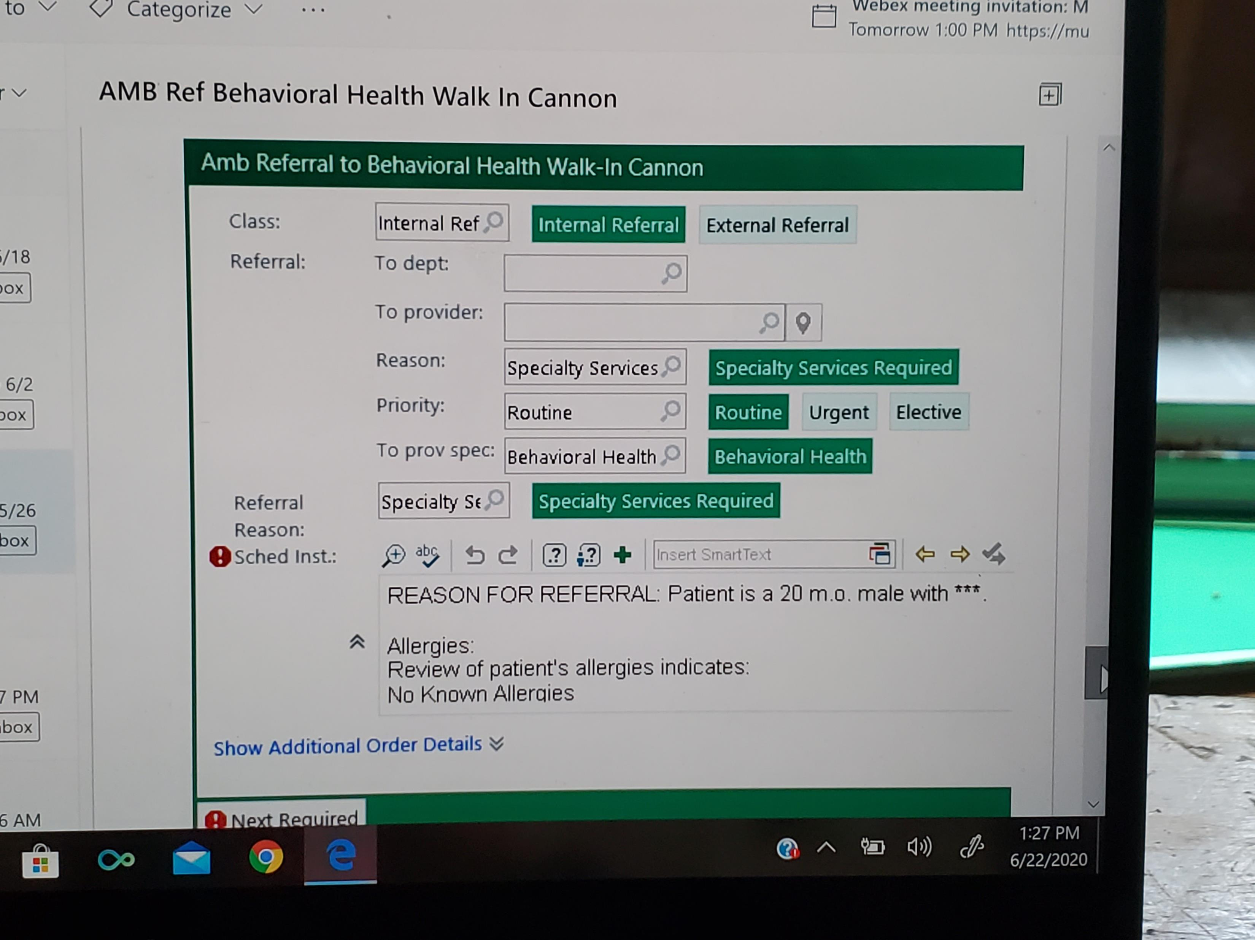
How to Refer to WRBH Clinic from with MUSC:
“Amb Referral to Behavioral Health Walk-In Cannon”

Slide 31
How to Refer Pregnant Patients with
Opioid Use Disorder:
Patient or Provider can text/call the MOMs Phone:
(843) 614-9510

Slide 32
Thank you
Questions? aujlar@musc.edu

