Slide 1
VTE During Pregnancy
Berry Campbell, MD
Project ECHO-Women’s Wellness
Prisma Health Midlands/UofSC School of Medicine Columbia

Slide 2
How do we best diagnose VTE during pregnancy?

Slide 3
80% have unilateral swelling and pain
Calf difference > 2cm
Compression sonography of proximal veins, distal veins
If inconclusive, consider:
- Empiric LMWH
- Repeat sonography 3-7d
- Consider MR/venography
PE: VQ scan – low radiation for fetus; lowest for mom
Spiral CT – lowest radiation for fetus; low for mom
Both are excellent, depends on availability at your center.

Slide 4
What serum testing for women with a history of VTE not tested before?

Slide 5
Anti-phospholipid Abs
Inherited Thrombophilias
- F5LM
- Prothrombin G20210A
- Anti-thrombin3
- Protein S, C

Slide 6
New VTE in pregnancy – how to manage?

Slide 7
PE → Admit if unstable, O2 sats labile, severe shortness of breath, or
severe pain
- LMWH vs IV heparin
DVT → outpatient Lovenox reasonable. Admit for severe pain.
* Most admit pregnant patient with newly diagnosed VTE for 24 hours.

Slide 8
What do you do if allergic to heparin?

Slide 9
- Most can use LMWH
- Allergy to LMWH → consult heme-onc
- If history of thrombocytopenia with heparin, Lovonox usually safe.
- Avoid oral agents

Slide 10
How do you decide the dose: prophylaxis vs intermediate vs therapeutic?

Slide 11
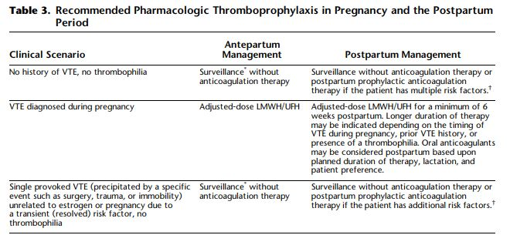
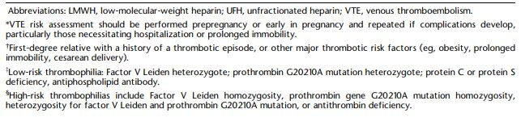
Recommended Pharmacologic Thromboprophylaxis in Pregnancy and the Postpartum Period

Slide 12
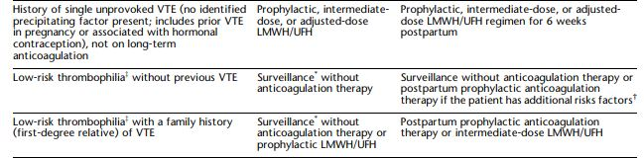
Recommended Pharmacologic Thromboprophylaxis in Pregnancy and the Postpartum Period

Slide 13
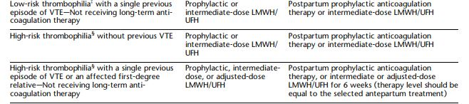
Recommended Pharmacologic Thromboprophylaxis in Pregnancy and the Postpartum Period

Slide 14
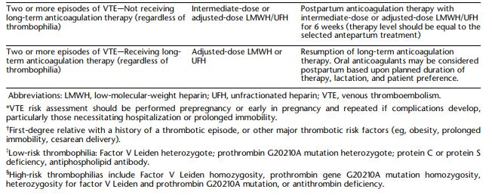
Recommended Pharmacologic Thromboprophylaxis in Pregnancy and the Postpartum Period

Slide 15
Do you monitor levels of LMWH in pregnancy?

Slide 16
Prophylaxis: No
Intermediate: No
Therapeutic: Anti-factor Xa
4-6 hours after injection → 0.6 – 1.0µ/mℓ
* If heparin, aPTT 1.5-2.5 x control 4-6 hours post injection

Slide 17
How do you manage LMWH/heparin surrounding delivery?

Slide 18
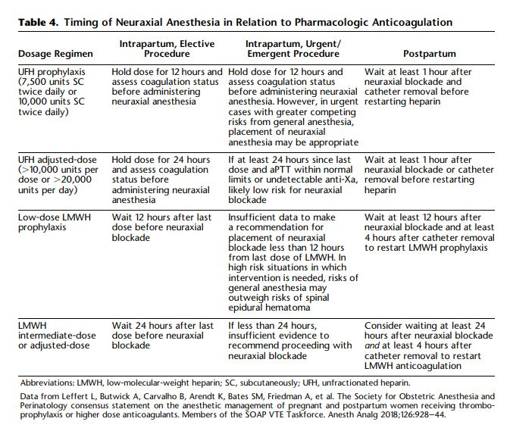

Slide 19
Do you convert to unfractionated heparin from LMWH at 36-37 weeks?

Slide 20
What do you do after cesarean section in the general population
(not on LMWH or heparin)?

Slide 21
Actual VTE risk quadruples but still low, ≈ 3/1000
All need pneumatic compression devices before, after, and until ambulating.
Ambulate early
Assess risk factors to decide whether Lovonox needed

Slide 22
Upcoming Sessions
1st and 3rd Wednesday each Month
3/2 | Management of Patient w/ Prior Covid Infection | Donna Johnson, MD
3/16 | Domestic Violence in Pregnancy | Donna Johnson, MD
4/6 | Obesity in pregnancy | Donna Johnson, MD
4/20 | Late Preterm Steroids | Donna Johnson, MD

