Slide 1

VTE Safety Bundles
2/2/22
Project ECHO
Michelle Flanagan, BSN, RNC-OB, C-EFM

Slide 2
Overarching Goal
Perinatal Safety
“The goal of the NPMS (National Partnership for Maternal Safety) is the adoption of the safety bundle by every birthing facility in the United States. A patient safety bundle is a set of straightforward, evidence-based recommendations for practice and care processes known to improve outcomes.”
Every Birthing Hospital
Every Perinatal Admission
Every
patient
Antepartum – Intrapartum – Postpartum
“Every patient – Every Time”
D'Alton, Mary E. MD, et al, National Partnership for Maternal Safety, Obstetrics & Gynecology: October 2016 - Volume 128 - Issue 4 - p 688-698

Slide 3
AIM Safety Bundle Format
Four (Five) domains:
Readiness
supports establishment of risk-assessment strategies throughout pregnancy
Recognition
reviews clinical recommendations from major existing guidelines for patients recognized to be at increased risk for thromboembolism
Response
outlines specific recommendations for prophylaxis for at-risk patients from the NPMS working group
Reporting and Systems Learning
includes recommendations for quality assurance and surveillance
Respectful Care (new)
D'Alton, Mary E. MD, et al, National Partnership for Maternal Safety, Obstetrics & Gynecology: October 2016 - Volume 128 - Issue 4 - p 688-698

Slide 4

Why VTE Safety Bundle?
“The goal of this safety bundle is to reduce the frequency of obstetric thromboembolism and improve maternal outcomes. The bundle is inherently multidisciplinary and is designed to assist in establishing a culture of safety. Although we recognize the need to individualize the specific details of these protocols to fit available resources, every unit should strive to implement prophylaxis strategies incorporating leadership from anesthesiology, obstetrics, midwifery, and nursing. The Council on Patient Safety in Women’s Health Care includes this safety bundle and resources to support its implementation and direct health care providers to a growing number of state and national quality collaboratives that stand ready to assist (www.safehealthcareforeverywoman.org).”
D'Alton, Mary E. MD, et al, National Partnership for Maternal Safety, Obstetrics & Gynecology: October 2016 - Volume 128 - Issue 4 - p 688-698

Slide 5
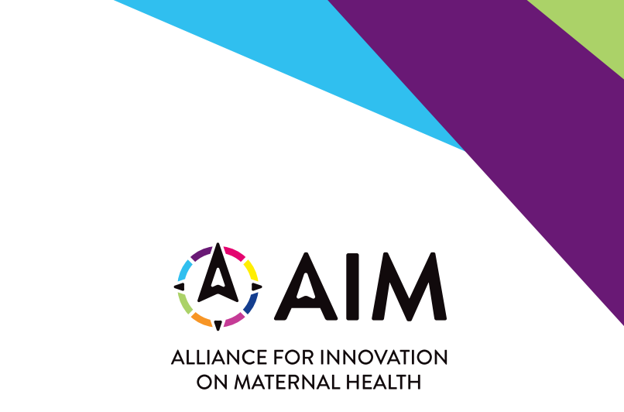

Slide 6
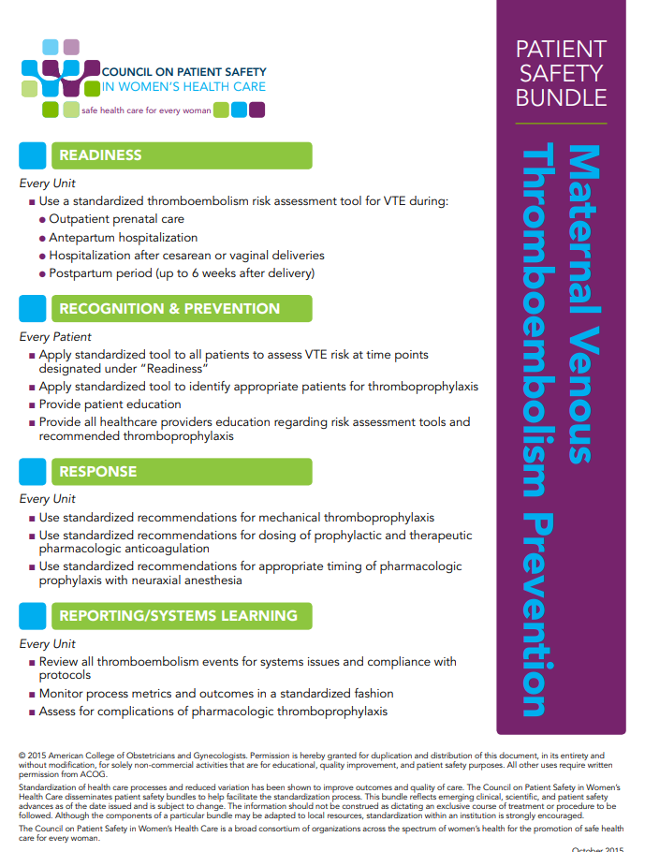
AIM Safety Bundle
https://safehealthcareforeverywoman.org/wp-content/uploads/VTE-Prevention-Bundle.pdf

Slide 7
Readiness
NPMS working group recommends the establishment of risk-assessment strategies for patients throughout pregnancy.
Risk assessment should occur at four timepoints in pregnancy:
  during the first prenatal visit
  during all antepartum admissions
  immediately postpartum during a hospitalization for childbirth
  on discharge home after a birth
Two widely used venous thromboembolism risk-assessment tools for nonobstetric hospitalized populations are the Caprini and Padua scoring systems.
D'Alton, Mary E. MD, et al, National Partnership for Maternal Safety, Obstetrics & Gynecology: October 2016 - Volume 128 - Issue 4 - p 688-698
Notes:
Readiness
For the “Readiness” component of the bundle, the NPMS working group recommends the establishment of risk-assessment strategies for patients throughout pregnancy. Risk assessment should occur at four timepoints in pregnancy: 1) during the first prenatal visit, 2) during all antepartum admissions, 3) immediately postpartum during a hospitalization for childbirth, and 4) on discharge home after a birth. The Joint Commission Core Measure Venous Thromboembolism Prophylaxis supports assessment of hospitalized patients for thromboembolism risk both after admission and after surgery25; although obstetric patients have been excluded from this requirement by the Joint Commission, the NPMS working group recommends that this measure be extended to pregnant and postpartum
patients. Patients at low and high risk for thromboembolism may be differentiated successfully based on risk factors. Two widely used venous thromboembolism risk-assessment tools for nonobstetric hospitalized populations are the Caprini and Padua scoring systems.5,6 In a retrospective study evaluating the Caprini system, risk of venous thromboembolism after surgery was 0.0% for a score of 0–1, 0.7% for a score of 2, 1.0% for a score of 3–4, and 1.9% for a score of 5 or higher.5 In a study of medical patients, a Padua score of 4 or higher was associated with an 11.0% risk of venous thromboembolism for patients not receiving prophylaxis and a 2.2% risk of venous thromboembolism for patients receiving prophylaxis. For patients with a score of less than 4, there was a 0.3% risk of venous thromboembolism.6 These scoring systems can be modified for obstetric patients (Appendixes 1 and 2, available online at http://links.lww.com/AOG/A834).

Slide 8
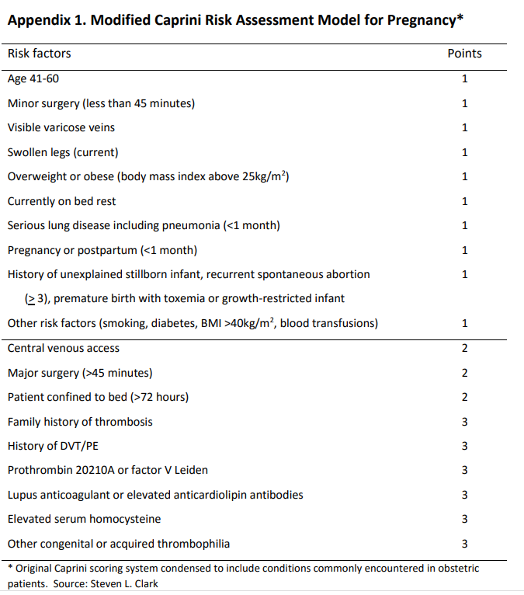
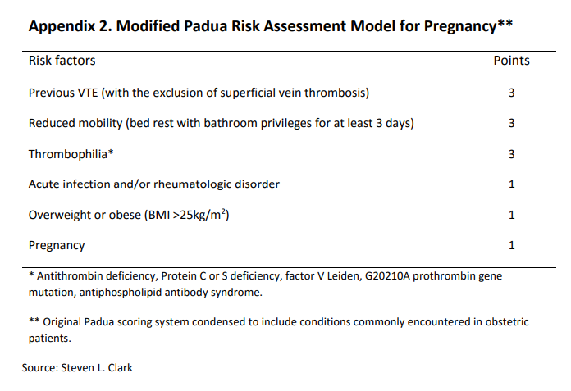
Risk Assessment Scoring
For hospitalized nonsurgical patients, those at high risk for venous thromboembolism were defined by Padua scores of 4 or higher.
D'Alton, Mary E. MD, et al, National Partnership for Maternal Safety, Obstetrics & Gynecology: October 2016 - Volume 128 - Issue 4 - p 688-698

Slide 9

Recognition
Emphasis on maternal risk should be recognized
  Routine screening of obstetric patients for venous thromboembolism risk factors will identify patients at high risk for thromboembolic events.
  Each center should use educational initiatives and guidelines to identify patients at increased risk for thromboembolism and who therefore might benefit from pharmacologic or mechanical thromboprophylaxis or both.
Major guidelines from the ACCP, the College, and the RCOG use to identify patients at high risk for venous thromboembolism requiring prophylaxis.
D'Alton, Mary E. MD, et al, National Partnership for Maternal Safety, Obstetrics & Gynecology: October 2016 - Volume 128 - Issue 4 - p 688-698
Notes:
The “Recognition” component of the bundle emphasizes that maternal risk should be recognized and that routine screening of obstetric patients for venous thromboembolism risk factors will identify patients at high risk for thromboembolic events. Each center should use educational initiatives and guidelines to identify patients at increased risk for thromboembolism and who therefore might benefit from pharmacologic or mechanical thromboprophylaxis or both.

Slide 10
Recommendations
Cesarean Birth Thromboprophylaxis –
Universal (All Women/Low Risk)
Cesarean Birth with Additional Risk Factors
  College recommends universal perioperative use of pneumatic compression devices for all women not already receiving pharmacologic thromboprophylaxis
  ACCP supports only early ambulation for “low-risk” women undergoing cesarean birth, mechanical compression devices for women with Caprini scores of 1–2 undergoing abdominal–pelvic surgery are recommended.
    According to the Caprini scoring system, all pregnant women undergoing even minor surgery would score at or above this range
  Note: women undergoing c/s birth who have additional risk factors for venous thromboembolism - recommendations are less clear
  The College recommends the combined use of pneumatic compression and unfractionated heparin or low-molecular-weight heparin for women with additional risk factors, but the College does not specify which risk factors qualify a woman for such additional therapy beyond prior thromboembolism events or thrombophilias.
  The ACCP recommendations suggest the combined use of mechanical and pharmacologic thromboprophylaxis for patients undergoing abdominal–pelvic surgery who have Caprini scores of 5 or higher.
    In pregnancy, this primarily would involve women with personal or family histories of venous thromboembolism or a known thrombophilia but also would apply to other women with multiple common risk factors.
Antepartum Management and Thromboprophylaxis for Vaginal Birth
  College Recommendations for hospitalized antepartum patients and for those delivering vaginally are less clear
  Recommends either prophylactic or therapeutic anticoagulation for women “at significant risk of venous thromboembolism during pregnancy or the postpartum period, such as those with high risk acquired or inherited thrombophilias.”
Summary
  The suggested protocols of these two groups may be harmonized by applying the ACCP recommendations for hospitalized, nonsurgical patients to antepartum and postpartum (vaginal birth) patients while using the more specific College guidelines for that subgroup of women with thrombophilia.
D'Alton, Mary E. MD, et al, National Partnership for Maternal Safety, Obstetrics & Gynecology: October 2016 - Volume 128 - Issue 4 - p 688-698
Notes:
The “Recognition” component of the bundle emphasizes that maternal risk should be recognized and that routine screening of obstetric patients for venous thromboembolism risk factors will identify patients at high risk for thromboembolic events. Each center should use educational initiatives and guidelines to identify patients at increased risk for thromboembolism and who therefore might benefit from pharmacologic or mechanical thromboprophylaxis or both.

Slide 11
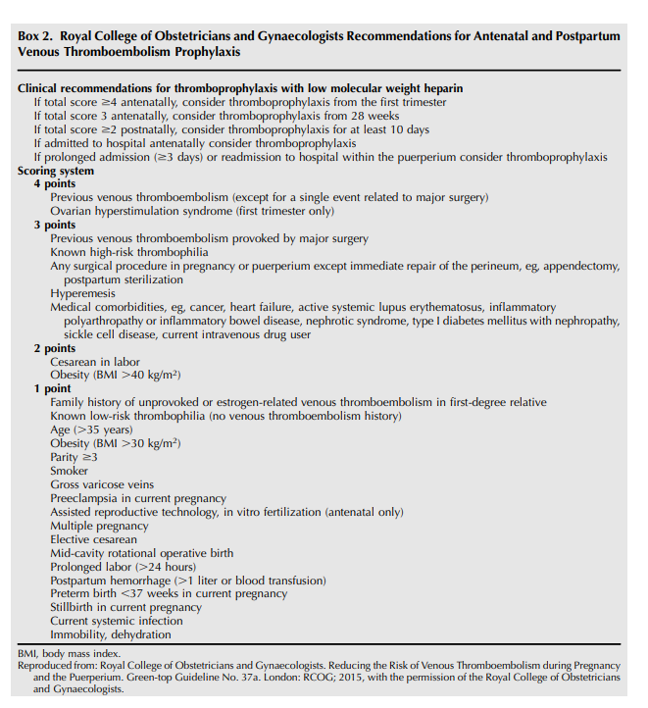
Royal College Recommendations
D'Alton, Mary E. MD, et al, National Partnership for Maternal Safety, Obstetrics & Gynecology: October 2016 - Volume 128 - Issue 4 - p 688-698

Slide 12

Response
When patients are identified as high risk for thromboembolism, the response should be appropriate thromboprophylaxis based on risk factors and the clinical situation. Based on the review of available research evidence and current major guideline recommendations, the NPMS working group recommends the following prophylaxis strategies
D'Alton, Mary E. MD, et al, National Partnership for Maternal Safety, Obstetrics & Gynecology: October 2016 - Volume 128 - Issue 4 - p 688-698

Slide 13
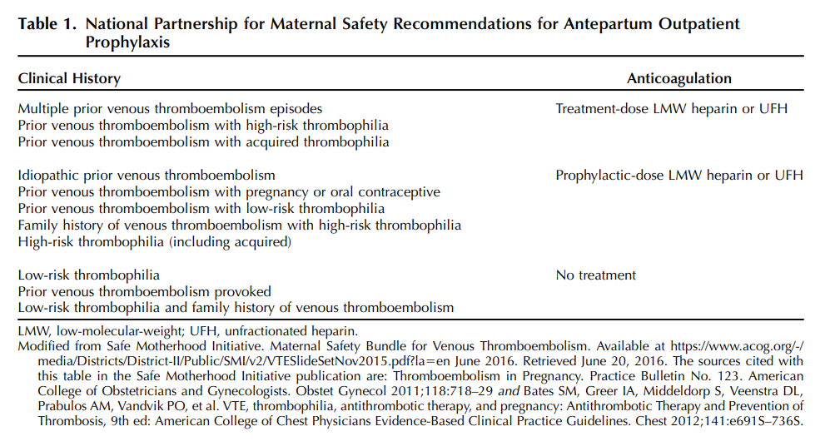
Response
Inpatient Antepartum Thromboprophylaxis
  The NPMS working group recommends thromboprophylaxis with daily LMW heparin or twice-daily unfractionated heparin for all antepartum patients hospitalized for at least 72 hours who are not at high risk for bleeding or imminent childbirth.
  Patients receiving unfractionated heparin or LMW heparin on an outpatient basis should have this treatment continued if hospitalized.
  For women at high risk for childbirth or bleeding, mechanical thromboprophylaxis or a prophylactic dose of unfractionated heparin (5,000 units every 12 hours) should be used.
  The selective use of unfractionated heparin rather than LMW heparin may facilitate intrapartum neuraxial anesthesia.
D'Alton, Mary E. MD, et al, National Partnership for Maternal Safety, Obstetrics & Gynecology: October 2016 - Volume 128 - Issue 4 - p 688-698

Slide 14
Response Continued
Vaginal Birth
Cesarean Birth
For women with a history of venous thromboembolism or a thrombophilia, the NPMS working group recommends intrapartum use of pneumatic compression while in bed and postpartum administration of LMW heparin or unfractionated heparin.
  These recommendations would result in fewer women receiving pharmacologic prophylaxis than those cared for using RCOG recommendations, which support thromboprophylaxis for women with risk factors such as obesity, smoking, and advanced maternal age.
For women at high risk for venous thromboembolism based on RCOG criteria or Padua scores of 4 or higher, pharmacologic prophylaxis with LMW heparin or unfractionated heparin may be considered
The NPMS working group recommends
  All women undergoing cesarean birth who are not receiving pharmacologic prophylaxis receive perioperative mechanical thromboprophylaxis with pneumatic compression devices, which should be continued until the patient is fully ambulatory.
  Women with Risk factors - NPMS recommends use of pharmacologic thromboprophylaxis
    A careful review reveals that many women undergoing cesarean birth will have multiple risk factors and therefore might be considered at particularly high risk based on RCOG criteria or the modified Caprini scoring systems
    Given the challenges in consistently identifying women with risk factors and issues related to poor compliance with mechanical devices, hospitals may choose a strategy in which all women undergoing cesarean birth receive postoperative thromboprophylaxis with unfractionated or low-molecular-weight heparin unless there is a specific contraindication.
      This approach is consistent with the RCOG recommendations.
  Although there are no data on the optimal timing of initiating heparin postoperatively, the NPMS working group supports the routine administration of prophylactic unfractionated heparin when postcesarean patients otherwise meet criteria for postanesthesia care unit discharge.
D'Alton, Mary E. MD, et al, National Partnership for Maternal Safety, Obstetrics & Gynecology: October 2016 - Volume 128 - Issue 4 - p 688-698

Slide 15
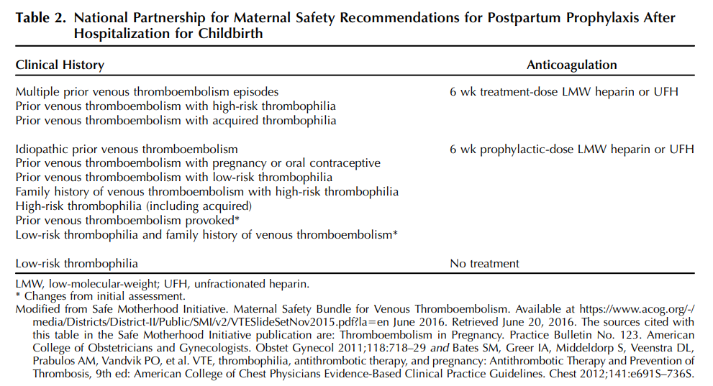
Response
Extended Postpartum Thromboprophylaxis
NPMS working group recommendations for risk assessment and thromboprophylaxis recommendations for extended pharmacologic postpartum anticoagulation on hospital discharge from a hospitalization for childbirth.
  These recommendations are based primarily on College and ACCP criteria.
D'Alton, Mary E. MD, et al, National Partnership for Maternal Safety, Obstetrics & Gynecology: October 2016 - Volume 128 - Issue 4 - p 688-698

Slide 16
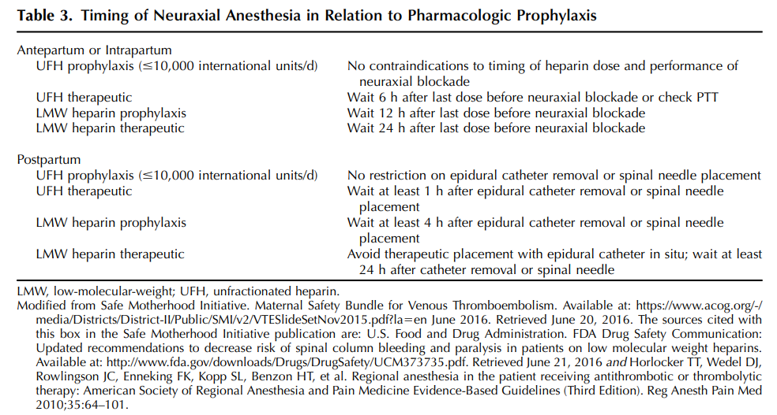
Response
Timing of Anesthesia
At the time of publication, preliminary recommendations from guidelines from the American Society for Regional Anesthesia and Pain Medicine (ASRA) on venous thromboembolism prophylaxis and neuraxial anesthesia suggest that neuraxial procedures be delayed at least 4 (and preferably 6) hours after a 5,000-unit dose of subcutaneous unfractionated heparin
Longer intervals are recommended for LMW heparin and other unfractionated heparin regimens.
Additionally, the preliminary ASRA recommendations support restricting use of concurrent nonsteroidal antiinflammatory drugs after neuraxial anesthesia with certain regimens of pharmacologic anticoagulation
D'Alton, Mary E. MD, et al, National Partnership for Maternal Safety, Obstetrics & Gynecology: October 2016 - Volume 128 - Issue 4 - p 688-698
Notes:
Inpatient Antepartum Thromboprophylaxis
The NPMS working group recommends thromboprophylaxis with daily LMW heparin or twice-daily unfractionated heparin for all antepartum patients hospitalized for at least 72 hours who are not at high risk for bleeding or imminent childbirth. Patients receiving unfractionated heparin or LMW heparin on an outpatient basis should have this treatment continued if hospitalized. For women at high risk for childbirth or bleeding, mechanical thromboprophylaxis or a prophylactic dose of unfractionated heparin (5,000 units every 12 hours) should be used. The selective use of unfractionated heparin rather than LMW heparin may facilitate intrapartum neuraxial anesthesia.
Vaginal Birth For women with a history of venous thromboembolism or a thrombophilia, the NPMS working group recommends intrapartum use of pneumatic compression while in bed and postpartum administration of LMW heparin or unfractionated heparin. These recommendations would result in fewer women receiving pharmacologic prophylaxis than those cared for using RCOG recommendations, which support thromboprophylaxis for women with risk factors such as obesity, smoking, and advanced maternal age. For women at high risk for venous thromboembolism based on RCOG criteria or Padua scores of 4 or higher, pharmacologic prophylaxis with LMW heparin or unfractionated heparin may be considered
Cesarean Birth The NPMS working group recommends that all women undergoing cesarean birth who are not receiving pharmacologic prophylaxis receive perioperative mechanical thromboprophylaxis with pneumatic compression devices, which should be continued until the patient is fully ambulatory. The NPMS recommends use of pharmacologic thromboprophylaxis for women with risk factors. A careful review reveals that many women undergoing cesarean birth will have multiple risk factors and therefore might be considered at particularly high risk based on RCOG criteria or the modified Caprini scoring systems (Appendix 1, http:// links.lww.com/AOG/A834). Given the challenges in consistently identifying women with risk factors and issues related to poor compliance with mechanical devices,29 hospitals may choose a strategy in which all women undergoing cesarean birth receive postoperative thromboprophylaxis with unfractionated or low-molecular-weight heparin unless there is a specific contraindication. This approach is consistent with the RCOG recommendations.21 Although there are no data on the optimal timing of initiating heparin postoperatively, the NPMS working group supports the routine administration of prophylactic unfractionated heparin when postcesarean patients otherwise meet criteria for postanesthesia care unit discharge.
Extended Postpartum Thromboprophylaxis Table 2 demonstrates NPMS working group recommendations for risk assessment and thromboprophylaxis recommendations for extended pharmacologic postpartum anticoagulation on hospital discharge from a hospitalization for childbirth. These recommendations are based primarily on College and ACCP criteria.7–9
Timing of Anesthesia At the time of publication, preliminary recommendations from guidelines from the American Society for Regional Anesthesia and Pain Medicine (ASRA) on venous thromboembolism prophylaxis and neuraxial anesthesia suggest that neuraxial procedures be delayed at least 4 (and preferably 6) hours after a 5,000-unit dose of subcutaneous unfractionated heparin (information available on the ASRA app under “heparin-prophylactic”/“neuraxial block”/ “place neuraxial block”31). Longer intervals are recommended for LMW heparin and other unfractionated heparin regimens. Additionally, the preliminary ASRA recommendations support restricting use of concurrent nonsteroidal antiinflammatory drugs after neuraxial anesthesia with certain regimens of pharmacologic anticoagulation

Slide 17
Reporting and Systems Learning
The NPMS working group recommends that individual centers review samples of their obstetric population to determine the prevalence of comorbid risk factors for venous thromboembolism to aid in tailoring prophylaxis policies.
  Once a policy has been enacted, we recommend routinely auditing medical records to ensure that risk assessment is being performed and at-risk patients are receiving appropriate prophylaxis.
  Although protocols and electronic medical record tools may aid in appropriate prophylaxis, medication administration in scenarios in which it is contraindicated is also possible.
  The proportion of patients receiving prophylaxis for whom prophylaxis is indicated should be audited and reported.
  Similarly, each obstetric thromboembolism event should be reviewed to determine whether optimal care and prophylaxis was provided.
  Finally, adverse events and complications from pharmacologic prophylaxis should be reviewed and reported.
D'Alton, Mary E. MD, et al, National Partnership for Maternal Safety, Obstetrics & Gynecology: October 2016 - Volume 128 - Issue 4 - p 688-698

Slide 18


Slide 19
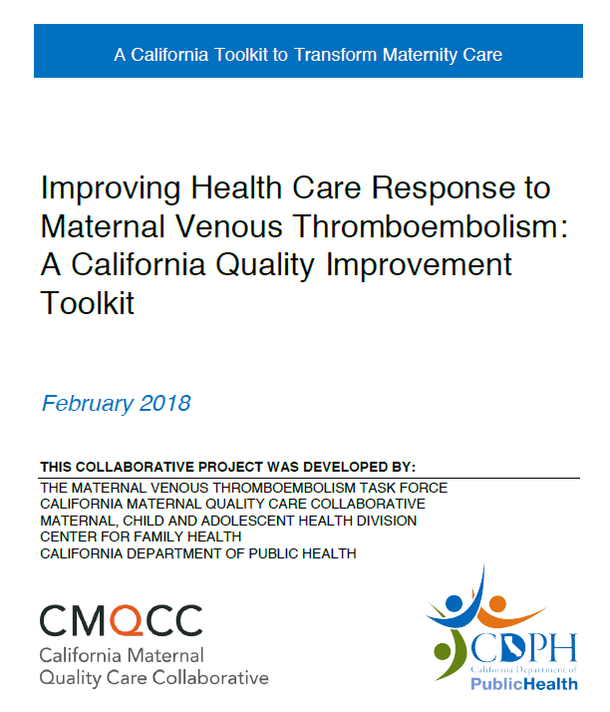
CMQCC Toolkit - VTE
Standardized VTE risk assessment should occur throughout pregnancy, including these four important time points:
First prenatal visit / Outpatient prenatal care
Antepartum hospitalization (non-delivery)
Delivery hospitalization including cesarean and vaginal birth
Post-discharge extended duration anticoagulation
cmqcc.org – VTE Toolkit

Slide 20
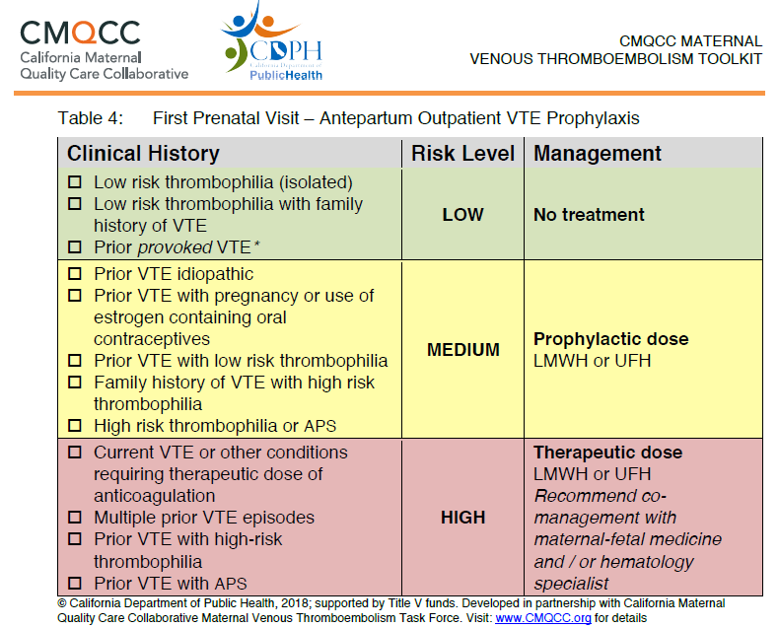
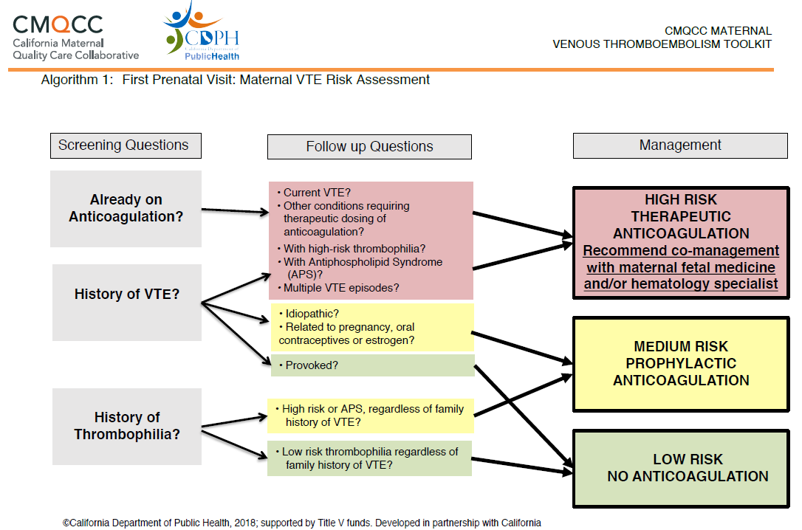
Assessment 1: Prenatal Visit
cmqcc.org – VTE Toolkit

Slide 21
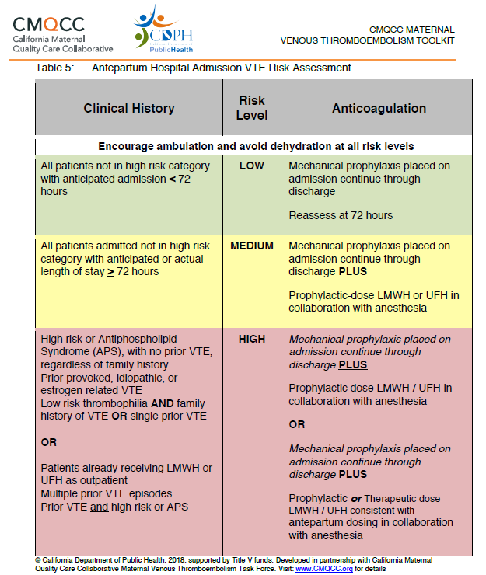
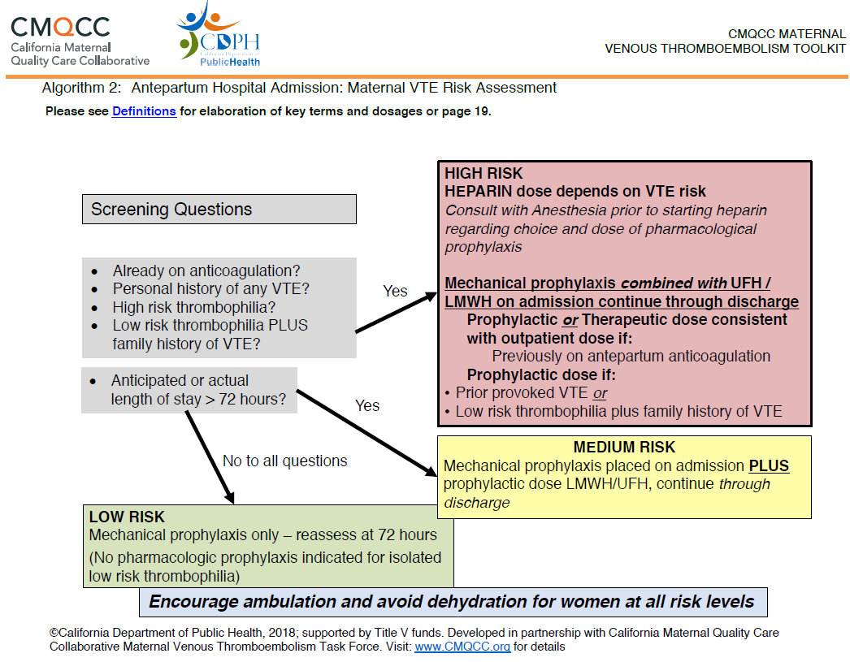
Assessment 2: Antepartum Hospitalization (non-delivery)
cmqcc.org – VTE Toolkit

Slide 22
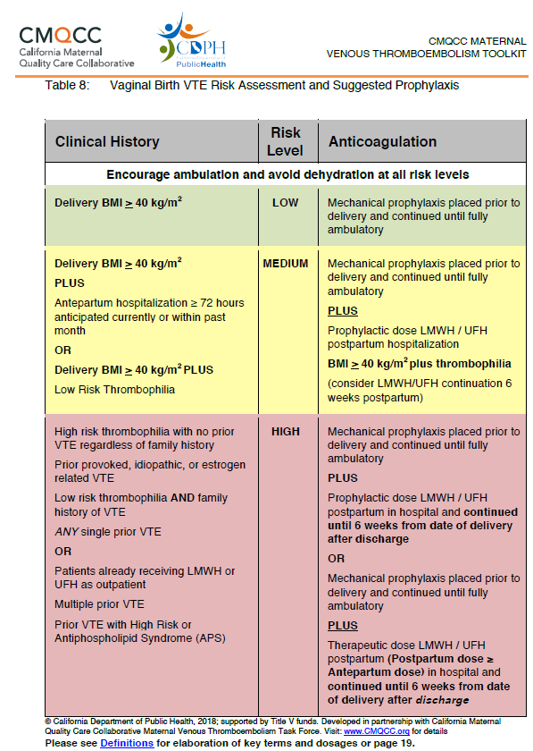
Assessment 3:
Delivery Hospitalization –
Vaginal Birth
cmqcc.org – VTE Toolkit

Slide 23
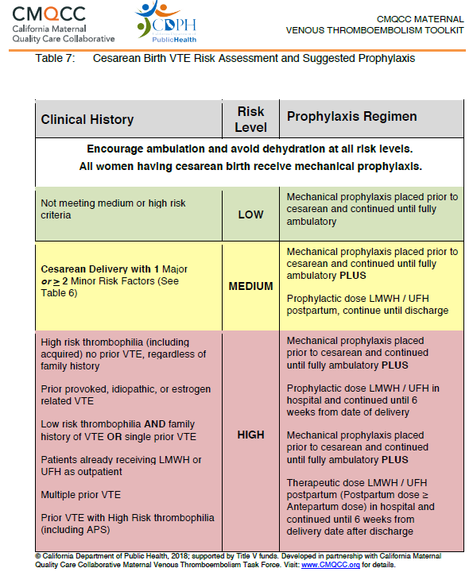
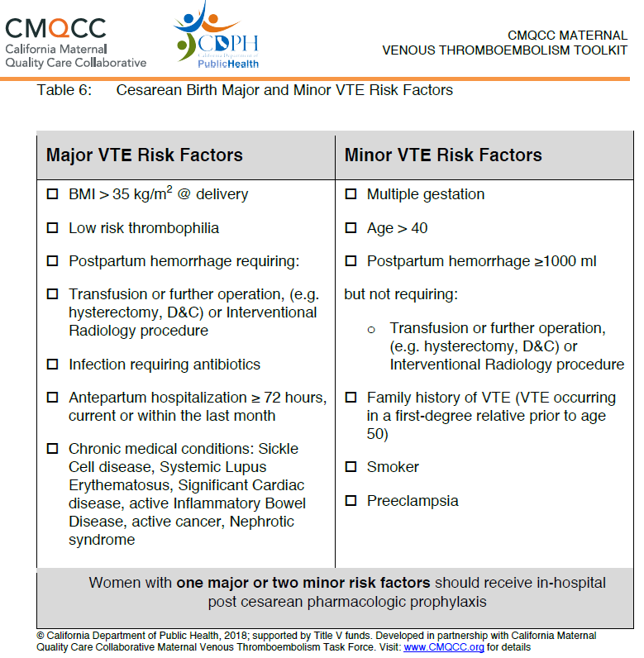
Assessment 3:
Delivery Hospitalization –
Cesarean Birth
cmqcc.org – VTE Toolkit

Slide 24
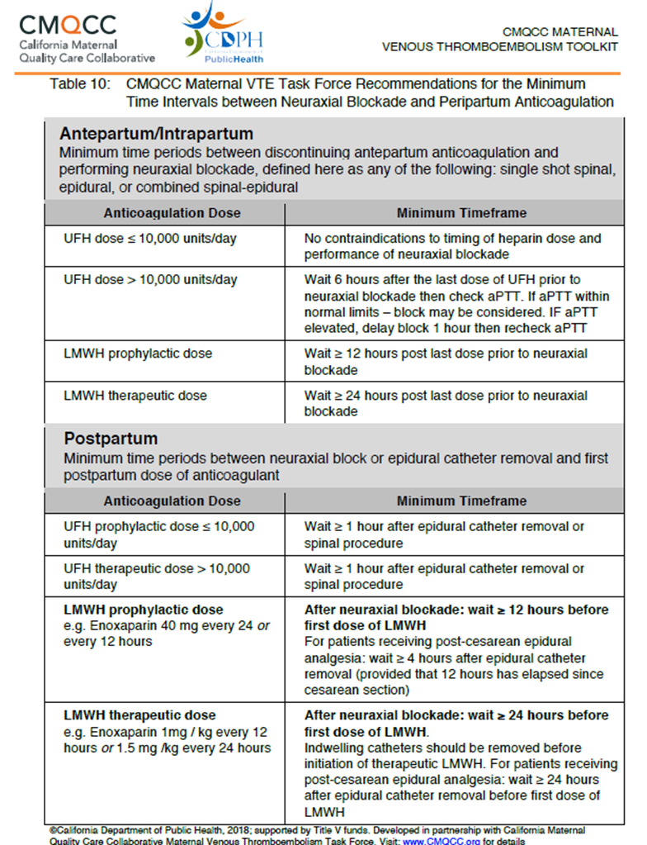
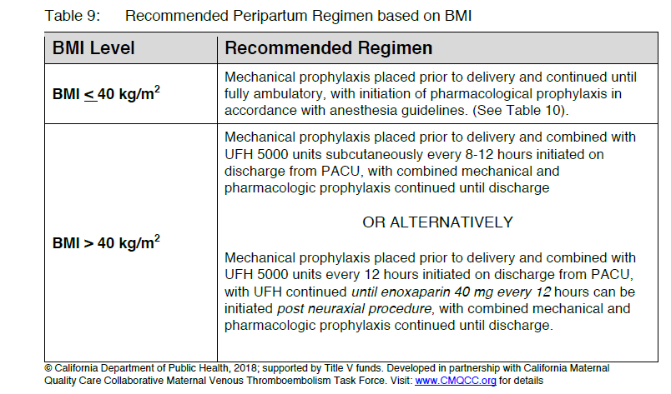
Additional Considerations:
BMI & Anesthesia
cmqcc.org – VTE Toolkit

Slide 25
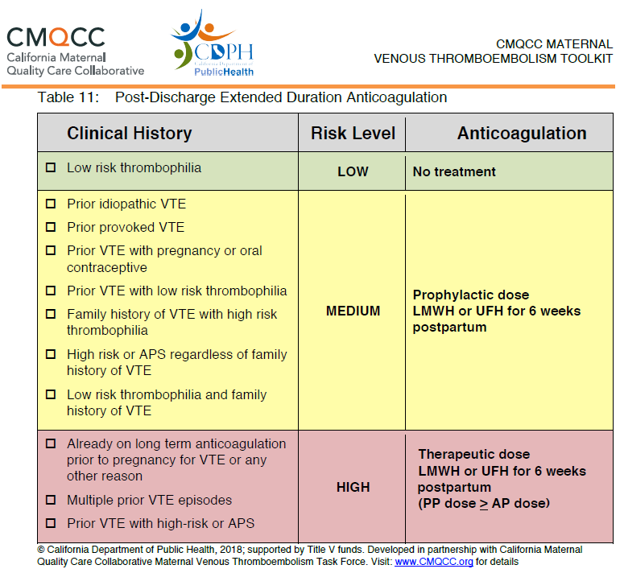
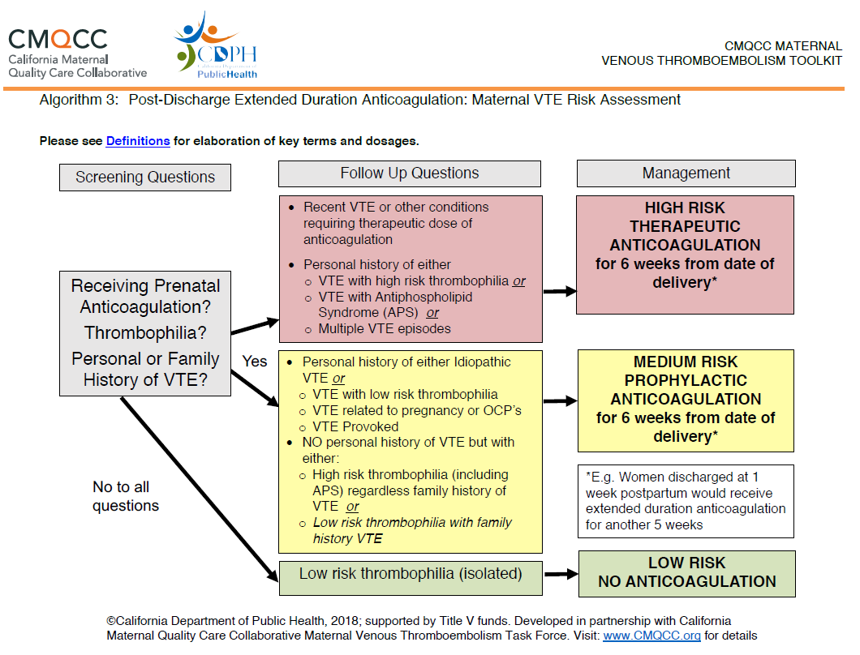
Assessment 4:
Post Delivery / Post Discharge
cmqcc.org – VTE Toolkit

Slide 26


Slide 27
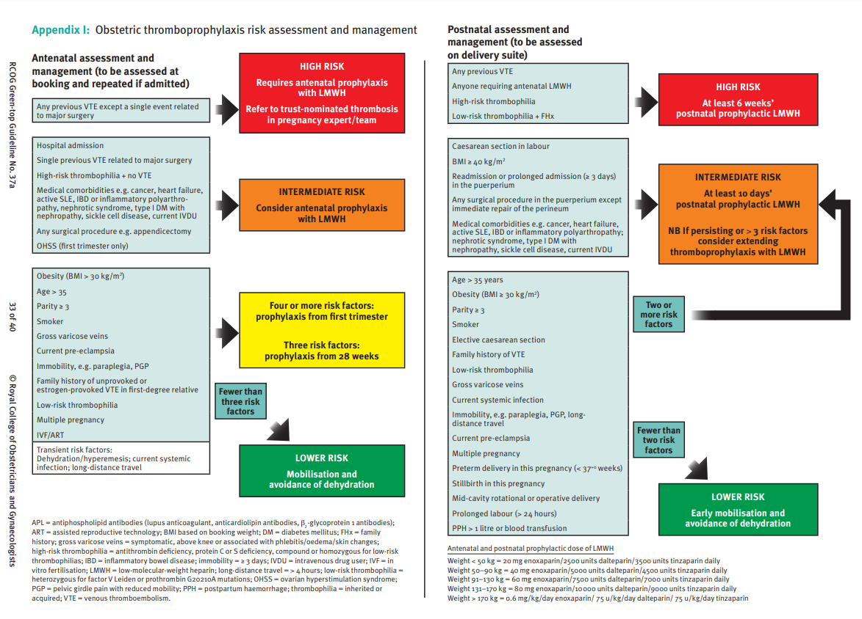
RCOG
https://www.rcog.org.uk/globalassets/documents/guidelines/gtg-37a.pdf

Slide 28
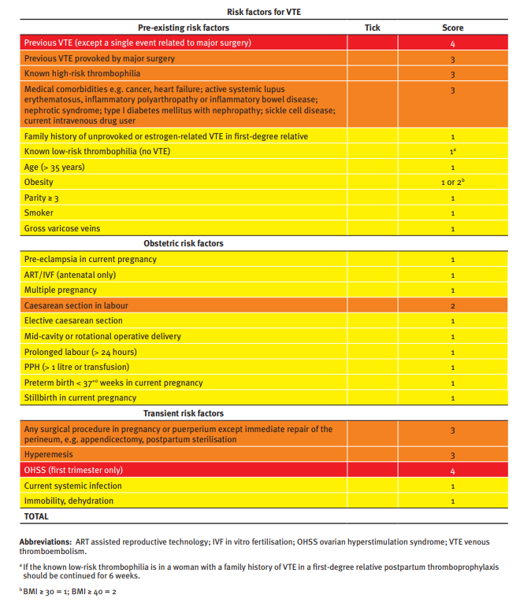
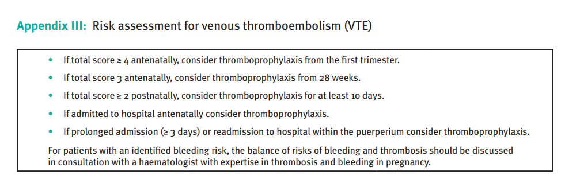
RCOG
https://www.rcog.org.uk/globalassets/documents/guidelines/gtg-37a.pdf

Slide 29


Slide 30
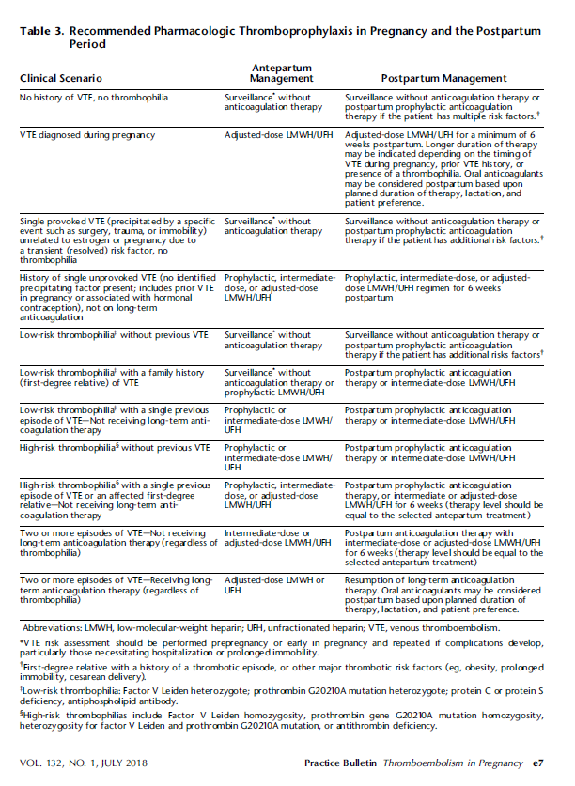
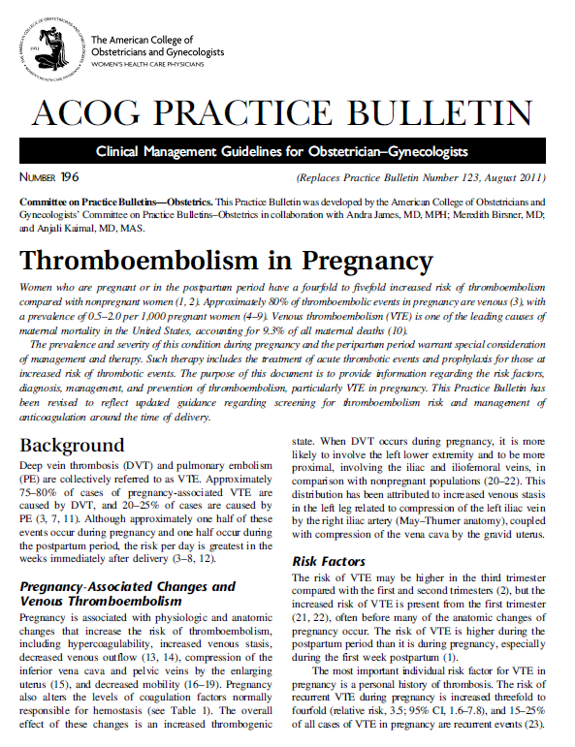
Additional Support

Slide 31
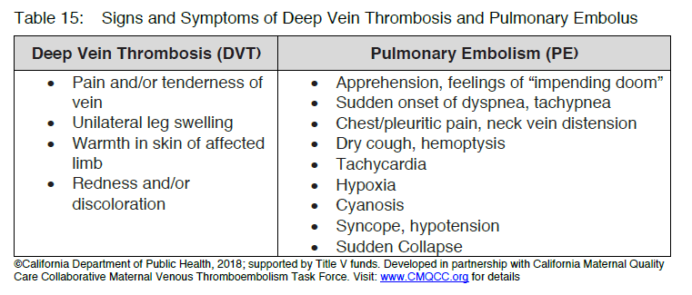
Nursing Practices to Identify and Minimize VTE Risk in all Women (CMQCC)
All hospitalized antepartum patients should be encouraged on admission to maintain full ambulation, adequate hydration and utilize mechanical prophylaxis (knee-length sequential compression devices) while in bed.
Sequential compression devices should be used until 24 hours after the cesarean birth or until fully ambulatory.
Administer anticoagulants as indicated by risk assessment and providers’ orders 12-24 hours after cesarean birth.
If a woman is on anticoagulants, monitor for bleeding and instruct her (and her significant others) to notify the health care team if she experiences any of the following: nose or gum bleeding, excessive bruising or hematuria.
Provide women and their families with information on oral anticoagulants, including their impact on breastfeeding and the effect of other medications and foods that affect INR, including over the counter medications, prescriptions, and foods rich in Vitamin K (broccoli, lettuce, and spinach). In addition, advise women to notify their provider if they become pregnant or plan to conceive while on anticoagulant medications.
Warfarin, LMWH, UFH are all compatible with breastfeeding
Discharge instructions should be provided to the woman and her family which should include signs & symptoms of DVT/PE, when to notify her provider or seek urgent care as well as lifestyle changes and preventable risk factors (smoking, obesity).
Nurses play a pivotal role in the prevention of both DVT and PE among pregnant and postpartum women.
Notes:
Nurses play a pivotal role in the prevention of both DVT and PE among pregnant and postpartum women. Prevention strategies, inclusive of, but not limited to timely and appropriate recognition, early diagnosis and treatment, and education can save lives and have long-term effects on women’s health. A long-term benefit of early diagnosis and treatment is a decrease in the risk of post-thrombotic syndrome as a complication that may lead to long term pain and venous insufficiency.

Slide 32


Slide 33
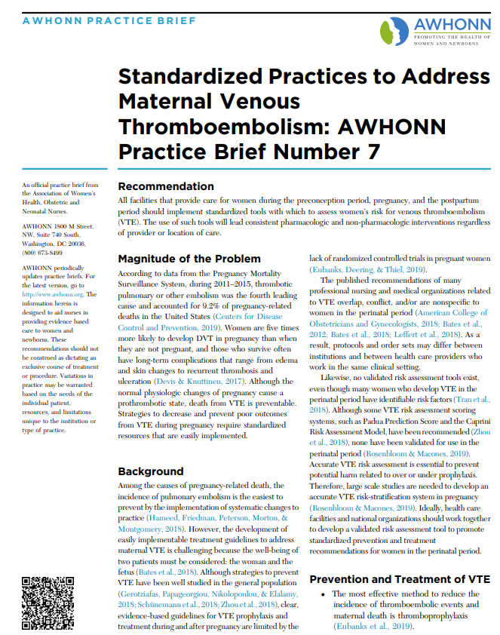
https://www.awhonn.org/practice-briefs/

Slide 34

Putting it all together

Slide 35
Education provided regarding risk assessment tools and recommended prophylaxis for VTE
Perinatal Healthcare Providers
Assess ALL patients for VTE Risk
Use standard recommendations for mechanical thrombo-prophylaxis
Use Standard recommendation for dosing of prophylactic and therapeutic pharmacologic anticoagulation
Use standardized recommendation for appropriate timing of pharmacologic prophylaxis with neuraxial anesthesia
Prophylaxis / Treatment Required for patient
Reporting / Systems Learning
Review all thromboembolism events for systems issues and compliance with protocols
Monitor process metrics and outcomes
Assess for complications of pharmacologic thromobo-prophylaxis
Outpatient Prenatal Care
Antepartum Hospitalization
Delivery Hospitalization
Postpartum visit (6 weeks post delivery)
Pregnancy
→
→
Postpartum
Risk Assessment tool for Intrapartum Admission
Vaginal Delivery
Cesarean Delivery
Risk assessment tool for VTE in Prenatal Care
Risk assessment tool for VTE in Antepartum Admission
Risk Assessment for VTE in Postpartum Period
Pre-Pregnancy assessment for women with known VTE risk
Does patient qualify for prophylaxis?
Yes
No
Provide Patient Education on options for treatment
Begin standard treatment
Prophylaxis qualification:
Modified Caprini
Modified Padua
CMQCC
RCOG

Slide 36

Patient Education

Slide 37
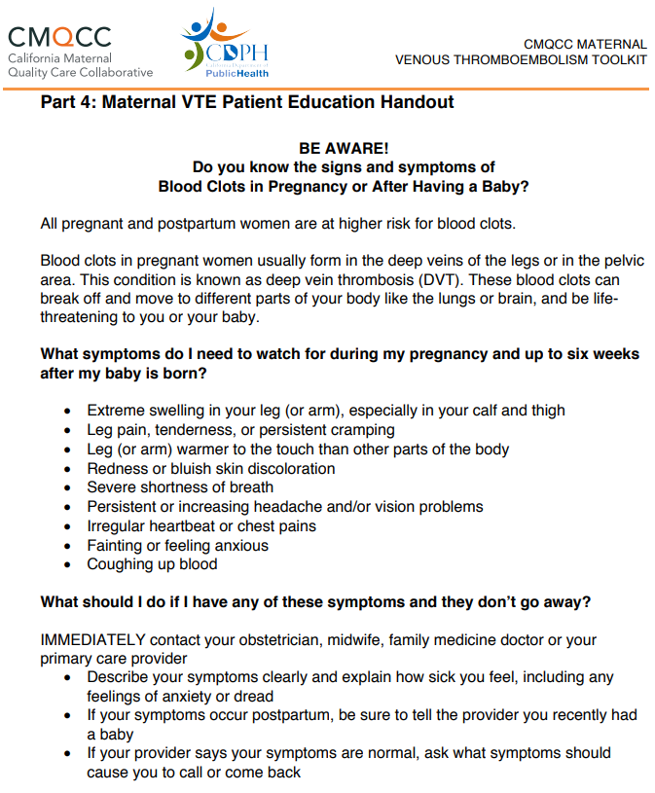
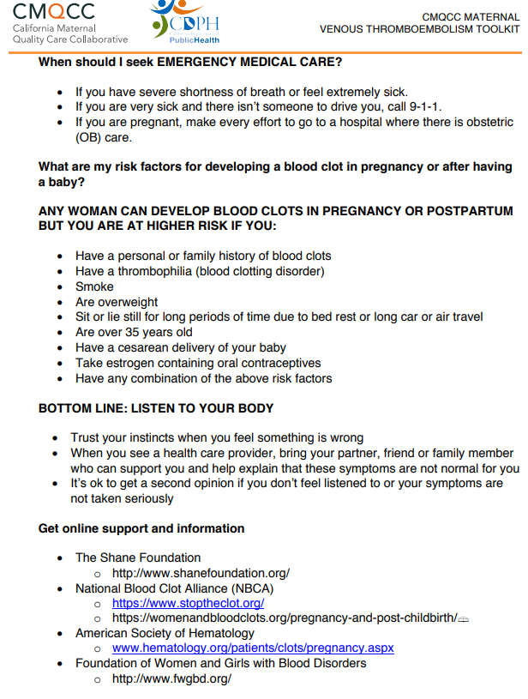
Patient Education
cmqcc.org
– VTE Toolkit

Slide 38
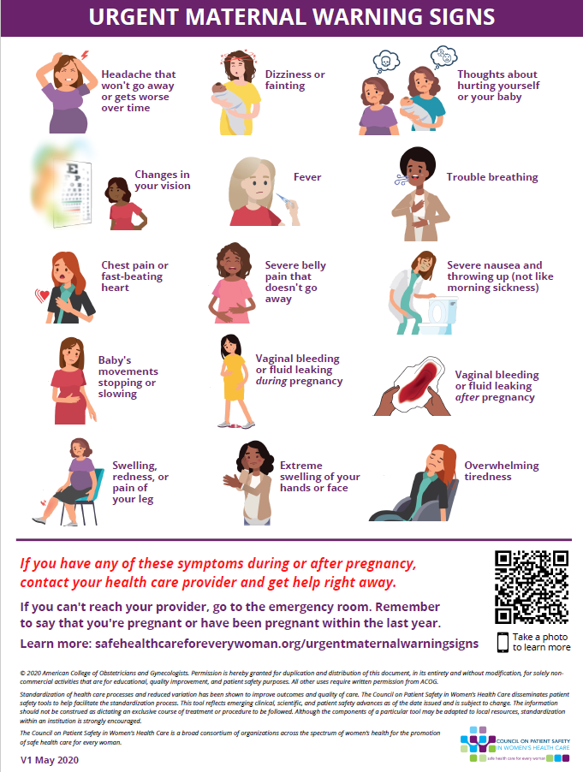
www.safehealthcareforeverywoman.org

Slide 39

Case Review

